Slide 1
A free CD of this message will be available following the service
2 . 1 2 – 1 7
This message will also be available for podcast later in the week a calvaryokc.com

Slide 2
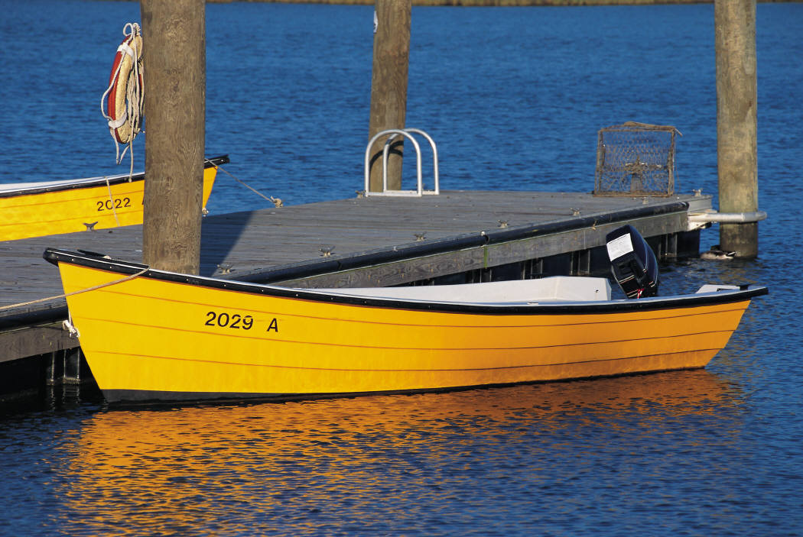
2 . 1 2 – 1 7
For Sale

Slide 3
2 . 1 2 – 1 7
Laodicea 1800 – Present
Philadelphia 1800 - Present
Sardis 1517 - Present
Thyatira 590 - Present
Pergamos 314 - 590
Smyrna 100 - 314
Ephesus 32 - 100
200
400
600
800
1000
1200
1400
1600
1800
2000

Slide 4
2 . 1 2 – 1 7
Pergamos ~ Pergamum (NASB, NIV, etc.), better
pergos – tower (high place); gamos – married
“Married to the High Place”
200,000 volume library
10,000 seat theater

Slide 5
2 . 1 2 – 1 7
Rod of Asclepius
William Barclay ~ “Sufferers were allowed to spend the night in the darkness of the temple. In the temple there were tame snakes. In the night the sufferer might be touched by one of these tame and harmless snakes as it glided over the ground on which he lay. The touch of the snake was held to be the touch of the god himself, and the touch was held to bring health and healing.”

Slide 6
2 . 1 2 – 1 7

Slide 7
2 . 1 2 – 1 7
Rev. 1:16 ~ He had in His right hand seven stars, out of His mouth went a sharp two-edged sword, and His countenance was like the sun shining in its strength.
Heb. 4:12 ~ For the word of God is living and powerful, and sharper than any two-edged sword, piercing even to the division of soul and spirit, and of joints and marrow, and is a discerner of the thoughts and intents of the heart.

Slide 8
2 . 1 2 – 1 7

Slide 9
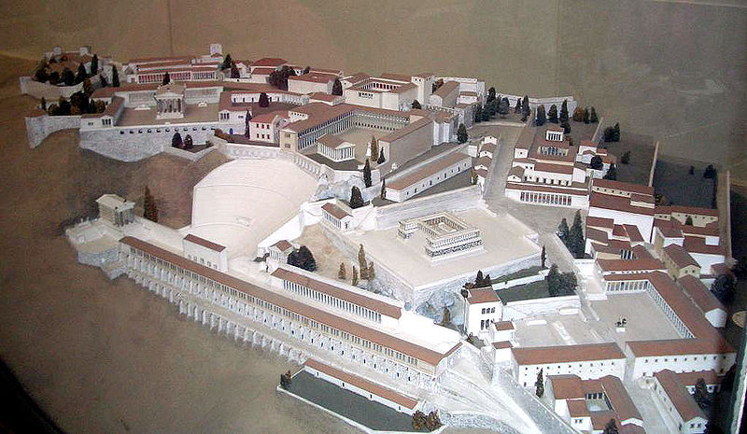
2 . 1 2 – 1 7
Altar of Zeus

Slide 10
2 . 1 2 – 1 7

Slide 11
2 . 1 2 – 1 7
Martyr ~ martus – witness

Slide 12
2 . 1 2 – 1 7

Slide 13
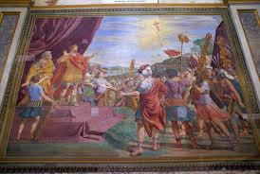
2 . 1 2 – 1 7
“In Hoc Signo Vinces”

Slide 14
2 . 1 2 – 1 7

Slide 15
2 . 1 2 – 1 7
John Trapp ~ "Nothing hath so enriched hell as fair faces."

Slide 16
2 . 1 2 – 1 7

Slide 17
2 . 1 2 – 1 7
Nicolaitans ~ nikē + laos = Conquered people (laity)

Slide 18
2 . 1 2 – 1 7
1 Sam. 24:6 ~ And he said to his men, "The LORD forbid that I should do this thing to my master, the LORD’S anointed, to stretch out my hand against him, seeing he is the anointed of the LORD."
1 Sam. 26:9 ~ And David said to Abishai, "Do not destroy him; for who can stretch out his hand against the LORD’S anointed, and be guiltless?"

Slide 19
2 . 1 2 – 1 7

Slide 20
2 . 1 2 – 1 7
A. W. Tozer ~ "Christians don't tell lies they just go to church and sing them."

Slide 21
2 . 1 2 – 1 7

Slide 22
2 . 1 2 – 1 7
John 6:48-51 ~ ⁴⁸ I am the bread of life. ⁴⁹ Your fathers ate the manna in the wilderness, and are dead. ⁵⁰ This is the bread which comes down from heaven, that one may eat of it and not die. ⁵¹ I am the living bread which came down from heaven. If anyone eats of this bread, he will live forever; and the bread that I shall give is My flesh, which I shall give for the life of the world."

Slide 23
2 . 1 2 – 1 7

