Slide 1
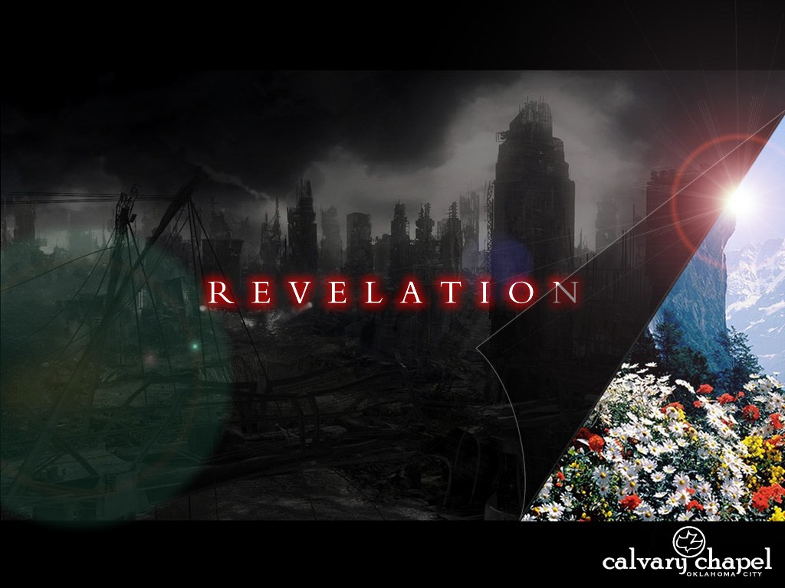
A free CD of this message will be available following the service
2 . 8 - 1 1
This message will also be available for podcast later in the week a calvaryokc.com

Slide 2
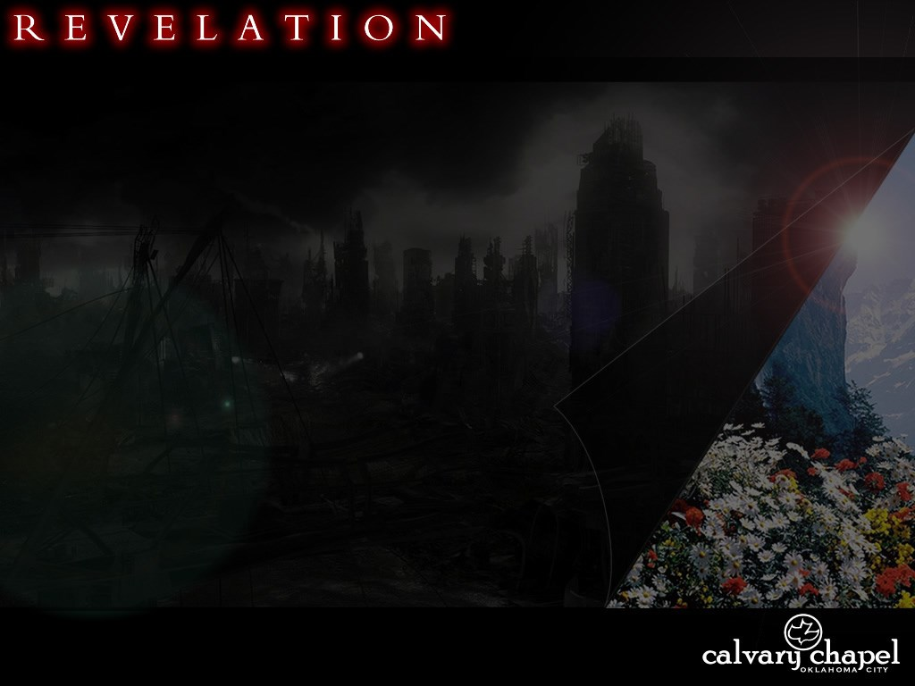
2 . 8 - 1 1
Laodicea 1800 – Present
Philadelphia 1800 - Present
Sardis 1517 - Present
Thyatira 590 - Present
Pergamos 314 - 590
Smyrna 100 - 314
Ephesus 32 - 100
200
400
600
800
1000
1200
1400
1600
1800
2000

Slide 3
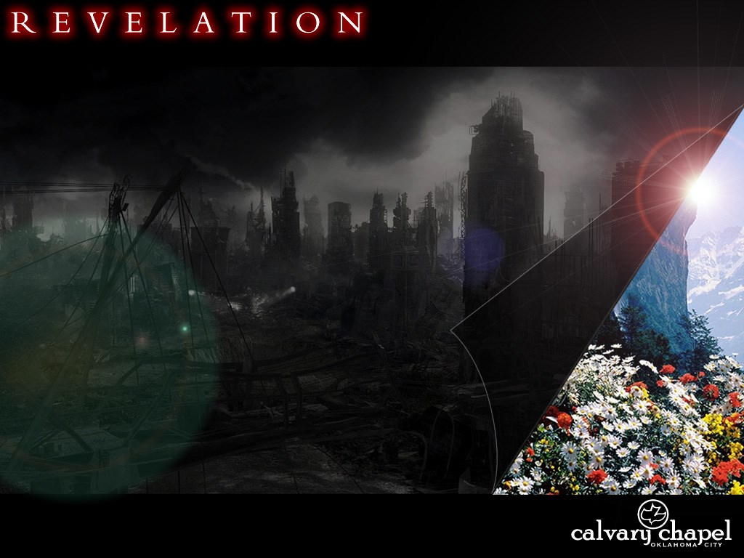
2 . 8 - 1 1

Slide 4
2 . 8 - 1 1
Tertullian – “The blood of the martyrs is the seed of the church."
Richard Wurmbrand ― "It was strictly forbidden to preach to other prisoners. It was understood that whoever was caught doing this received a severe beating. A number of us decided to pay the price for the privilege of preaching, so we accepted their (the Communists') terms. It was a deal; we preached and they beat us. We were happy preaching. They were happy beating us, so everyone was happy."

Slide 5
2 . 8 - 1 1
160,000-175,000 Christian martyrs per year
One every 5 minutes
200,000,000 Christians in 60 countries denied fundamental rights

Slide 6
2 . 8 - 1 1

Slide 7
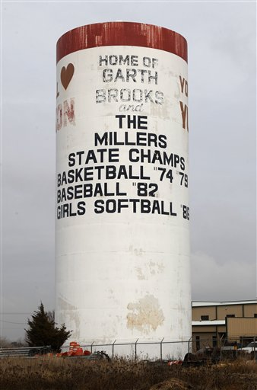
2 . 8 - 1 1
Smyrna ~ myrrh – from Heb. marar (bitterness)
Home of Homer
The Suffering Church (AD 100 - 314)

Slide 8
2 . 8 - 1 1

Slide 9
2 . 8 - 1 1
Phil. 1:29 ~ For to you it has been granted on behalf of Christ, not only to believe in Him, but also to suffer for His sake,

Slide 10
2 . 8 - 1 1

Slide 11
2 . 8 - 1 1
Poverty ~ not penas (hand-to-mouth poor)
But ptōcheia (utterly destitute)
David Guzik ~ "In contrast, the Christians at Laodicea thought they were rich, but they were really poor (Revelation 3:17). Laodicea was a poor rich church. Smyrna was a rich poor church. Better to be a rich poor church than a poor rich church."

Slide 12
2 . 8 - 1 1
Rom. 2:28-29 ~ ²⁸ For he is not a Jew who is one outwardly, nor is circumcision that which is outward in the flesh; ²⁹ but he is a Jew who is one inwardly; and circumcision is that of the heart, in the Spirit, not in the letter; whose praise is not from men but from God.

Slide 13
2 . 8 - 1 1

Slide 14
2 . 8 - 1 1
Diocletian 284-305
10 Seasons of Roman Persecution
Aurelian 270-275
Valerian 253-260
Date of Revelation
Decius 249-251
Maximinus 235-238
Severus 193-211
Marcus Aurelius 161-169
Trajan 98-117
Domitian 81-96
Nero 54-68
75
100
125
150
175
200
225
250
275
300

Slide 15
2 . 8 - 1 1

Slide 16
2 . 8 - 1 1
What are the earmarks of an "Overcoming Church"?
What are the earmarks of an “Suffering Church"?
They understand they are not their own, they've been bought with a price
They constantly defend their "rights"
Phil. 3:10 ~ that I may know Him and the power of His resurrection, and the fellowship of His sufferings, being conformed to His death,
Matt. 10:28 ~ And do not fear those who kill the body but cannot kill the soul. But rather fear Him who is able to destroy both soul and body in hell.
Phil. 3:20 ~ For our citizenship is in heaven, from which we also eagerly wait for the Savior, the Lord Jesus Christ,
1 Cor. 6:19-20 ~ ¹⁹ Or do you not know that your body is the temple of the Holy Spirit who is in you, whom you have from God, and you are not your own? ²⁰ For you were bought at a price; therefore glorify God in your body and in your spirit, which are God’s.
They do not fear for their own life
They fear men more than God
Desire in all ways to iden-tify with Christ's suffering, death and resurrection
They are slaves to comfort and security
Realize this world is not their home
The cares of this life always take priority

Slide 17
2 . 8 - 1 1
Alistair Begg ― "If you live in such a manner as to stand the test of the last judgment, you can depend upon it that the world will not speak well of you."

Slide 18
2 . 8 - 1 1
Rev. 20:6 ~ Blessed and holy is he who has part in the first resurrection. Over such the second death has no power, but they shall be priests of God and of Christ, and shall reign with Him a thousand years.
D. L. Moody ~ "He who is born once, dies twice; he who is born twice, dies once."

Slide 19
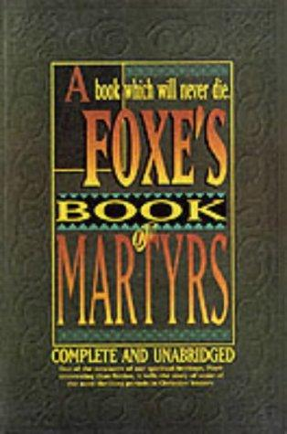
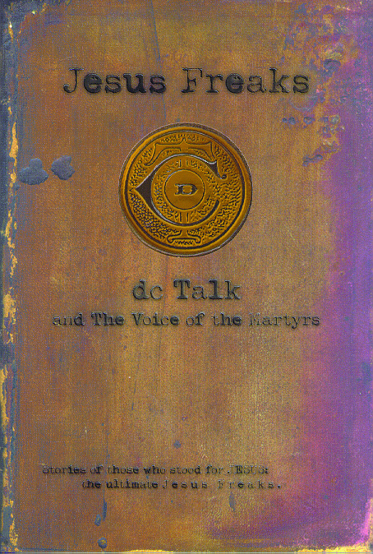
2 . 8 - 1 1

Slide 20
2 . 8 - 1 1

