Slide 1

A free CD of this message will be available following the service
2 . 1 - 7
This message will also be available for podcast later in the week a calvaryokc.com

Slide 2
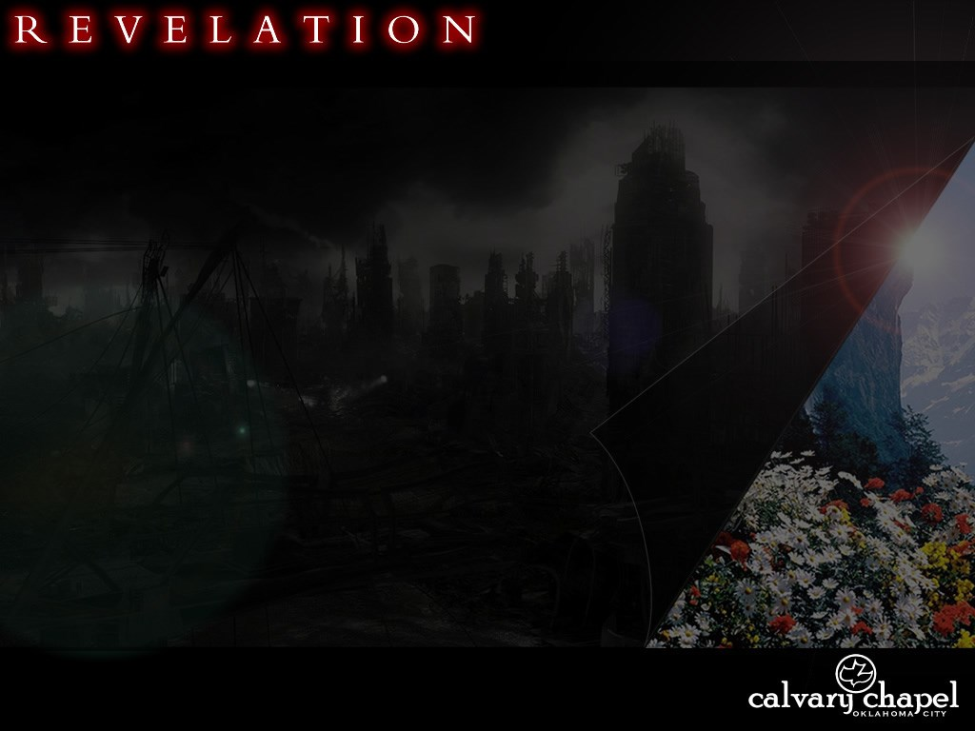
2 . 1 - 7
1.19 ~ Write the things which you have seen …
Chapter 1
… and the things which are …
Chapters 2-3
… and the things which will take place after this.
Chapters 4-22

Slide 3
2 . 1 - 7
Jewish-Roman War
The Revelation
AD 35
AD 45
AD 55
AD 65
AD 75
AD 85
AD 95
60 years

Slide 4
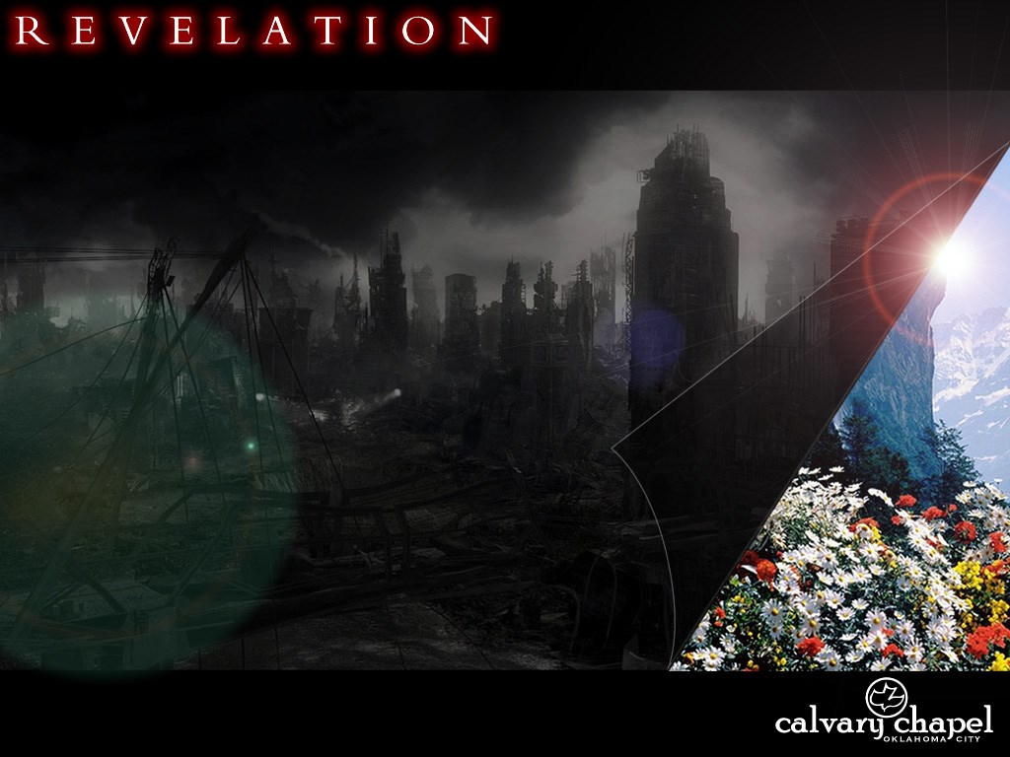
2 . 1 - 7

Slide 5
2 . 1 - 7
The Seven Churches:
1) Local
2) Prophetic
3) Contemporary

Slide 6
2 . 1 - 7
Prophetic:
1) Ephesus ~ Apostolic Church, 33 - 100 AD
2) Smyrna ~ Persecuted Church, 100 - 314 AD
3) Pergamos ~ Pagan Church, 314 - 590 AD
4) Thyatira ~ Roman Church, 590 - present
5) Sardis ~ Reformation Church, 1517 – present
6) Philadelphia ~ Revived Church, 1800 – present
7) Laodicea ~ Relaxed Church, 1800 – present

Slide 7
2 . 1 - 7

Slide 8
2 . 1 - 7
1.13-16 ~ ¹³ and in the midst of the seven lampstands One like the Son of Man, clothed with a garment down to the feet and girded about the chest with a golden band. ¹⁴ His head and hair were white like wool, as white as snow, and His eyes like a flame of fire; ¹⁵ His feet were like fine brass, as if refined in a furnace, and His voice as the sound of many waters; ¹⁶ He had in His right hand seven stars, out of His mouth went a sharp two-edged sword, and His countenance was like the sun shining in its strength.

Slide 9
2 . 1 - 7

Slide 10
2 . 1 - 7
1:20 ~ The mystery of the seven stars which you saw in My right hand, and the seven golden lampstands: The seven stars are the angels of the seven churches, and the seven lampstands which you saw are the seven churches.

Slide 11
2 . 1 - 7

Slide 12

2 . 1 - 7
Angel ~ aggelos – literally, messenger
John the Baptist – Matt. 11.10 ~ For this is he of whom it is written: ‘Behold, I send My messenger before Your face, Who will prepare Your way before You.
Fred
Jesus
The 2 spies – James 2.25 ~ Likewise, was not Rahab the harlot also justified by works when she received the messengers and sent them out another way?
John
Pastor Billy Bob

Slide 13
2 . 1 - 7

Slide 14
2 . 1 - 7
Patience ~ hupomonē – to remain under
NLT ~ patient endurance

Slide 15
2 . 1 - 7
Didache 11:1 ~ "Let every apostle who comes to you be received as the Lord. But he shall not remain more than one day; or two days, if there's a need. But if he remains three days, he is a false prophet. And when the apostle goes away, let him take nothing but bread until he lodges. If he asks for money, he is a false prophet."
"And every prophet who orders a meal in the Spirit does not eat it, unless he is indeed a false prophet. And every prophet who teaches the truth, but does not do what he teaches, is a false prophet … But whoever says in the Spirit, Give me money, or something else, you shall not listen to him."

Slide 16
2 . 1 - 7
C. H. Spurgeon ~ “This was grand of them: it showed a backbone of truth. I wish some of the churches of this age had a little of this holy decision about them; for nowadays, if a man be clever; he may preach the vilest lie that was ever vomited from the mouth of hell, and it will go down with some.”

Slide 17
2 . 1 - 7

Slide 18
2 . 1 - 7
1 John 4:19-21 ~ ¹⁹ We love Him because He first loved us. ²⁰ If someone says, "I love God," and hates his brother, he is a liar; for he who does not love his brother whom he has seen, how can he love God whom he has not seen? ²¹ And this commandment we have from Him: that he who loves God must love his brother also.

Slide 19
2 . 1 - 7

Slide 20
2 . 1 - 7
Verse 5
Remember
Repent
~ metanoeō – to change mind
Redo

Slide 21
2 . 1 - 7

Slide 22
2 . 1 - 7
Nicolaitans
+ laos -- people
~ nikē – to conquer
Hence, conquered people (laity)

Slide 23
2 . 1 - 7

