Slide 1
A free CD of this message will be available following the service
1 . 1 - 20
This message will also be available for podcast later in the week a calvaryokc.com

Slide 2
1 . 1 - 20
Eschatology
eschatos (last things) + logos (to study)

Slide 3
1 . 1 - 20

Slide 4
1 . 1 - 20
4 Methods of Interpretation:
1. Historicist:
Believes that prophecy has been and will be fulfilled during the current church age
2. Idealist:
Does not believe the Bible indicates the timing of events
3. Preterist:
Believes that most, if not all prophecy has already been fulfilled
4. Futurist:
Believes that prophetic events will be fulfilled in the future

Slide 5
1 . 1 - 20

Slide 6
1 . 1 - 20
The Book of Revelation
s
Not John's but Jesus'
The Revelation of Jesus Christ
apokalupsis ~ literally, away from hiding

Slide 7
1 . 1 - 20
Servants
~ doulos – bond slave
Shortly ~ tachos – also quickly, speedily
John Walvoord ~ “‘quickly or suddenly coming to pass,’ indicating rapidity of execution after the beginning takes place. The idea is not that the event may occur soon, but that when it does, it will be sudden.”

Slide 8
1 . 1 - 20

Slide 9
1 . 1 - 20
Wuest's Expanded Translation of the New Testament ~ … spiritually prosperous is he who reads in the worship assembly of the local church and spiritually prosperous are those who hear the words of this prophecy and observe the things which in it have been written and are on record, for the strategic, epochal season is imminent.

Slide 10
1 . 1 - 20

Slide 11
1 . 1 - 20
Seven Spirits ~ i.e. the seven-fold Spirit (Is. 11:2-3)
¹ There shall come forth a Rod from the stem of Jesse, And a Branch shall grow out of his roots. ² The Spirit of the LORD shall rest upon Him, The Spirit of wisdom and understanding, The Spirit of counsel and might, The Spirit of knowledge and of the fear of the LORD. ³ His delight is in the fear of the LORD, And He shall not judge by the sight of His eyes, Nor decide by the hearing of His ears;

Slide 12
1 . 1 - 20

Slide 13
1 . 1 - 20
Firstborn ~ prototokos – 8 of 9x is a direct reference to Jesus
Prototokos speaks more to pre-eminence; to position rather than birth order

Slide 14
1 . 1 - 20

Slide 15
1 . 1 - 20
C. H. Spurgeon ~ “Some of you are very like a mouse behind the wainscot. You are in the Lord’s house, but you are not known as one of the family: sometimes you give a little squeak in your hiding-place, and sometimes come out at night, as the mouse does, to pick up a crumb or two, without being seen. Is this worthy of yourself? Is it worthy of your Lord and Master?”

Slide 16
1 . 1 - 20

Slide 17
1 . 1 - 20
Zech. 12:10 ~ They will look upon Me whom they have pierced; they will mourn for Him as one who mourns for his only son, and grieve for Him as one grieves for a firstborn.

Slide 18
1 . 1 - 20

Slide 19
1 . 1 - 20
Lord ~ NIV, NASB – Lord God

Slide 20
1 . 1 - 20

Slide 21
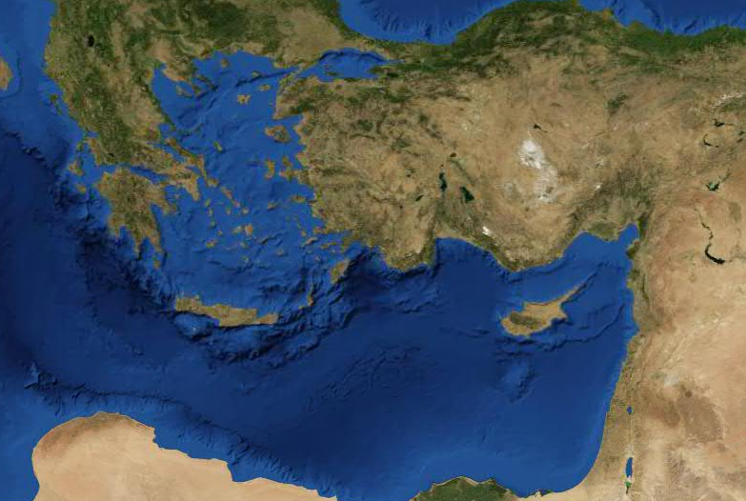
1 . 1 - 20
Pergamos
Thyatira
Sardis
Asia
Smyrna
Philadelphia
Patmos
Laodicea
Ephesus

Slide 22
1 . 1 - 20

Slide 23
1 . 1 - 20
Dan. 7:9 ~ I watched till thrones were put in place, And the Ancient of Days was seated; His garment was white as snow, And the hair of His head was like pure wool. His throne was a fiery flame, Its wheels a burning fire;

Slide 24
1 . 1 - 20

Slide 25
1 . 1 - 20
Is. 44:6 ~ Thus says the LORD, the King of Israel, And his Redeemer, the LORD of hosts: "I am the First and I am the Last; Besides Me there is no God."
Hades ~ not, hell (KJV)

Slide 26
1 . 1 - 20

Slide 27
1 . 1 - 20
Things which you have seen ~ chapter 1
Things which are ~ chapters 2-3
Things which will take place after this ~ chapters 4-22
After this ~ meta tauta (1st of 10x in Revelation)

Slide 28
1 . 1 - 20

