Slide 1
Psalms
the book of
146-150

Slide 2
the book of
Psalms
146-150
Final 5 Psalms begin and end with Hallelujah!

Slide 3
the book of
Psalms
146-150

Slide 4
the book of
Psalms
146-150
NASB ~ Do not trust in princes,
In mortal man, in whom there is no salvation.

Slide 5
the book of
Psalms
146-150

Slide 6
the book of
Psalms
146-150
spirit ~ ruach – KJV, breath

Slide 7
the book of
Psalms
146-150

Slide 8
the book of
Psalms
146-150
Ps. 20:7 ~ Some trust in chariots, and some in horses; But we will remember the name of the LORD our God.

Slide 9
the book of
Psalms
146-150

Slide 10
the book of
Psalms
146-150
grains of sand on the earth
10²⁵
stars in the universe
100,000,000,000,000,000,000,000,000

Slide 11
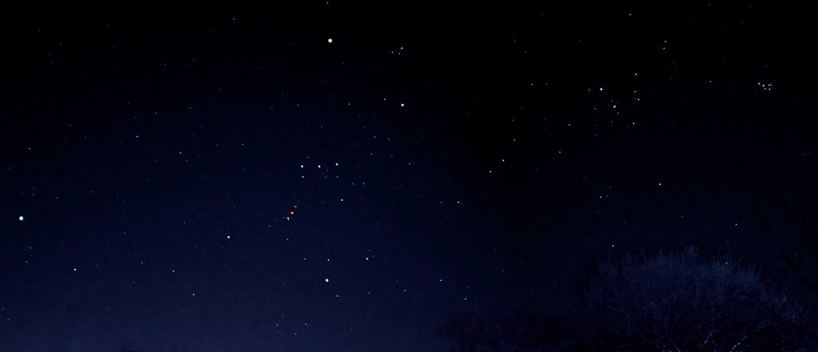
the book of
Psalms
146-150
Job 38:31 ~ Can you bind the cluster of the Pleiades, Or loose the belt of Orion?
Orion
belt
Pleiades
all by name ~ Betelgeuse and Adelbaran

Slide 12
the book of
Psalms
146-150

Slide 13
the book of
Psalms
146-150
sea creatures ~ KJV, dragons

Slide 14
the book of
Psalms
146-150

Slide 15
the book of
Psalms
146-150
C. H. Spurgeon ~ “When called to fight, the meek are very hard to overcome; they are just as steady in conflict as they are steadfast in patience. Besides, their way of fighting is of an extraordinary sort, for they sing to God but keep their swords in their hands. They can do two things at a time: if they do not wield the trowel and the sword, at least they sing and strike.”
Eccl. 9:10 ~ Whatever your hand finds to do, do it with your might; for there is no work or device or knowledge or wisdom in the grave where you are going.

Slide 16
the book of
Psalms
146-150

Slide 17
the book of
Psalms
146-150
C. H. Spurgeon ~ “We have now reached the last summit of the mountain chain of Psalms. It rises high into the clear azure, and its brow is bathed in the sunlight of the eternal world of worship.”
Where ~ v. 1
Why ~ v. 2
How ~ vv. 3-5
Who ~ v. 6

Slide 18
the book of
Psalms
146-150

Slide 19
the book of
Psalms
146-150
C. H. Spurgeon ~ “We have now reached the last summit of the mountain chain of Psalms. It rises high into the clear azure, and its brow is bathed in the sunlight of the eternal world of worship.”
Where ~ v. 1
Why ~ v. 2
How ~ vv. 3-5
Who ~ v. 6

Slide 20
the book of
Psalms
146-150

Slide 21
the book of
Psalms
146-150
C. H. Spurgeon ~ “His being is unlimited, and his praise should correspond therewith. He possesses a multitude or a plenitude of greatness, and therefore he should be greatly praised. There is nothing little about God, and there is nothing great apart from him.”

Slide 22
the book of
Psalms
146-150

Slide 23
the book of
Psalms
146-150
flutes ~ KJV, organs

Slide 24
the book of
Psalms
146-150

Slide 25
the book of
Psalms
146-150
Col. 3:16 ~ Let the word of Christ dwell in you richly in all wisdom, teaching and admonishing one another in psalms and hymns and spiritual songs, singing with grace in your hearts to the Lord.
James 5:13a ~ Is anyone cheerful? Let him sing psalms.

Slide 26
the book of
Psalms
146-150

Slide 27
the book of
Psalms
146-150
C. H. Spurgeon ~ “He gave them breath, let them breathe his praise. His name is in the Hebrew composed rather of breathings than of letters, to show that all breath comes from him: therefore let it be used for him. Join all ye living things in the eternal song. Be ye least or greatest, withhold not your praises. What a day will it be when all things in all places unite to glorify the one only living and true God! This will be the final triumph of the church of God.”

Slide 28
the book of
Psalms
146-150

