Slide 1
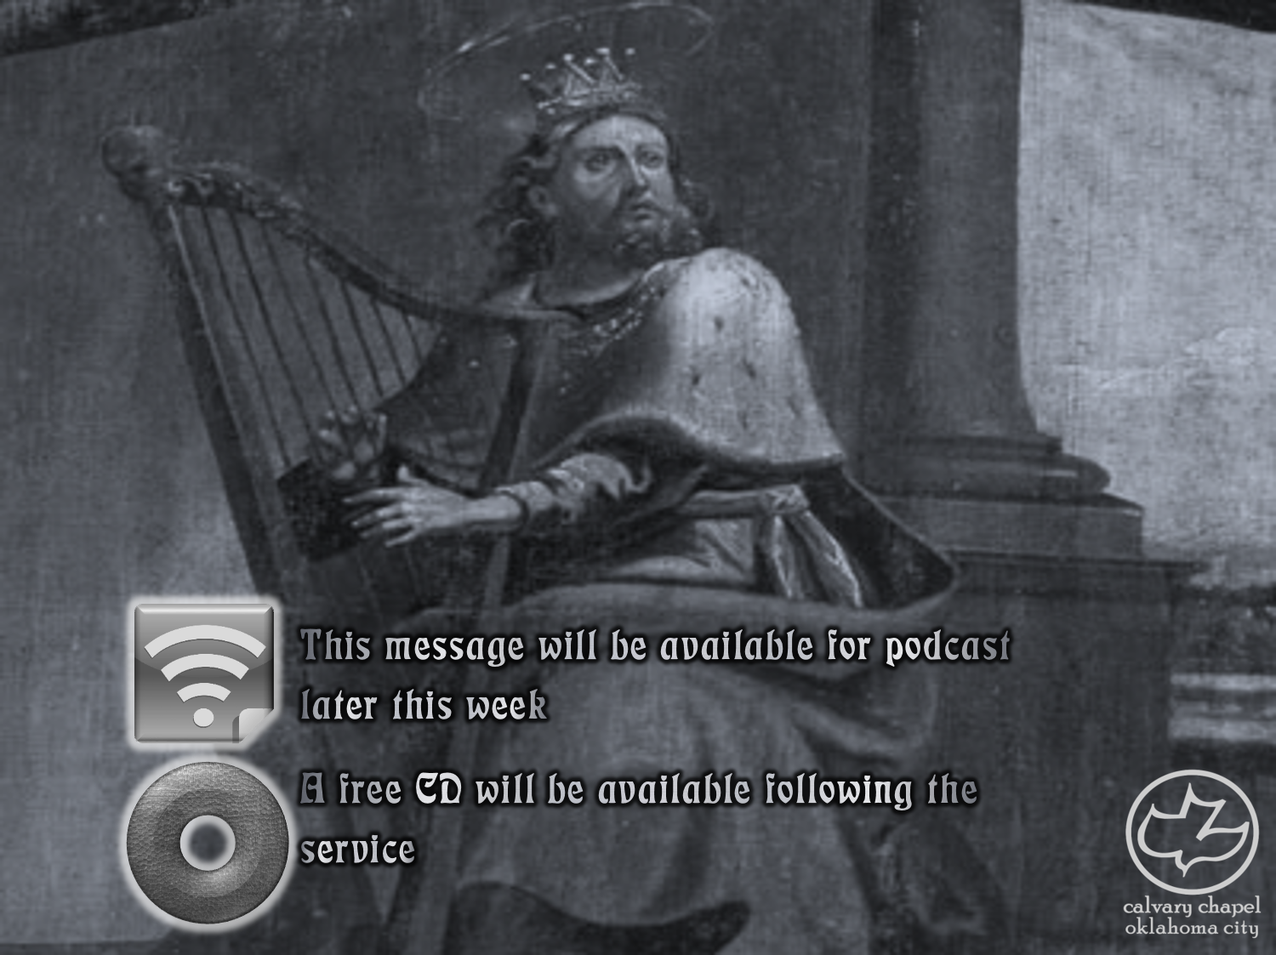

Psalms
the book of
139-141

Slide 2
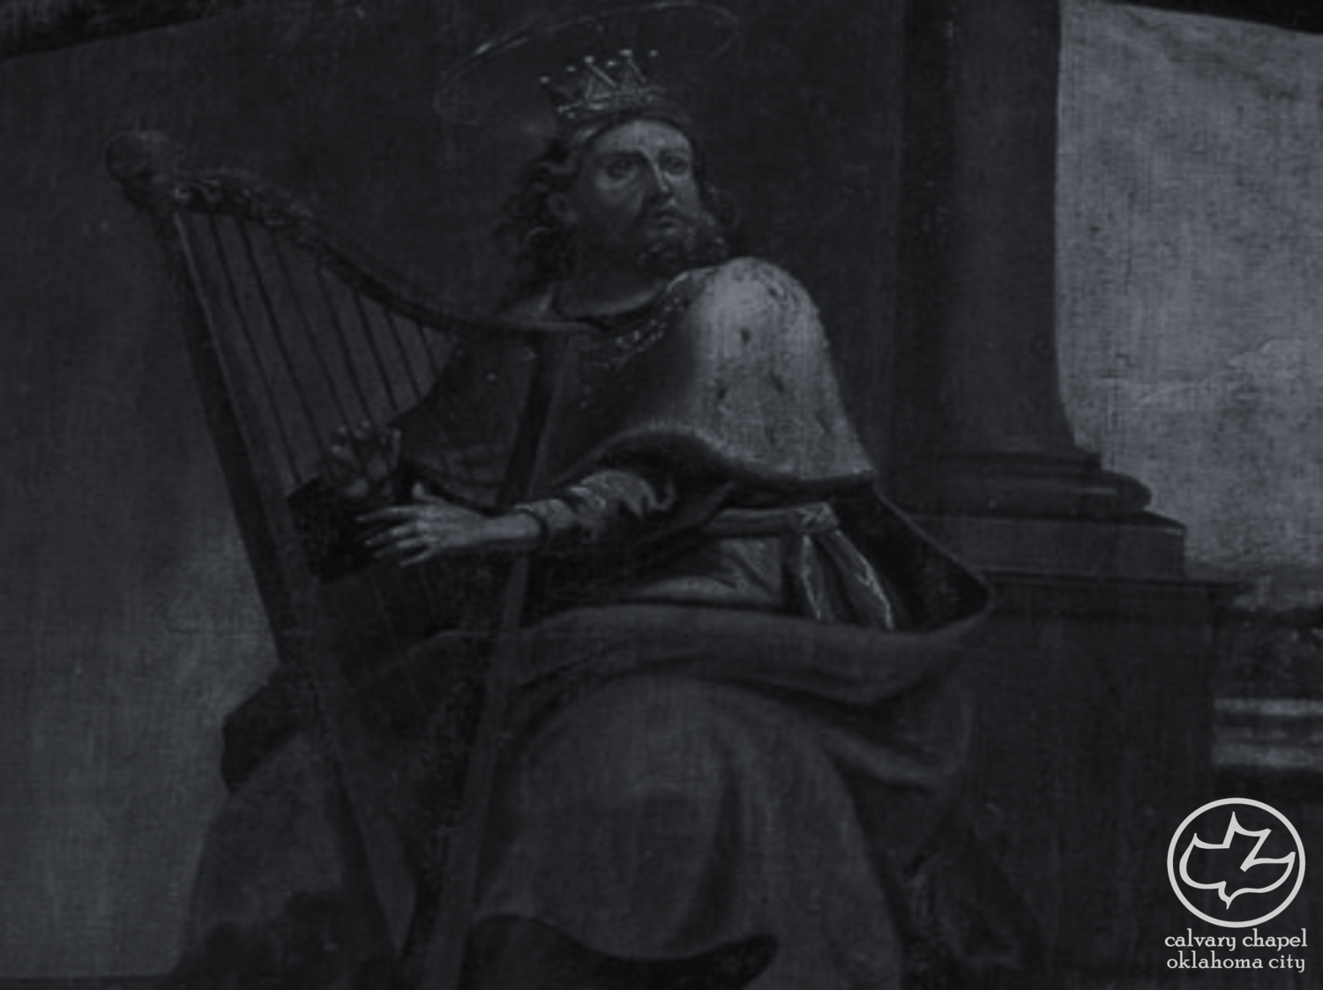
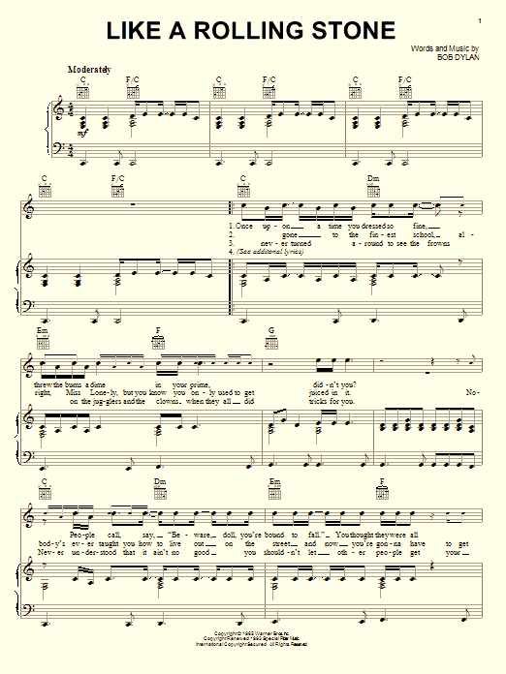

the book of
Psalms
139-141

Slide 3
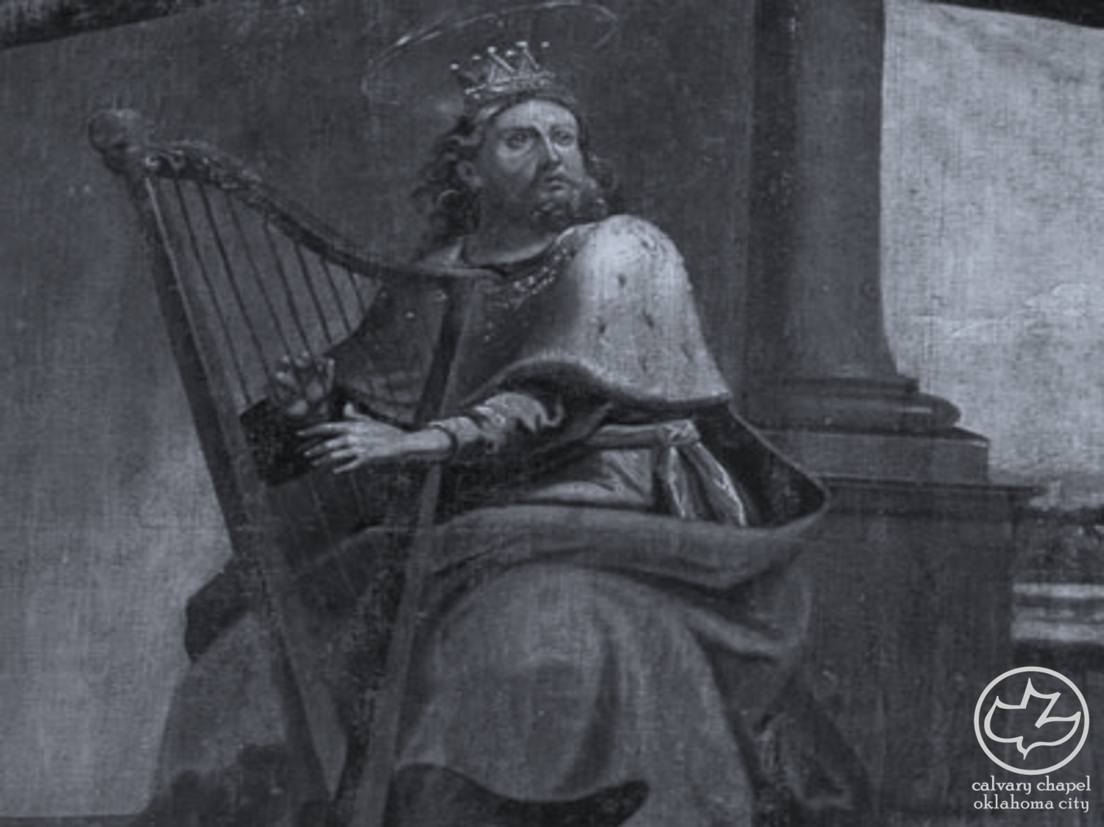
the book of
Psalms
139-141

Slide 4
the book of
Psalms
139-141
C. H. Spurgeon ~ “My most common and casual acts, my most needful and necessary movements, are noted by thee, and thou knowest the inward thoughts which regulate them. Whether I sink in lowly self-renunciation, or ascend in pride, thou seest the motions of my mind, as well as those of my body. This is a fact to be remembered every moment sitting down to consider, or rising up to act, we are still seen, known, and read by Jehovah our Lord.”

Slide 5
the book of
Psalms
139-141

Slide 6
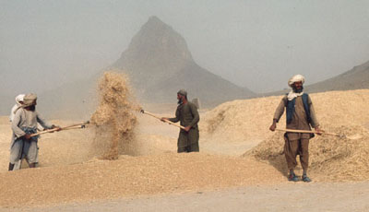
the book of
Psalms
139-141
comprehend ~ NASB, scrutinize
NIV, discern
KJV, compassest
From a Hebrew word meaning winnow
Winnowing fan

Slide 7
the book of
Psalms
139-141

Slide 8
the book of
Psalms
139-141
NASB ~ If I make my bed in ¹ Sheol, behold, You are there.
footnote ¹ ~ i.e. the nether world

Slide 9
the book of
Psalms
139-141

Slide 10
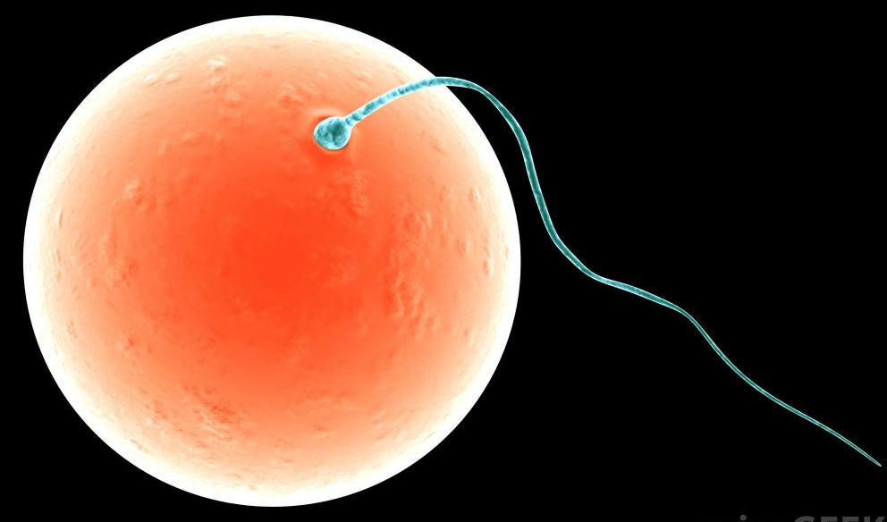
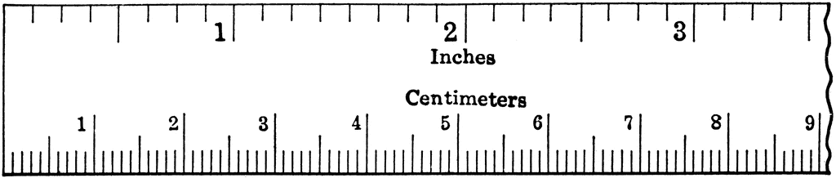
the book of
Psalms
139-141
.1 mm
inches 1/8
mm

Slide 11

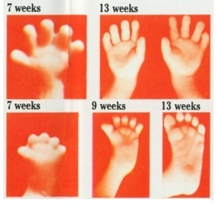
the book of
Psalms
139-141
7 weeks
9 weeks
13 weeks

Slide 12
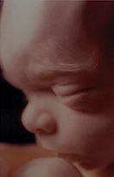
the book of
Psalms
139-141
4 weeks ~ detectable heartbeat
6 weeks ~ measurable brainwaves
1st trimester
8 weeks ~ fingerprints are formed
11 weeks ~ facial expressions
13 weeks ~ gender determined
16 weeks ~ swims and somersaults
2nd trimester
20 weeks ~ responds to sounds

Slide 13
the book of
Psalms
139-141

Slide 14
the book of
Psalms
139-141
covered ~ better – NASV, wove; or NIV, knit

Slide 15
the book of
Psalms
139-141

Slide 16

the book of
Psalms
139-141
Cells
Bones
Skin
Motion

Slide 17
the book of
Psalms
139-141

Slide 18
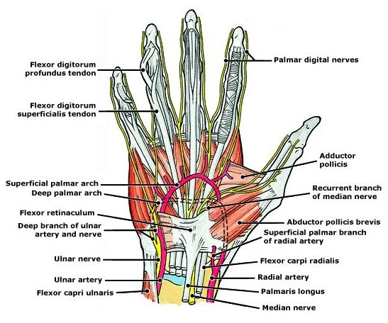
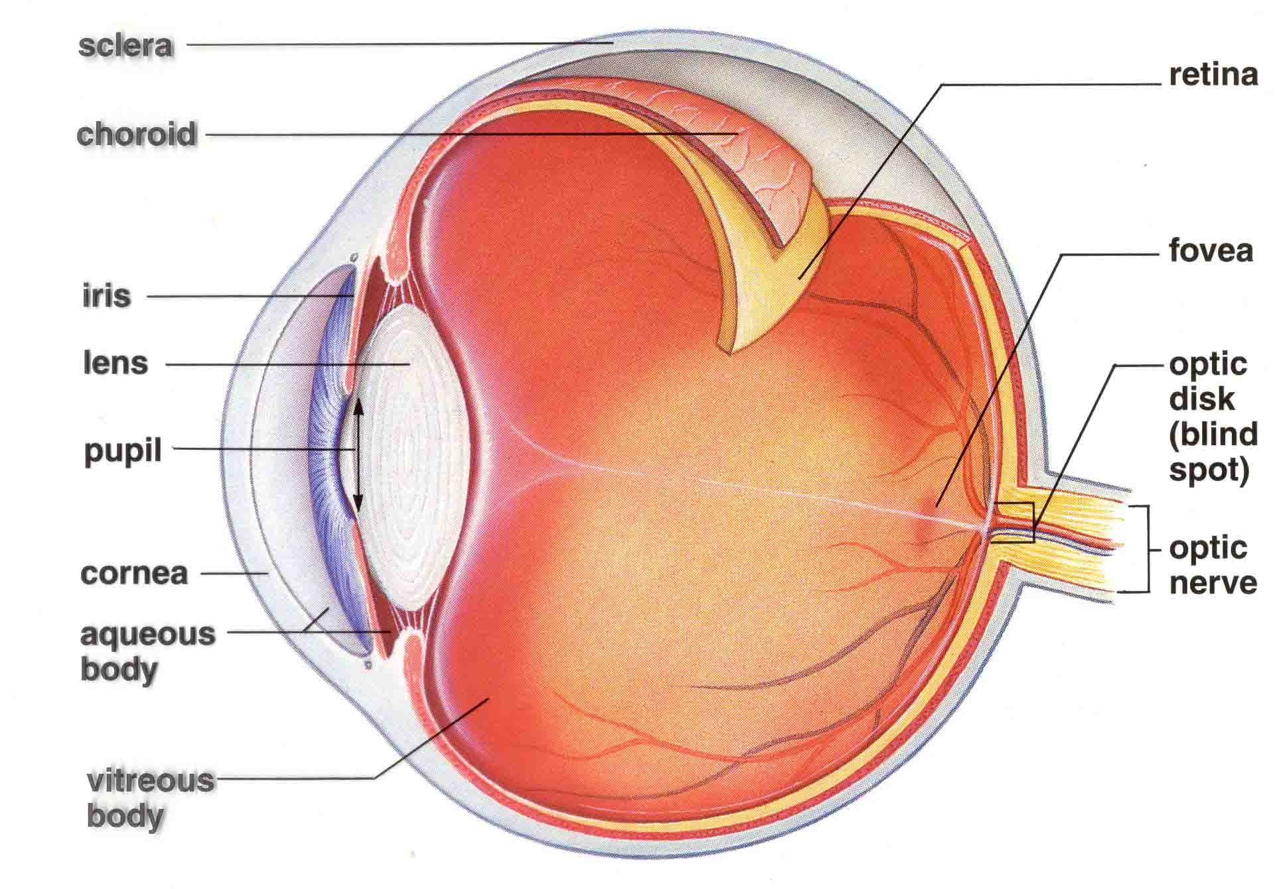
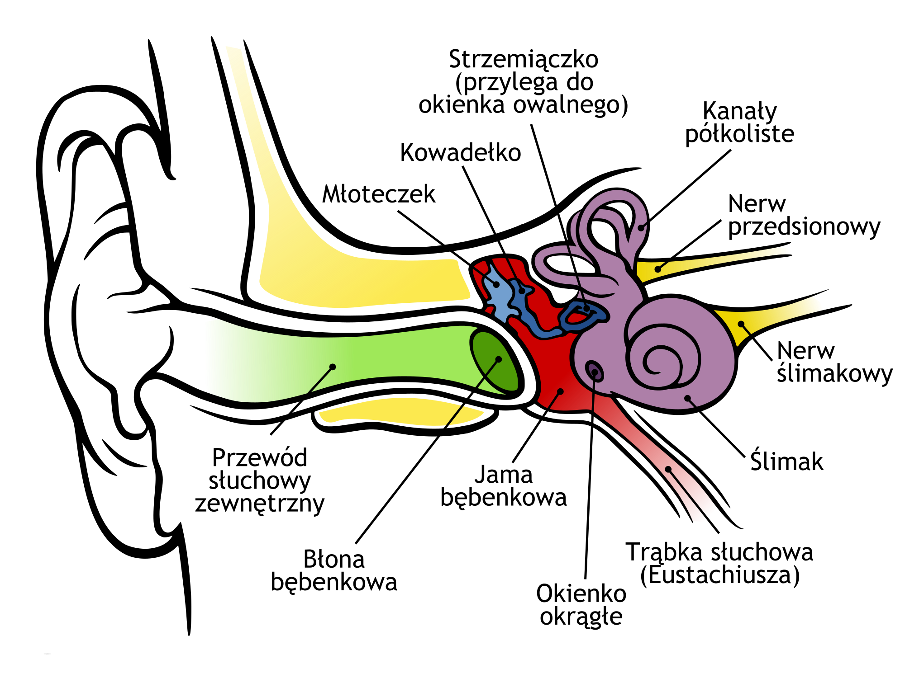
the book of
Psalms
139-141

Slide 19
the book of
Psalms
139-141

Slide 20
the book of
Psalms
139-141
1 Cor. 2:1-5 ~ ¹ And I, brethren, when I came to you, did not come with excellence of speech or of wisdom declaring to you the testimony of God. ² For I determined not to know anything among you except Jesus Christ and Him crucified. ³ I was with you in weakness, in fear, and in much trembling. ⁴ And my speech and my preaching were not with persuasive words of human wisdom, but in demonstration of the Spirit and of power, ⁵ that your faith should not be in the wisdom of men but in the power of God.

Slide 21
the book of
Psalms
139-141
Martin Luther ~ “God created the world out of nothing” and as long as we remain nothing, He can make something out of us.

Slide 22
the book of
Psalms
139-141

Slide 23


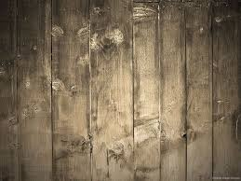
the book of
Psalms
139-141
I am pro-life
cuz … Jesus is pro-life

Slide 24
the book of
Psalms
139-141

Slide 25
the book of
Psalms
139-141
10²⁵ grains of sand on the earth
100,000,000,000,000,000,000,000,000
Jer. 29:11 ~ For I know the thoughts that I think toward you, says the Lord, thoughts of peace and not of evil, to give you a future and a hope.
Luke 12:6-7 ~ ⁶ Are not five sparrows sold for two copper coins? And not one of them is forgotten before God. ⁷ But the very hairs of your head are all numbered. Do not fear therefore; you are of more value than many sparrows.

Slide 26
the book of
Psalms
139-141

Slide 27


the book of
Psalms
139-141
violent ~ hamas
The Hamas Party ~ Harakat al-Muqāwamah al-ʾIslāmiyyah for Islamic Resistance Movement
A
L
National Abortion Rights Action League
N
R
A
N
A
R
A
L
Pronounced NAY-ral
Pronounced gnarl

Slide 28
the book of
Psalms
139-141

Slide 29
the book of
Psalms
139-141
Lord is translation for Yahweh (Hebrew for God’s Name)
Lord is translation for Adonai (Hebrew for Lord)
God is translation for Elohim (Hebrew for God)
God the Lord is translation for Yahweh Adonai

Slide 30
the book of
Psalms
139-141

Slide 31
the book of
Psalms
139-141
C. H. Spurgeon ~ “There is a voice to the great Father in every cry, and groan, and tear of his children: he can understand what they mean when they are quite unable to express it.”

Slide 32
the book of
Psalms
139-141

Slide 33

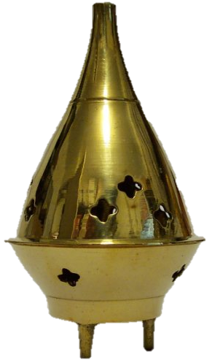

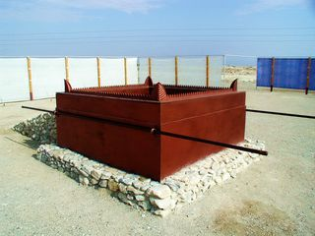
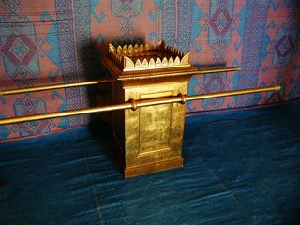
the book of
Psalms
139-141
150 '
Ark
Table of Showbread
Bronze Laver
Golden Altar
Menorah
75'
15 '
45 '
Bronze Altar
This Photo by Unknown Author is licensed under CC BY-SA

Slide 34
the book of
Psalms
139-141
Lev. 10:1-2 ~ ¹ Then Nadab and Abihu, the sons of Aaron, each took his censer and put fire in it, put incense on it, and offered profane fire before the Lord, which He had not commanded them. ² So fire went out from the Lord and devoured them, and they died before the Lord.
profane fire ~ KJV, NASB – strange fire
NIV, ESV – unauthorized fire
LXX – the word for foreign(er)
NLT– the wrong kind of fire

Slide 35
the book of
Psalms
139-141

Slide 36
the book of
Psalms
139-141
Prov. 27:4-5 ~ ⁵ Open rebuke is better
Than love carefully concealed.
⁶ Faithful are the wounds of a friend,
But the kisses of an enemy are deceitful.
C. H. Spurgeon ~ “When the ungodly smile upon us their flattery is cruel; when the righteous smite us their faithfulness is kind. Sometimes godly men rap hard; they do not merely hint at evil, but hammer at it; and even then we are to receive the blows in love, and be thankful to the hand which smites so heavily. Fools resent reproof; wise men endeavour to profit by it.”

Slide 37
the book of
Psalms
139-141

Slide 38
the book of
Psalms
139-141
C. H. Spurgeon ~ “It may not be a Christian prayer, but it is a very just one, and it takes a great deal of grace to refrain from crying Amen to it; in fact, grace does not work towards making us wish otherwise concerning the enemies of holy men. Do we not all wish the innocent to be delivered, and the guilty to reap the result of their own malice? Of course we do, if we are just men. There can be no wrong in desiring that to happen in our own case which we wish for all good men.
Yet is there a more excellent way.”

Slide 39
the book of
Psalms
139-141

