Slide 1
Psalms
the book of
135-138

Slide 2
the book of
Psalms
135-138
Begins and ends with hallelujah ~ Praise the Lord

Slide 3
the book of
Psalms
135-138

Slide 4
the book of
Psalms
135-138
Muhammed ~ est. 150,000,000
Hebrew ~ Yehoshua (Ya-HO-shoo-ah)
Aramaic ~ Yeshua (Ya-SHOO-ah)
Latin ~ Iosue (ee-OH-soo-ay)
Greek ~ Iēsous (ee-AY-soos)
Jesus
Spanish ~ Jesus (HAY-soos)
English ~ Joshua (Josh-shoo-ah)

Slide 5
the book of
Psalms
135-138

Slide 6
the book of
Psalms
135-138
When used by men: always speaking of gold and jewels
special treasure
When used by God: always speaking of His people

Slide 7
the book of
Psalms
135-138

Slide 8
the book of
Psalms
135-138
Deut. 3:11 ~ Og king of Bashan
13’ 6”
6'

Slide 9
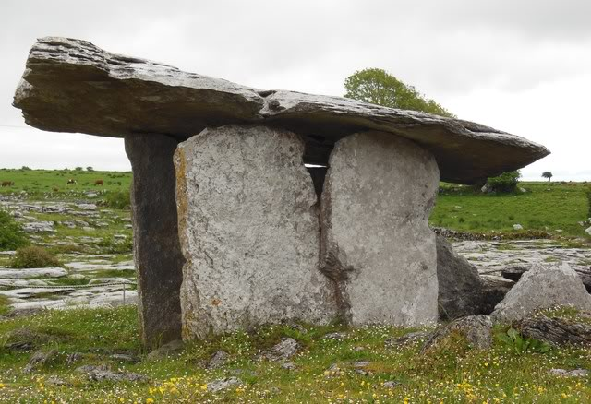
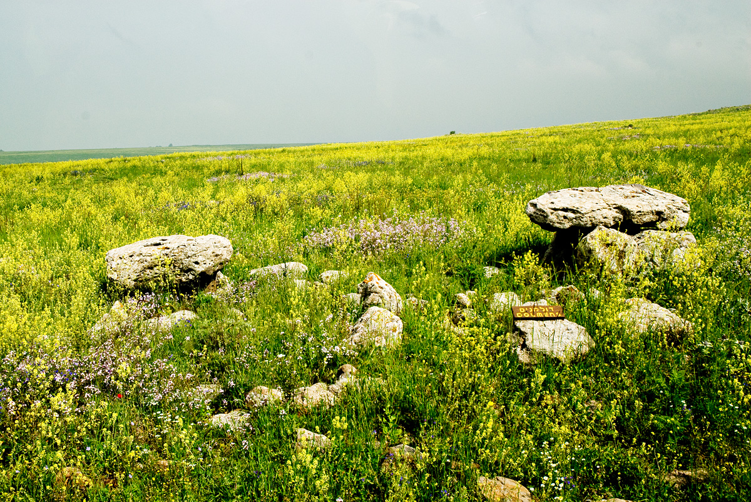
the book of
Psalms
135-138
Dolmens
12-15’
Gamla National Park

Slide 10
the book of
Psalms
135-138

Slide 11
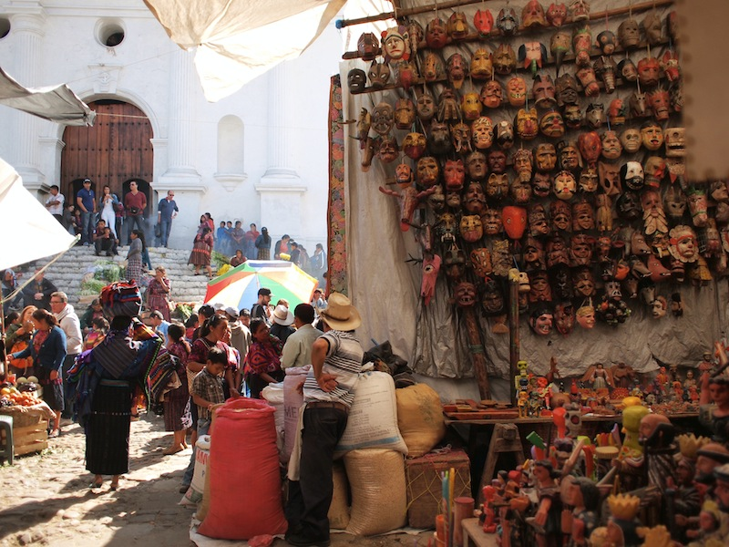
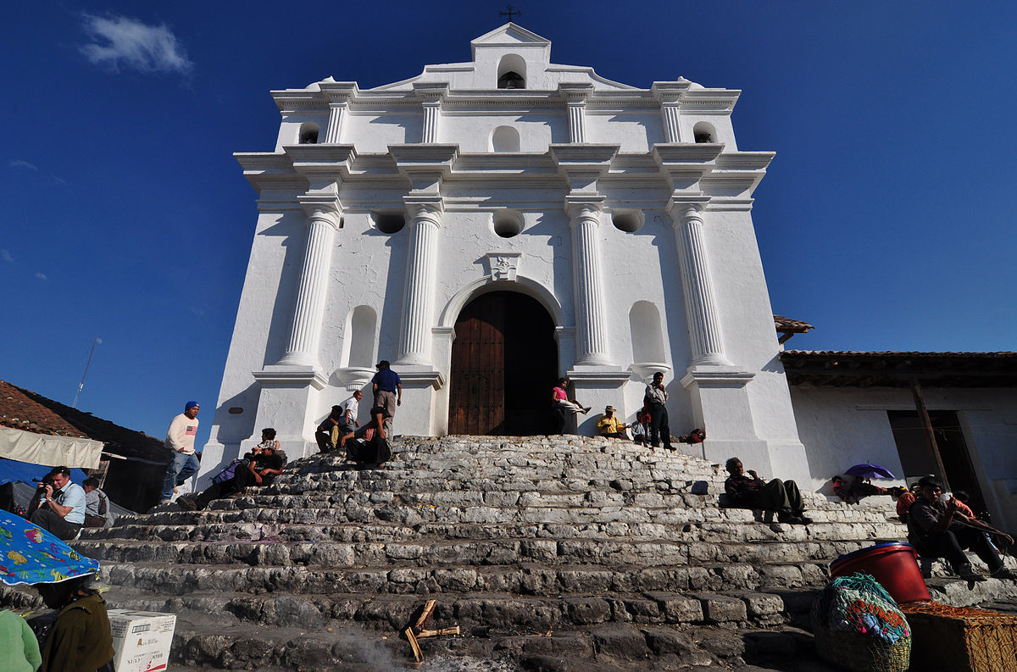
the book of
Psalms
135-138
Iglesia de Santo Tomás
Chichicastenango, Guatemala

Slide 12
the book of
Psalms
135-138

Slide 13
the book of
Psalms
135-138
v. 1 ~ Yahweh
v. 2 ~ Elohim of Elohim
v. 3 ~ Adonai of Adonai

Slide 14
the book of
Psalms
135-138

Slide 15
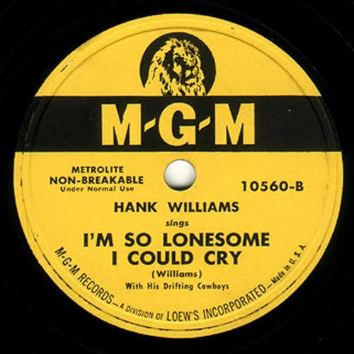
the book of
Psalms
135-138
Set to the tune of “I’m So Lonesome I Could Cry”

Slide 16
the book of
Psalms
135-138

Slide 17
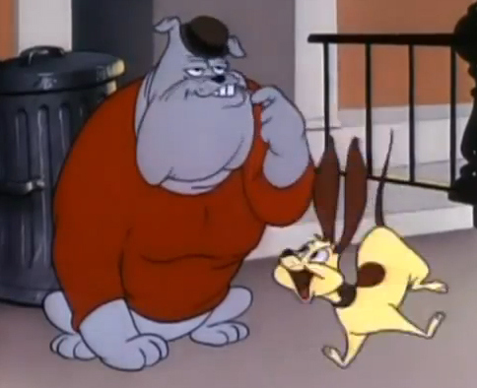
the book of
Psalms
135-138
NLT ~ “Destroy it!” they yelled.
“Level it to the ground!”
Babylon
Spike
Edom
Chester

Slide 18
the book of
Psalms
135-138

Slide 19
the book of
Psalms
135-138
C. H. Spurgeon ~ “The execrations of good men are terrible things, for they are not lightly uttered, and they are heard in heaven. 'The curse causeless shall not come;' but is there not a cause? Shall despots crush virtue beneath their iron heel and never be punished? Time will show.”

Slide 20
the book of
Psalms
135-138

Slide 21
the book of
Psalms
135-138
temple ~ generic word variously translated as tabernacle, temple, sanctuary, palace
NASB ~ … For You have magnified Your word according to all Your name.

Slide 22
the book of
Psalms
135-138

Slide 23
the book of
Psalms
135-138
“Antithetical parallelism” ~ “A” is emphasized by contrasting elements in “B”
Ps. 1:6 ~ For the Lord knows the way of the righteous, But the way of the ungodly shall perish.

Slide 24
the book of
Psalms
135-138

Slide 25
the book of
Psalms
135-138
perfect ~ i.e. perform
NASB ~ accomplish
NIV ~ fulfill

Slide 26
the book of
Psalms
135-138

