Slide 1
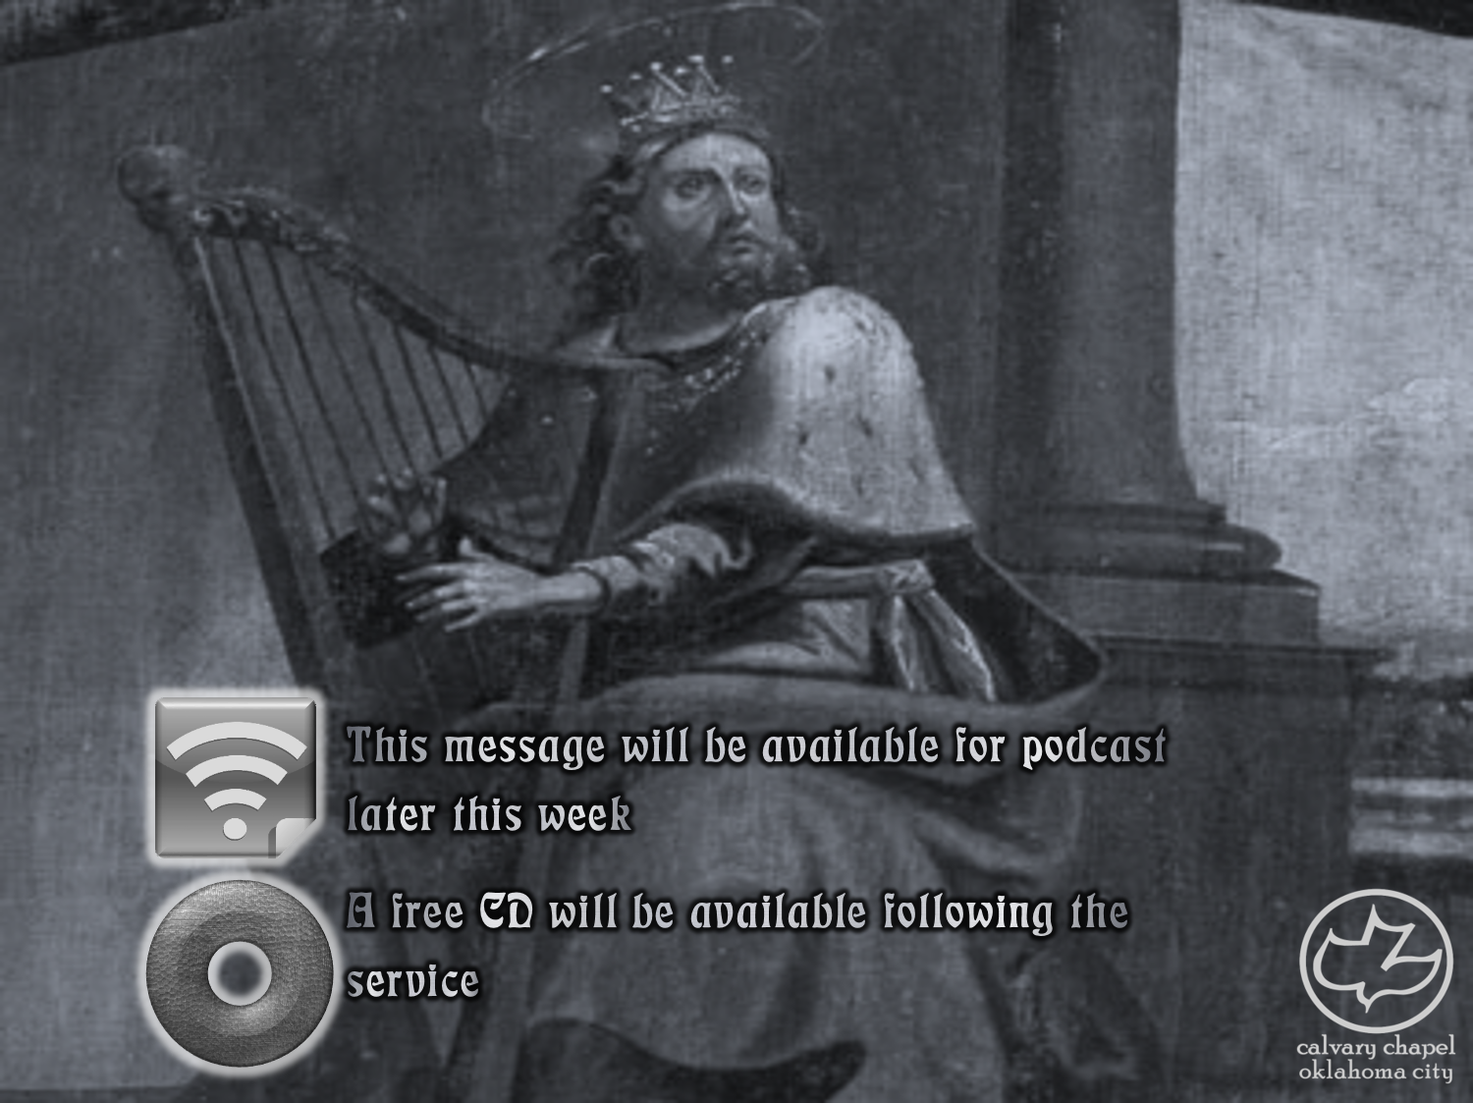

Psalms
the book of
128-134

Slide 2
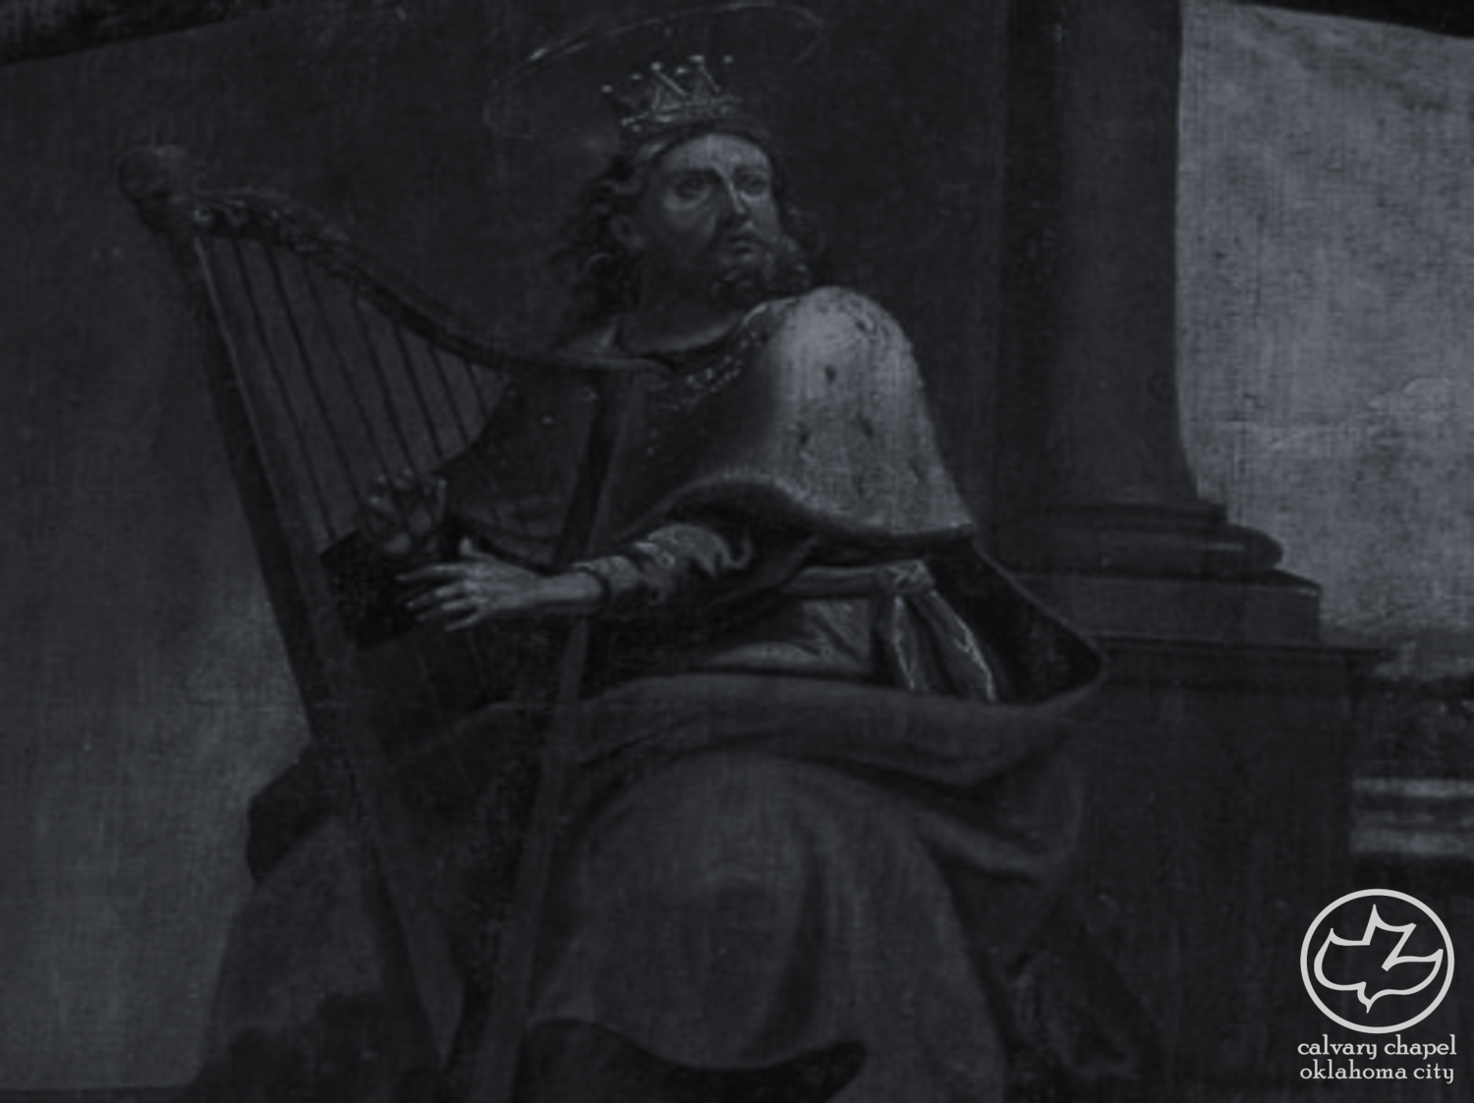
the book of
Psalms
128-134
15 Songs of Ascents (Ps. 120-134) ~ KJV, degrees
Three required “Pilgrim Feasts”:
Passover (14 Nisan)
Pentecost (50 days after 1st Sabbath after Passover)
Tabernacles (15 Tishri)
Mar
Apr
May
Jun
Jul
Aug
Sep
Oct
Nov
Dec
Jan
Feb
Mar
Nisan
Iyar
Sivan
Tammuz
Av
Elul
Tishri
Heshvan
Chislev
Tevet
Shevat
Adar

Slide 3
the book of
Psalms
128-134
Greatest Road Rock:
I’m Goin’ Home ~ Ten Years After
Route 66 ~ Rolling Stones
Radar Love ~ Golden Earring
Ramblin’ Man ~ Allman Brothers
On the Road Again ~ Willie Nelson
Psalms 120-134 ~ Various Artists
Psalms 120-134 ~ Various Artists

Slide 4
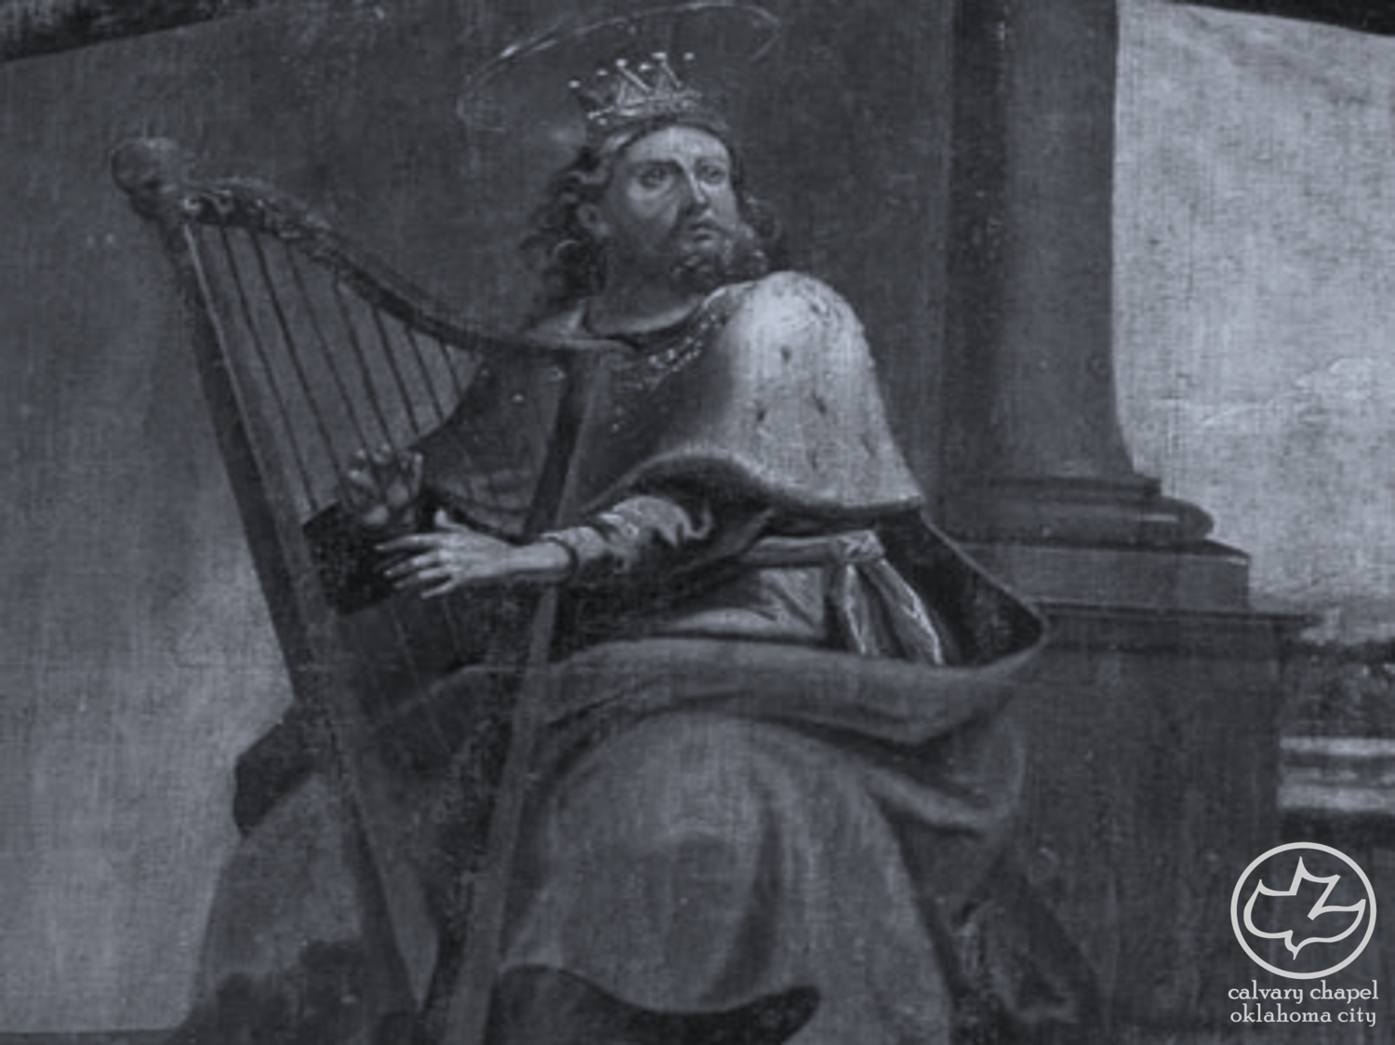
the book of
Psalms
128-134

Slide 5
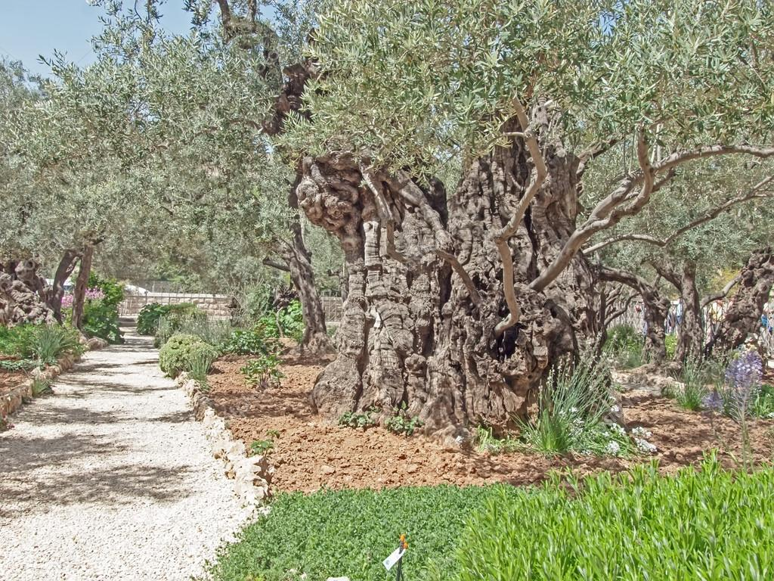
the book of
Psalms
128-134
Plants ~ literally, sprig or sucker

Slide 6
the book of
Psalms
128-134

Slide 7
the book of
Psalms
128-134
Eccl. 3:9-13 ~ ⁹ What profit has the worker from that in which he labors? ¹⁰ I have seen the God-given task with which the sons of men are to be occupied. ¹¹ He has made everything beautiful in its time. Also He has put eternity in their hearts, except that no one can find out the work that God does from beginning to end.¹² I know that nothing is better for them than to rejoice, and to do good in their lives, ¹³ and also that every man should eat and drink and enjoy the good of all his labor — it is the gift of God.

Slide 8
the book of
Psalms
128-134

Slide 9
the book of
Psalms
128-134
2 Cor. 4:8 ~ We are hard-pressed on every side, yet not crushed; we are perplexed, but not in despair;

Slide 10
the book of
Psalms
128-134

Slide 11
the book of
Psalms
128-134
Two inviolable truths:
God is God
God is good

Slide 12
the book of
Psalms
128-134

Slide 13
the book of
Psalms
128-134
C. H. Spurgeon ~ “If the Lord Jehovah makes us wait, let us do it with our whole hearts; for blessed are all they that wait for him. He is worth waiting for. The waiting itself is beneficial to us – it tries faith, exercises patience, trains submission and endears the blessing when it comes.”

Slide 14
the book of
Psalms
128-134

Slide 15
the book of
Psalms
128-134
C. H. Spurgeon ~ “It is a still greater thing if, upon searching himself thoroughly, a man can solemnly protest unto the Omniscient One that his heart is not haughty. That is to say, neither proud in his opinion of himself, contemptuous to others, nor self-righteous before the Lord; neither boastful of the past, proud of the present nor ambitious for the future.”

Slide 16
the book of
Psalms
128-134

Slide 17
the book of
Psalms
128-134
Vincent de Paul (1580-1660) ~ “Humility is nothing but truth, while pride is nothing but lying.”
Golda Meir (1898-1978) ~ “Don't be so humble. You're not that great.”

Slide 18
the book of
Psalms
128-134

Slide 19
the book of
Psalms
128-134
NLT ~ Instead, I have calmed and quieted myself,
like a weaned child who no longer cries for its mother’s milk.

Slide 20
the book of
Psalms
128-134

Slide 21
the book of
Psalms
128-134
Mighty One of Jacob ~ a Messianic title found in Is. 49:26 and 60:16

Slide 22
the book of
Psalms
128-134

Slide 23
the book of
Psalms
128-134
Anointed ~ mashiyach (ma-shē’-akh)
LXX ~ Christos

Slide 24
the book of
Psalms
128-134

Slide 25
the book of
Psalms
128-134
Rev. 19:12–15 ~ ¹² His eyes were like a flame of fire, and on His head were many crowns. He had a name written that no one knew except Himself. ¹³ He was clothed with a robe dipped in blood, and His name is called The Word of God. ¹⁴ And the armies in heaven, clothed in fine linen, white and clean, followed Him on white horses. ¹⁵ Now out of His mouth goes a sharp sword, that with it He should strike the nations. And He Himself will rule them with a rod of iron. He Himself treads the winepress of the fierceness and wrath of Almighty God.

Slide 26
the book of
Psalms
128-134
despotēs ~ an absolute ruler
In the New Testament ~ lord, master
Used of God 6x

Slide 27
the book of
Psalms
128-134

Slide 28
the book of
Psalms
128-134
C. H. Spurgeon ~ “It is a wonder seldom seen, therefore behold it! It may be seen, for it is the characteristic of real saints, - therefore fail not to inspect it! It is well worthy of admiration; pause and gaze upon it! It will charm you into imitation, therefore note it well! God looks on with approval, therefore consider it with attention.”

Slide 29
the book of
Psalms
128-134

Slide 30
the book of
Psalms
128-134
Oil ~ Sacred
Refreshing
Anointing
Holy Spirit
Flows
Permeates

Slide 31
the book of
Psalms
128-134

Slide 32
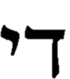
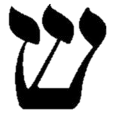
the book of
Psalms
128-134
~ Shaddai (Almighty)
N
Tyropoeon Valley
Hinnom Valley
Temple
Mount
Jerusalem
Kidron Valley
City of David

Slide 33
the book of
Psalms
128-134

