Slide 1
Psalms
the book of
119:1-72

Slide 2
the book of
Psalms
119:1-72
10 words for “the Word” in Psalm 119:
Word (dabar) ~ what God has spoken to us
Word (‘imrah) ~ what God has brought to light
Law (torah) ~ what God has given as the rule of our life
Commandments (mitzvah) ~ what God has commanded
Precepts ~ what God has laid upon us to be kept
Statutes ~ what God has established as the laws of his kingdom
Judgments ~ what God has decided concerning our duty and destiny
Testimonies ~ what God has given as His authoritative declaration of truth
Way ~ what God has revealed in how we are to walk

Slide 3
the book of
Psalms
119:1-72
v. 1 ~ א Aleph
v. 13 ~ ב Beth
v. 2 ~ א Aleph
v. 14 ~ ב Beth
v. 3 ~ א Aleph
v. 15 ~ ב Beth
v. 4 ~ א Aleph
v. 16 ~ ב Beth
v. 5 ~ א Aleph
v. 17 ~ ג Gimel
v. 6 ~ א Aleph
v. 18 ~ ג Gimel
Etc.
v. 7 ~ א Aleph
v. 19 ~ ג Gimel
v. 8 ~ א Aleph
v. 20 ~ ג Gimel
v. 9 ~ ב Beth
v. 21 ~ ג Gimel
v. 10 ~ ב Beth
v. 22 ~ ג Gimel
v. 11 ~ ב Beth
v. 23 ~ ג Gimel
v. 12 ~ ב Beth
v. 24 ~ ג Gimel

Slide 4
the book of
Psalms
119:1-72
Ps 119
Hebrew
English
Ps 119
Hebrew
English
1-8
א aleph
(silent)
89-96
ל lamed
L
9-16
ב beth
B
97-104
מ mem
M
17-24
ג gimel
G
105-112
נ‍ nun
N
25-32
ד daleth
D
113-120
ס samek
S
33-40
ה he
H
121-218
ע ayin
(silent)
41-48
ו waw
V
129-136
פ‍ pe
P
49-56
ז zayin
Z
137-144
צ‍ tsadde
Z/TZ
57-64
ח heth
Kh
145-152
ק qoph
K
65-72
ט teth
T
153-160
ר resh
R
73-80
י yod
Y
161-168
ש shin
S
81-88
כ kaph
K
169-176
ת tau
T

Slide 5
the book of
Psalms
119:1-72
C. H. Spurgeon ~ “Many superficial readers have imagined that it harps upon one string and abounds in pious repetitions and redundancies; but this arises from the shallowness of the reader’s own mind: those who have studied this divine hymn, and carefully noted each line of it, are amazed at the variety and profundity of the thought.”
William Wilberforce, 1819 ~ “I walked from Hyde Park Corner repeating the 119th Psalm in great comfort.”

Slide 6
the book of
Psalms
119:1-72
Hebrew children memorized it to learn the alphabet
George Wishart (Scottish Anglican bishop) (1599-1671) requested it sung at his execution
Was pardoned 2/3 of the way through

Slide 7
the book of
Psalms
119:1-72

Slide 8
the book of
Psalms
119:1-72
aleph: Theme ~ Happy is the man who loves the Word

Slide 9
the book of
Psalms
119:1-72

Slide 10
the book of
Psalms
119:1-72
NLT ~ Oh, that my actions would consistently
reflect your decrees!

Slide 11
the book of
Psalms
119:1-72

Slide 12
the book of
Psalms
119:1-72
beth: Theme ~ The Word is purifying

Slide 13
the book of
Psalms
119:1-72

Slide 14
the book of
Psalms
119:1-72
Hidden ~ literally, stored
This Photo by Unknown Author is licensed under CC BY-NC-SA

Slide 15
the book of
Psalms
119:1-72

Slide 16
the book of
Psalms
119:1-72
gimel: Theme ~ The Word is a road map in a strange land

Slide 17
the book of
Psalms
119:1-72

Slide 18
the book of
Psalms
119:1-72
1 Corinthians 2:14 ~ But the natural man does not receive the things of the Spirit of God, for they are foolishness to him; nor can he know them, because they are spiritually discerned.

Slide 19
the book of
Psalms
119:1-72

Slide 20
the book of
Psalms
119:1-72
daleth: Theme ~ The world has weighed me down, the Word lifts me up

Slide 21
the book of
Psalms
119:1-72

Slide 22
the book of
Psalms
119:1-72
Revive ~ KJV, quicken

Slide 23
the book of
Psalms
119:1-72

Slide 24
the book of
Psalms
119:1-72
Cling ~ dabaq
Gen 2:24 ~ Therefore a man shall leave his father and mother and be joined to his wife, and they shall become one flesh.

Slide 25
the book of
Psalms
119:1-72

Slide 26
the book of
Psalms
119:1-72
he: Theme ~ I don’t want to go back to the world – the Word will preserve me

Slide 27
the book of
Psalms
119:1-72

Slide 28
the book of
Psalms
119:1-72
waw: Theme ~ The Word will keep me close to the Lord

Slide 29
the book of
Psalms
119:1-72

Slide 30
the book of
Psalms
119:1-72
1 Peter 3:15 ~ But sanctify the Lord God in your hearts, and always be ready to give a defense to everyone who asks you a reason for the hope that is in you, with meekness and fear;

Slide 31
the book of
Psalms
119:1-72

Slide 32
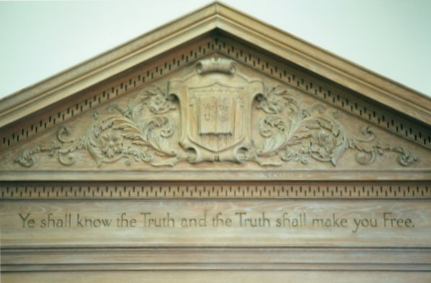
the book of
Psalms
119:1-72

Slide 33
the book of
Psalms
119:1-72

Slide 34
the book of
Psalms
119:1-72
zayin: Theme ~ The Word is my consolation

Slide 35
the book of
Psalms
119:1-72

Slide 36
the book of
Psalms
119:1-72
heth: Theme ~ The Lord is known through His Word

Slide 37
the book of
Psalms
119:1-72

Slide 38
the book of
Psalms
119:1-72
tet: Theme ~ The Word reveals the Lord’s just purposes

Slide 39
the book of
Psalms
119:1-72

