Slide 1
Psalms
the book of
113-118

Slide 2
the book of
Psalms
113-118
113-118 are the Hallel (Praise) Psalms
Contains no superscriptions or titles
Sung during Passover
113-114 sung at the beginning of the meal
115-118 sung at the conclusion of the meal

Slide 3
the book of
Psalms
113-118

Slide 4
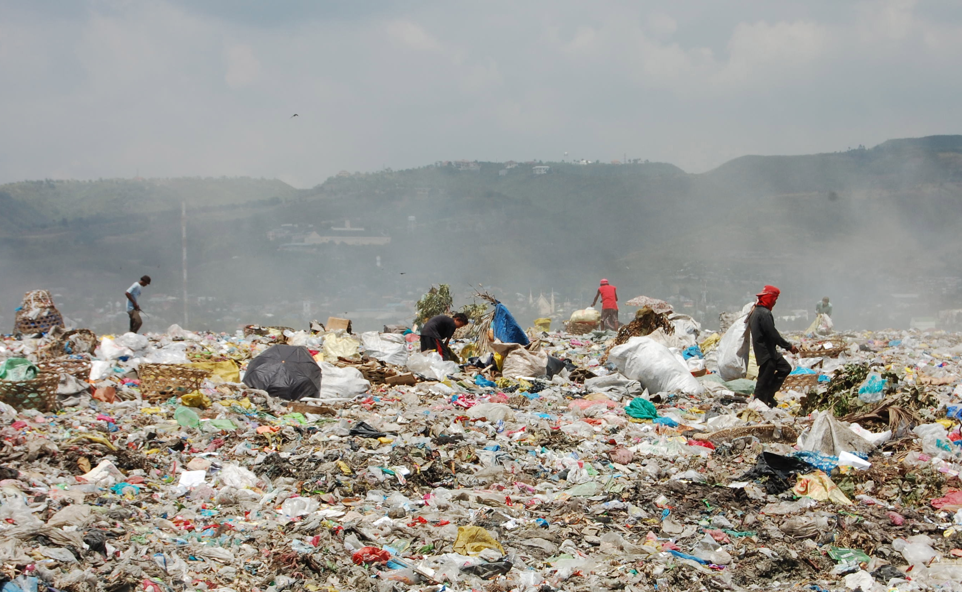
the book of
Psalms
113-118

Slide 5
the book of
Psalms
113-118

Slide 6
the book of
Psalms
113-118
In all of man’s religions and philosophies,
God is either:
aloof or denigrated
Process Theology
Deism
God is removed and uninvolved in man’s affairs
God is limited and “thinks” in linear processes

Slide 7
the book of
Psalms
113-118
C. H. Spurgeon ~ “‘Our Rock is not as their rock’; we have a God who is high above all gods, and yet who is our Father, knowing what we have need of before we ask him; our Shepherd, who supplies our needs; our Guardian, who counts the hairs of our heads; our tender and considerate Friend, who sympathizes in all our griefs. Truly the name of our condescending God should be praised wherever it is known.”

Slide 8
the book of
Psalms
113-118
Deut. 32:31-33 ~ ³¹ For their rock is not like our Rock,
Even our enemies themselves being judges.
³² For their vine is of the vine of Sodom
And of the fields of Gomorrah;
Their grapes are grapes of gall,
Their clusters are bitter.
³³ Their wine is the poison of serpents
And the cruel venom of cobras.

Slide 9
the book of
Psalms
113-118

Slide 10
the book of
Psalms
113-118
Strange language ~ literally, who spoke unintelligibly
Douay-Rheims ~ When Israel went out of Egypt, the house of Jacob from a barbarous people:

Slide 11
the book of
Psalms
113-118

Slide 12
the book of
Psalms
113-118
Ex. 17:6 ~ Behold, I will stand before you there on the rock in Horeb; and you shall strike the rock, and water will come out of it, that the people may drink.
Num. 20:8 ~ Take the rod; you and your brother Aaron gather the congregation together. Speak to the rock before their eyes, and it will yield its water; thus you shall bring water for them out of the rock, and give drink to the congregation and their animals.
1 Cor. 10:2-4 ~ ² all were baptized into Moses in the cloud and in the sea, ³ all ate the same spiritual food, ⁴ and all drank the same spiritual drink. For they drank of that spiritual Rock that followed them, and that Rock was Christ.

Slide 13
the book of
Psalms
113-118

Slide 14
the book of
Psalms
113-118
“Deliver me, for you are my god!”
(Is. 44:17)

Slide 15
the book of
Psalms
113-118

Slide 16
the book of
Psalms
113-118
Haste ~ probably better, alarm (NIV, NASB, ESV)

Slide 17
the book of
Psalms
113-118

Slide 18
the book of
Psalms
113-118
Ps. 117
Gen. 1 – Ps. 116
Ps. 118 – Rev. 22
594 chapters
594 chapters

Slide 19
the book of
Psalms
113-118

Slide 20
the book of
Psalms
113-118
Merciful kindness ~ chesed – loyal love
NLT ~ For He unfailing love for us is powerful;

Slide 21
the book of
Psalms
113-118

Slide 22
the book of
Psalms
113-118
Matt. 26:30 ~ And when they had sung a hymn, they went out to the Mount of Olives.

Slide 23
the book of
Psalms
113-118

Slide 24
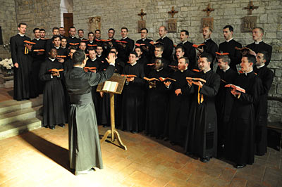
the book of
Psalms
113-118

Slide 25
the book of
Psalms
113-118

Slide 26
the book of
Psalms
113-118
Save now ~ hosanna

Slide 27
the book of
Psalms
113-118

Slide 28
the book of
Psalms
113-118
Matt. 23:37-39 ~ ³⁷ “O Jerusalem, Jerusalem, the one who kills the prophets and stones those who are sent to her! How often I wanted to gather your children together, as a hen gathers her chicks under her wings, but you were not willing! ³⁸ See! Your house is left to you desolate; ³⁹ for I say to you, you shall see Me no more till you say, ‘Blessed is He who comes in the name of the Lord!’”

Slide 29
the book of
Psalms
113-118

Slide 30
the book of
Psalms
113-118
Spurgeon ~ “The Psalm concludes as it began, making a complete circle of joyful adoration. We can well suppose that the notes at the close of the loud hallelujah were more swift, more sweet, more loud than at the beginning. To the sound of trumpet and harp, Israel, the house of Aaron, and all that feared the Lord, forgetting their distinctions, joined in one common hymn, testifying again to their deep gratitude to the Lord’s goodness, and to the mercy which is unto eternity.”

Slide 31
the book of
Psalms
113-118

