Slide 1
Psalms
the book of
107-109

Slide 2
the book of
Psalms
107-109
Divided into 5 books
Book 1
Book 2
Book 3
Book 4
Book 5
1-41
Genesis
Foundations
42-72
Exodus
Redemption
73-89
Leviticus
Worship
90-106
Numbers
Wanderings
107-150
Deuteronomy
Promised Life

Slide 3
the book of
Psalms
107-109

Slide 4
the book of
Psalms
107-109
For His mercy
endures
forever.

Slide 5
the book of
Psalms
107-109

Slide 6
the book of
Psalms
107-109
Redeemed ~ (verb) ga’al; (noun) go’el
Kinsman-redeemer ~ 25:5-10
Avenger of blood ~ Josh. 20:2-6

Slide 7
the book of
Psalms
107-109
Requirements of the go’el
Near relative
Phil. 2:6-7 ~ ⁶ who, being in the form of God, did not consider it robbery to be equal with God, ⁷ but made Himself of no reputation, taking the form of a bondservant, and coming in the likeness of men.

Slide 8
the book of
Psalms
107-109
Requirements of the go’el
Near relative
Able to redeem
1 Pet. 1:18-19 ~ ¹⁸ knowing that you were not redeemed with corruptible things, like silver or gold, from your aimless conduct received by tradition from your fathers, ¹⁹ but with the precious blood of Christ, as of a lamb without blemish and without spot.

Slide 9
the book of
Psalms
107-109
Requirements of the go’el
Near relative
Able to redeem
Willing to redeem
Heb. 12:2 ~ looking unto Jesus, the author and finisher of our faith, who for the joy that was set before Him endured the cross, despising the shame, and has sat down at the right hand of the throne of God.

Slide 10
the book of
Psalms
107-109

Slide 11
the book of
Psalms
107-109
Assyrian captivity of Israel (beginning 721 BC)
Persian captivity of Israel/Judah (ending 444 BC)
700 BC
650 BC
600 BC
550 BC
500 BC
450 BC
Millennium?
Babylonian captivity of Judah (beginning 604 BC)

Slide 12
the book of
Psalms
107-109

Slide 13
the book of
Psalms
107-109
Also vv. 15, 21 and 31

Slide 14
the book of
Psalms
107-109

Slide 15
the book of
Psalms
107-109
C. H. Spurgeon ~ “The sight of such goodness makes a right-minded man long to see the Lord duly honored for his amazing mercy. When dungeon doors fly open, and chains are snapped, who can refuse to adore the glorious goodness of the Lord? It makes the heart sick to think of such gracious mercies remaining unsung: we cannot but plead with men to remember their obligations and extol the Lord their God.”

Slide 16
the book of
Psalms
107-109

Slide 17
the book of
Psalms
107-109
Heb. 13:15 ~ Therefore by Him let us continually offer the sacrifice of praise to God, that is, the fruit of our lips, giving thanks to His name.

Slide 18
the book of
Psalms
107-109

Slide 19
the book of
Psalms
107-109
KJV ~ He maketh the storm a calm, so that the waves thereof are still.
KJV ~ Then are they glad because they be quiet;

Slide 20
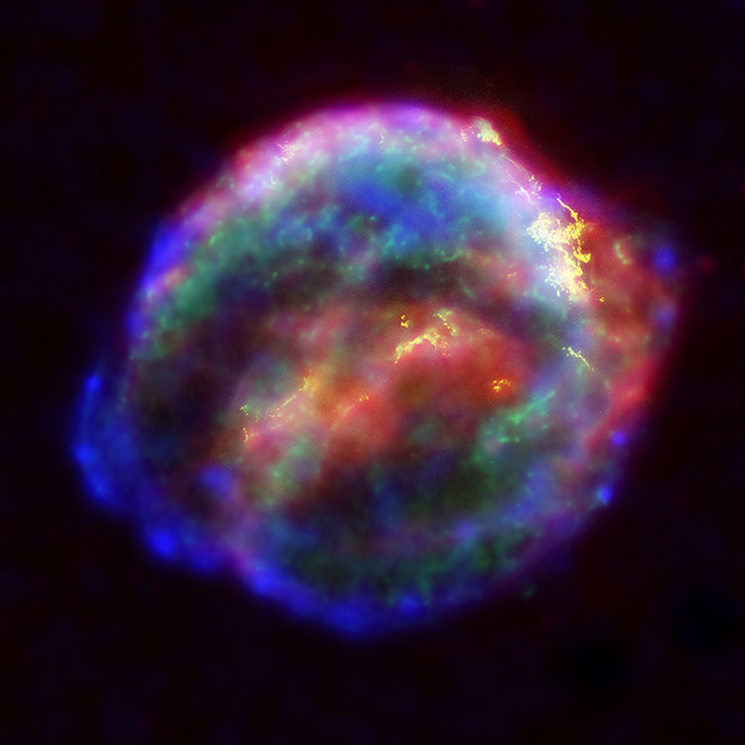
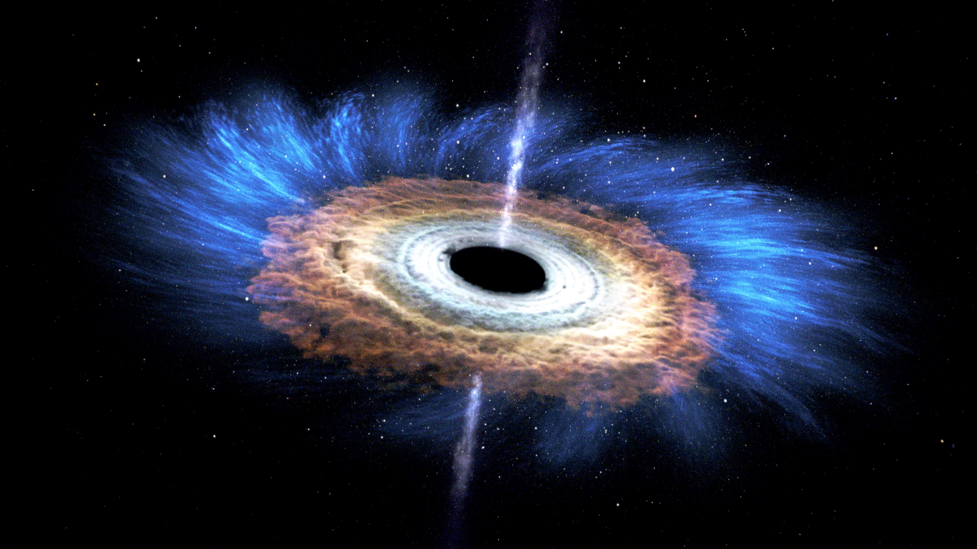
the book of
Psalms
107-109
Black holes
Supernovas
DNA

Slide 21
the book of
Psalms
107-109
Cell membrane
Nucleus
Cytoplasm
The “Simple Cell”

Slide 22
the book of
Psalms
107-109

Slide 23
the book of
Psalms
107-109
Medley ~ vv. 1-5 = 57:7-11
vv. 6-13 = 60:5-12
C. H. Spurgeon ~ “The Holy Spirit is not so short of expressions that he needs to repeat himself, and the repetition cannot be meant merely to fill the book: there must be some intention in the arrangement of two former divine utterances in a new connection; whether we can discover that intent is another matter. It is at least ours to endeavor to do so, and we may expect divine assistance therein.”

Slide 24
the book of
Psalms
107-109

Slide 25
the book of
Psalms
107-109
Psalms 46:1-2a ~ ​¹ God is our refuge and strength
A very present help in trouble.
^{2a} Therefore we will not fear,

Slide 26
the book of
Psalms
107-109

Slide 27
the book of
Psalms
107-109
Imprecatory psalm with a capital
“M”

Slide 28
the book of
Psalms
107-109

Slide 29
the book of
Psalms
107-109
C. H. Spurgeon ~ “What a smart this is to the soul, to be hated in proportion to the gratitude which it deserved, hated by those it loved, and hated because of its love.”

Slide 30
the book of
Psalms
107-109

Slide 31
the book of
Psalms
107-109
Accuser ~ sawtawn – KJV, Satan
C. H. Spurgeon ~ “The curse is an awful one, but it is most natural that it should come to pass: those who serve Satan may expect to have his company, his assistance, his temptations, and at last his doom.”

Slide 32
the book of
Psalms
107-109

Slide 33
the book of
Psalms
107-109
Lex talionis ~ let the punishment fit the crime

Slide 34
the book of
Psalms
107-109

