Slide 1
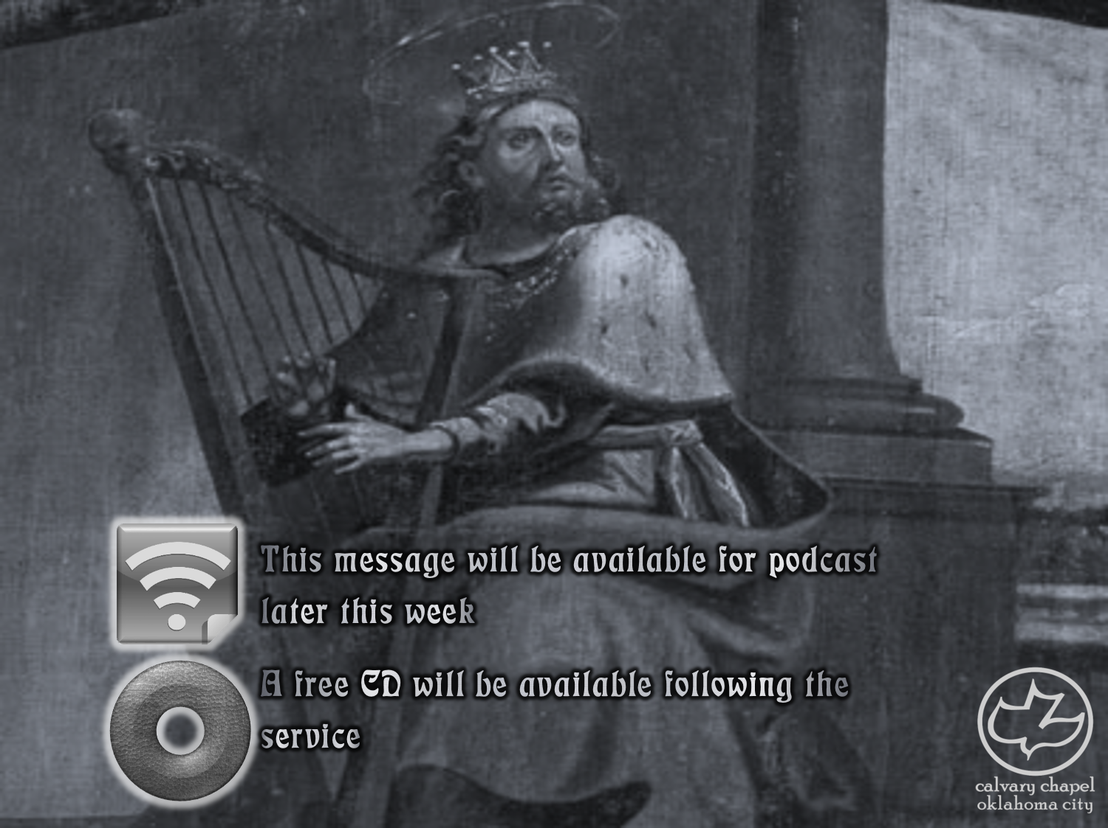

Psalms
the book of
105-106

Slide 2
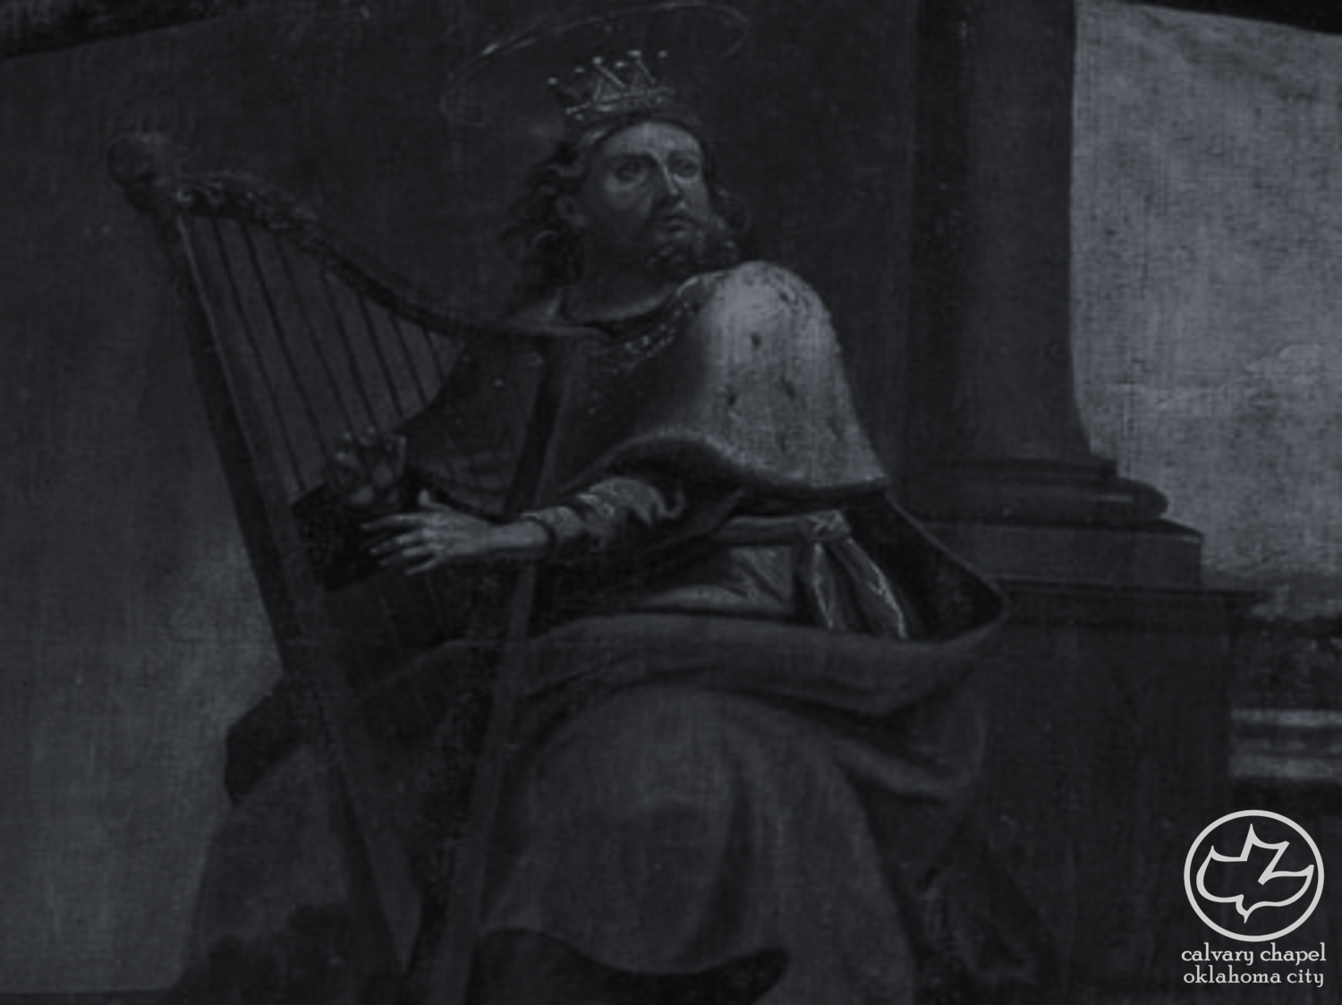
the book of
Psalms
105-106
Psalm 105 describes God’s initiation of love for Israel
Psalm 106 reflects Israel’s response to His love

Slide 3
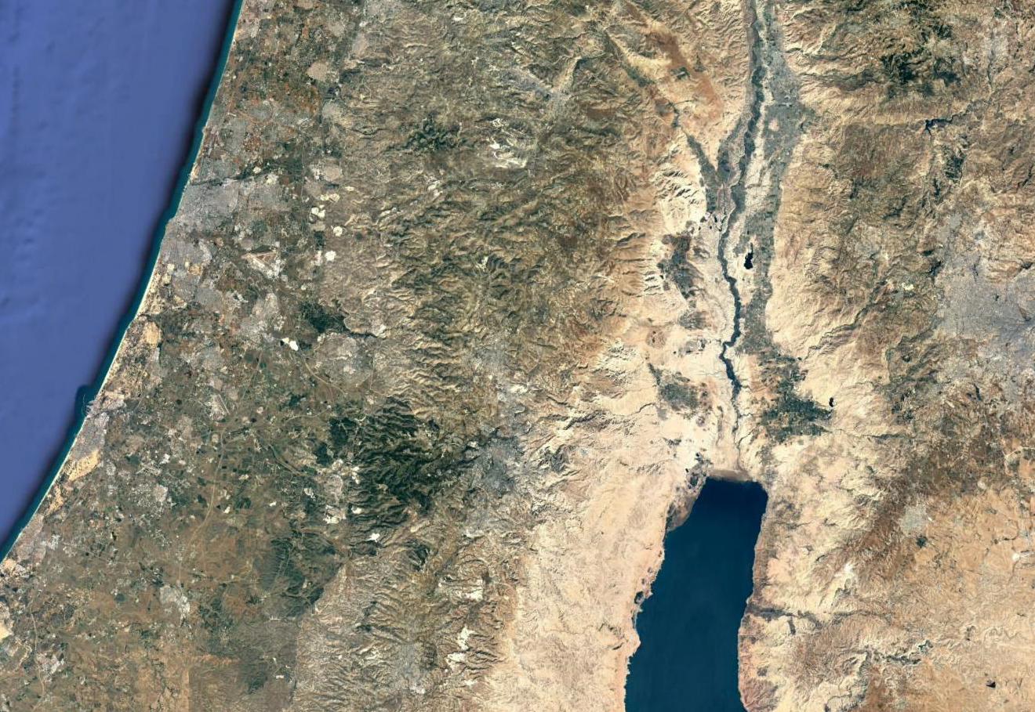
the book of
Psalms
105-106
1
Shiloh
5
Ekron
2
Ebenezer
6
Beth Shemesh
3
Ashdod
7
Kirjath Jearim
1
4
Gath
8
Jerusalem
3
7
5
6
Route of the Ark of the Covenant
2
8
4

Slide 4
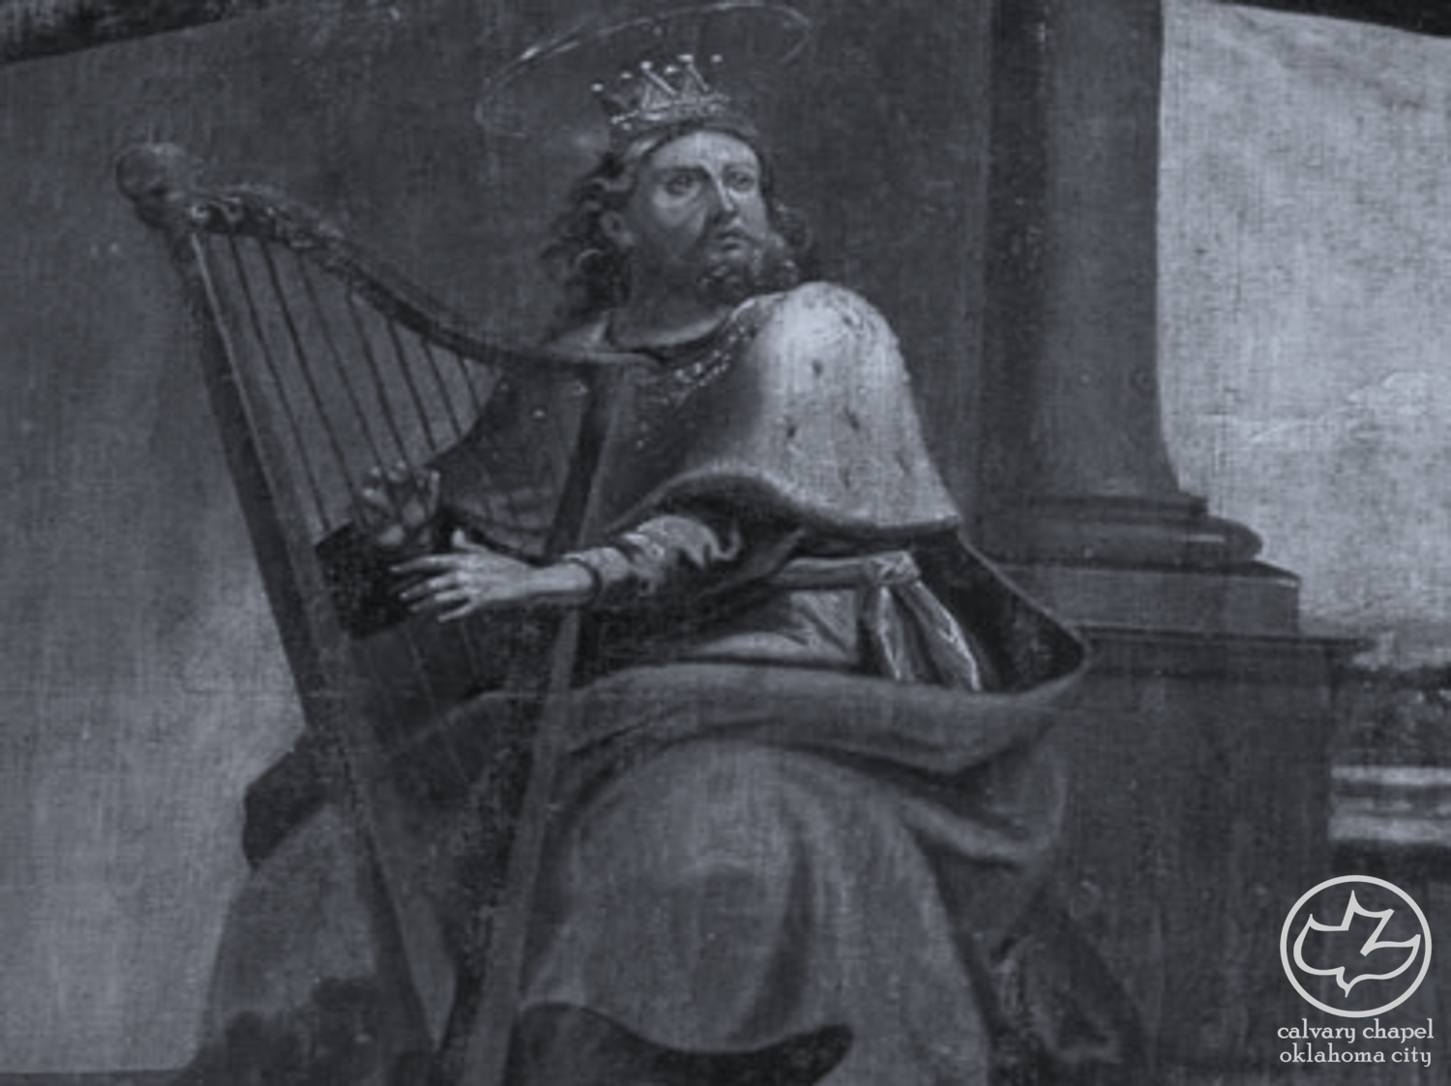
the book of
Psalms
105-106

Slide 5
the book of
Psalms
105-106
C. H. Spurgeon ~ “If we would keep these in remembrance our faith would be stronger, our gratitude warmer, our devotion more fervent, and our love more intense. Shame upon us that we should let slip what it would seem impossible to forget.”

Slide 6
the book of
Psalms
105-106

Slide 7
the book of
Psalms
105-106
Made ~ karath – literally, to cut

Slide 8
the book of
Psalms
105-106

Slide 9
the book of
Psalms
105-106
NASB footnote ~ His soul came into irons

Slide 10
the book of
Psalms
105-106

Slide 11
the book of
Psalms
105-106
Exodus 12:12 ~ For I will pass through the land of Egypt on that night, and will strike all the firstborn in the land of Egypt, both man and beast; and against all the gods of Egypt I will execute judgment: I am the Lord.

Slide 12
the book of
Psalms
105-106

Slide 13
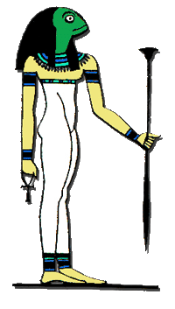
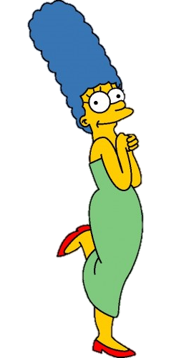
the book of
Psalms
105-106
Heqt ~ goddess of fertility

Slide 14
the book of
Psalms
105-106

Slide 15
the book of
Psalms
105-106
Ex. 3:21-22 ~ ²¹ And I will give this people favor in the sight of the Egyptians; and it shall be, when you go, that you shall not go empty-handed. ²² But every woman shall ask of her neighbor, namely, of her who dwells near her house, articles of silver, articles of gold, and clothing; and you shall put them on your sons and on your daughters. So you shall plunder the Egyptians.

Slide 16
the book of
Psalms
105-106

Slide 17
the book of
Psalms
105-106
C. H. Spurgeon ~ “This song is for the assembled people, and they are all exhorted to join in praise to Jehovah. It is not meet for a few to praise and the rest to be silent; but all should join. If David were present in churches where quartettes and choirs carry on all the singing, he would turn to the congregation and say, ‘Praise ye the Lord.’”

Slide 18
the book of
Psalms
105-106

Slide 19
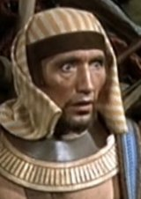
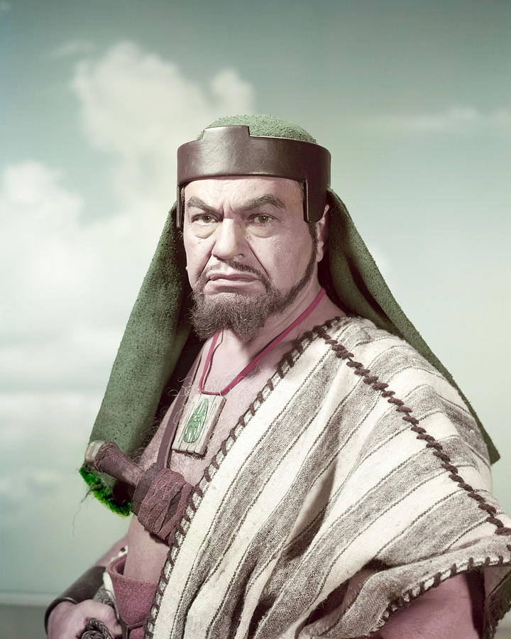
the book of
Psalms
105-106

Slide 20
the book of
Psalms
105-106

Slide 21
the book of
Psalms
105-106
Dead ~ i.e. lifeless idols
NIV ~ and ate sacrifices offered to lifeless gods;

Slide 22
the book of
Psalms
105-106

Slide 23
the book of
Psalms
105-106
Deeds ~ KJV, inventions (also Ps. 99:8)

Slide 24
the book of
Psalms
01-03

Slide 25
the book of
Psalms
105-106
Two universal words:
Amen
Hallelujah
“Yes, may it be so”
“Praise the Lord”

Slide 26
the book of
Psalms
105-106
C. H. Spurgeon ~ “Has not his mercy endured for ever, and should not his praise be of like duration? Jehovah, the God of Israel, has blessed his people, should they not also bless him? They have all been spared by his grace, let them all join in the adoration with loud unanimous voice. What a thunder of praise would thus be caused! Yet should a nation thus magnify him, yea, should all the nations past and present unite in the solemn acclaim, it would fall far short of his deserts.”

Slide 27
the book of
Psalms
105-106
Divided into 5 books
Book 1
Book 2
Book 3
Book 4
Book 5
1-41
Genesis
Foundations
42-72
Exodus
Redemption
73-89
Leviticus
Worship
90-106
Numbers
Wanderings
107-150
Deuteronomy
Promised Life

Slide 28
the book of
Psalms
105-106

