Slide 1
Psalms
the book of
103-104

Slide 2
the book of
Psalms
103-104
C. H. Spurgeon ~ “As in the lofty Alps some peaks rise above all others, so among even the inspired Psalms there are heights of song which overtop the rest. This one hundred and third Psalm has ever seemed to us to be the Monte Rosa of the divine chain of mountains of praise, glowing with a ruddier light than any of the rest. It is as the apple tree among the trees of the wood, and its golden fruit has a flavor such as no fruit ever bears unless it has been ripened in the full sunshine of mercy.”

Slide 3
the book of
Psalms
103-104

Slide 4
the book of
Psalms
103-104
C. H. Spurgeon ~ “We are too prone to engrave our trials in marble and write our blessings in sand.”

Slide 5
the book of
Psalms
103-104

Slide 6
the book of
Psalms
103-104
Mouth ~ NASB, years
NIV, desires
NLT, life
ESV, satisfies you with good

Slide 7
the book of
Psalms
103-104

Slide 8
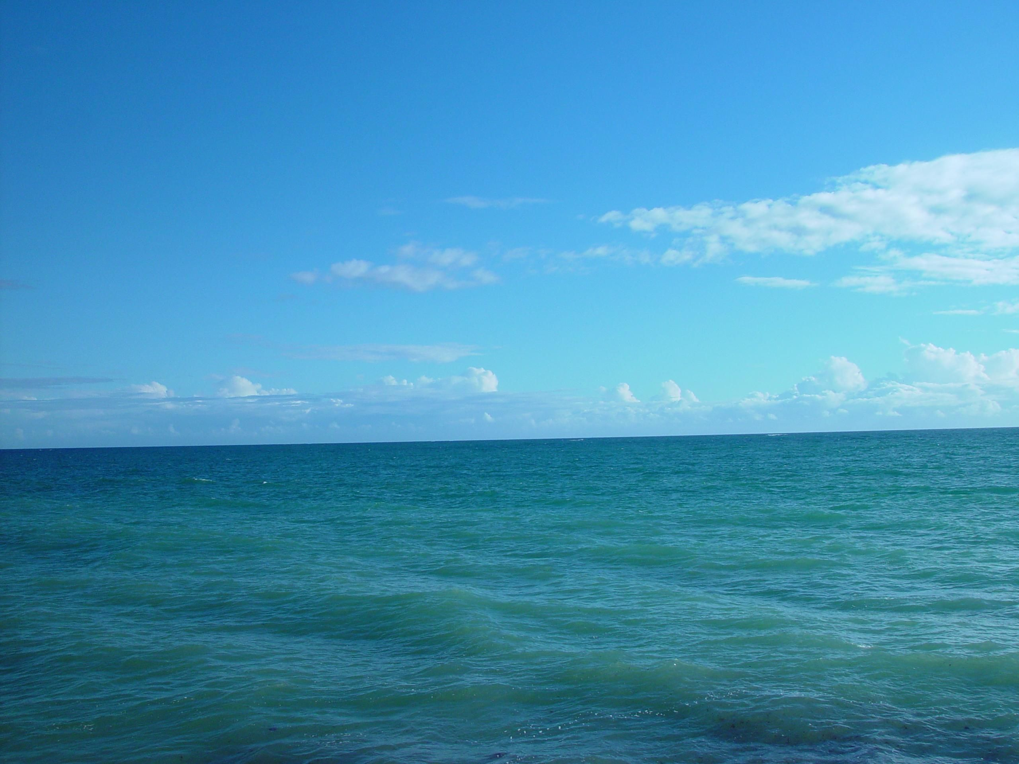
the book of
Psalms
103-104
Sea of
No fishing allowed
Forgetfulness

Slide 9
the book of
Psalms
103-104

Slide 10
the book of
Psalms
103-104
C. H. Spurgeon ~ “Fly as far as the wing of imagination can bear you, and if you journey through space eastward, you are further from the west at every beat of your wing. If sin be removed so far, then we may be sure that the scent, the trace, the very memory of it must be entirely gone. If this be the distance of its removal, there is no shade of fear of its ever being brought back again; even Satan himself could not achieve such a task. Our sins are gone, Jesus has borne them away. Far as the place of sunrise is removed from yonder west,

Slide 11
the book of
Psalms
103-104
C. H. Spurgeon ~ where the sun sinks when his day’s journey is done, so far were our sins carried by our scapegoat nineteen centuries ago, and now if they be sought for, they shall not be found, yea, they shall not be, saith the Lord.”

Slide 12
the book of
Psalms
103-104

Slide 13
the book of
Psalms
103-104
I Need Thee Every Hour
I need Thee, O I need Thee;
Every hour I need Thee;
O bless me now, my Savior,
I come to Thee. – Annie S. Hawks, © 1872

Slide 14
the book of
Psalms
103-104

Slide 15
the book of
Psalms
103-104
You are here
gnitsalrevE
Everlasting

Slide 16
the book of
Psalms
103-104

Slide 17
the book of
Psalms
103-104
C. H. Spurgeon ~ “He must be blind indeed who does not see that nature is the work of a king. These are solemn strokes of God's severer mind, terrible touches of his sterner attributes, broad lines of inscrutable mystery, and deep shadings of overwhelming power, and these make creation's picture a problem never to be solved, except by admitting that he who drew it giveth no account of his matters, but ruleth all things according to the good pleasure of his will.”

Slide 18
the book of
Psalms
103-104
Ode to the 6 days of creation
vv. 1-6 = 1st and 2nd days
Day 1 (Gen. 1:3-5) ~ light and time
Day 2 (Gen. 1:6-8) ~ sky and waters separated
vv. 7-18 = 3rd day
Day 3 (Gen. 1:9-13) ~ dry ground, bodies of water, plants
vv. 19-23 = 4th day
Day 4 Gen. 1:14-19) ~ sun, moon, stars, planets
vv. 24-30 = 5th and 6th days
Day 5 (Gen. 1:20-23) ~ fish and birds
Day 6 (Gen. 1:24-30; 2:7, 15-25) ~ land animals and man

Slide 19
the book of
Psalms
103-104

Slide 20
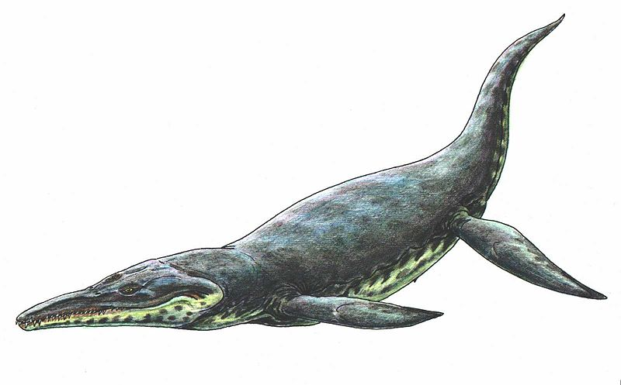
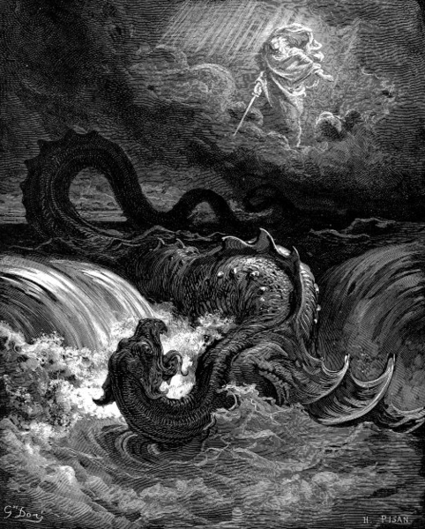
the book of
Psalms
103-104
What was Leviathan (twisted, coiled)?
6x in Old Testament (2x in Job, 2x in Psalms, 2x in Isaiah)
Crocodile?
Whale?
Mythological?
Extinct dinosaur? (Plesiosaur?)
Job 41:19-21 ~ ¹⁹ Out of his mouth go burning lights;
Sparks of fire shoot out.
²⁰ Smoke goes out of his nostrils,
As from a boiling pot and burning rushes.
²¹ His breath kindles coals,
And a flame goes out of his mouth.

Slide 21
the book of
Psalms
103-104

Slide 22
the book of
Psalms
103-104
Spirit ~ ruach – also breath

Slide 23
the book of
Psalms
103-104
vv. 31-35 = 7th day
Day 7 (Gen. 2:2-3) ~ God rested

Slide 24
the book of
Psalms
103-104

Slide 25
the book of
Psalms
103-104
Praise the Lord ~ Hallelujah
halal
Jah

Slide 26
the book of
Psalms
103-104

