Slide 1
Psalms
the book of
98-102

Slide 2
the book of
Psalms
98-102
Nations ~ KJV, heathen
goyim ~ Gentiles

Slide 3
the book of
Psalms
98-102

Slide 4
the book of
Psalms
98-102
John Wesley ~ “Sing lustily, and with a good courage. Beware of singing as if you were half dead or half asleep; but lift up your voice with strength. Be no more afraid of your voice now, nor more ashamed of its being heard, than when you sung the songs of Satan.”

Slide 5
the book of
Psalms
98-102

Slide 6
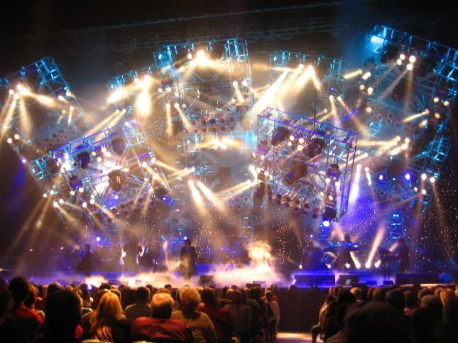
the book of
Psalms
98-102

Slide 7
the book of
Psalms
98-102

Slide 8
the book of
Psalms
98-102
Psalm 96:13 ~ For He is coming, for He is coming to judge the earth.
He shall judge the world with righteousness,
And the peoples with His truth.

Slide 9
the book of
Psalms
98-102

Slide 10
the book of
Psalms
98-102
Isaiah 6:1-3 ~ ¹ In the year that King Uzziah died, I saw the Lord sitting on a throne, high and lifted up, and the train of His robe filled the temple. ² Above it stood seraphim; each one had six wings: with two he covered his face, with two he covered his feet, and with two he flew. ³ And one cried to another and said:
“Holy, holy, holy is the Lord of hosts;
The whole earth is full of His glory!”

Slide 11
the book of
Psalms
98-102
Father, Son and the Holy Spirit
Holy means “holy”
Holy, holy means “holier”
Holy, holy, holy means “absolutest, mostest holiest than anything holier

Slide 12
the book of
Psalms
98-102
YHWH ~ I AM WHO I AM
Most English Bibles ~ Lord
Lord ~ Adonai
Literally, I-will-be-what-I-will-be
The Becoming One

Slide 13
the book of
Psalms
98-102

Slide 14
the book of
Psalms
98-102
Deeds ~ KJV, inventions
Better, NIV ~ misdeeds or ESV ~ wrongdoings

Slide 15
the book of
Psalms
98-102

Slide 16
the book of
Psalms
98-102
Perfect ~ most modern English versions say blameless
Completeness, maturity

Slide 17
the book of
Psalms
98-102

Slide 18
the book of
Psalms
98-102
Shadow that lengthens ~ evening of life or seeming to never end

Slide 19
the book of
Psalms
98-102

Slide 20
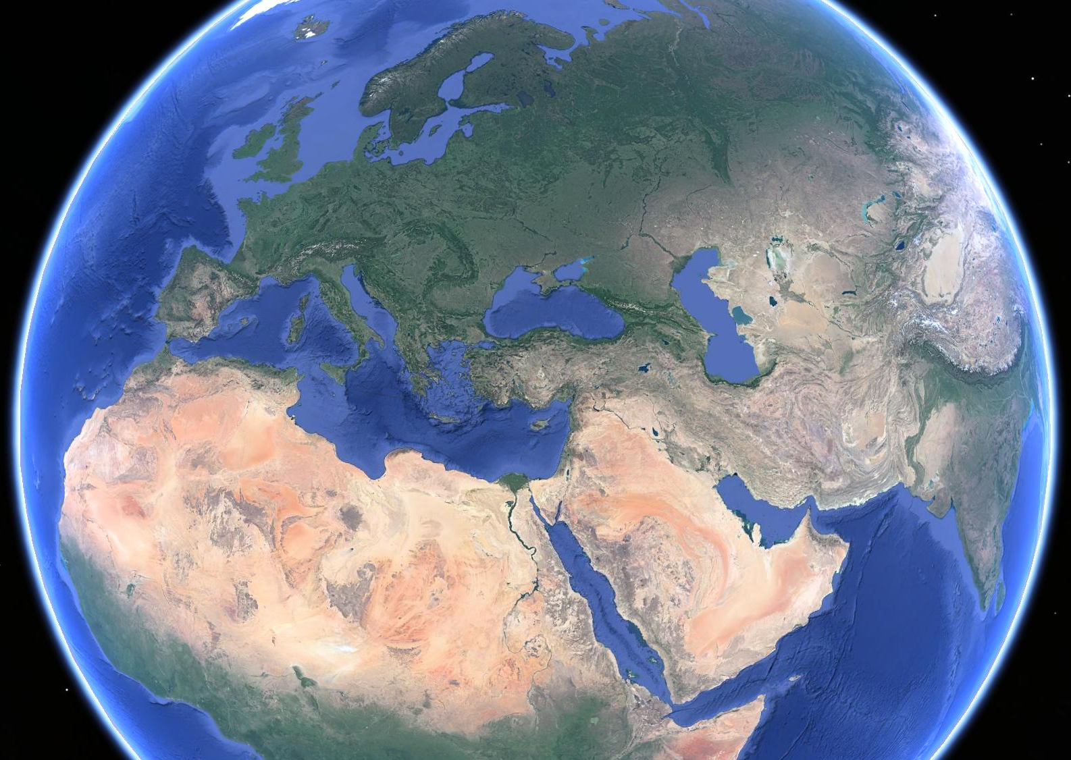
the book of
Psalms
98-102
Ezekiel
38-39
Russia
Ukraine
Kazakhstan
Bulgaria
Romania
Georgia
Azerbaijan
Israel
Turkey
Armenia
Syria
Iran
Libya
Saudi Arabia
Sudan

Slide 21
the book of
Psalms
98-102

Slide 22
the book of
Psalms
98-102

Slide 23
the book of
Psalms
98-102
Population about that of New York City
World leader in food production technology
#1 on the Global Technology Index
Highest concentration of engineers (135 per 10,000 cf 85 per 10,000 in the US)
#2 in innovation (World Economic Forum)
#1 in military technology
#1 in micro-technology
Cutting edge medicine
Aroma coffee

Slide 24
the book of
Psalms
98-102

Slide 25
the book of
Psalms
98-102
Grow ~ KJV, wax
2nd Law of Thermodynamics
~ “Everything in the universe to going from a state of order to a state of disorder … within an isolated system”

Slide 26
the book of
Psalms
98-102

