Slide 1
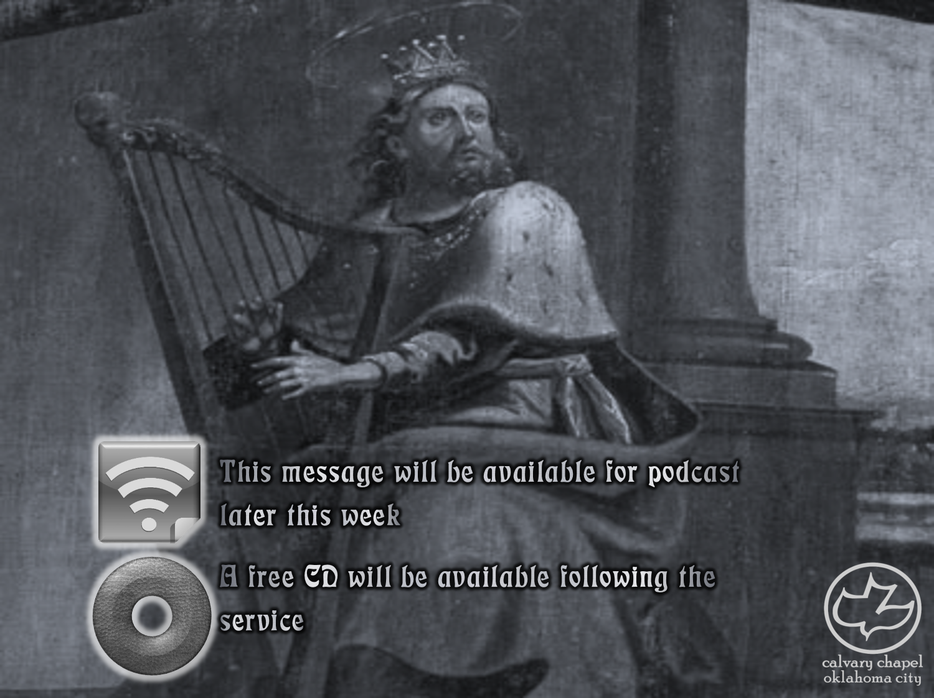

Psalms
the book of
94:20-22

Slide 2
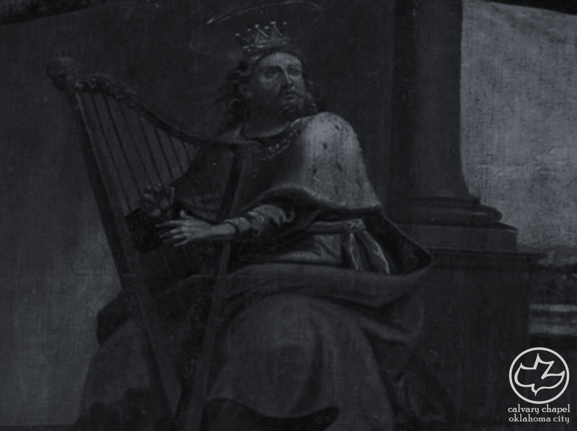
the book of
Psalms
94:20-22
Millennial (or Kingdom) Psalms: 94-100

Slide 3
the book of
Psalms
94:20-22

Slide 4
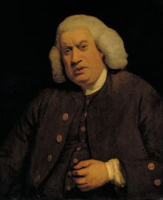
the book of
Psalms
94:20-22
Samuel Johnson (1709-1784) ~ “Revenge is an act of passion, vengeance of justice;
injuries are revenged,
crimes are avenged.”

Slide 5
the book of
Psalms
94:20-22

Slide 6
the book of
Psalms
94:20-22
Punishment ~ literally, reward (KJV)
NASB ~ Render recompense to the proud
NIV ~ pay back to the proud what they deserve

Slide 7
the book of
Psalms
94:20-22

Slide 8
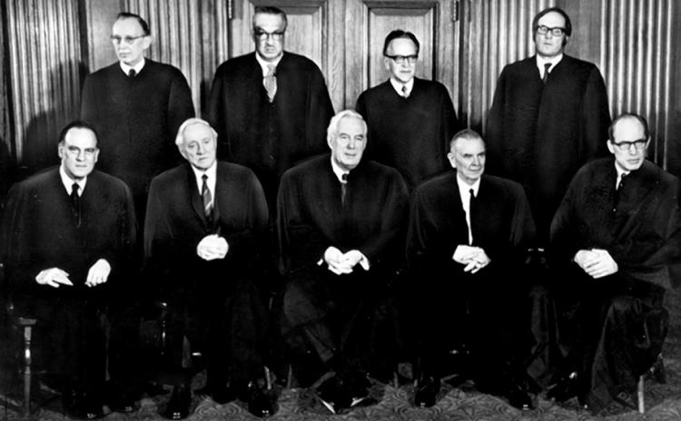
the book of
Psalms
94:20-22
Harry Blackmun
Lewis Powell
Thurgood Marshall
William Rehnquist
William O. Douglas
Earl Warren
Byron White
Potter Stewart
William J. Brennan
“Due process” clause of the 14th Amendment:
“acts as a safeguard from arbitrary denial of life, liberty, or property by the government outside the sanction of law.”
“Roe v. Wade,” Jan. 22, 1972 – 7-2 vote

Slide 9
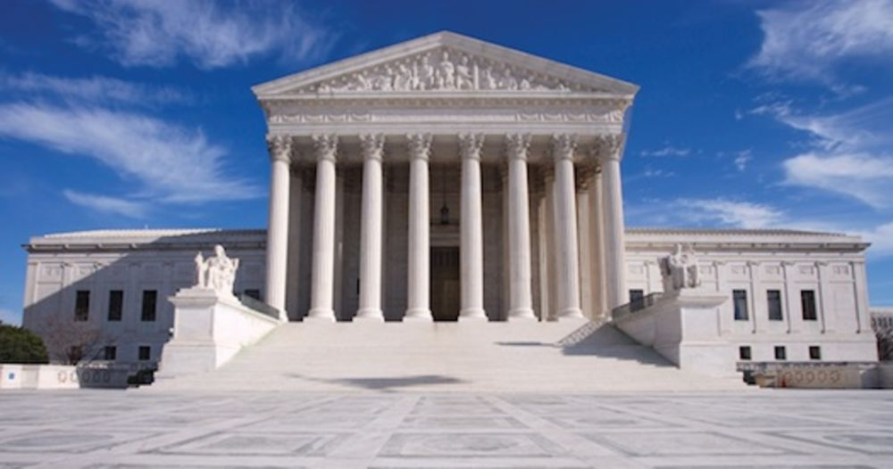
the book of
Psalms
94:20-22
Over 60,000,000

Slide 10
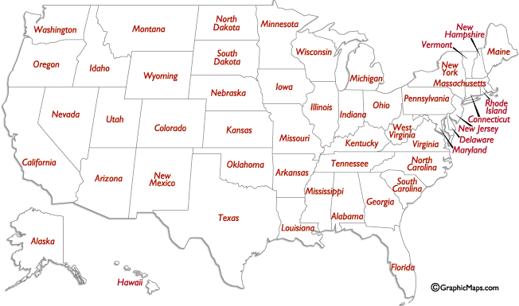
the book of
Psalms
94:20-22
Greater than the population of these states combined

Slide 11
the book of
Psalms
94:20-22
Ps. 48:2 Living Bible ~ What a glorious sight! See Mount Zion rising north of the city high above the plains for all to see – Mount Zion, joy of all the earth, the residence of the great King.

Slide 12
the book of
Psalms
94:20-22

Slide 13
the book of
Psalms
94:20-22
Rebellion (meribah) ~ Exodus 17

Slide 14

the book of
Psalms
94:20-22
⁴ For He has spoken in a certain place of the seventh day in this way: “And God rested on the seventh day from all His works”;(Gen. 2:2) ⁵ and again in this place: “They shall not enter My rest.” (Ex. 17)
⁶ Since therefore it remains that some must enter it, and those to whom it was first preached did not enter because of disobedience, ⁷ again He designates a certain day, saying in David, “Today,” (Ps. 95:7) after such a long time, as it has been said:
“Today, if you will hear His voice,
Do not harden your hearts.” (Heb. 3:7, 3:15, 4:7)
Hebrews 4:4-10 ~
⁸ For if Joshua had given them rest, then He would not afterward have spoken of another day. ⁹ There remains therefore a rest for the people of God. ¹⁰ For he who has entered His rest has himself also ceased from his works as God did from His.
4000
3000
2000
1000
BC - AD
1000
2000
God rested on the 7th day
Exodus 17
David
Hebrews
Today?

Slide 15
the book of
Psalms
94:20-22

Slide 16
the book of
Psalms
94:20-22
C. H. Spurgeon ~ “If manna and miracles could not satisfy Israel, neither would they have been content with the land which flowed with milk and honey…Was it not enough that they had revolted all along that marvelous wilderness march? Should they be allowed to make new Massahs and Meribahs in the Promised Land itself?”

Slide 17
the book of
Psalms
94:20-22

Slide 18
the book of
Psalms
94:20-22
C. H. Spurgeon ~ “This is the only beauty which he cares for in our public services, and it is one for which no other can compensate. Beauty of architecture and apparel he does not regard; moral and spiritual beauty is that in which his soul delighteth. Worship must not be rendered to God in a slovenly, sinful, superficial manner; we must be reverent, sincere, earnest, and pure in heart both in our prayers and praises. Purity is the white linen of the Lord’s choristers, righteousness is the comely garment of his priests, holiness is the royal apparel of his servitors.”

Slide 19
the book of
Psalms
94:20-22

Slide 20
the book of
Psalms
94:20-22
Nations ~ KJV, heathens – goyim

Slide 21
the book of
Psalms
94:20-22

Slide 22
the book of
Psalms
94:20-22
C. H. Spurgeon ~ “At this moment he is on the road, and the hour of his coming draweth nigh. His great assize is proclaimed. Hear ye not the trumpets? His foot is on the threshold.”

Slide 23
the book of
Psalms
94:20-22

Slide 24
the book of
Psalms
94:20-22
Prov. 25:2a ~ It is the glory of God to conceal a matter …
C. H. Spurgeon ~ “This passage should teach us the impertinence of attempting to pry into the essence of the Godhead, the vanity of all endeavors to understand the mystery of the Trinity in Unity, the arrogance of arraigning the Most High before the bar of human reason, the folly of dictating to the Eternal One the manner in which he should proceed.”

Slide 25
the book of
Psalms
94:20-22

Slide 26
the book of
Psalms
94:20-22
Rejoice ~ better, rejoiced (as in KJV, NLT and NASB)
Prophetic past tense

Slide 27
the book of
Psalms
94:20-22

Slide 28
the book of
Psalms
94:20-22
C. H. Spurgeon ~ “For he hates it, his fire consumes it, his lightnings blast it, his presence shakes it out of its place, and his glory confounds all the lovers of it.”

Slide 29
the book of
Psalms
94:20-22

