Slide 1
Psalms
the book of
91-93

Slide 2
the book of
Psalms
91-93
C. H. Spurgeon ~ “To them the veil is rent, the mercy-seat is revealed, the covering cherubs are manifest, and the awful glory of the Most High is apparent: these, like Simeon, have the Holy Ghost upon them, and like Anna they depart not from the temple; they are the courtiers of the Great King, the valiant men who keep watch around the bed of Solomon, the virgin souls who follow the Lamb whithersoever he goeth. Elect out of the elect, they have ‘attained unto the first three,’ and shall walk with their Lord in white, for they are worthy.”

Slide 3
the book of
Psalms
01-03

Slide 4
the book of
Psalms
91-93
Four names for God:
Most High (v. 1) ~ Elyon
Superlative form of a root meaning elevation
Almighty (v. 1) ~ Shaddai
From a root meaning to be burly, powerful, impregnable
Lord ~ YHWH
God’s covenant name (I AM that I AM)
God ~ Elohim
Plural form of generic word for God

Slide 5
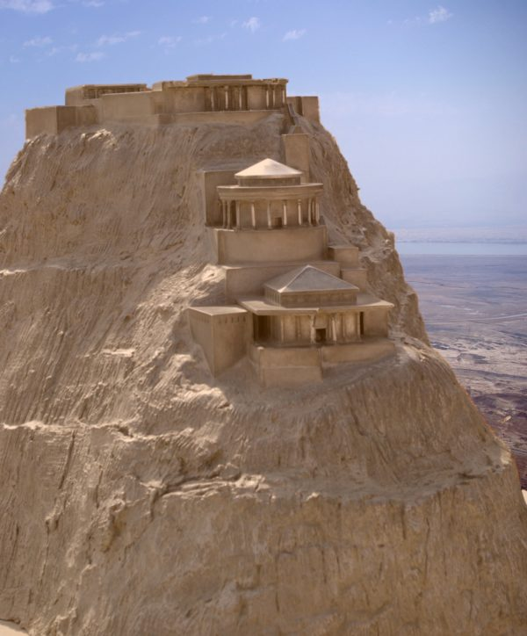
the book of
Psalms
91-93
Fortress ~ metsudah – Masada

Slide 6
the book of
Psalms
01-03

Slide 7
the book of
Psalms
91-93
Perilous ~ KJV, noisome

Slide 8
the book of
Psalms
01-03

Slide 9
the book of
Psalms
91-93
Is. 66:2 ~ For all those things My hand has made,
And all those things exist,”
Says the Lord.

Slide 10
the book of
Psalms
01-03

Slide 11
the book of
Psalms
91-93
Matthew 4:5–7 ~ ⁵ Then the devil took Him up into the holy city, set Him on the pinnacle of the temple, ⁶ and said to Him, “If You are the Son of God, throw Yourself down. For it is written:
‘He shall give His angels charge over you,’
and,
‘In their hands they shall bear you up,
Lest you dash your foot against a stone.’”
⁷ Jesus said to him, “It is written again, ‘You shall not tempt the Lord your God.’”

Slide 12
the book of
Psalms
91-93
Matt. 18:10 ~ Take heed that you do not despise one of these little ones, for I say to you that in heaven their angels always see the face of My Father who is in heaven.

Slide 13
the book of
Psalms
01-03

Slide 14
the book of
Psalms
91-93
Love ~ 11x in Old Testament – to cling
Translated variously: delights (in), longs (for), desire, bands

Slide 15
the book of
Psalms
01-03

Slide 16
the book of
Psalms
91-93
C. H. Spurgeon ~ “To give thanks to God is but a small return for the great benefits wherewith he daily loadeth us; yet as he by his Spirit calls it a good thing, we must not despise it, or neglect it. We thank men when they oblige us, how much more ought we to bless the Lord when he benefits us. Devout praise is always good, it is never out of season, never superfluous, but it is especially suitable to the Sabbath; a Sabbath without thanksgiving is a Sabbath profaned.”

Slide 17
the book of
Psalms
01-03

Slide 18
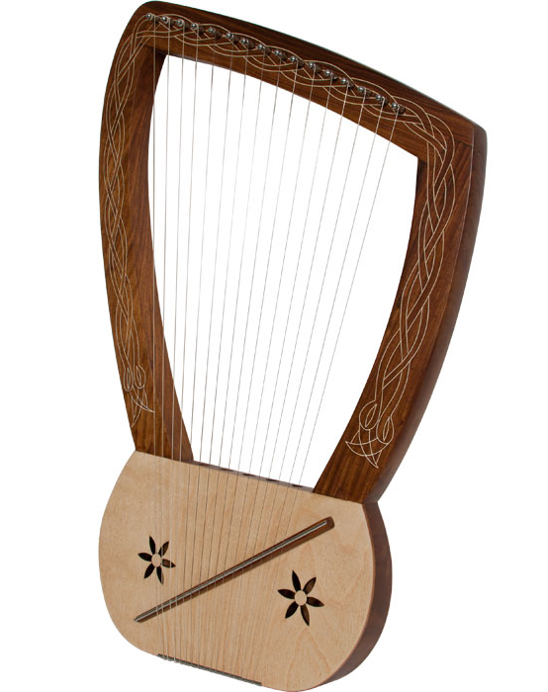
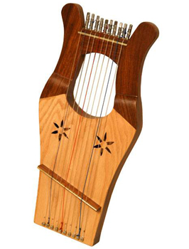
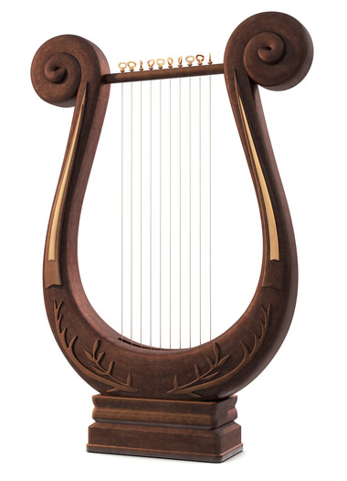
the book of
Psalms
91-93
Harp
Instrument of 10 strings
Lute

Slide 19
the book of
Psalms
01-03

Slide 20
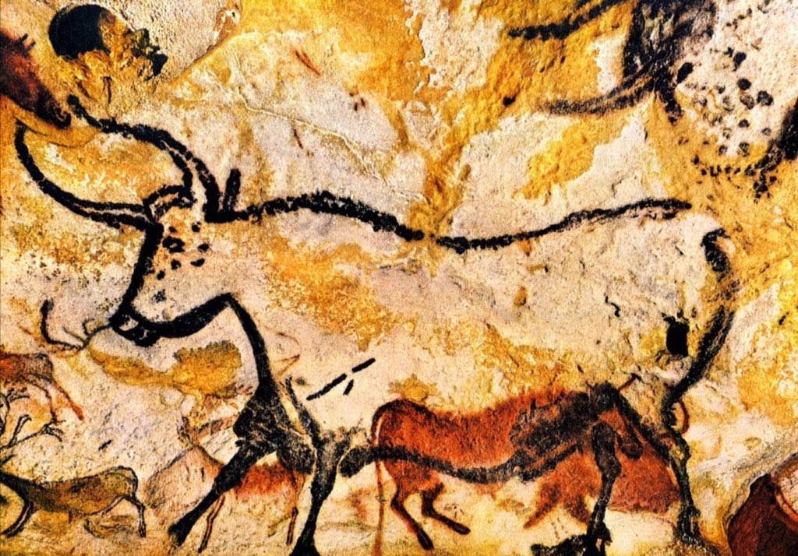
the book of
Psalms
91-93
Wild ox ~ KJV, unicorn
Most likely an extinct auroch
6’

Slide 21
the book of
Psalms
01-03

Slide 22
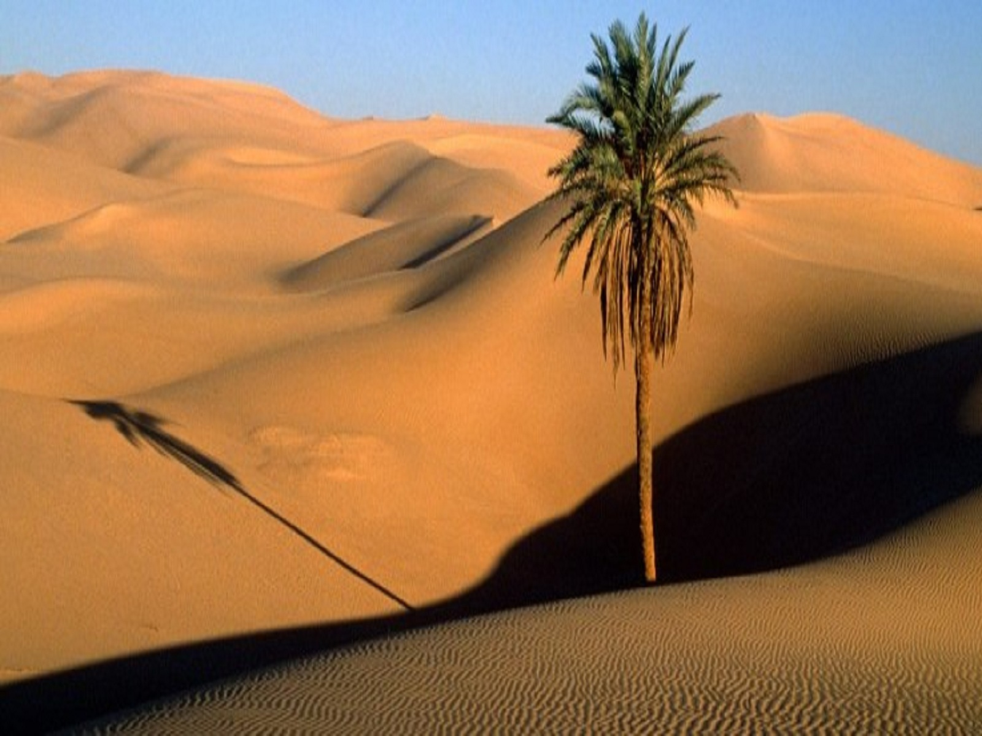
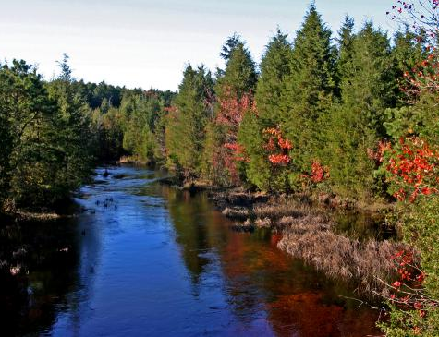
the book of
Psalms
91-93

Slide 23
the book of
Psalms
01-03

Slide 24
the book of
Psalms
91-93
KJV, fat and fruitful
Eccl. 12:13-14 (NLT) ~ ¹³ That’s the whole story. Here now is my final conclusion: Fear God and obey his commands, for this is everyone’s duty. ¹⁴ God will judge us for everything we do, including every secret thing, whether good or bad.

Slide 25
the book of
Psalms
01-03

Slide 26
the book of
Psalms
91-93
v. 2 ~ To declare Your lovingkindness in the morning,
And Your faithfulness every night,
v. 15 ~ To declare that the Lord is upright;
He is my rock, and there is no unrighteousness in Him.

Slide 27
the book of
Psalms
01-03

Slide 28
the book of
Psalms
91-93
C. H. Spurgeon ~ “Other teachings are uncertain, but the revelations of heaven are infallible. As the rocks remain unmoved amid the tumult of the sea, so does divine truth resist all the currents of man's opinion and the storms of human controversy; they are not only sure, but very sure. Glory be to God, we have not been deluded by a cunningly-devised fable: our faith is grounded upon the eternal truth of the Most High.”

Slide 29
the book of
Psalms
01-03

