Slide 1
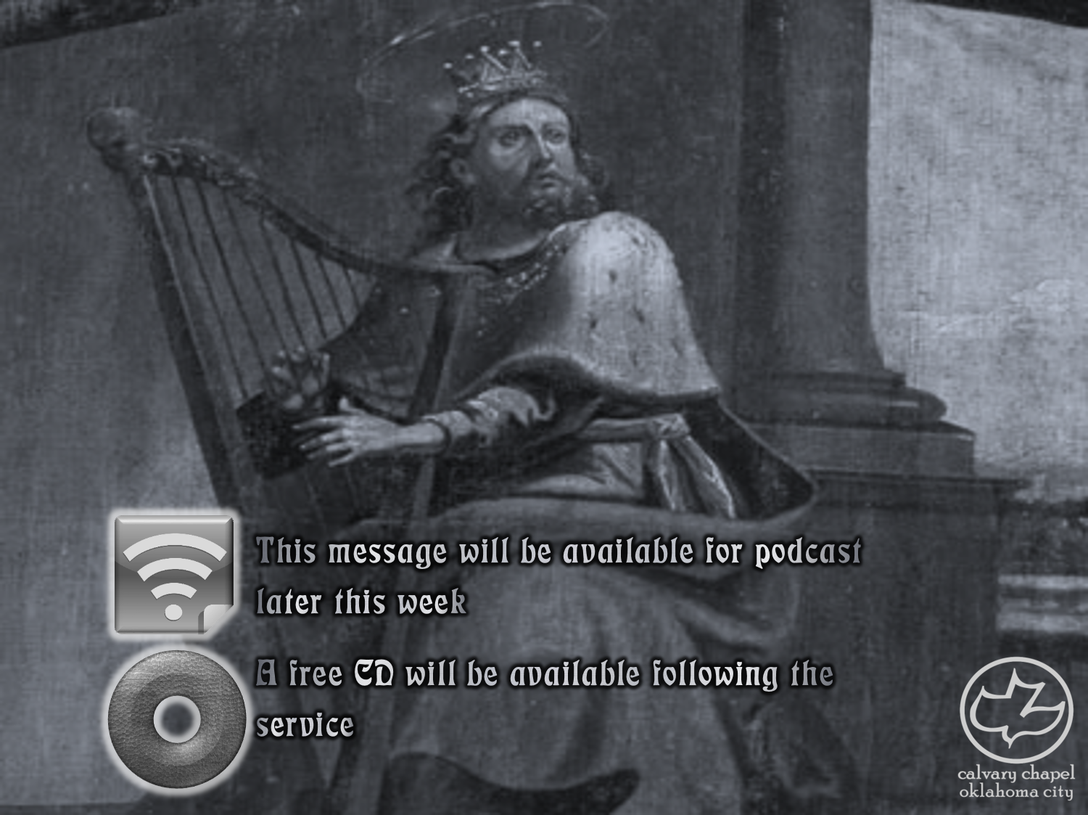

Psalms
the book of
88-90

Slide 2
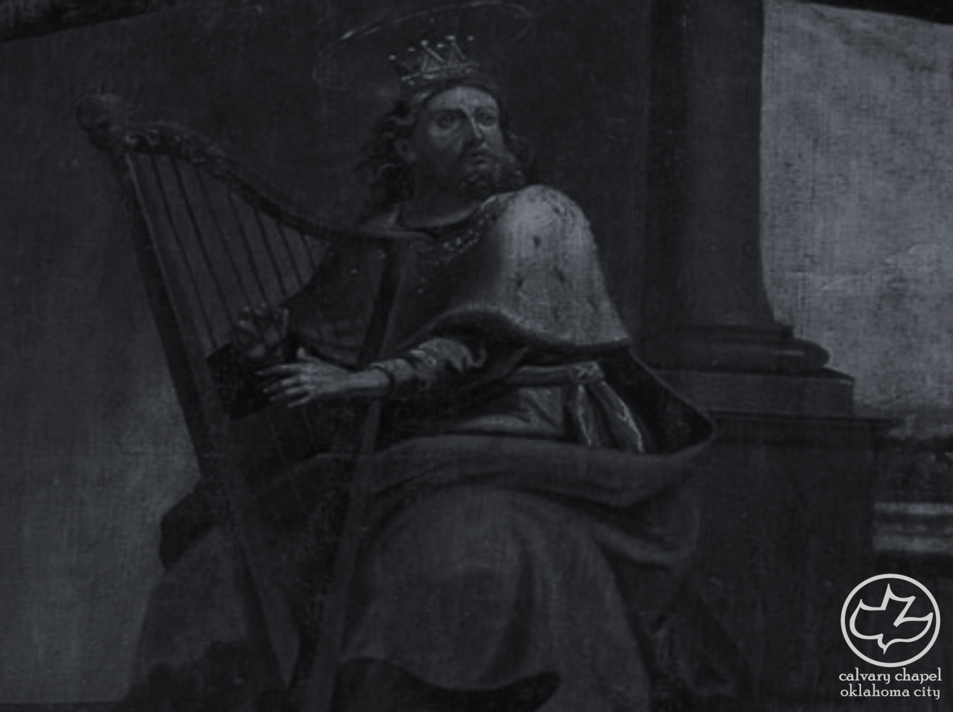
the book of
Psalms
88-90
Martin Marty (b. 1928) ~ “(Psalm 88 is) a wintry landscape of unrelieved bleakness.”

Slide 3
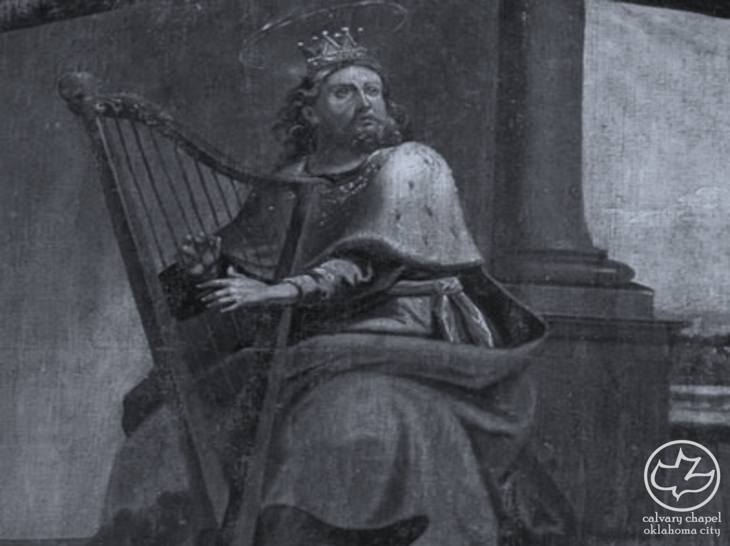
the book of
Psalms
88-90

Slide 4
the book of
Psalms
88-90
“Mahalath Leannoth”
NLT ~ A song to be sung to the tune “The Suffering of Affliction.”
1 Chron. 15:17 ~ So the Levites appointed Heman the son of Joel; and of his brethren, Asaph the son of Berechiah; and of their brethren, the sons of Merari, Ethan the son of Kushaiah;

Slide 5
the book of
Psalms
88-90

Slide 6
the book of
Psalms
88-90
C. H. Spurgeon ~ “’I have cried day and night before thee.’ His distress had not blown out the sparks of his prayer, but quickened them into a greater ardency, till they burned perpetually like a furnace at full blast … Perhaps, if Heman’s pain had not been incessant his supplications might have been intermittent;”

Slide 7
the book of
Psalms
88-90

Slide 8
the book of
Psalms
88-90
Ps. 22:1 ~ My God, My God, why have You forsaken Me?

Slide 9
the book of
Psalms
88-90

Slide 10
the book of
Psalms
88-90
1 Cor. 15:55 ~ O Death, where is your sting?
O Hades, where is your victory?
“It’s Friday, but Sunday’s comin’”

Slide 11
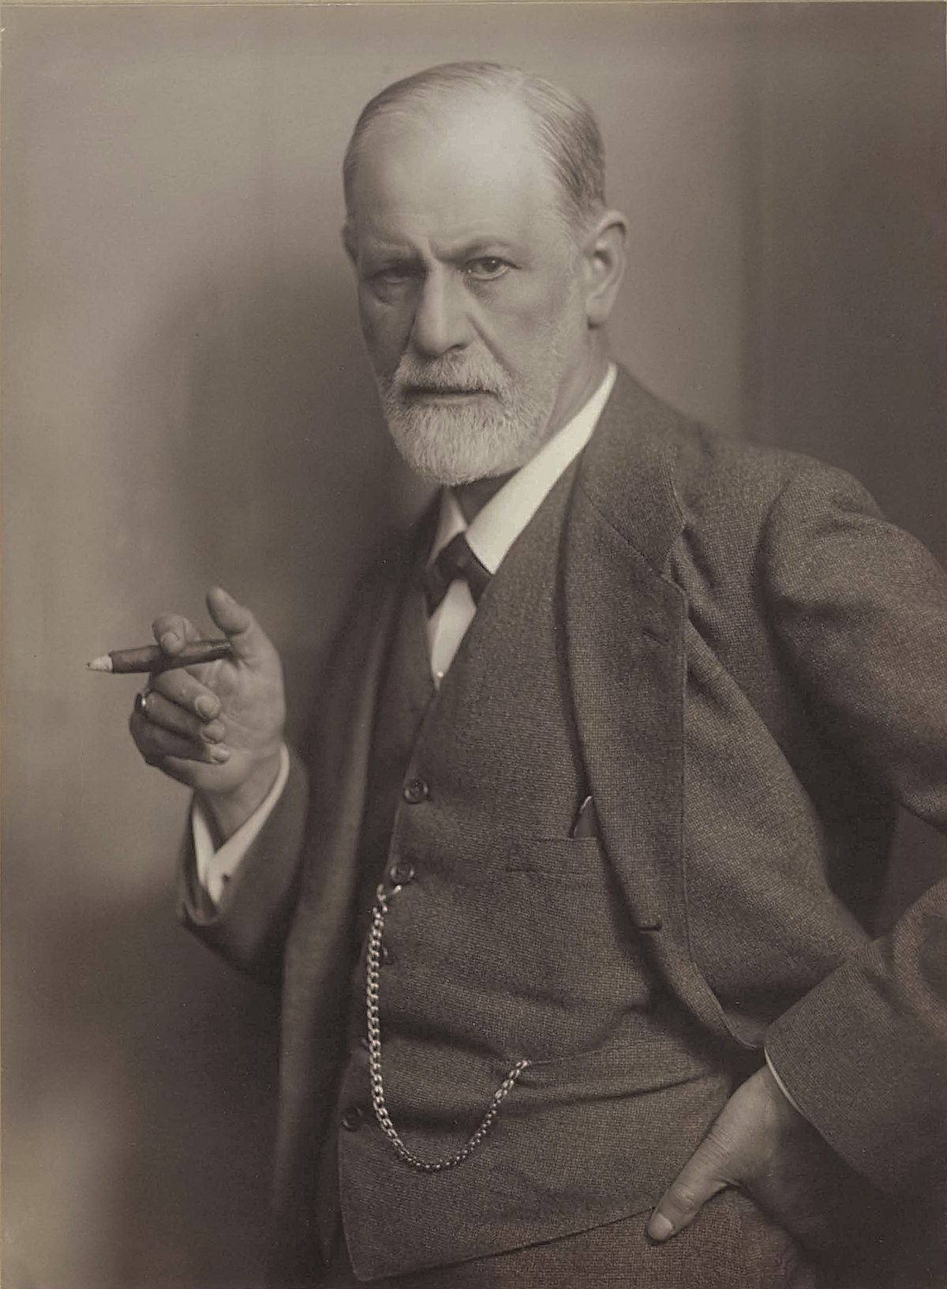
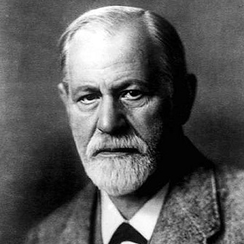
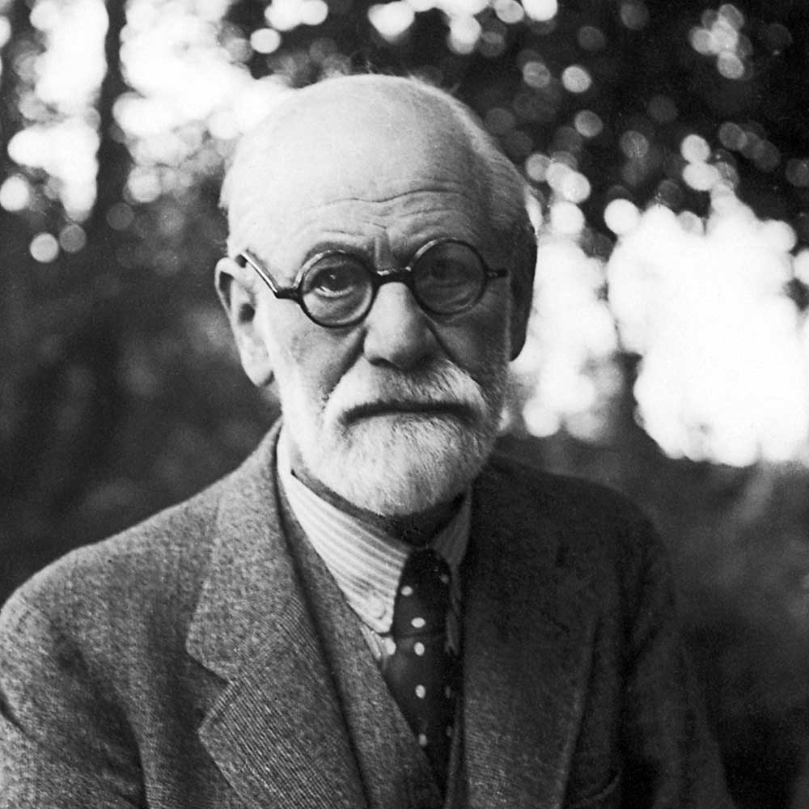
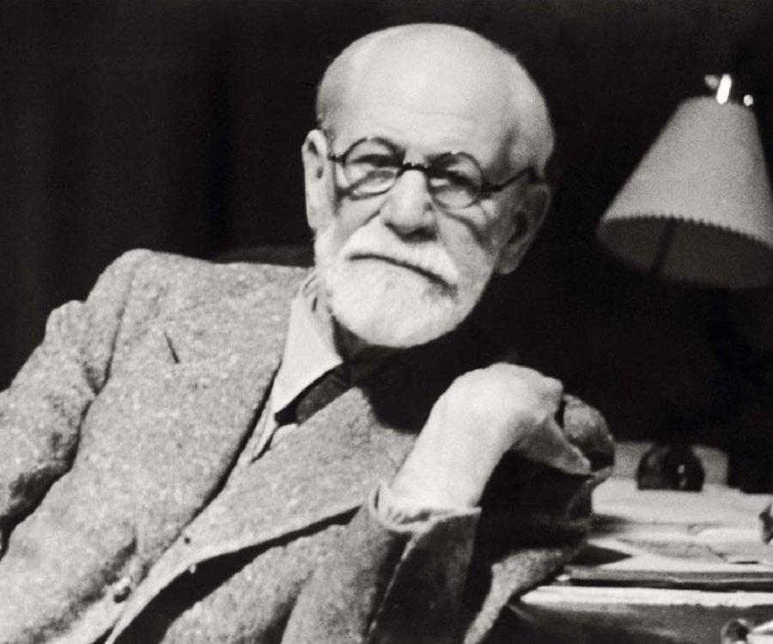
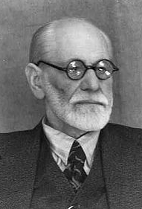
the book of
Psalms
88-90
Sigmund Freud (1856-1939) ~ “And finally there is the painful riddle of death, for which no remedy at all has yet been found, nor probably ever will be.”

Slide 12
the book of
Psalms
88-90

Slide 13
the book of
Psalms
88-90
1 Kings 4:30-31 ~ ³⁰ Thus Solomon's wisdom excelled the wisdom of all the men of the East and all the wisdom of Egypt. ³¹ For he was wiser than all men—than Ethan the Ezrahite, and Heman, Chalcol, and Darda, the sons of Mahol; and his fame was in all the surrounding nations.

Slide 14
the book of
Psalms
88-90

Slide 15
the book of
Psalms
88-90
Ps 85:10 ~ Mercy and truth have met together;

Slide 16
the book of
Psalms
88-90

Slide 17
the book of
Psalms
88-90
Outwit ~ KJV, exact upon
NIV, subject him to tribute

Slide 18
the book of
Psalms
88-90

Slide 19
the book of
Psalms
88-90
Divided into 5 books
Book 1
Book 2
Book 3
Book 4
Book 5
1-41
Genesis
Foundations
42-72
Exodus
Redemption
73-89
Leviticus
Worship
90-106
Numbers
Wanderings
107-150
Deuteronomy
Promised Life

Slide 20
the book of
Psalms
88-90

Slide 21
the book of
Psalms
88-90
C. H. Spurgeon ~ “Before those elder giants had struggled forth from nature’s womb, as her dread firstborn, the Lord was glorious and self-sufficient. Mountains to him, though hoar with the snows of ages, are but new-born babes, young things whose birth was but yesterday, mere novelties of an hour.”

Slide 22
the book of
Psalms
88-90

Slide 23
the book of
Psalms
88-90
Destruction ~ dakka’ – to crush or grind to dust

Slide 24
the book of
Psalms
88-90

Slide 25


the book of
Psalms
88-90
Me
Present Age
Eternity past
Eternity future
Garden of Eden
White Throne Judgment

Slide 26
the book of
Psalms
88-90
4022 yr. of human history
4000 BC
3000 BC
2000 BC
1000 BC
BC - AD
AD 1000
AD 2000
Adam 930 yrs.
Adam II
Adam III
Adam IV
Adam V
Adam VI
Adam lived 1/6 of man’s existence

Slide 27
the book of
Psalms
88-90

Slide 28
the book of
Psalms
88-90
David Brainerd (1718-1747) ~ “Oh, how precious is time, and how it pains me to see it slide away, while I do so little to any good purpose. Oh, that God would make me more fruitful and spiritual.”

Slide 29
the book of
Psalms
88-90

