Slide 1
Psalms
the book of
078-080

Slide 2
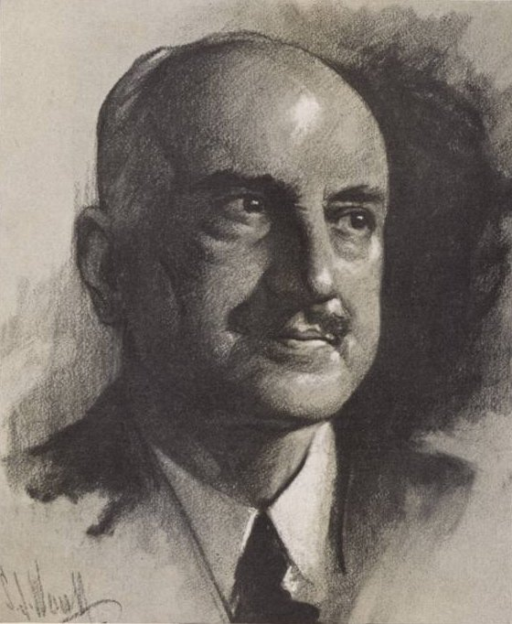
the book of
Psalms
078-080
Jorge Santayana (1863-1952) ~ “Those who cannot remember the past are condemned to repeat it.”

Slide 3
the book of
Psalms
078-080

Slide 4
the book of
Psalms
078-080
Law ~ torah – NASB, instruction; NIV, teaching

Slide 5
the book of
Psalms
078-080

Slide 6
the book of
Psalms
078-080
Dark sayings ~ NLT, hidden things

Slide 7
the book of
Psalms
078-080

Slide 8
the book of
Psalms
078-080
Angels’ ~ not malak
‘abbiyr – literally, mighty ones

Slide 9
the book of
Psalms
078-080

Slide 10
the book of
Psalms
078-080
Num. 11:32 ~ And the people stayed up all that day, all night, and all the next day, and gathered the quail (he who gathered least gathered ten homers);

Slide 11
the book of
Psalms
078-080

Slide 12
the book of
Psalms
078-080
KJV, they were not estranged from their lust

Slide 13
the book of
Psalms
078-080

Slide 14
the book of
Psalms
078-080
Ps. 106:15 ~ He gave them their request,
But sent leanness into their soul.

Slide 15
the book of
Psalms
078-080

Slide 16
the book of
Psalms
078-080
Sandy Adams ~ “All we are is a warm puff of breath on a cold morning. All we are is a is just hot air. We’re nothing but a glorified burp.”

Slide 17
the book of
Psalms
078-080

Slide 18
the book of
Psalms
078-080
KJV ~ by sending evil angels among them.
evil ~ ra – more in the sense of catastrophic, calamitous

Slide 19
the book of
Psalms
078-080

Slide 20
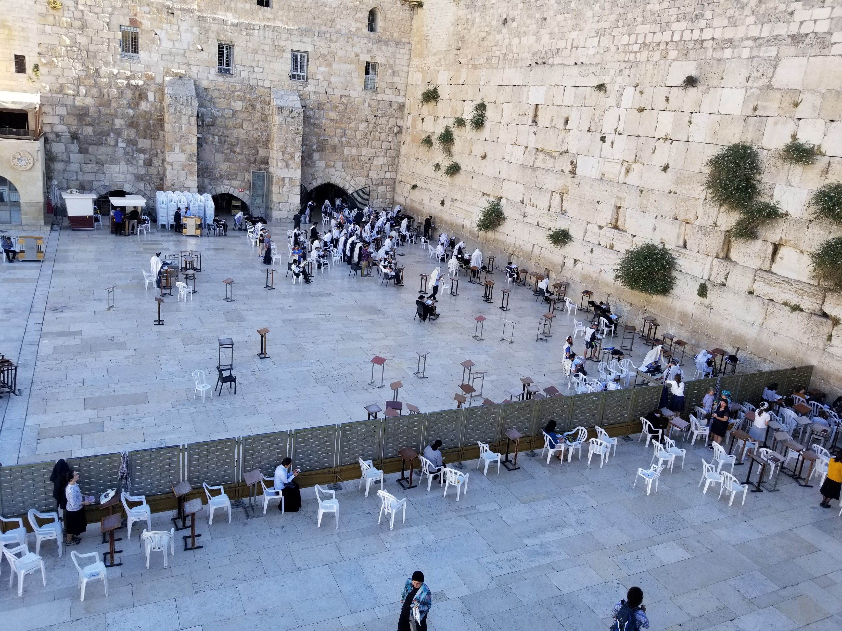
the book of
Psalms
078-080

Slide 21
the book of
Psalms
078-080

Slide 22
the book of
Psalms
078-080
Luke 12:48b ~ … For everyone to whom much is given, from him much will be required …

Slide 23
the book of
Psalms
078-080

Slide 24
the book of
Psalms
078-080
C. H. Spurgeon ~ “This is masterly pleading. No argument has such force as this. God’s glory was tarnished in the eyes of the heathen by the defeat of his people, and the profanation of his temple; therefore, his distressed servants implore his aid, that his great name may no more be the scorn of blaspheming enemies.”

Slide 25
the book of
Psalms
078-080

Slide 26
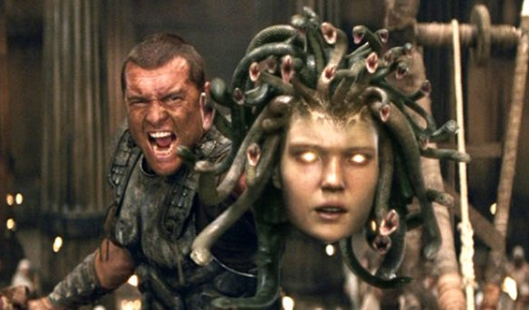
the book of
Psalms
078-080
C. H. Spurgeon ~ “Why should those impious mouths be filled with food so sweet to them, but so bitter to us? When the afflictions of God’s people become the derision of sinners, and cause them to ridicule religion, we have good ground for expostulation with the Lord.”

Slide 27
the book of
Psalms
078-080

Slide 28
the book of
Psalms
078-080
Sevenfold ~ complete

Slide 29
the book of
Psalms
078-080

Slide 30
the book of
Psalms
078-080
v. 3 ~ Restore us, O God;
v. 7 ~ Restore us, O God of hosts;
v. 19 ~ Restore us, O LORD God of hosts;
Table of Showbread
Golden Altar
Bronze Laver
Bronze Altar
Ark
Menorah

Slide 31
the book of
Psalms
078-080

