Slide 1
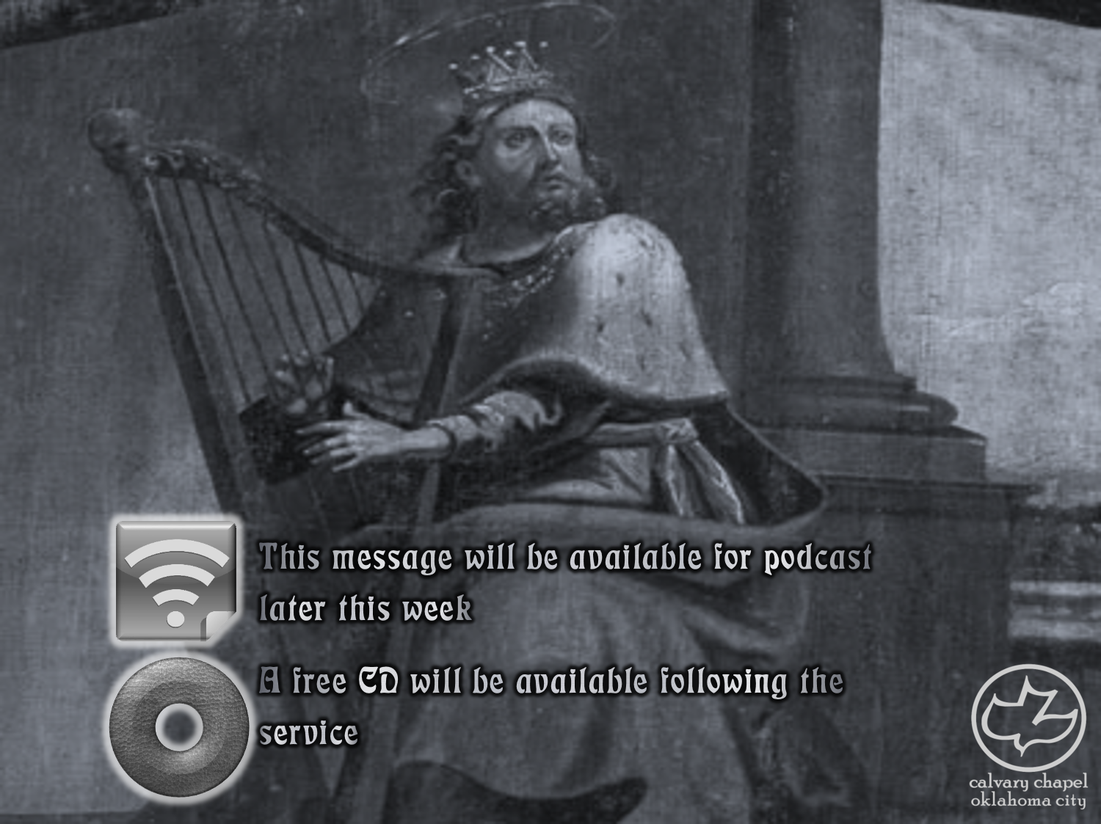

Psalms
the book of
75-77

Slide 2
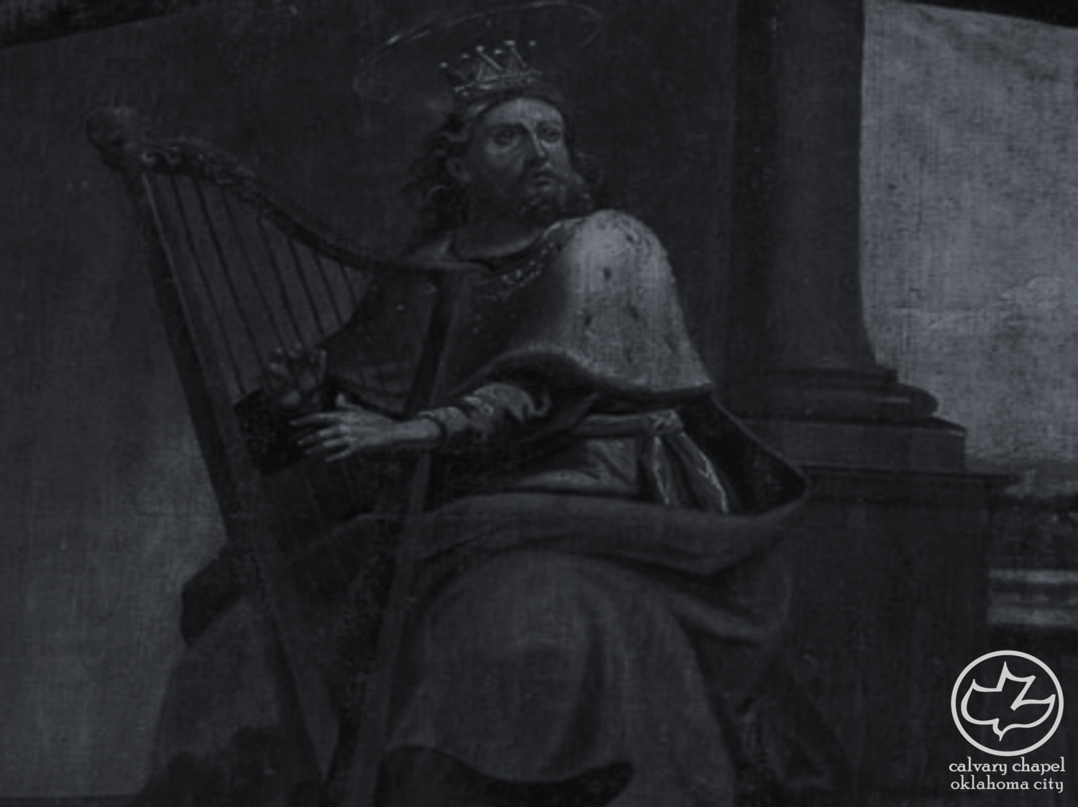
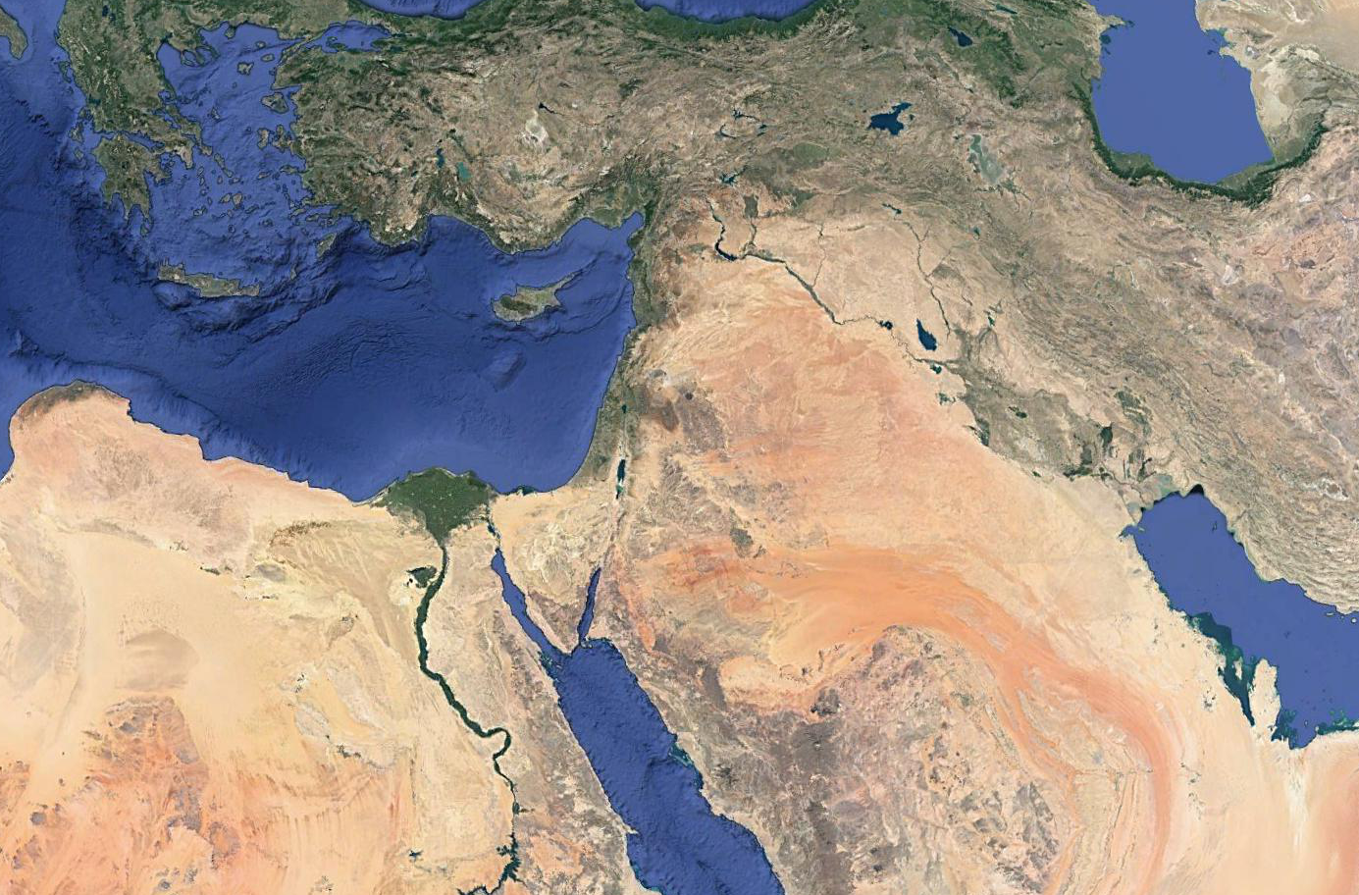
the book of
Psalms
75-77
Nineveh
Assyrian Empire

Slide 3
the book of
Psalms
75-77
Typical Assyrian kings’ inscription ~ “I destroyed, devastated and burned with fire.”
Ashurnasirpal II (ruled 883-859 BC) ~ “I flayed many right through my land and draped their skins over the walls. I burned their adolescent boys and girls . . . a pillar of heads I erected in front of the city.”

Slide 4
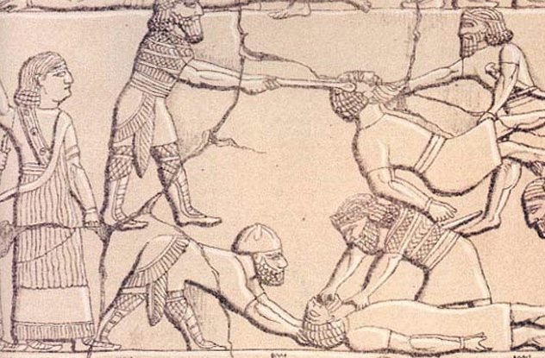
the book of
Psalms
75-77

Slide 5
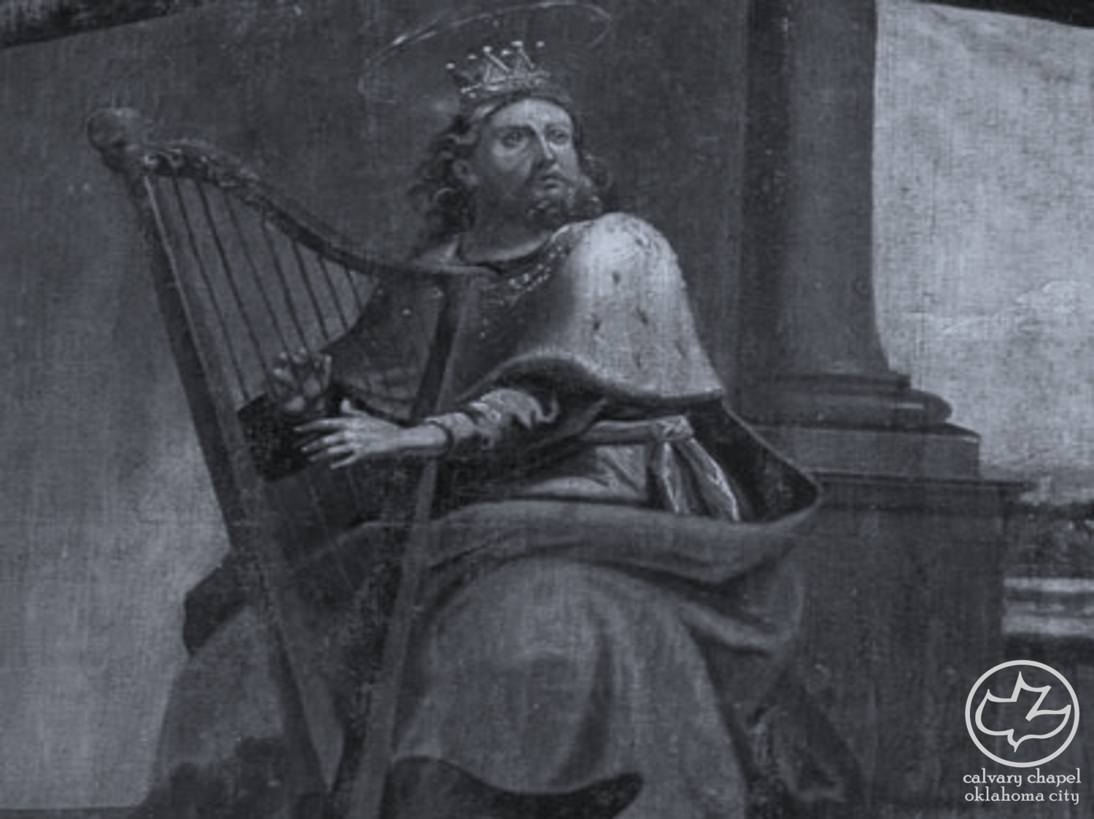
the book of
Psalms
75-77

Slide 6
the book of
Psalms
75-77
Name ~ i.e. His presence

Slide 7
the book of
Psalms
75-77

Slide 8
the book of
Psalms
75-77
Justice
System
Military
Intelligence
Jumbo
Shrimp
NIV
Study Bible
Country
Music

Slide 9
the book of
Psalms
75-77

Slide 10
the book of
Psalms
75-77
NLT ~ Don’t raise your fists in defiance at the heavens

Slide 11
the book of
Psalms
75-77

Slide 12
the book of
Psalms
75-77
Matt. 23:12 ~ And whoever exalts himself will be humbled, and he who humbles himself will be exalted.

Slide 13
the book of
Psalms
75-77

Slide 14
the book of
Psalms
75-77
Rev. 14:9–10 ~ ⁹ Then a third angel followed them, saying with a loud voice, “If anyone worships the beast and his image, and receives his mark on his forehead or on his hand, ¹⁰ he himself shall also drink of the wine of the wrath of God, which is poured out full strength into the cup of His indignation. He shall be tormented with fire and brimstone in the presence of the holy angels and in the presence of the Lamb.

Slide 15
the book of
Psalms
75-77

Slide 16
the book of
Psalms
75-77
Salem ~ i.e. Jerusalem
Tabernacle ~ literally, lair (Jer. 25:38) or den (Ps. 10:9)

Slide 17
the book of
Psalms
75-77

Slide 18
the book of
Psalms
75-77
C. H. Spurgeon ~ “In the spiritual conflicts of this and every age, the like will be seen; no weapon that is formed against the church shall prosper, and every tongue that rises against her in judgment she shall condemn. ‘Selah.’ It is meet that we should dwell on so soul-stirring a theme, and give the Lord our grateful adoration, — hence a pause is inserted.”

Slide 19
the book of
Psalms
75-77

Slide 20
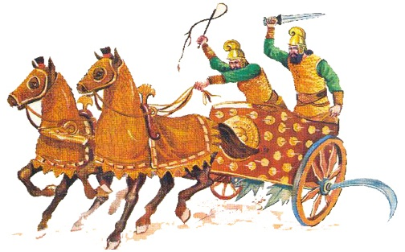
the book of
Psalms
75-77

Slide 21
the book of
Psalms
75-77

Slide 22
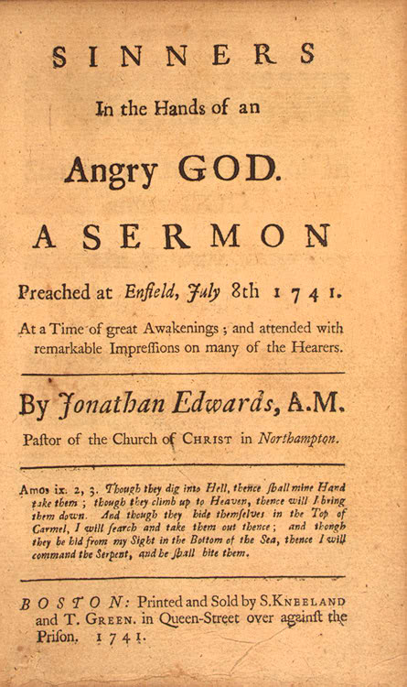
the book of
Psalms
75-77

Slide 23
the book of
Psalms
75-77
Jonathan Edwards (1703-1758) ~ “Unconverted men walk over the pit of hell on a rotten covering, and there are innumerable places in this covering so weak that they will not bear their weight, and these places are not seen …
“Your wickedness makes you as it were heavy as lead, and to tend downwards with great weight and pressure towards hell; and if God should let you go, you would immediately sink and swiftly descend and plunge into the bottomless gulf, and your healthy constitution, and your own care and prudence, and best contrivance, and all
your righteousness, would have no more influence to

Slide 24
the book of
Psalms
75-77
Jonathan Edwards (1703-1758) ~ uphold you and keep you out of hell, than a spider’s web would have to stop a falling rock …
“The bow of God’s wrath is bent, and the arrow made ready on the string, and justice bends the arrow at your heart, and strains the bow, and it is nothing but the mere pleasure of God, and that of an angry God, without any promise or obligation at all, that keeps the arrow one moment from being made drunk with your blood ...
“O sinner! Consider the fearful danger you are in: it is
a great furnace of wrath, a wide and bottomless pit,

Slide 25
the book of
Psalms
75-77
Jonathan Edwards (1703-1758) ~ full of the fire of wrath, that you are held over in the hand of that God, whose wrath is provoked and incensed as much against you, as against many of the damned in hell.
“You hang by a slender thread, with the flames of divine wrath flashing about it, and ready every moment to singe it, and burn it asunder; and you have no interest in any Mediator, and nothing to lay hold of to save yourself, nothing to keep off the flames of wrath, nothing of your own, nothing that you ever have done, nothing that you can do, to induce God to spare you one moment.”

Slide 26
the book of
Psalms
75-77

Slide 27
the book of
Psalms
75-77
C. H. Spurgeon ~ “To vow or not is a matter of choice, but to discharge our vows is our bounden duty. He who would defraud God, his own God, is a wretch indeed. He keeps his promises, let not his people fail in theirs. He is their faithful God and deserves to have a faithful people.”

Slide 28
the book of
Psalms
75-77

Slide 29
the book of
Psalms
75-77
Hand ~ KJV, sore

Slide 30
the book of
Psalms
75-77

Slide 31
the book of
Psalms
75-77
KJV ~ Is His mercy clean gone forever?

Slide 32
the book of
Psalms
75-77

