Slide 1
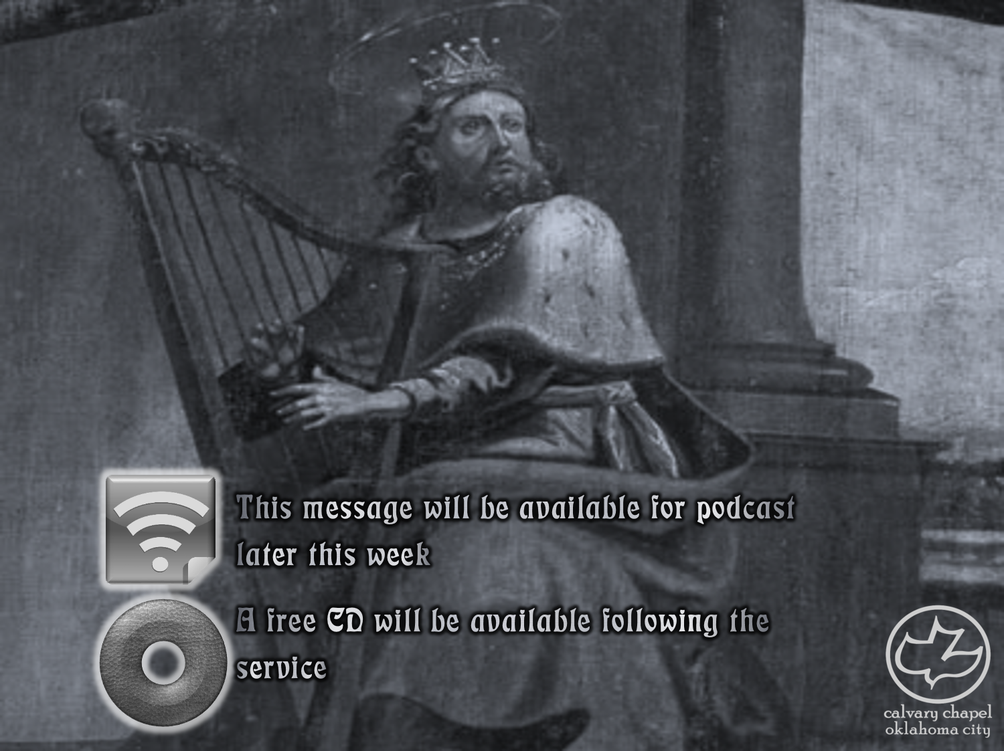

Psalms
the book of
69-71

Slide 2
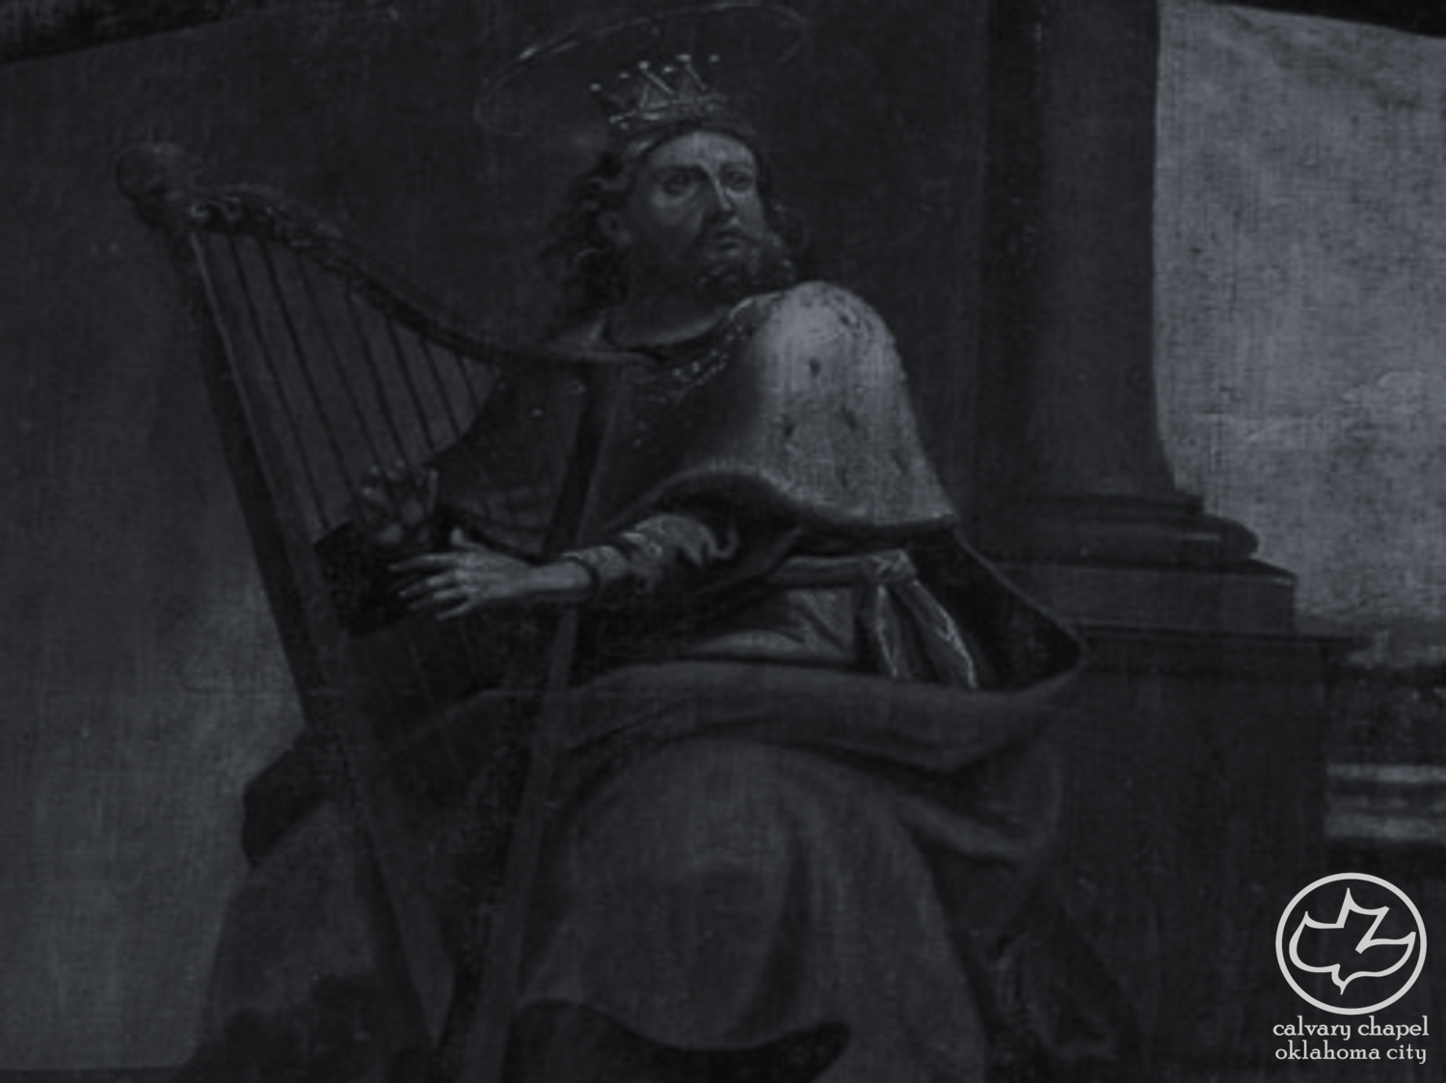
the book of
Psalms
69-71
2nd most quoted Psalm in the New Testament
vv. 1-21 ~ Victim (I, me, my)
vv. 22-28 ~ Vengeance (they, them, their)
vv. 29-36 ~ Victory (He, Him, His)

Slide 3
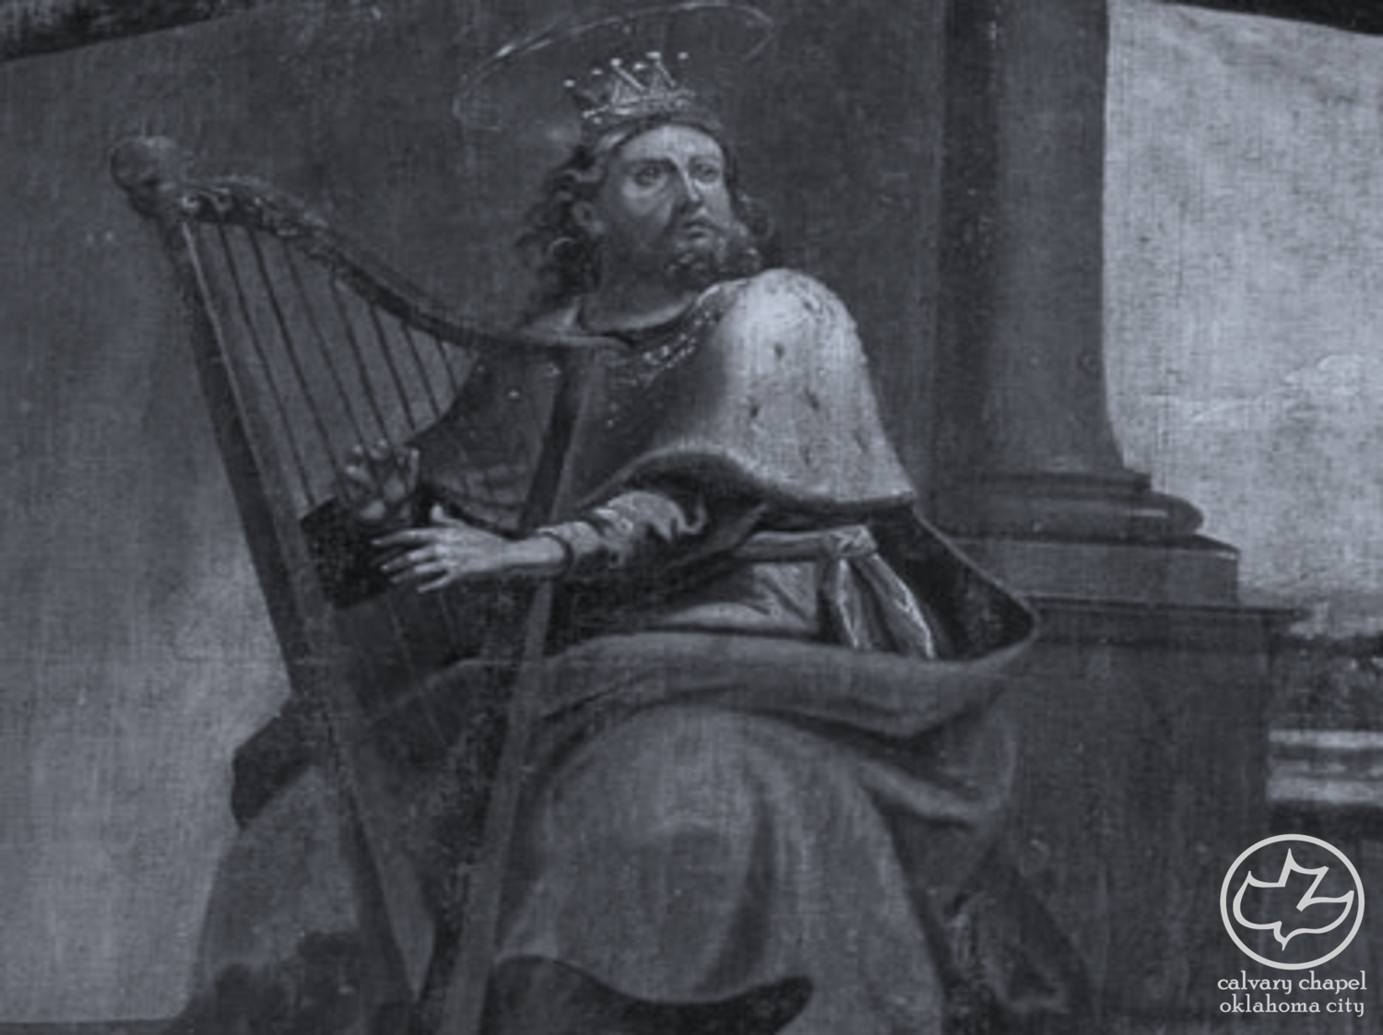
the book of
Psalms
69-71

Slide 4
the book of
Psalms
69-71
Matt. 27:41a ~ He saved others; Himself He cannot save.
C. H. Spurgeon ~ “Many of us know what watching and waiting mean; and we know something of the failing eye when hope is long deferred: but in all this Jesus bears the palm (i.e., is the winner); no eyes ever failed as his did or for so deep a cause. No painter can ever depict those eyes; their pencils fail in every feature of his all fair but: all marred countenance, but most of all do they come short when they venture to portray those eyes which were fountains of tears.”

Slide 5
the book of
Psalms
69-71

Slide 6

the book of
Psalms
69-71

Slide 7
the book of
Psalms
69-71

Slide 8
the book of
Psalms
69-71
Mark 3:20-21 ~ ²⁰ Then the multitude came together again, so that they could not so much as eat bread. ²¹ But when His own people heard about this, they went out to lay hold of Him, for they said, “He is out of His mind.”

Slide 9
the book of
Psalms
69-71
Mark 3:31-35 ~ ³¹ Then His brothers and His mother came, and standing outside they sent to Him, calling Him. ³² And a multitude was sitting around Him; and they said to Him, “Look, Your mother and Your brothers are outside seeking You.”
³³ But He answered them, saying, “Who is My mother, or My brothers?” ³⁴ And He looked around in a circle at those who sat about Him, and said, “Here are My mother and My brothers! ³⁵ For whoever does the will of God is My brother and My sister and mother.”

Slide 10
the book of
Psalms
69-71

Slide 11
the book of
Psalms
69-71
Matt. 26:38 ~ Then He said to them, “My soul is exceedingly sorrowful, even to death. Stay here and watch with Me.”

Slide 12
the book of
Psalms
69-71

Slide 13
the book of
Psalms
69-71
John 19:28-30 ~ ²⁸ After this, Jesus, knowing that all things were now accomplished, that the Scripture might be fulfilled, said, “I thirst!” ²⁹ Now a vessel full of sour wine was sitting there; and they filled a sponge with sour wine, put it on hyssop, and put it to His mouth.
³⁰ So when Jesus had received the sour wine, He said, “It is finished!” And bowing His head, He gave up His spirit.
Ps. 22:15b ~ My tongue clings to My jaws;

Slide 14
the book of
Psalms
69-71

Slide 15
the book of
Psalms
69-71
Almost identical to Psalm 40:13-17

Slide 16
the book of
Psalms
69-71

Slide 17
the book of
Psalms
69-71
C. H. Spurgeon ~ “Not only on God must we rest, as a man stands on a rock, but in him must we trust, as a man hides in a cave. The more intimate we are with the Lord, the firmer will our trust be. God knows our faith, and yet he loves to hear us avow it; hence, the Psalmist not only trusts in the Lord, but tells him that he is so trusting.”

Slide 18
the book of
Psalms
69-71

Slide 19
the book of
Psalms
69-71
Prov. 18:10 ~ The name of the Lord is a strong tower;
The righteous run to it and are safe.

Slide 20
the book of
Psalms
69-71

Slide 21
the book of
Psalms
69-71
C. H. Spurgeon ~ “When I cannot rejoice in what I have, I will look forward to what shall be mine, and will still rejoice. Hope will live on a bare common, and Sing on a branch laden down with snow. No date and no place are unsuitable for hope. Hell alone excepted, hope is a dweller in all regions.”

Slide 22
the book of
Psalms
69-71

