Slide 1
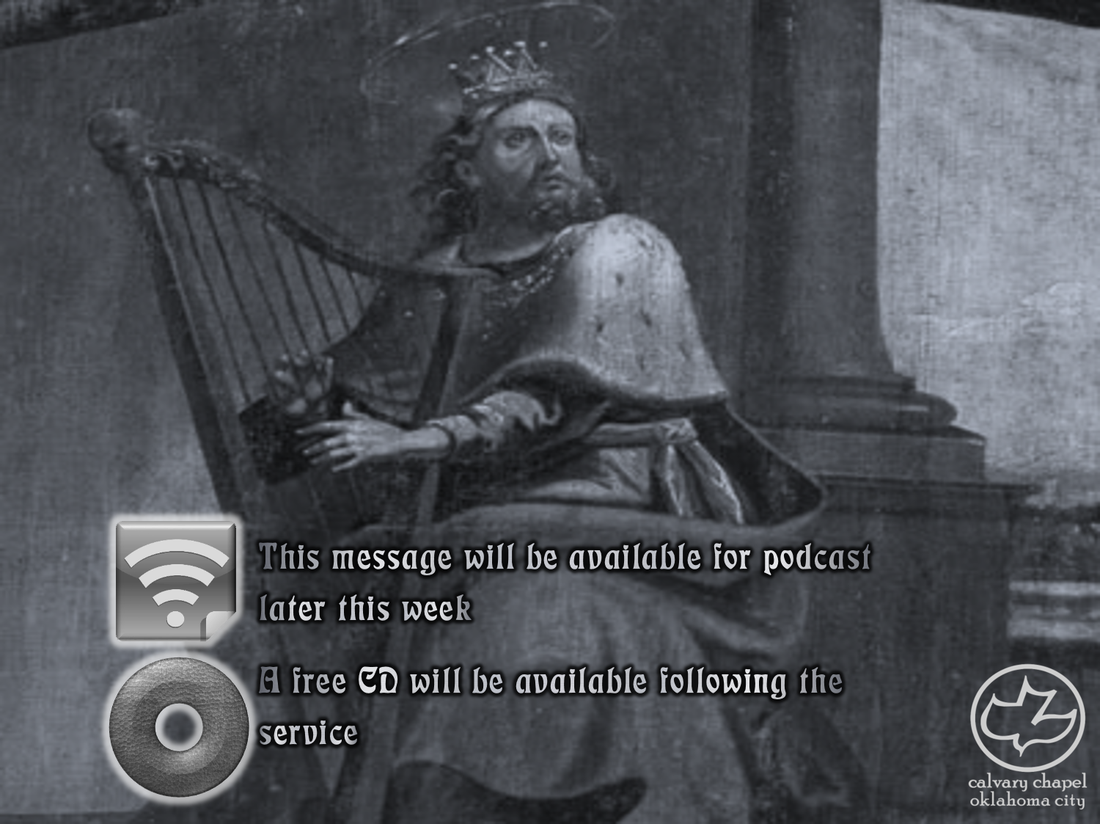

Psalms
the book of
66-68

Slide 2
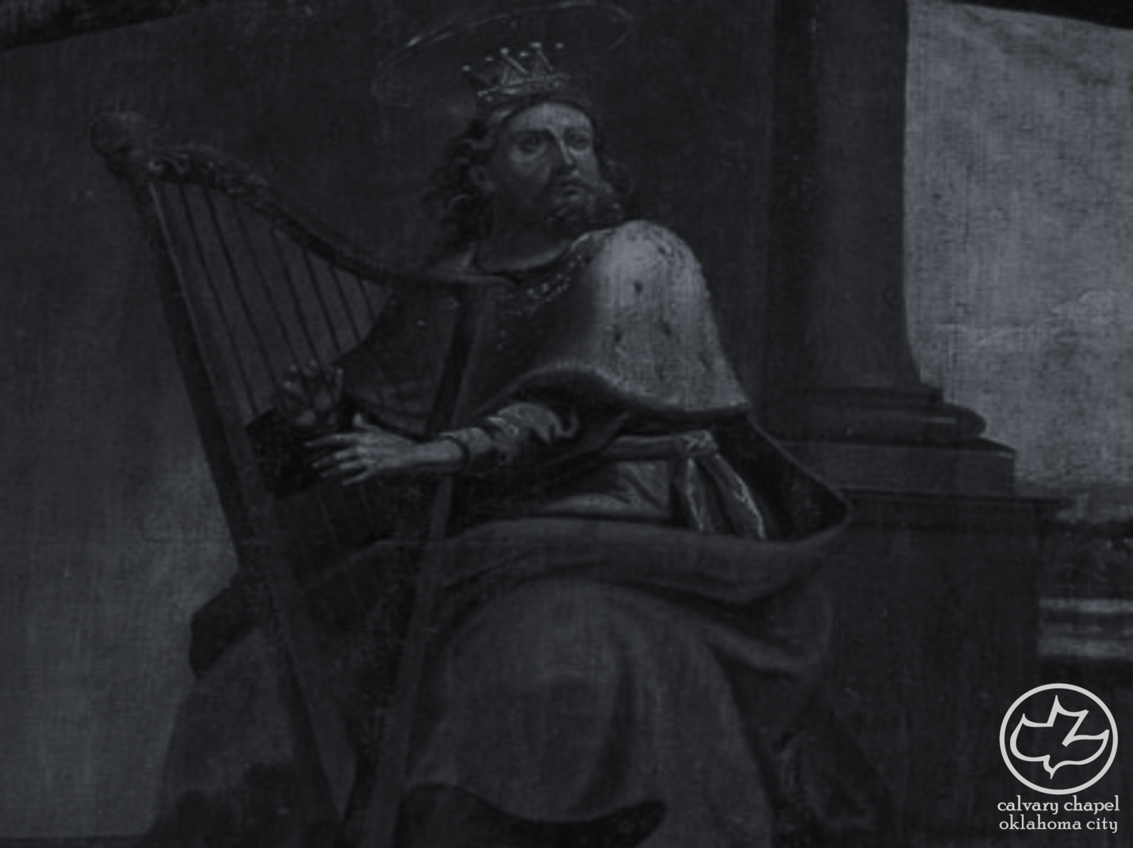
the book of
Psalms
66-68
NASB ~ Your enemies will give feigned obedience to You.
Literally, deceive

Slide 3
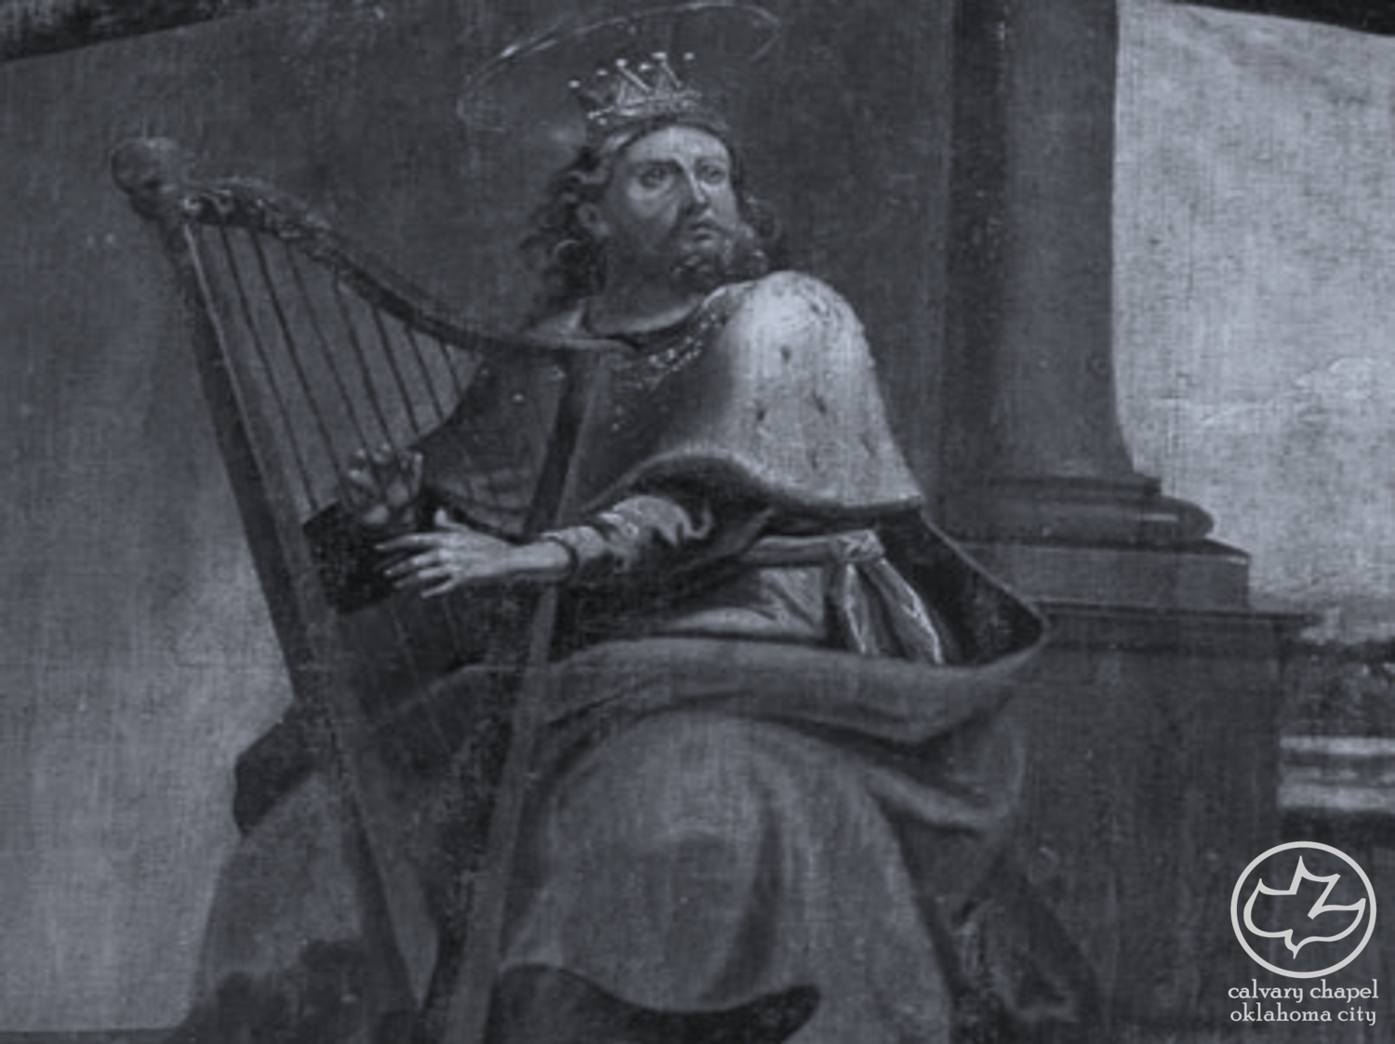
the book of
Psalms
66-68

Slide 4
the book of
Psalms
66-68
William Law (1686-1769) ~ “Would you know who is the greatest saint in the world? It is not he who prays most or fasts most; it is not he who gives most alms, or is more eminent for temperance, chastity, or justice; but it is he who is always thankful to God who wills everything that God willeth, who receives everything as an instance of God's goodness, and has a heart always ready to praise God for it.”

Slide 5
the book of
Psalms
66-68
Westminster Catechism:
Q. 1. What is the chief end of man?
A. Man’s chief end is to glorify God, and to enjoy him forever.

Slide 6
the book of
Psalms
66-68

Slide 7
the book of
Psalms
66-68
Burnt offerings ~ consecration

Slide 8
the book of
Psalms
66-68

Slide 9
the book of
Psalms
66-68
Is. 59:1-2 ~ Behold, the LORD’S hand is not shortened,
That it cannot save;
Nor His ear heavy,
That it cannot hear.
But your iniquities have separated you from your God;
And your sins have hidden His face from you,
So that He will not hear.

Slide 10
the book of
Psalms
66-68

Slide 11
the book of
Psalms
66-68
Psalm 67 ~ “the Missionary Psalm”

Slide 12
the book of
Psalms
66-68

Slide 13
the book of
Psalms
66-68
Num. 6:24-26 ~ ²⁴ The Lord bless you and keep you;
²⁵ The Lord make His face shine upon you,
And be gracious to you;
²⁶ The Lord lift up His countenance upon you,
And give you peace.

Slide 14
the book of
Psalms
66-68

Slide 15
the book of
Psalms
66-68
C. H. Spurgeon ~ “May every man bring his music, every citizen his canticle, every peasant his praise, every prince his Psalm.”

Slide 16
the book of
Psalms
66-68

Slide 17
the book of
Psalms
66-68
ESV ~ ¹ God shall arise, his enemies shall be scattered;
and those who hate him shall flee before him!
² As smoke is driven away, so you shall drive them away;
as wax melts before fire,
so the wicked shall perish before God!
³ But the righteous shall be glad;
they shall exult before God;
they shall be jubilant with joy!

Slide 18
the book of
Psalms
66-68

Slide 19
the book of
Psalms
66-68
Jesus is Yah-shua, I AM salvation

Slide 20
the book of
Psalms
66-68

Slide 21
the book of
Psalms
66-68
Defender ~ KJV, NASB – judge (i.e. advocate)

Slide 22
the book of
Psalms
66-68

Slide 23
the book of
Psalms
66-68
C. H. Spurgeon ~ “Within the guarded circle there was plenty for all; all were poor in themselves, yet there were no beggars in all the camp, for celestial fare was to be had for the gathering, We, too, still dwell within the circling protection of the Most High, and find goodness made ready for us: although poor and needy by nature, we are enriched by grace; divine preparations in the decree, the covenant, the atonement, providence, and the Spirit’s work, have made ready for us a fullness of the blessing of the Lord.”

Slide 24
the book of
Psalms
66-68

Slide 25
the book of
Psalms
66-68
1 Sam. 30:24 ~ For who will heed you in this matter? But as his part is who goes down to the battle, so shall his part be who stays by the supplies; they shall share alike.
KJV ~ so shall his part be that tarrieth by the stuff: they shall part alike.

Slide 26
the book of
Psalms
66-68

Slide 27
the book of
Psalms
66-68
C. H. Spurgeon ~ “It is a hard passage, a nut for the learned to crack. If we knew all that was known when this ancient hymn was composed, the allusion would no doubt strike us as being beautifully appropriate, but as we do not, we will let it rest among the unriddled things.”

Slide 28
the book of
Psalms
66-68

Slide 29
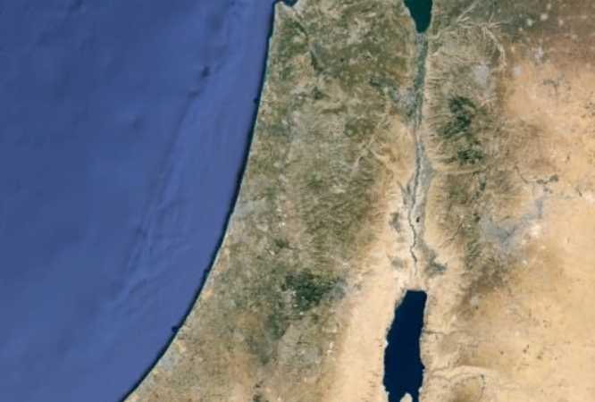
the book of
Psalms
66-68
Zalmon (Ebal)
Jerusalem

Slide 30
the book of
Psalms
66-68

Slide 31
the book of
Psalms
66-68
Fume ~ KJV, Why leap ye?

Slide 32
the book of
Psalms
66-68

Slide 33
the book of
Psalms
66-68
NLT ~ Praise the Lord; praise God our savior!
For each day he carries us in his arms.

Slide 34
the book of
Psalms
66-68

