Slide 1
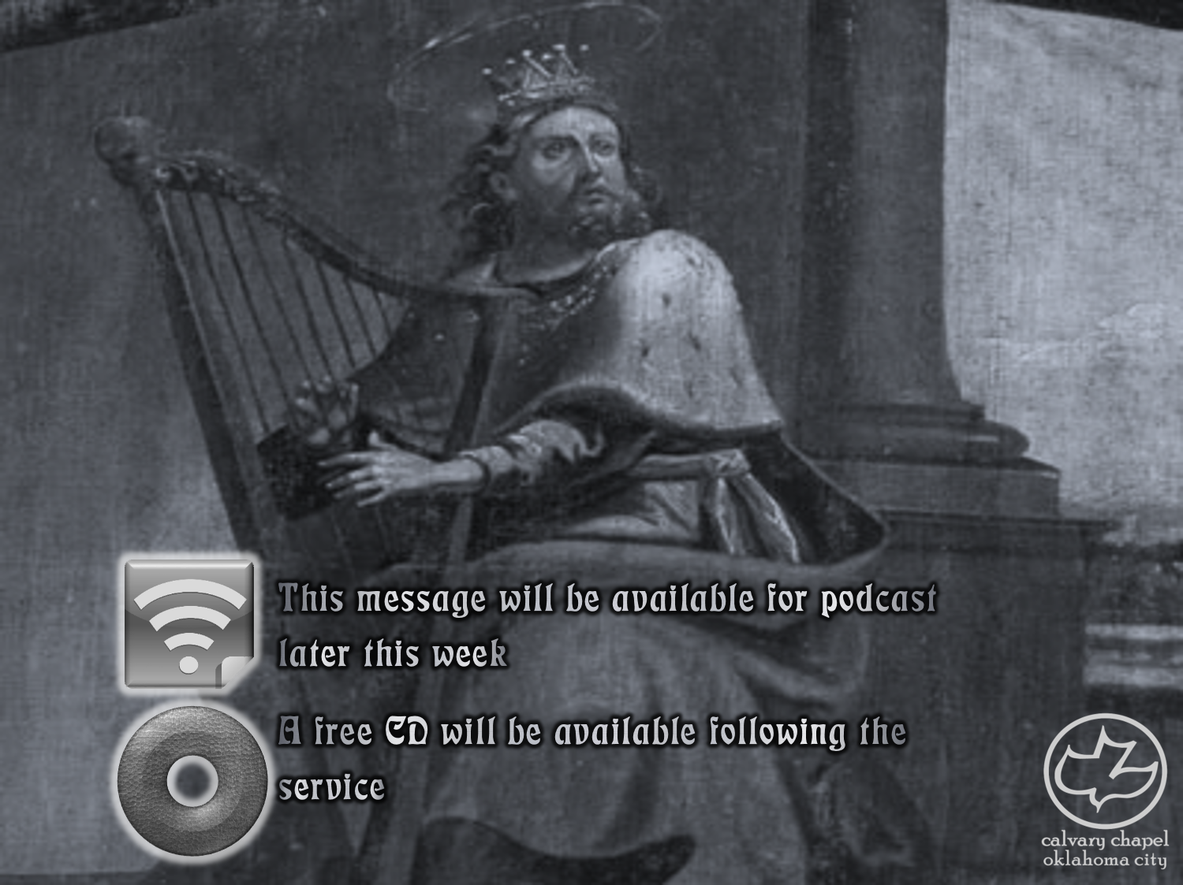

Psalms
the book of
51-53

Slide 2
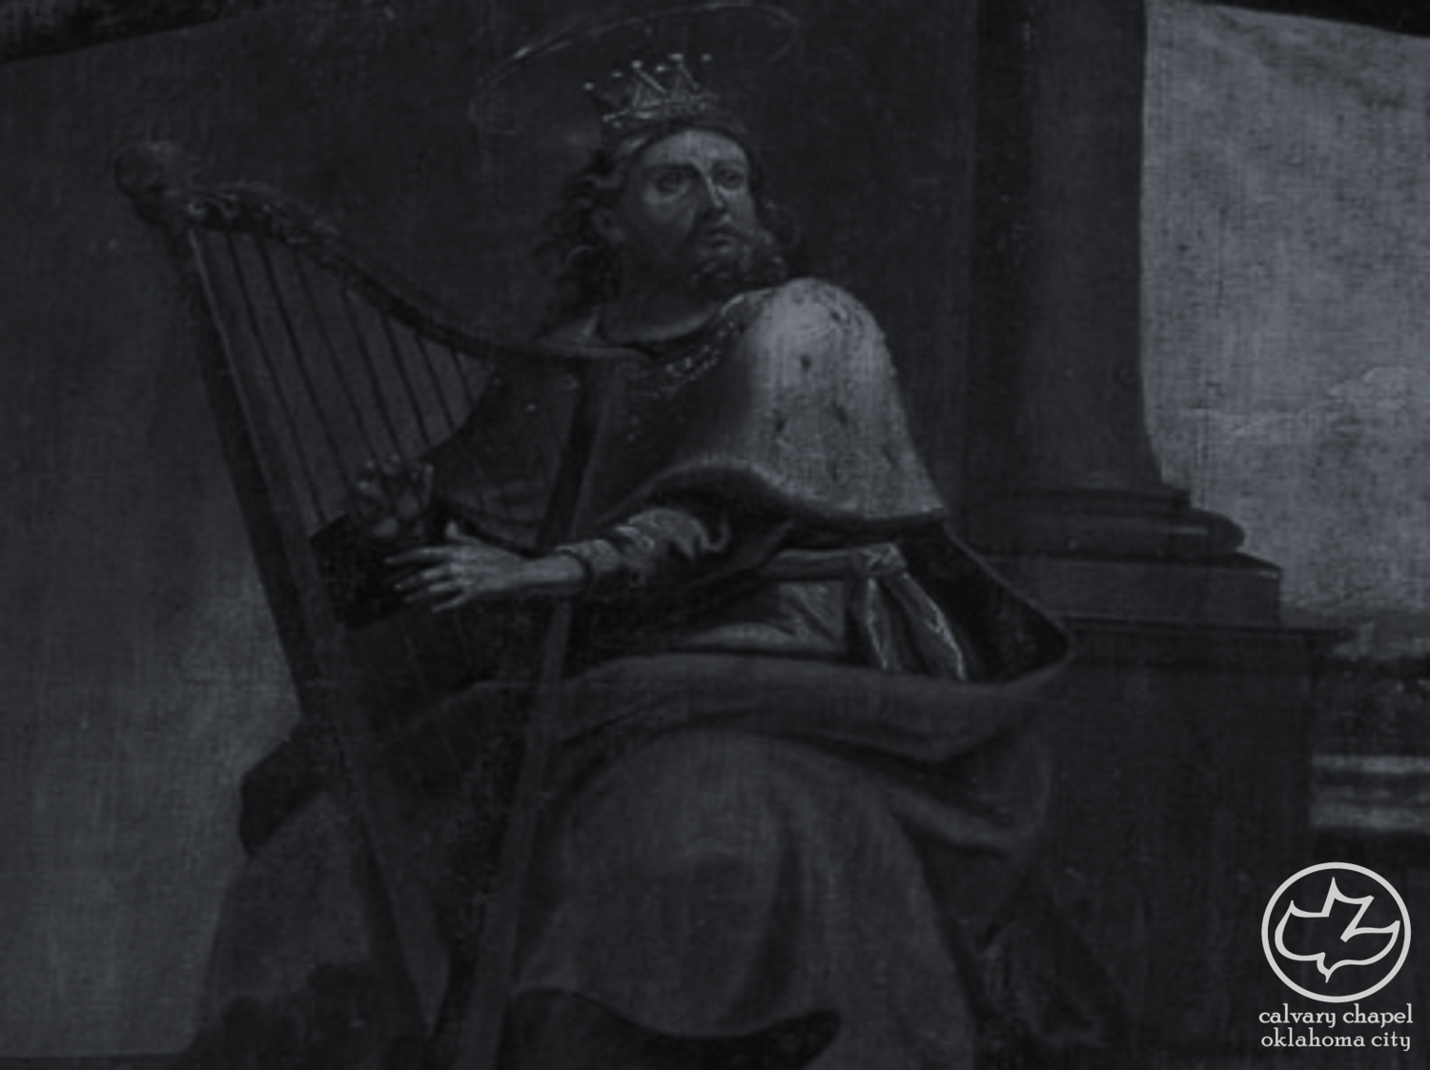
the book of
Psalms
51-53
2 Samuel 12:1-7a
Num. 32:23 ~ But if you do not do so, then take note, you have sinned against the Lord; and be sure your sin will find you out.

Slide 3
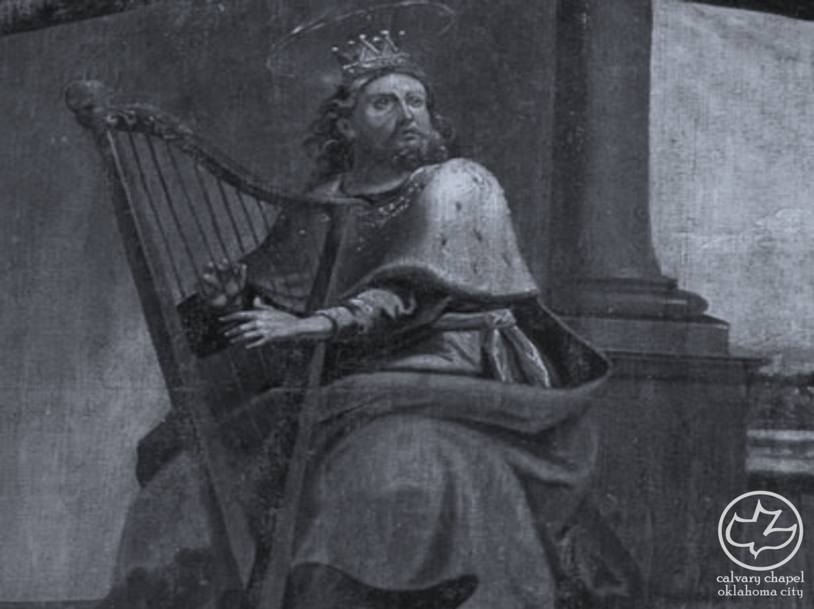
the book of
Psalms
51-53

Slide 4
the book of
Psalms
51-53
Wash ~ kabas – to trample, to wash by stamping (with the feet)
C. H. Spurgeon ~ “The hypocrite is content if his garments be washed; but the true suppliant cries, ‘wash me.’ The careless soul is content with a nominal cleansing, but the truly–awakened conscience desires a real and practical washing, and that of a most complete and efficient kind.”

Slide 5
the book of
Psalms
51-53

Slide 6
the book of
Psalms
51-53
True repentance: Hating the sin more than the consequences of it

Slide 7
the book of
Psalms
51-53

Slide 8
the book of
Psalms
51-53
Create ~ bara – to create out of nothing
C. H. Spurgeon ~ “What! Has sin so destroyed us that the Creator must be called in again?”

Slide 9
the book of
Psalms
51-53

Slide 10
the book of
Psalms
51-53
Holy Spirit ~ Principle of First Mention

Slide 11
the book of
Psalms
51-53

Slide 12
the book of
Psalms
51-53
Contemplation ~ maschil – or, instruction

Slide 13
the book of
Psalms
51-53

Slide 14
the book of
Psalms
51-53
C. H. Spurgeon ~ “Behold the man! The great, vainglorious man. He found a fortress, but not in God; he gloried in his might, but not in the Almighty. Where is he now? How has it fared with him in the hour of his need? Behold his ruin, and be instructed.”

Slide 15
the book of
Psalms
51-53

Slide 16
the book of
Psalms
51-53
Mahalath ~ sickness
Also, Psalm 88

Slide 17
the book of
Psalms
51-53

Slide 18
the book of
Psalms
51-53
C. H. Spurgeon ~ “And this he does because he is a fool. Being a fool he speaks according to his nature; being a great fool he meddles with a great subject, and comes to a wild conclusion. The atheist is, morally, as well as mentally, a fool, a fool in the heart as well as in the head; a fool in morals as well as in philosophy … They are rotten. It is idle to compliment them as sincere doubters, and amiable thinkers — they are putrid. There is too much dainty dealing nowadays with atheism; it is not a harmless error, it is an offensive, putrid sin, and righteous men should look upon it in that light.”

Slide 19
the book of
Psalms
51-53

Slide 20
the book of
Psalms
51-53
1. No one can know there is no God
Atheist ~ a (no) + theos (God) = without God
Agnostic ~ a (no) + ginoskō (to know) = without knowledge
Latin ~ without knowledge ~ ignōrō (plural ~ ignoramus)
2. Everyone is gonna worship something

Slide 21
the book of
Psalms
51-53

