Slide 1
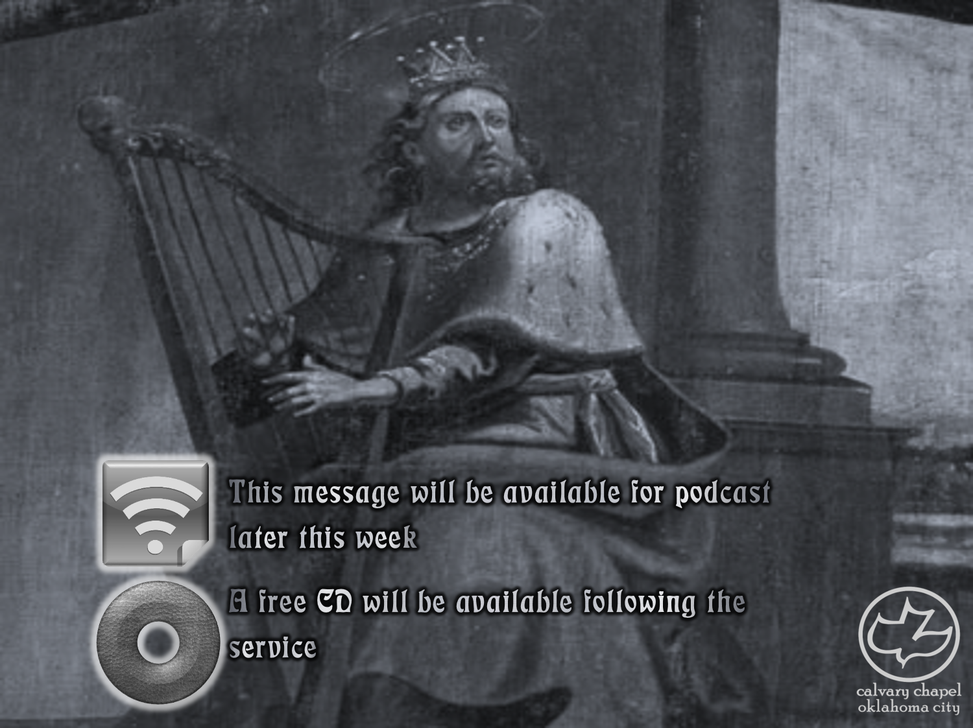

Psalms
the book of
45-47

Slide 2
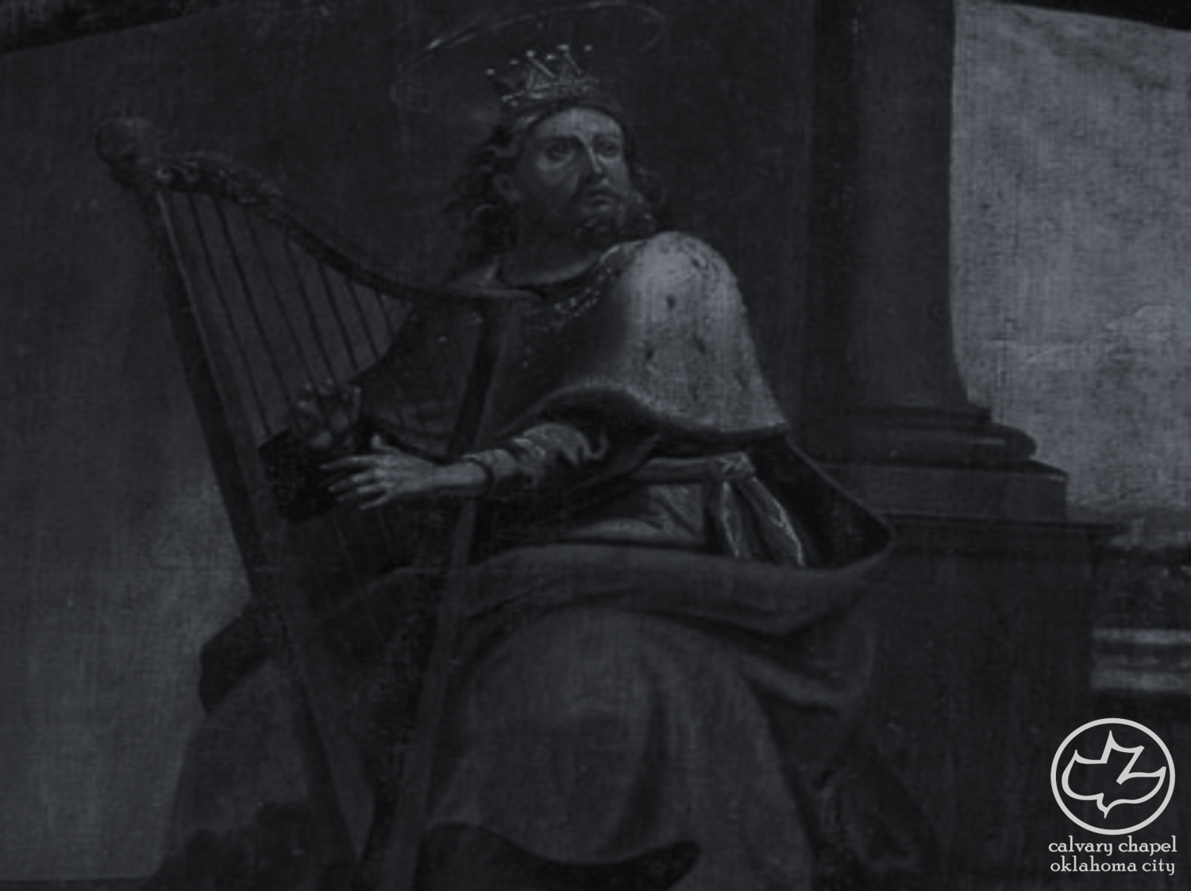
the book of
Psalms
45-47
Set to “The Lilies” ~ KJV, NASB – Shoshannim
“The New Testament has been hidden in the Old Testament;
The Old Testament has been revealed in the New Testament”

Slide 3
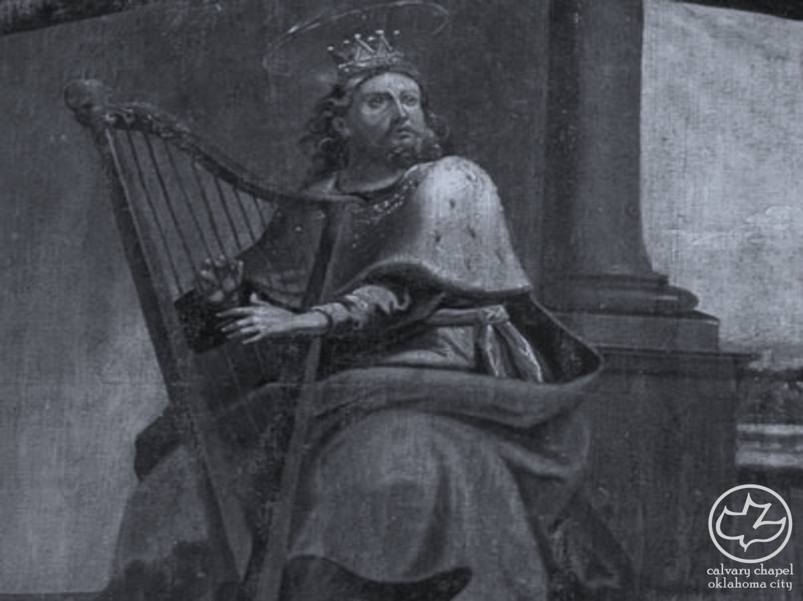
the book of
Psalms
45-47

Slide 4
the book of
Psalms
45-47
Overflowing ~ bubbling or boiling

Slide 5
the book of
Psalms
45-47

Slide 6
the book of
Psalms
45-47
Heb. 1:8-9
NWT (v. 6) ~ God is your throne to time indefinite, even forever;
The scepter of your kingship is a scepter of uprightness

Slide 7
the book of
Psalms
45-47

Slide 8
the book of
Psalms
45-47
C. H. Spurgeon ~ “Note that not only is Jesus most sweet, but even his garments are so; everything that he has to do with is perfumed by his person. ‘All’ his garments are thus fragrant; not some of them, but all; we delight as much in his purple of dominion as in the white linen of his priesthood, his mantle as our prophet is as dear to us as his seamless coat as our friend. All his dress is fragrant with all sweetness.”

Slide 9
the book of
Psalms
45-47

Slide 10
the book of
Psalms
45-47
Queen ~ the Bride of Christ

Slide 11
the book of
Psalms
45-47

Slide 12


the book of
Psalms
45-47
psalms 46-48 form a trilogy
Psalm 46 predicts God's protection of the Jews during the Tribulation
Psalm 47 predicts the establishment of the Lord's Kingdom during the Millennium
Psalm 48 predicts the final rebellion and God's ultimate victory
7-year Tribulation
1000-year Millennium
New Heavens New Earth

Slide 13
the book of
Psalms
45-47

Slide 14
the book of
Psalms
45-47
Alamoth ~ plural for almah – a young woman, virgin
Acts 20:22-24a ~ ²² And see, now I go bound in the spirit to Jerusalem, not knowing the things that will happen to me there, ²³ except that the Holy Spirit testifies in every city, saying that chains and tribulations await me. ²⁴ But none of these things move me …
Selah ~ vv. 3, 7, 11

Slide 15
the book of
Psalms
45-47

Slide 16
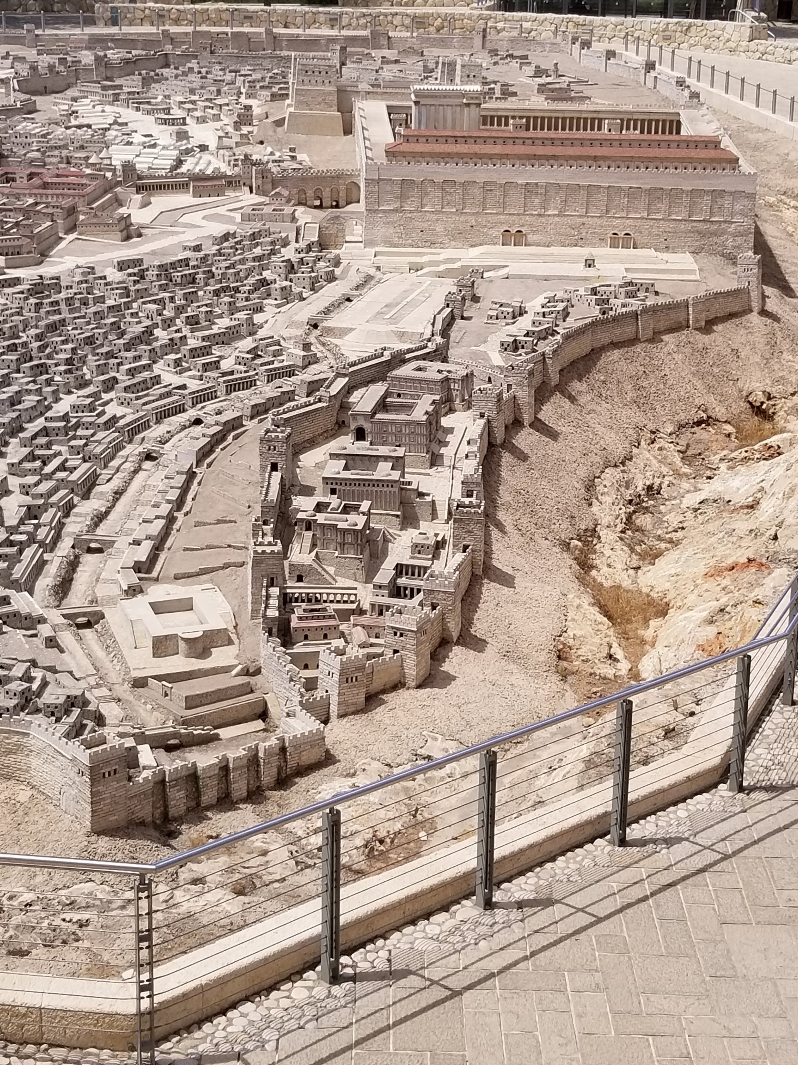
the book of
Psalms
45-47
Hezekiah’s tunnel?
Ezekiel’s river in chapter 47:1-12
Rev. 22:1 ~ And he showed me a pure river of water of life, clear as crystal, proceeding from the throne of God and of the Lamb.
Gihon
Springs
Pool of Siloam
C. H. Spurgeon ~ “Divine grace like a smoothly flowing, fertilizing, full, and never-failing river, yields refreshment and consolation to believers. This is the river of the water of life, of which the church … partakes evermore.”
1777’

Slide 17
the book of
Psalms
45-47

Slide 18
the book of
Psalms
45-47
Merrihew Standard Version ~ Shut up! and know that I am God;
C. H. Spurgeon ~ “Hold off your hands, ye enemies! Sit down and wait in patience, ye believers! Acknowledge that Jehovah is God, ye who feel the terrors of his wrath! Adore him, and him only, ye who partake in the protections of his grace.”

Slide 19
the book of
Psalms
45-47

Slide 20
the book of
Psalms
45-47
Rom. 8:38-39 ~ ³⁸ For I am persuaded that neither death nor life, nor angels nor principalities nor powers, nor things present nor things to come, ³⁹ nor height nor depth, nor any other created thing, shall be able to separate us from the love of God which is in Christ Jesus our Lord.

Slide 21
the book of
Psalms
45-47

Slide 22
the book of
Psalms
45-47
The Kingdom Age

Slide 23
the book of
Psalms
45-47

Slide 24
the book of
Psalms
45-47
Understanding ~ maskil
C. H. Spurgeon ~ “Is it not a sin to be tickling men's ears with sounds when we profess to be adoring the Lord? What has a sensuous delight in organs, anthems, etc., to do with devotion? Do not men mistake physical effects for spiritual impulses? Do they not often offer to God strains far more calculated for human amusement than for divine acceptance?”

Slide 25
the book of
Psalms
45-47

