Slide 1
Psalms
the book of
42-44

Slide 2
the book of
Psalms
42-44
Book Two: Psalms 42–72

Slide 3
the book of
Psalms
42-44

Slide 4
the book of
Psalms
42-44
Contemplation ~ maschil (KJV, NASB, NIV)
2nd of 13 in Psalms (Ps. 32)
KJV ~ for the Sons of Korah
C. H. Spurgeon ~ “…it may be surmised that after their remarkable election to mercy, they became so filled with gratitude that they addicted themselves to sacred music in order that their spared lives might be consecrated to the glory of God.”

Slide 5
the book of
Psalms
42-44

Slide 6
the book of
Psalms
42-44
John 7:37-38 ~ ³⁷ On the last day, that great day of the feast, Jesus stood and cried out, saying, “If anyone thirsts, let him come to Me and drink. ³⁸ He who believes in Me, as the Scripture has said, out of his heart will flow rivers of living water.”
Is. 44:3 ~ For I will pour water on him who is thirsty,
And floods on the dry ground;
I will pour My Spirit on your descendants,
And My blessing on your offspring…

Slide 7
the book of
Psalms
42-44
C. H. Spurgeon ~ “Not merely for the temple and the ordinances, but for fellowship with God himself. None but spiritual men can sympathise with this thirst.”

Slide 8
the book of
Psalms
42-44

Slide 9
the book of
Psalms
42-44
John Trapp (1601-1669) ~ “David chideth David out of the dumps”

Slide 10
the book of
Psalms
42-44

Slide 11
the book of
Psalms
42-44
Help ~ KJV, health
yeshuah

Slide 12
the book of
Psalms
42-44

Slide 13
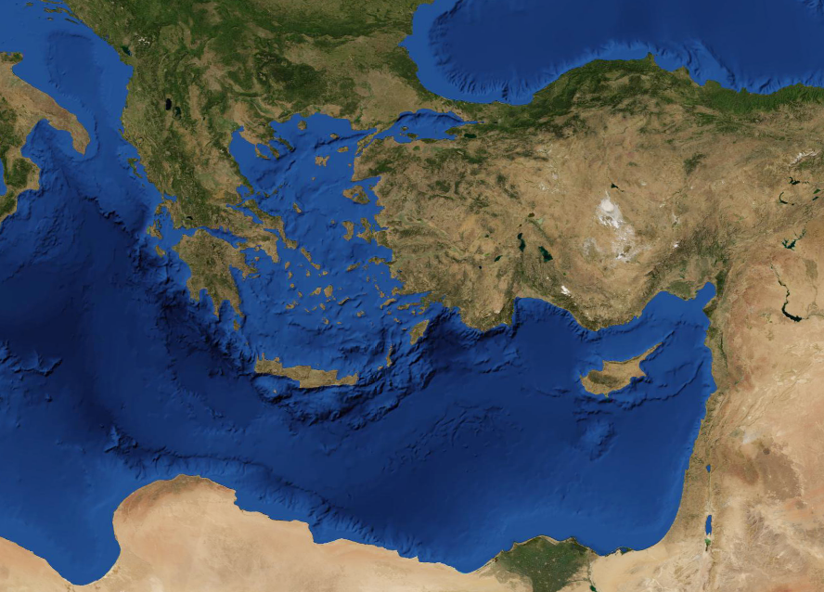
the book of
Psalms
42-44
Bithynia
Troas
Phrygia
Asia

Slide 14
the book of
Psalms
42-44

Slide 15
the book of
Psalms
42-44
Mercies’ ~ chesed
2 Tim. 2:11-13 ~ This is a faithful saying:
For if we died with Him,
We shall also live with Him. ¹² If we endure,
We shall also reign with Him.
If we deny Him,
He also will deny us. ¹³ If we are faithless,
He remains faithful;
He cannot deny Himself.

Slide 16
the book of
Psalms
42-44

Slide 17
the book of
Psalms
42-44
Psalm 1 ~ the Preface Psalm

Slide 18
the book of
Psalms
42-44

