Slide 1
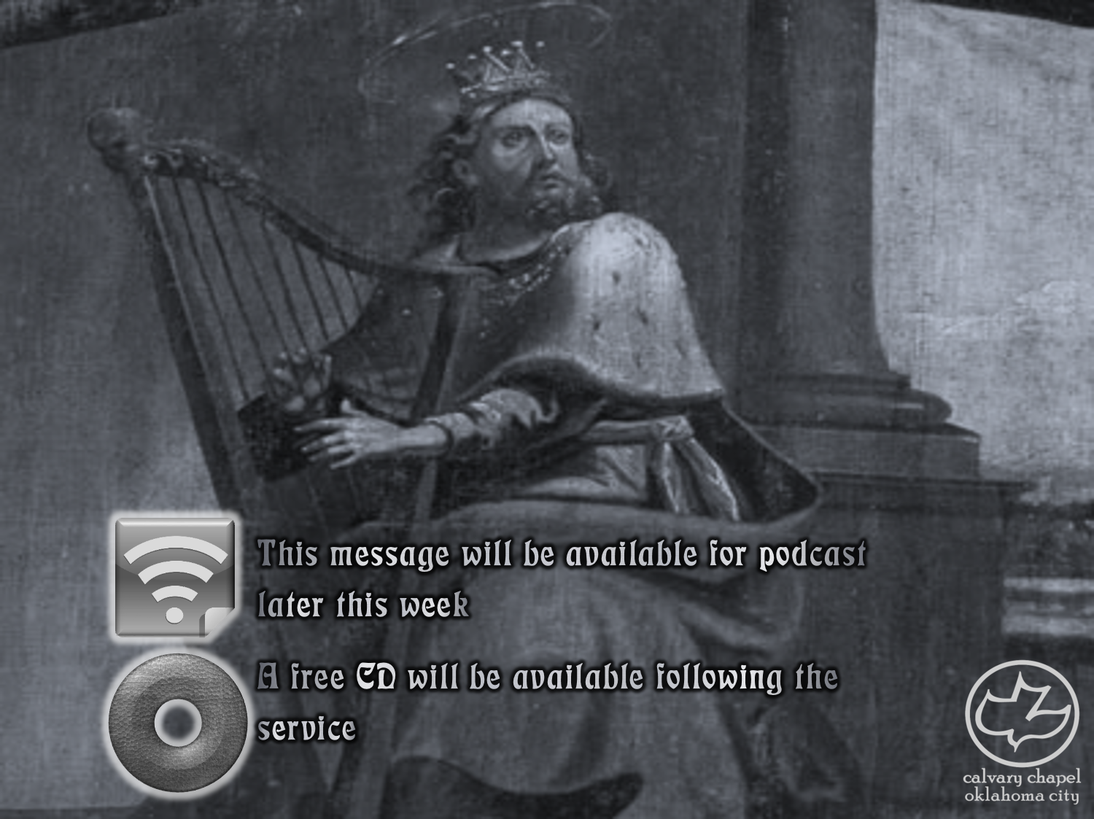

Psalms
the book of
40-41

Slide 2
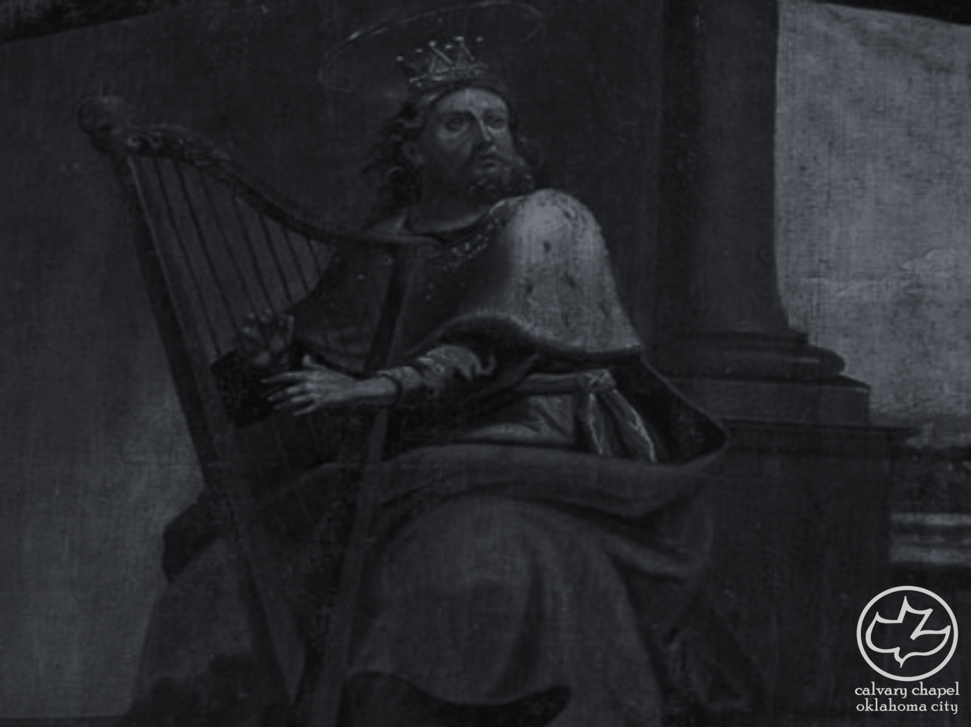
the book of
Psalms
40-41
A Messianic Psalm
2
8
16
22
24
31
34
40
41
45
68
69
72
89
102
104
109
110
118
132
Most, but not all, are written by David

Slide 3
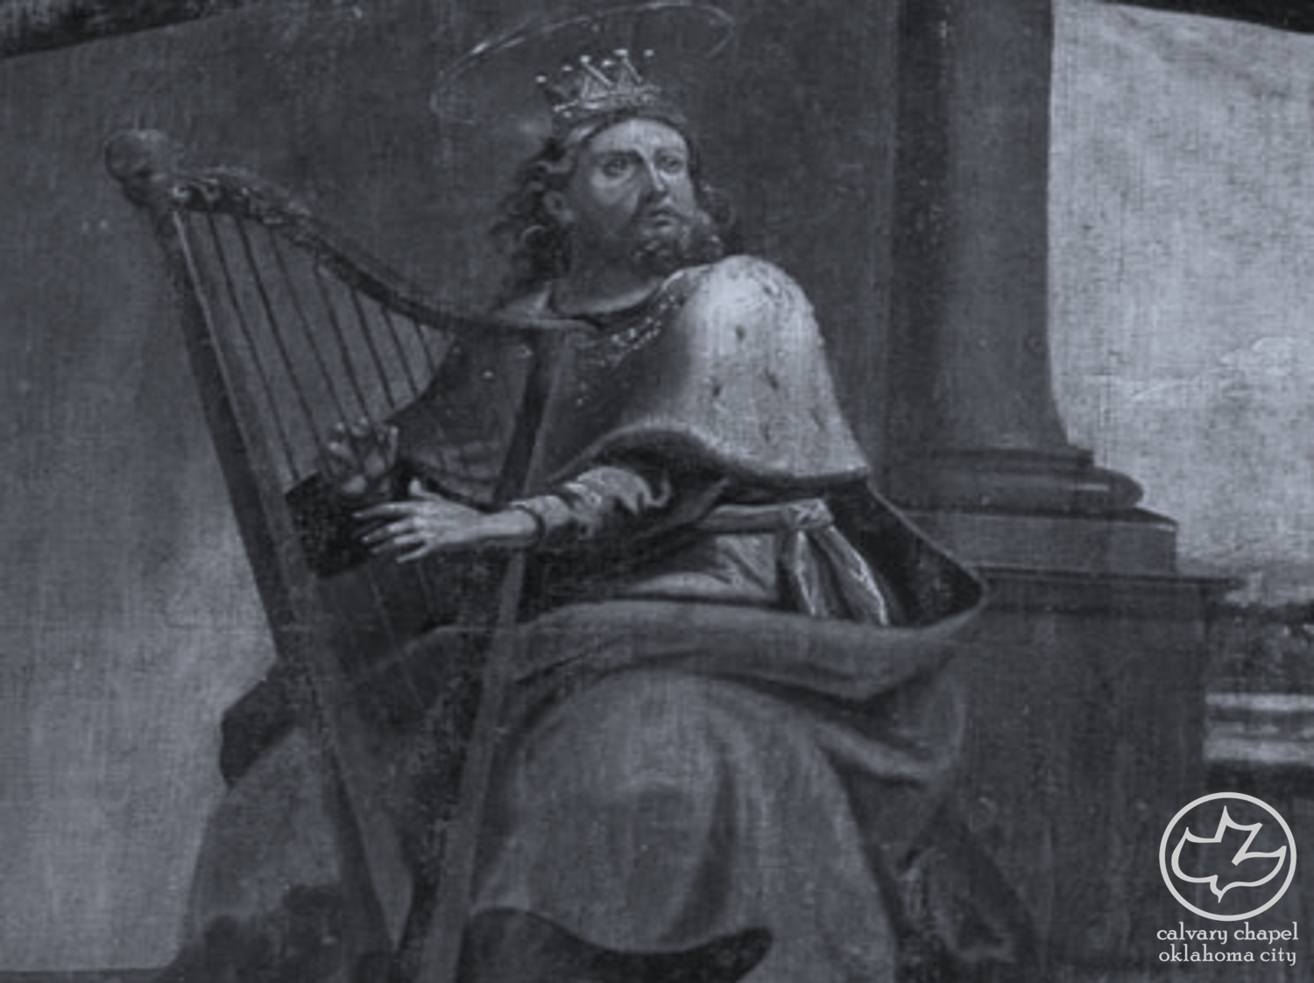
the book of
Psalms
40-41

Slide 4
the book of
Psalms
40-41
Waited patiently ~ literally, in waiting I waited
From a root meaning to bind (or twist)

Slide 5
the book of
Psalms
40-41

Slide 6
the book of
Psalms
40-41
Horrible ~ usually translated noise or tumult

Slide 7
the book of
Psalms
40-41
C. H. Spurgeon ~ “Our Lord in his anguish was like a captive in the oubliettes, forgotten of all mankind, immured amid horror, darkness, and desolation. Yet the Lord Jehovah made him to ascend from all his abasement; he retraced his steps from that deep hell of anguish into which he had been cast as our substitute. He who thus delivered our surety in extremis, will not fail to liberate us from our far lighter griefs.”

Slide 8
the book of
Psalms
40-41

Slide 9
the book of
Psalms
40-41
Opened ~ karaw – to dig
Deut 15:12-17 ~ ¹² If your brother, a Hebrew man, or a Hebrew woman, is sold to you and serves you six years, then in the seventh year you shall let him go free from you. ¹³ And when you send him away free from you, you shall not let him go away empty-handed; ¹⁴ you shall supply him liberally from your flock, from your threshing floor, and from your winepress. From what the Lord has blessed you with, you shall give to him. ¹⁵ You shall remember that you were a slave in the land of Egypt,
and the Lord your God redeemed you;

Slide 10
the book of
Psalms
40-41
Opened ~ karaw – to dig
Deut 15:12-17 ~ therefore I command you this thing today. ¹⁶ And if it happens that he says to you, ‘I will not go away from you,’ because he loves you and your house, since he prospers with you, ¹⁷ then you shall take an awl and thrust it through his ear to the door, and he shall be your servant forever. Also to your female servant you shall do likewise.
doulos ~ bond-servant

Slide 11
the book of
Psalms
40-41
Phil. 2:4-7 (Merrihew Standard Version) ~ ⁴ You are concerned with how things affect you … at the very least, think of others in the same way. ⁵ In fact, look at things in the same way that Jesus did during His time on earth. ⁶ For even though had the very nature of God, He never saw His deity as something He needed to defend or hold on to. ⁷ In fact, He completely set His rights as God aside as He showed Himself in complete indentureship to both man and the Father. In this, He revealed also His total humanity and when we looked at Him, this is what we saw.

Slide 12
the book of
Psalms
40-41

Slide 13
the book of
Psalms
40-41
Heb. 10:5-9 ~ ⁵ Therefore, when He came into the world, He said:
“Sacrifice and offering You did not desire,
But a body You have prepared for Me.
⁶ In burnt offerings and sacrifices for sin
You had no pleasure.
⁷ Then I said, ‘Behold, I have come —
In the volume of the book it is written of Me —
To do Your will, O God.’”
⁸ Previously saying, “Sacrifice and offering, burnt offerings, and offerings for sin You did not desire, nor had pleasure in them” (which are offered according to the law), ⁹ then He said, “Behold, I have come to do Your will, O God.” He takes away the first
that He may establish the second.

Slide 14
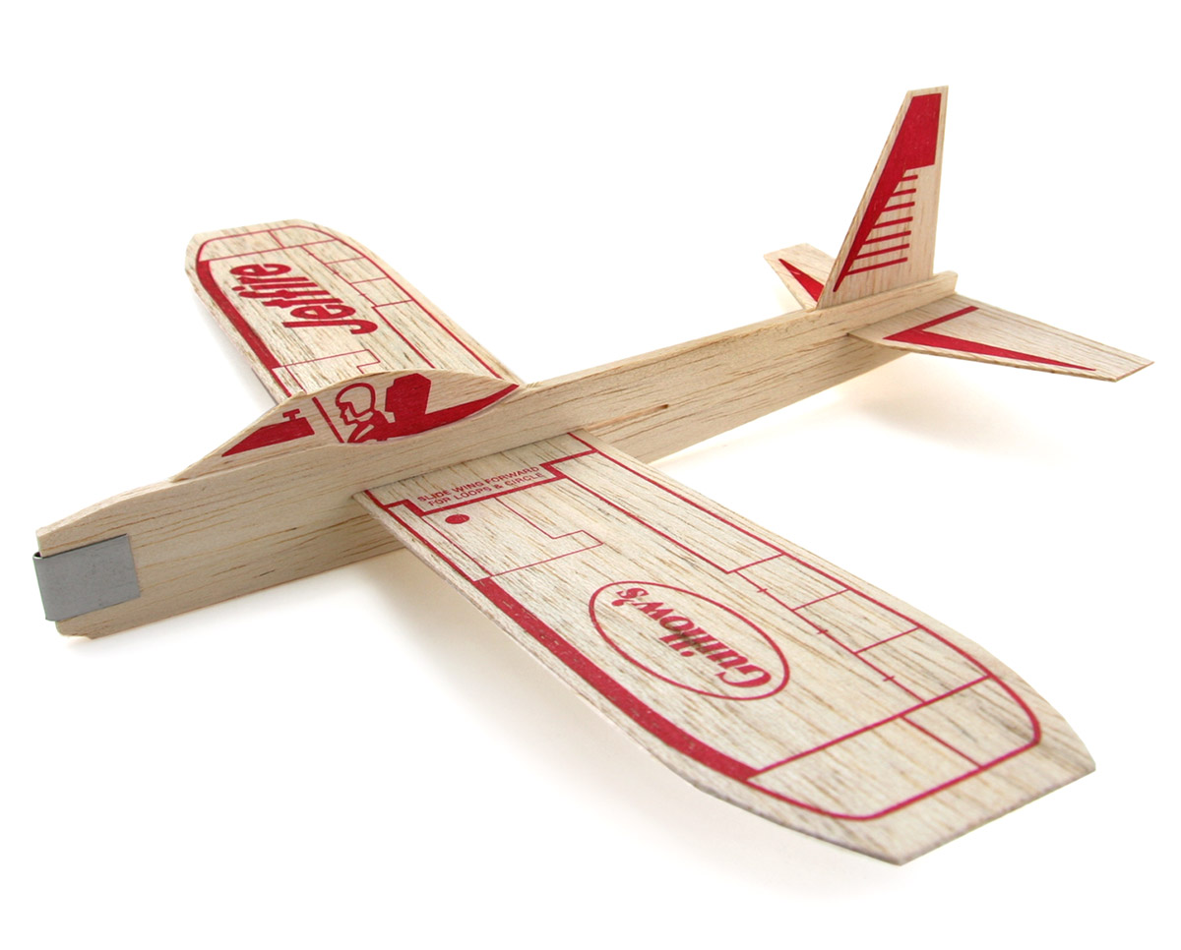
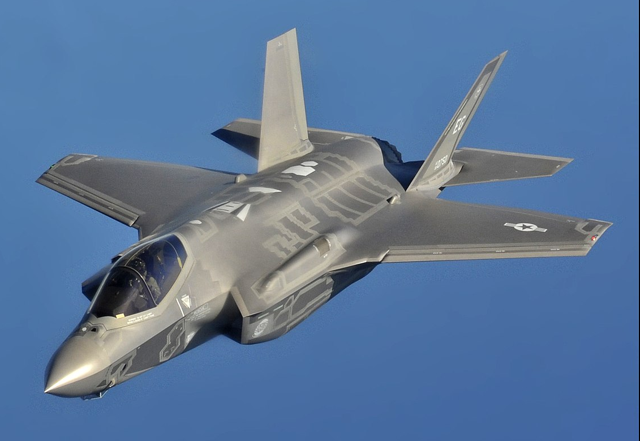
the book of
Psalms
40-41

Slide 15
the book of
Psalms
40-41

Slide 16
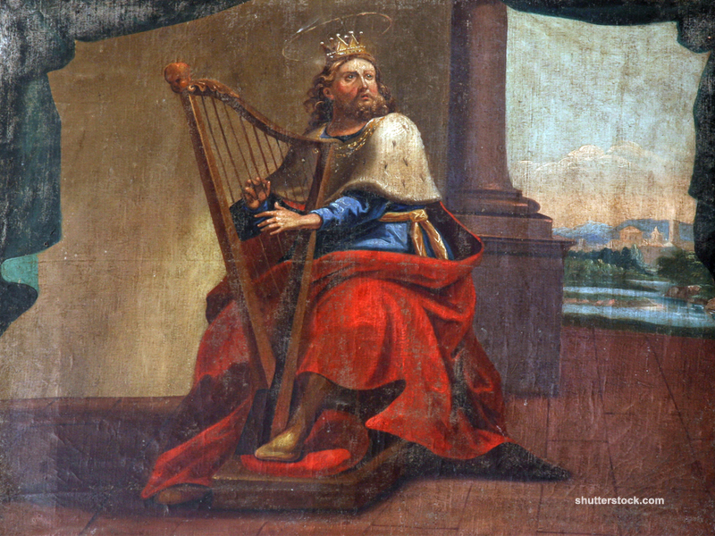
the book of
Psalms
40-41

Slide 17
the book of
Psalms
40-41

Slide 18
the book of
Psalms
40-41
Prov. 19:17 ~ He who has pity on the poor lends to the Lord,
And He will pay back what he has given.

Slide 19
the book of
Psalms
40-41

Slide 20
the book of
Psalms
40-41
John 13:18 ~ I do not speak concerning all of you. I know whom I have chosen; but that the Scripture may be fulfilled, “He who eats bread with Me has lifted up his heel against Me.”

Slide 21
the book of
Psalms
40-41

Slide 22
the book of
Psalms
40-41
Divided into 5 books
Book 1
Book 2
Book 3
Book 4
Book 5
1-41
Genesis
Foundations
42-72
Exodus
Redemption
73-89
Leviticus
Worship
90-106
Numbers
Wanderings
107-150
Deuteronomy
Promised Life

Slide 23
the book of
Psalms
40-41

