Slide 1
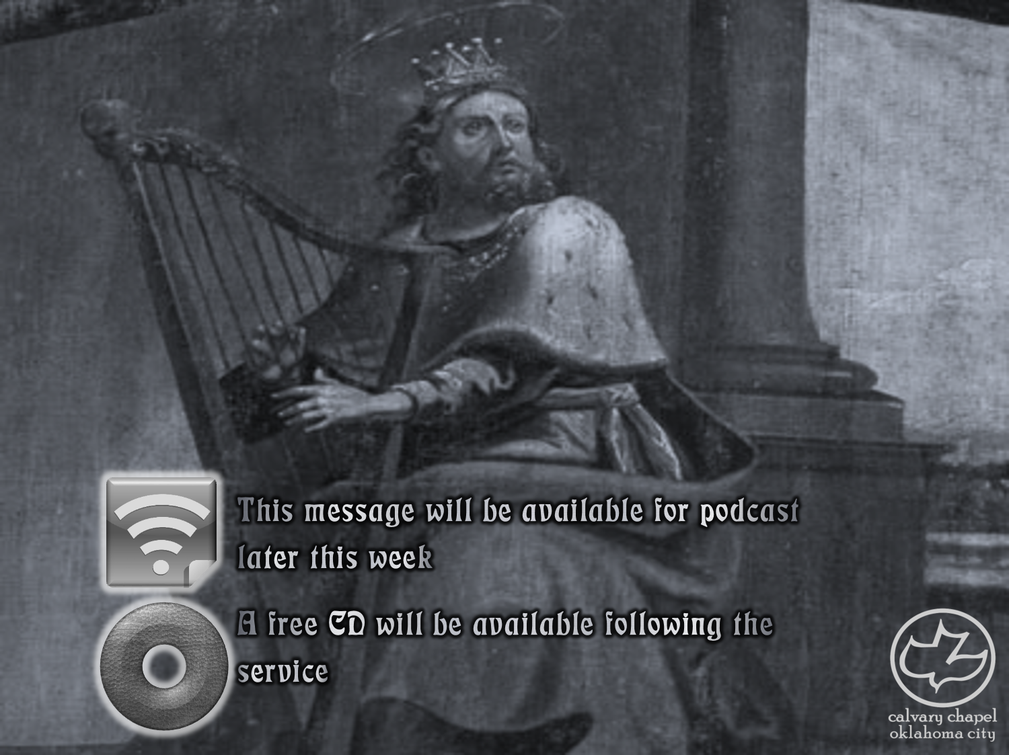

Psalms
the book of
37-39

Slide 2
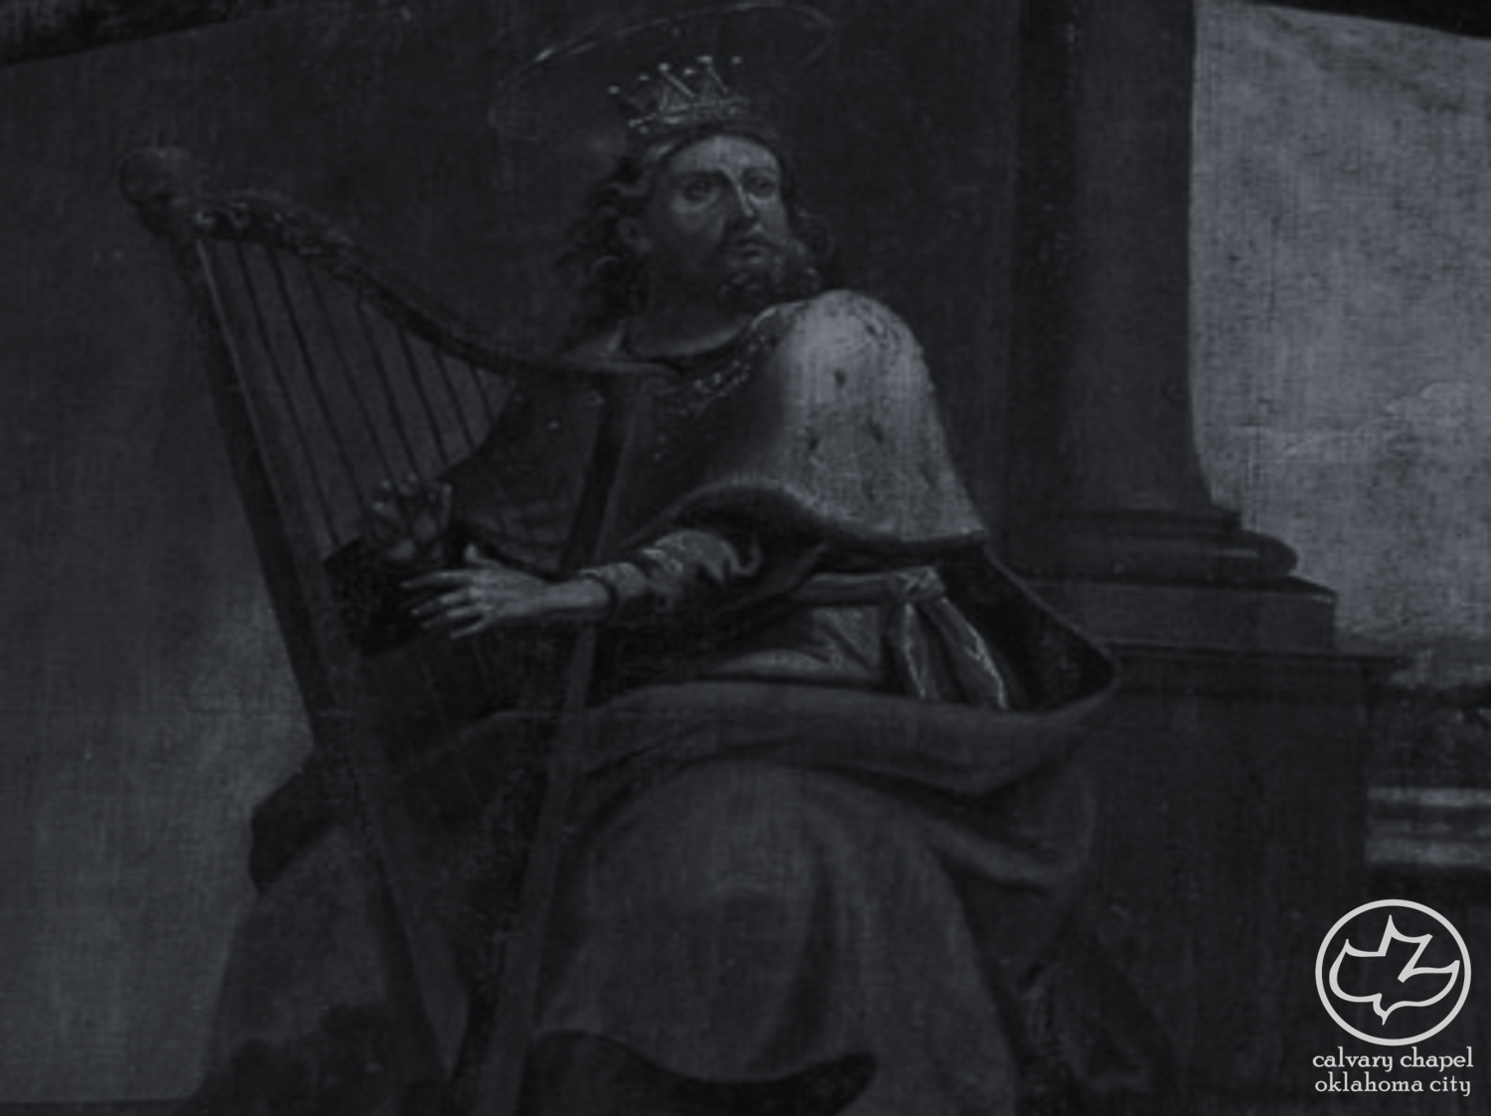
the book of
Psalms
37-39
Phil. 2:12-13 ~ ¹² Therefore, my beloved, as you have always obeyed, not as in my presence only, but now much more in my absence, work out your own salvation with fear and trembling; ¹³ for it is God who works in you both to will and to do for His good pleasure.

Slide 3
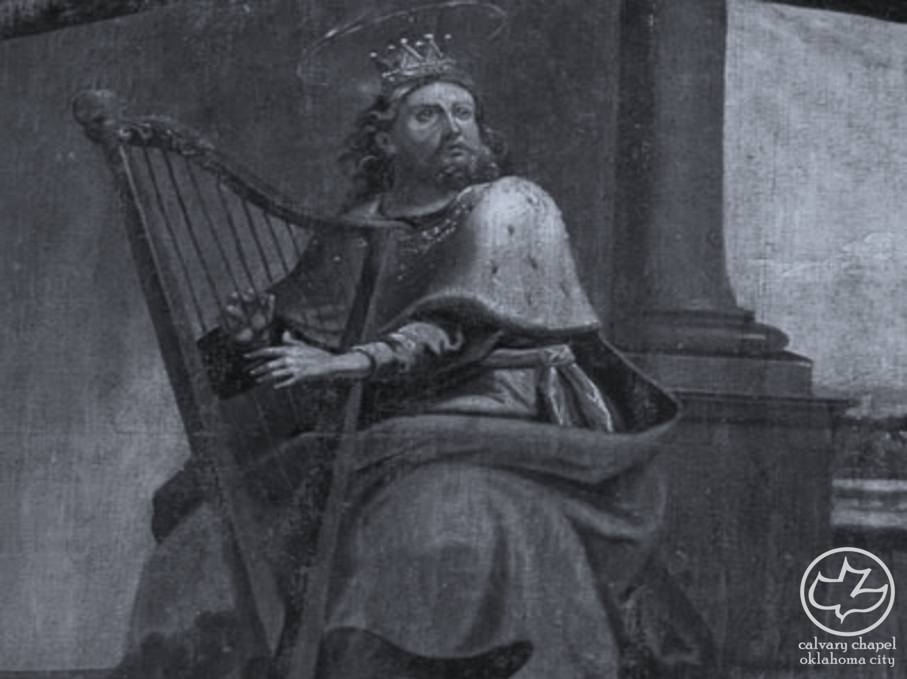
the book of
Psalms
37-39

Slide 4
the book of
Psalms
37-39
NLT ~ For the strength of the wicked will be shattered,

Slide 5
the book of
Psalms
37-39

Slide 6
the book of
Psalms
37-39
splendor of the meadows ~ KJV, fat of lambs

Slide 7
the book of
Psalms
37-39

Slide 8
the book of
Psalms
37-39
justice ~ not judgment (as in KJV)

Slide 9
the book of
Psalms
37-39

Slide 10
the book of
Psalms
37-39
Jer. 31:33 ~ But this is the covenant that I will make with the house of Israel after those days, says the Lord: I will put My law in their minds, and write it on their hearts; and I will be their God, and they shall be My people.

Slide 11
the book of
Psalms
37-39

Slide 12
the book of
Psalms
37-39
Read on Yom Kippur
3rd of the 7 “Penitential Psalms”

Slide 13
the book of
Psalms
37-39

Slide 14
the book of
Psalms
37-39
feeble ~ literally, to be made numb

Slide 15
the book of
Psalms
37-39

Slide 16
the book of
Psalms
37-39
Jeduthun ~ along with Asaph and Heman, they appear to be the main worship leaders appointed by David

Slide 17
the book of
Psalms
37-39
Dean John Perowne (1823-1904) ~ “The holy singer had long pent up his feelings; and though busy thoughts were stirring within him, he would not give them utterance. He could not bare his bosom to the rude gaze of an unsympathizing world. And he feared lest, while telling his perplexities, some word might drop from his lips which would give the wicked an occasion to speak evil against God. And when at last, unable to repress his strong emotion, he speaks to God and not to man, it is as one who feels how hopeless the problem of life is, except as seen in the light of God.”

Slide 18
the book of
Psalms
37-39

Slide 19
the book of
Psalms
37-39
muzzle ~ KJV, bridle
Things I wish I had said
Things I wish I had not said

Slide 20
the book of
Psalms
37-39

Slide 21
the book of
Psalms
37-39
Robert Murray M’Cheyne (1813-1843) ~ “Live so as to be missed.”

Slide 22
the book of
Psalms
37-39

Slide 23
the book of
Psalms
37-39
C. H. Spurgeon ~ “Think of eternity, and an angel is as a new–born babe, the world a fresh blown bubble, the sun a spark just fallen from the fire, and man a nullity. Before the Eternal, all the age of frail man is less than one ticking of a clock.”

Slide 24
the book of
Psalms
37-39

Slide 25
the book of
Psalms
37-39
KJV, Surely every man walketh in a vain shew:

Slide 26
the book of
Psalms
37-39

