Slide 1
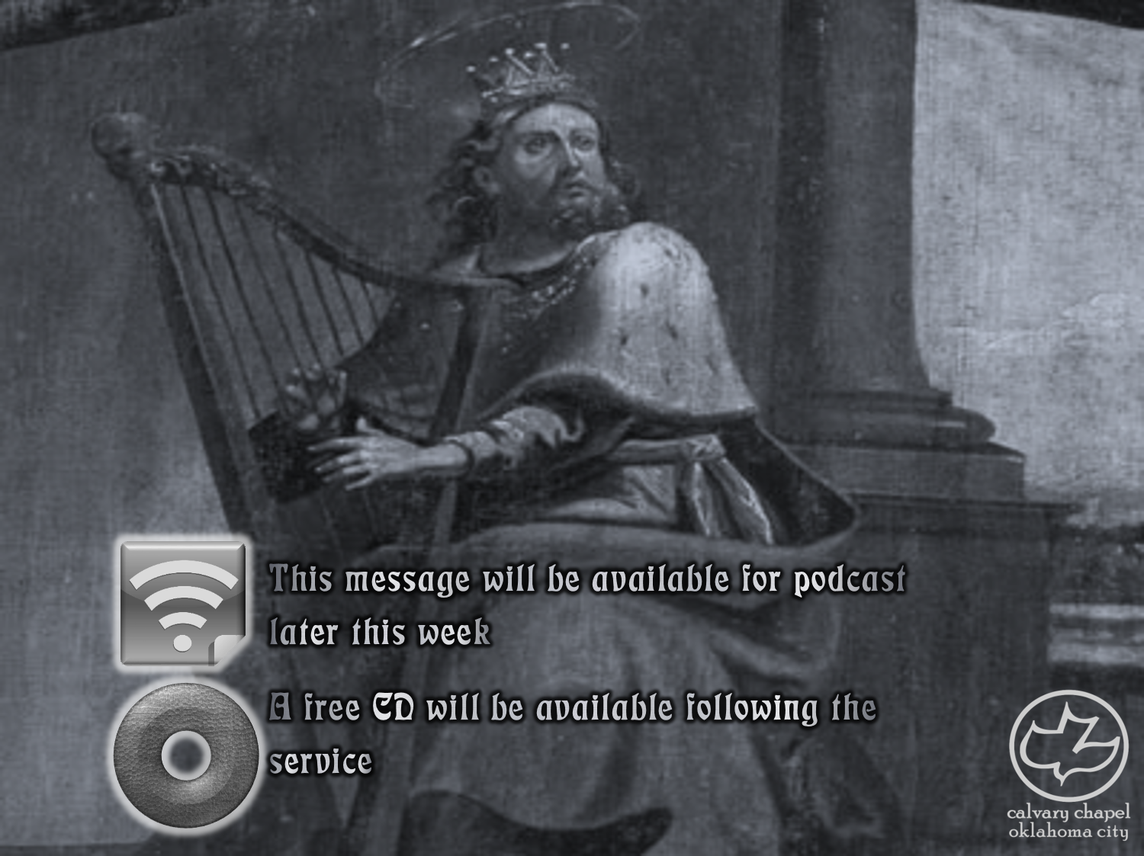

Psalms
the book of
34-36

Slide 2
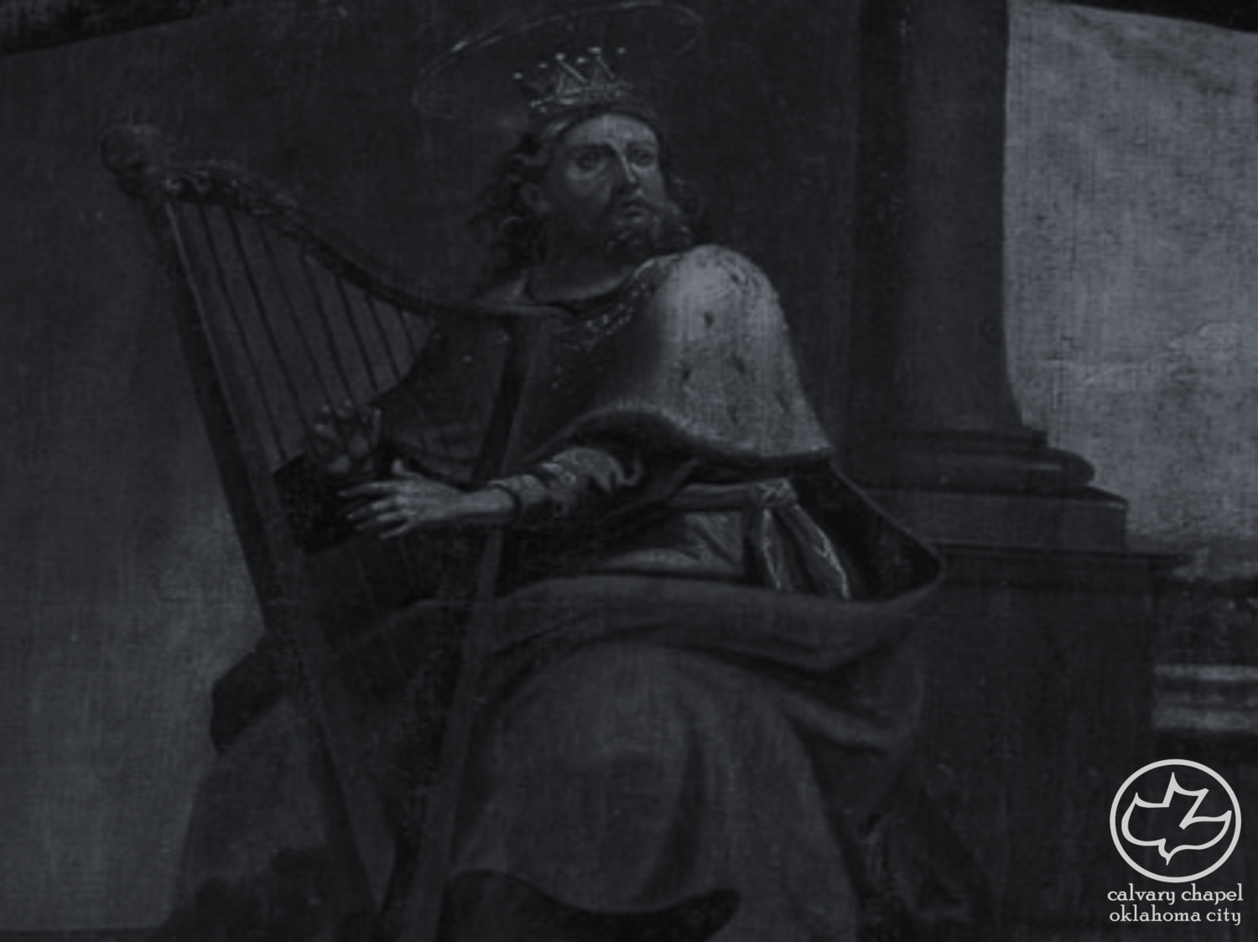
the book of
Psalms
34-36
Acrostic psalms
1. Aleph *************************
**********************************
**********************************
A Aleph
B Beth
G Gimel
D Daleth
2. Beth *************************
**********************************
**********************************
3. Gimel ************************
**********************************
**********************************

Slide 3
the book of
Psalms
34-36
Acrostic psalms
1. Aleph *************************
Aleph ***************************
Aleph ***************************
A Aleph
B Beth
G Gimel
D Daleth
2. Beth *************************
Beth ****************************
Beth ****************************
3. Gimel ************************
Gimel **************************
Gimel **************************

Slide 4
the book of
Psalms
34-36
Acrostic psalms
1. Aleph ************************
**********************************
**********************************
7. Gimel ***********************
**********************************
**********************************
A Aleph
B Beth
G Gimel
D Daleth
2. Aleph ************************
**********************************
**********************************
8. Gimel ***********************
**********************************
**********************************
3. Aleph ************************
**********************************
**********************************
9. Gimel ***********************
**********************************
**********************************
4. Beth *************************
**********************************
**********************************
10. Daleth **********************
**********************************
**********************************
5. Beth *************************
**********************************
**********************************
11. Daleth **********************
**********************************
**********************************
6. Beth *************************
**********************************
**********************************
12. Daleth **********************
**********************************
**********************************

Slide 5
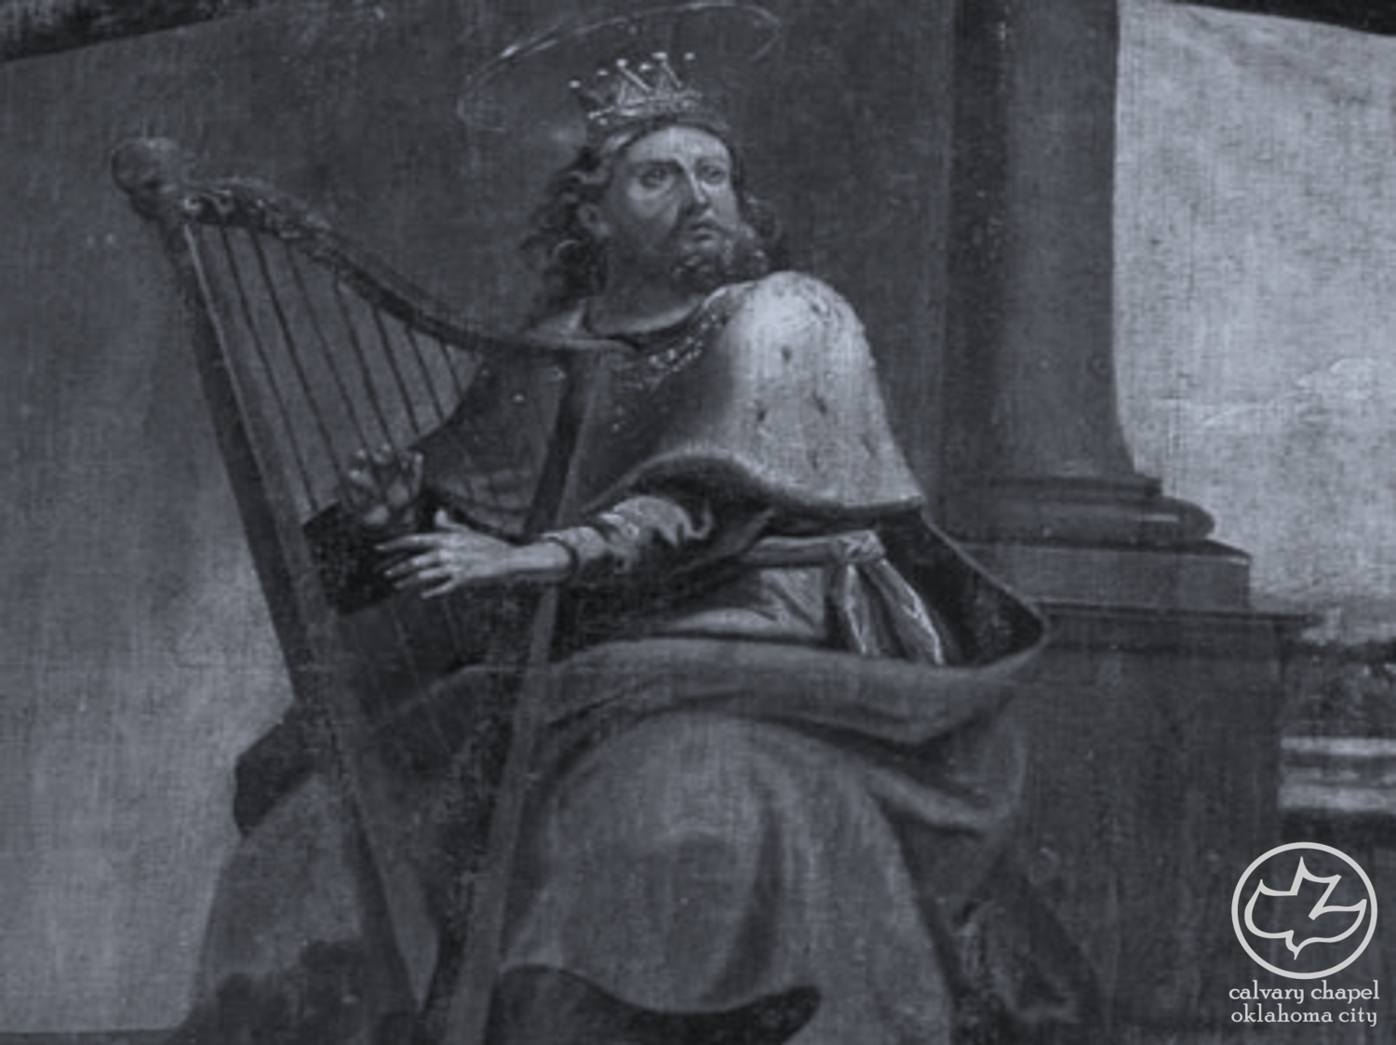
the book of
Psalms
34-36

Slide 6
the book of
Psalms
34-36
1 Sam. 21:10 ~ Then David arose and fled that day from Saul, and went to Achish king of Gath.
Abimelech is more of a title

Slide 7
the book of
Psalms
34-36

Slide 8
the book of
Psalms
34-36
C. H. Spurgeon – “Faith is the soul’s taste; they who test the Lord by their confidence always find him good, and they become themselves blessed.”

Slide 9
the book of
Psalms
34-36

Slide 10
the book of
Psalms
34-36
John 19:36 ~ For these things were done that the Scripture should be fulfilled, “Not one of His bones shall be broken.”

Slide 11
the book of
Psalms
34-36

Slide 12
the book of
Psalms
34-36
Imprecate ~ to wish harm upon; to invoke evil upon
Lev. 19:18 ~ You shall not take vengeance, nor bear any grudge against the children of your people, but you shall love your neighbor as yourself: I am the Lord.
Prov. 24:17 ~ Do not rejoice when your enemy falls,
And do not let your heart be glad when he stumbles;

Slide 13
the book of
Psalms
34-36

Slide 14
the book of
Psalms
34-36
Hyperbole ~ “A figure of speech in which exaggeration is used for emphasis or effect”
2 Chron. 1:15 ~ Also the king made silver and gold as common in Jerusalem as stones.
Matt. 5:30 ~ And if your right hand causes you to sin, cut it off and cast it from you;

Slide 15
the book of
Psalms
34-36

Slide 16
the book of
Psalms
34-36
Ps. 109:16-18 ~ ¹⁶ Because he did not remember to show mercy,
But persecuted the poor and needy man,
That he might even slay the broken in heart.
¹⁷ As he loved cursing, so let it come to him;
As he did not delight in blessing, so let it be far from him.
¹⁸ As he clothed himself with cursing as with his garment,
So let it enter his body like water,
And like oil into his bones.

Slide 17
the book of
Psalms
34-36

Slide 18
the book of
Psalms
34-36
Jesus pronounced “Woes” on Bethsaida, Chorazin and Capernaum (Matt. 11:20-24)
And the scribes and the Pharisees (Matt. 23:13-29)
1 Cor. 16:22 ~ If anyone does not love the Lord Jesus Christ, let him be accursed. (anathema)

Slide 19
the book of
Psalms
34-36

Slide 20
the book of
Psalms
34-36
Rev. 10:8-10 ~ ⁸ Then the voice which I heard from heaven spoke to me again and said, “Go, take the little book which is open in the hand of the angel who stands on the sea and on the earth.”
⁹ So I went to the angel and said to him, “Give me the little book.”
And he said to me, “Take and eat it; and it will make your stomach bitter, but it will be as sweet as honey in your mouth.”
¹⁰ Then I took the little book out of the angel’s hand and ate it, and it was as sweet as honey in my mouth. But when I
had eaten it, my stomach became bitter.

Slide 21
the book of
Psalms
34-36
John Piper ~ “There is a kind of hate for the sinner (viewed as morally corrupt and hostile to God) that may coexist with pity and even a desire for their salvation... [T]hat there comes a point of such extended, hardened, high-handed lovelessness toward God that it may be appropriate to call down anathema on it.”

Slide 22
the book of
Psalms
34-36

Slide 23
the book of
Psalms
34-36
Rev. 6:10 ~ And they cried with a loud voice, saying, “How long, O Lord, holy and true, until You judge and avenge our blood on those who dwell on the earth?”

Slide 24
the book of
Psalms
34-36

Slide 25
the book of
Psalms
34-36
NIV ~ my prayers returned to me unanswered…

Slide 26
the book of
Psalms
34-36

Slide 27
the book of
Psalms
34-36
NASB ~ Transgression speaks to the ungodly within his heart; (also the KJV)

Slide 28
the book of
Psalms
34-36

Slide 29
the book of
Psalms
34-36
fullness of Your house ~ KJV, fatness of Thy house
p
h
t
Spell that
a

Slide 30
the book of
Psalms
34-36

