Slide 1
Psalms
the book of
31-33

Slide 2
the book of
Psalms
31-33
vv. 1-8 ~ Trust and trials
vv. 9-18 ~ Overcoming trials through trust
vv. 9-18 ~ A triumphant trust

Slide 3
the book of
Psalms
31-33

Slide 4
the book of
Psalms
31-33
1 Sam. 17:45 ~ … “You come to me with a sword, with a spear, and with a javelin. But I come to you in the name of the LORD of hosts, the God of the armies of Israel, whom you have defied.”

Slide 5
the book of
Psalms
31-33

Slide 6
the book of
Psalms
31-33
Psalm 32 praises God for forgiveness of sin
Psalm 51 petitions God for forgiveness of sin

Slide 7
the book of
Psalms
31-33

Slide 8
the book of
Psalms
31-33
Contemplation ~ Maskil (NASB, NIV)
Literally, an instructive (didactic) poem
1st of 13 Maskils in the Psalms

Slide 9
the book of
Psalms
31-33

Slide 10
the book of
Psalms
31-33
transgression
~ willful rebellion
sin
~ falling short
iniquity
~ guilt (sin nature)

Slide 11
the book of
Psalms
31-33
Blessed ~ O how happy!
Psalm 1:1 ~ Blessed is the man
Who walks not in the counsel of the ungodly,
Nor stands in the path of sinners,
Nor sits in the seat of the scornful;

Slide 12
the book of
Psalms
31-33

Slide 13
the book of
Psalms
31-33
groaning ~ KJV, roaring – as a lion's roar

Slide 14
the book of
Psalms
31-33

Slide 15
the book of
Psalms
31-33
vitality ~ KJV, moisture
NLT ~ My strength evaporated like water in the summer heat.

Slide 16
the book of
Psalms
31-33

Slide 17
the book of
Psalms
31-33
Both LXX and Vulgate attribute it to David

Slide 18
the book of
Psalms
31-33

Slide 19
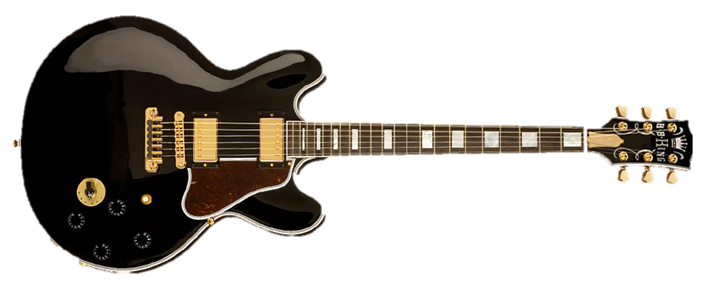
the book of
Psalms
31-33
harp ~ kinnowr
LXX ~ kithara – guitar
Lucille

Slide 20
the book of
Psalms
31-33

Slide 21
the book of
Psalms
31-33
shout of joy ~ KJV, loud noise
teruw’ah ~ sometimes translated alarm, blast, signal

Slide 22
the book of
Psalms
31-33

Slide 23
the book of
Psalms
31-33
C. H. Spurgeon – “Their persecutions, slanders, falsehoods, are like puff–balls flung against a granite wall—they produce no result at all; for the Lord overrules the evil, and brings good out of it. The cause of God is never in danger: infernal craft is outwitted by infinite wisdom, and satanic malice held in check by boundless power.”

Slide 24
the book of
Psalms
31-33

