Slide 1
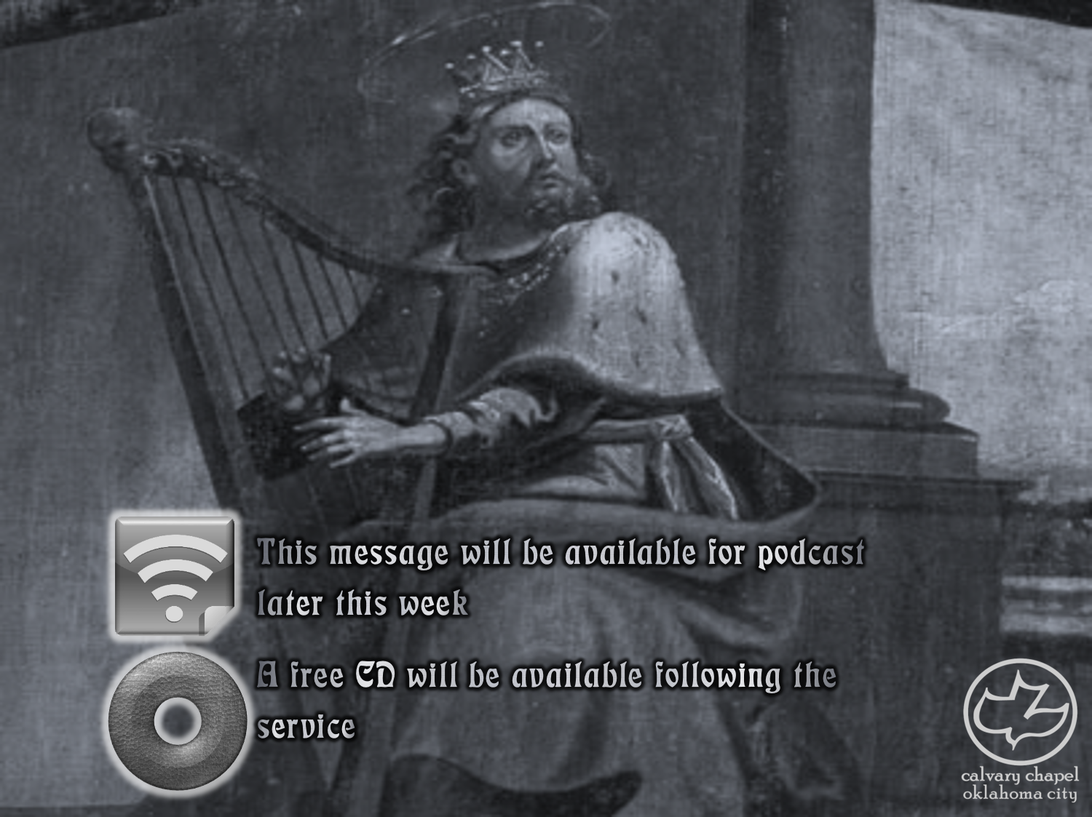

Psalms
the book of
27-30

Slide 2
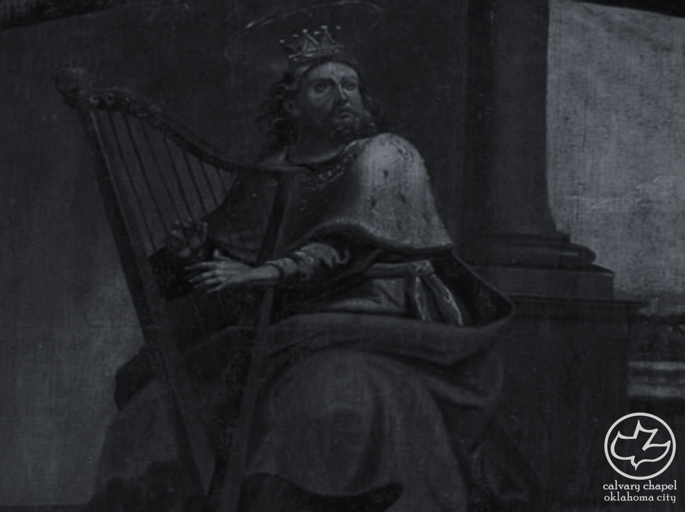
the book of
Psalms
27-30
Message ~ I’m asking GOD for one thing, only one thing:
To live with him in his house my whole life long.
I’ll contemplate his beauty;
I’ll study at his feet.

Slide 3
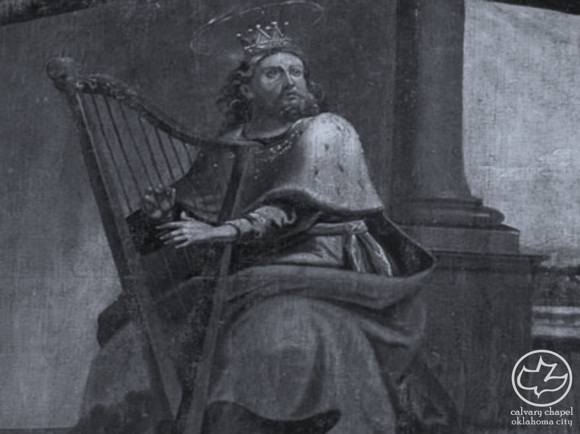
the book of
Psalms
27-30

Slide 4
the book of
Psalms
27-30
Beauty ~ no’am – pleasant (Naomi)

Slide 5
the book of
Psalms
27-30

Slide 6
the book of
Psalms
27-30
Wait ~ qavah – to wait or look eagerly for
1 Sam. 30:6b ~ But David strengthened (chazaq) himself in the Lord his God.

Slide 7
the book of
Psalms
27-30

Slide 8
the book of
Psalms
27-30
C. H. Spurgeon ~ “Mere formalists may be content without answers to their prayers, but genuine suppliants cannot; they are not satisfied with the results of prayer itself in calming the mind and subduing the will—they must go further and obtain actual replies from heaven, or they cannot rest.”

Slide 9
the book of
Psalms
27-30

Slide 10
the book of
Psalms
27-30
Deserve ~ KJV, their just desert

Slide 11
the book of
Psalms
27-30

Slide 12
the book of
Psalms
27-30
C. H. Spurgeon ~ “Prayer and praise are the two lips of the soul.”

Slide 13
the book of
Psalms
27-30

Slide 14
the book of
Psalms
27-30
Give ~ “give it up” – NIV; NASB, ascribe
mighty ones ~ literally, sons of God – i.e. angels
Message ~ Bravo, God, bravo!
Gods and all angels shout, “Encore!”

Slide 15
the book of
Psalms
27-30

Slide 16
the book of
Psalms
27-30
C. H. Spurgeon ~ “Thunder is in truth no mere electric phenomenon, but is caused by the interposition of God himself. Even the old heathen spake of Jupiter Tonans; but our modern wise men will have us believe in laws and forces, and anything or nothing so that they may be rid of God. Electricity of itself can do nothing; it must be called and sent upon its errand; and until the almighty Lord commissions it, its bolt of fire is inert and powerless. As well might a rock of granite, or a bar of iron fly in the midst of heaven, as the lightning go without being sent
by the great First Cause.”

Slide 17
the book of
Psalms
27-30

Slide 18
the book of
Psalms
27-30
Sirion ~ Mt. Hermon

Slide 19
the book of
Psalms
27-30

Slide 20
the book of
Psalms
27-30
deer give birth ~ NIV, twists the oaks
ESV footnote ~ “Revocalization yields ‘makes the oaks to shake.’”
“St p n th d m .”
i
e
e
o
i
e
o
o

Slide 21
the book of
Psalms
27-30

Slide 22
the book of
Psalms
27-30
Literally, A Psalm-Song ~ with or without musical accompaniment
Dedication ~ chanukah

Slide 23
the book of
Psalms
27-30

Slide 24
the book of
Psalms
27-30
Spurgeon – “Many a vessel founders in a calm. No temptation is so bad as tranquility.”

Slide 25
the book of
Psalms
27-30

Slide 26
the book of
Psalms
27-30
Psalm 1 ~ the Preface Psalm

Slide 27
the book of
Psalms
27-30

