Slide 1
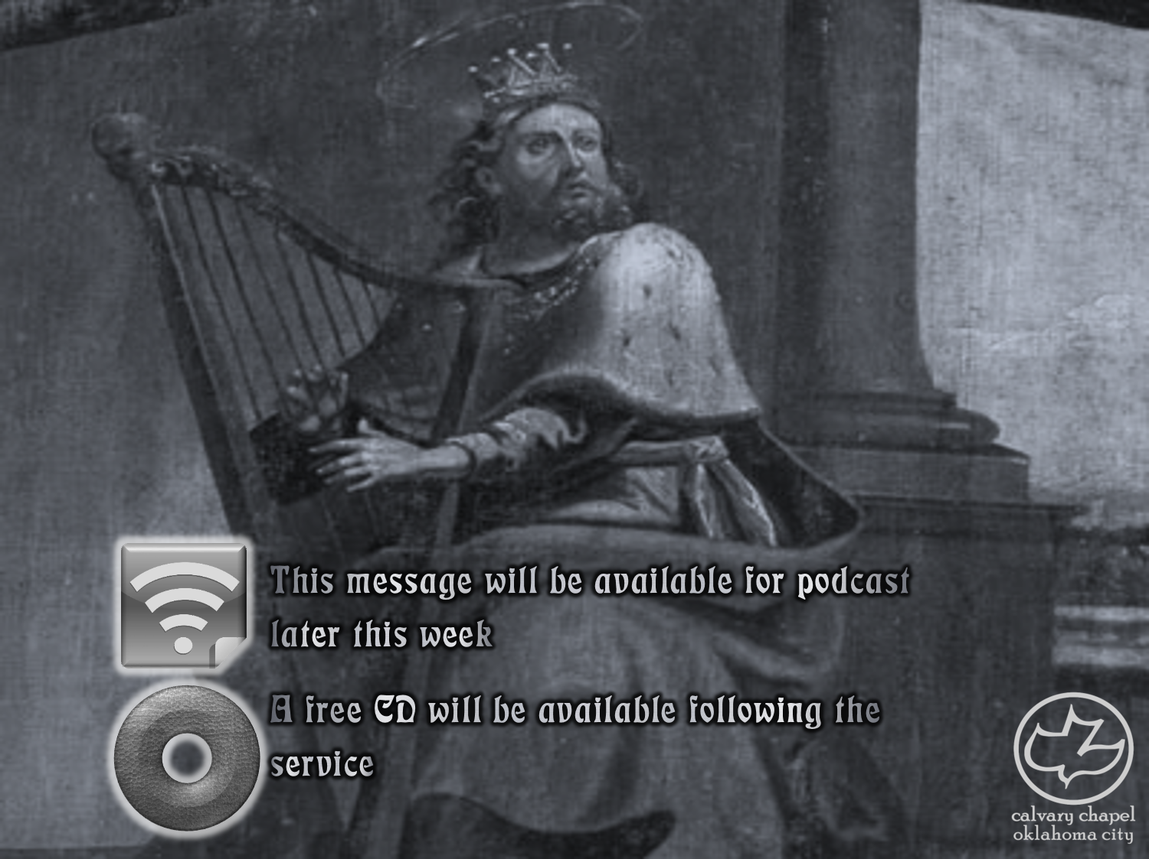

Psalms
the book of
24-26

Slide 2
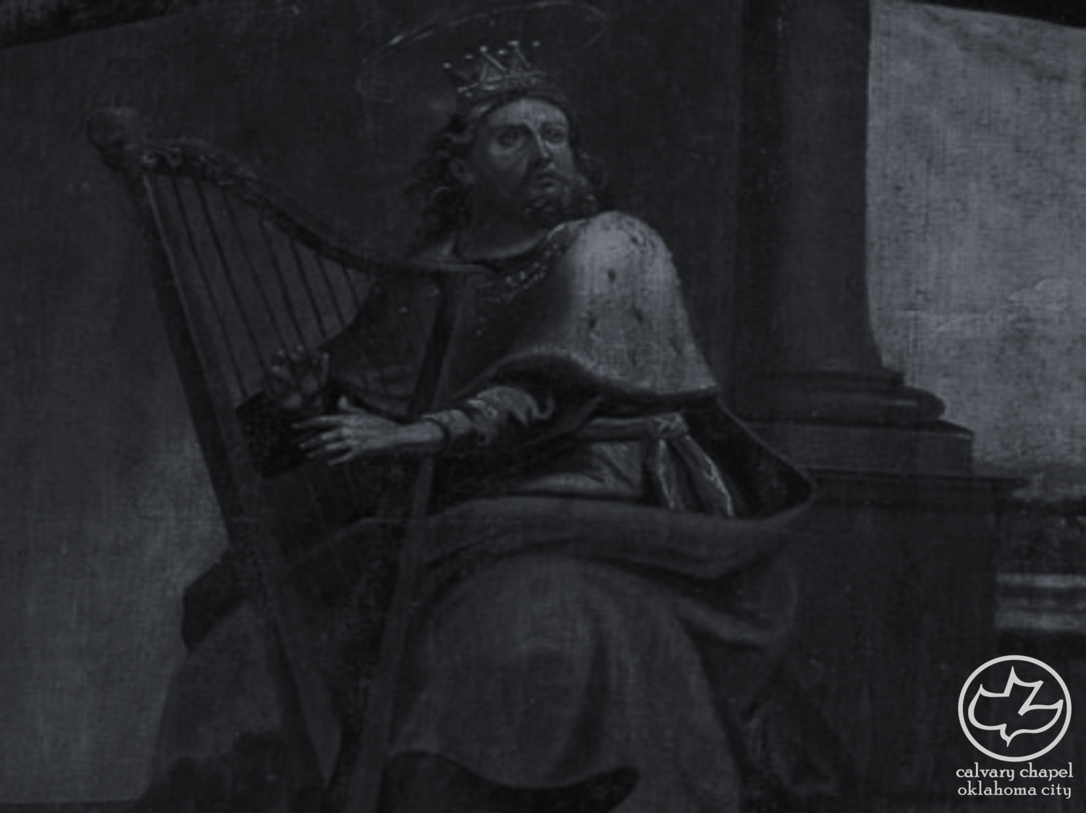
the book of
Psalms
24-26
Psalms 22-24 form a Messianic triad
Psalm 22 tells us what He did (He died for us)
Psalm 23 tells us what He is doing (He is our ever-present help)
Psalm 24 tells us what He is going to do

Slide 3
the book of
Psalms
24-26
Shir Shel Yom ~ Song of the Day of the Week
Monday ~ Psalm 24
Tuesday ~ Psalm 48
Wednesday ~ Psalm 82
Thursday ~ Psalm 94
Friday ~ Psalm 81
Saturday ~ Psalm 93
Sunday ~ Psalm 92

Slide 4
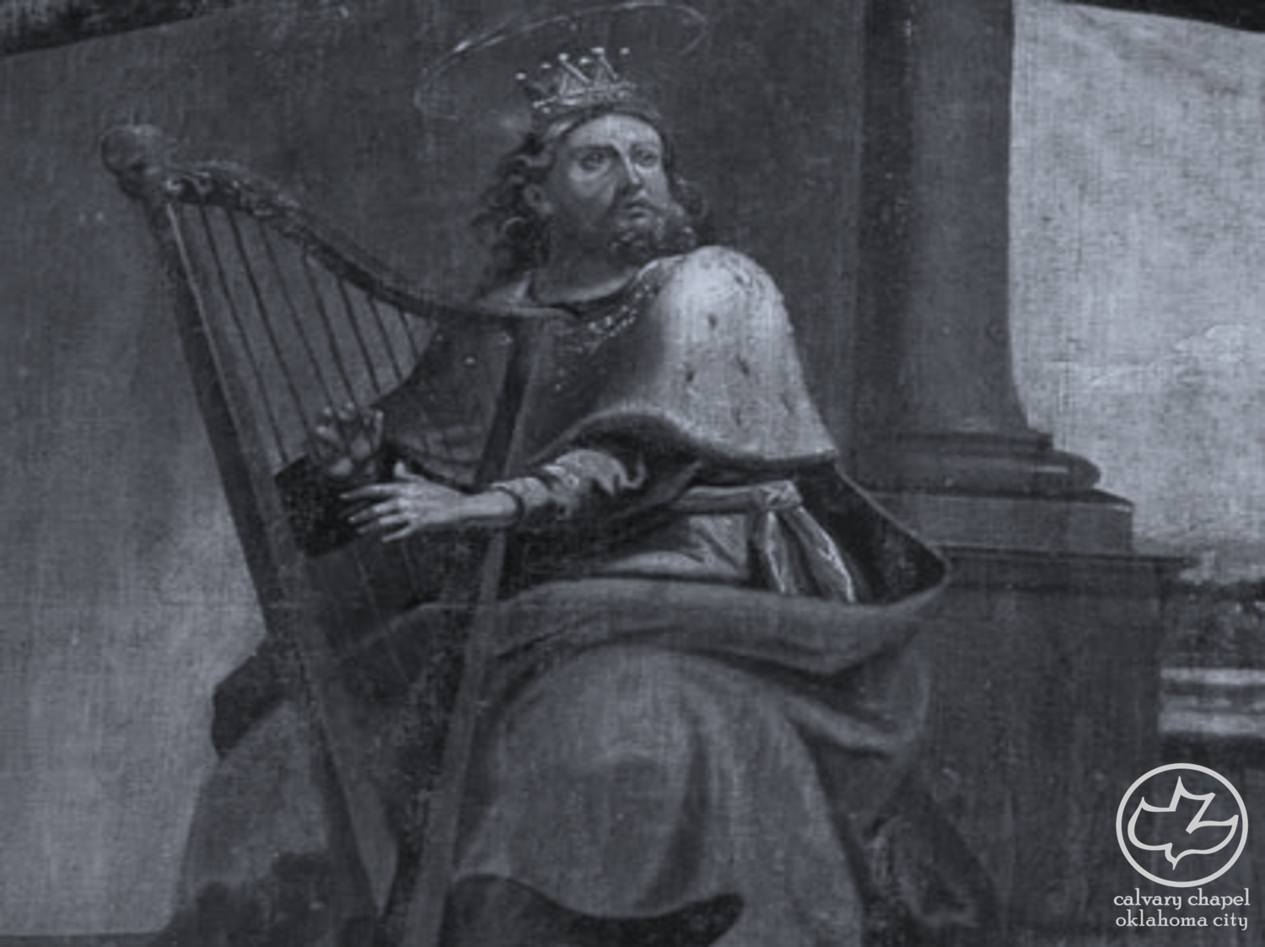
the book of
Psalms
24-26

Slide 5
the book of
Psalms
24-26
mercies ~ better, compassions
old ~ better everlasting
Living Bible ~ Overlook my youthful sins, O Lord! Look at me instead through eyes of mercy and forgiveness, through eyes of everlasting love and kindness.

Slide 6
the book of
Psalms
24-26

Slide 7
the book of
Psalms
24-26
C. H. Spurgeon ~ “The world winks at the sins of young men, and yet they are not so little after all; the bones of our youthful feastings at Satan’s table will stick painfully in our throats when we are old men. He who presumes upon his youth is poisoning his old age. How large a tear may wet this page as some of us reflect upon the past!”

Slide 8
the book of
Psalms
24-26

Slide 9
the book of
Psalms
24-26
secret ~ secret council; NIV, the Lord confides
C. H. Spurgeon ~ “This is a great secret. Carnal minds cannot guess what is intended by it, and even believers cannot explain it in words, for it must be felt to be known. The higher spiritual life is necessarily a path which the eagle’s eye hath not known, and which the lion’s whelp has not traveled; neither natural wisdom nor strength can force a door into this inner chamber. Saints have the key of heaven’s hieroglyphics; they can unriddle celestial enigmas. They are initiated into the fellowship of the skies;

Slide 10
the book of
Psalms
24-26
secret ~ secret council; NIV, the Lord confides
C. H. Spurgeon ~ they have heard words which it is not possible for them to repeat to their fellows.”

Slide 11
the book of
Psalms
24-26

Slide 12
the book of
Psalms
24-26
Vindicate ~ literally, Judge – KJV

Slide 13
the book of
Psalms
24-26

Slide 14
the book of
Psalms
24-26
mind ~ KJV, reins – literally, kidneys

Slide 15
the book of
Psalms
24-26

Slide 16
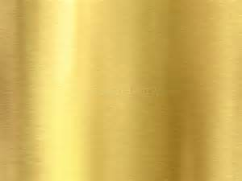

the book of
Psalms
24-26
chesed ~ 246x in Old Testament
50
100
150
200
chesed ~ 86x in Psalms

Slide 17
the book of
Psalms
24-26

Slide 18
the book of
Psalms
24-26
Glory ~ KJV, honor
kabade ~ from kabowd – to make heavy
NLT ~ I love your sanctuary, Lord, the place where your glorious presence dwells.

Slide 19
the book of
Psalms
24-26

