Slide 1
Psalms
the book of
22-23

Slide 2
the book of
Psalms
22-23
NASB ~ For the choir director; upon Aijeleth Hashshahar. A Psalm of David
Psalms 22-24 form a Messianic triad
Psalm 22 tells us what He did
Psalm 23 tells us what He is doing
Psalm 24 tells us what He is going to do

Slide 3
the book of
Psalms
22-23
C. H. Spurgeon ~ “It is the photograph of our Lord’s saddest hours, the record of his dying words, the lachrymatory of his last tears, the memorial of his expiring joys. David and his afflictions may be here in a very modified sense, but, as the star is concealed by the light of the sun, he who sees Jesus will probably neither see nor care to see David.”
1000
800
600
400
200
BC - AD
David
1035-961 BC
1st historical record
519 BC
Jesus crucifixion
33 AD

Slide 4
the book of
Psalms
22-23

Slide 5
the book of
Psalms
22-23
Mark 15:34 ~ And at the ninth hour Jesus cried out with a loud voice, saying, “Eloi, Eloi, lama sabachthani?” which is translated, “My God, My God, why have You forsaken Me?”

Slide 6
the book of
Psalms
22-23

Slide 7
the book of
Psalms
22-23
Matt. 27:45 ~ Now from the sixth hour until the ninth hour there was darkness over all the land.

Slide 8
the book of
Psalms
22-23

Slide 9
the book of
Psalms
22-23
C. H. Spurgeon ~ “What a contrast between ‘I am’ and ‘I am a worm’! yet such a double nature was found in the person of our Lord Jesus when bleeding on the tree.”
worm ~ tola or tola’ath – the crimson worm (coccus ilicis)

Slide 10
the book of
Psalms
22-23

Slide 11
the book of
Psalms
22-23
Matt. 27:39-44 ~ ³⁹ And those who passed by blasphemed Him, wagging their heads ⁴⁰ and saying, “You who destroy the temple and build it in three days, save Yourself! If You are the Son of God, come down from the cross.”
⁴¹ Likewise the chief priests also, mocking with the scribes and elders, said, ⁴² “He saved others; Himself He cannot save. If He is the King of Israel, let Him now come down from the cross, and we will believe Him. ⁴³ He trusted in God; let Him deliver Him now if He will have Him; for He said, ‘I am the Son of God.’”
⁴⁴ Even the robbers who were crucified with Him reviled
Him with the same thing.

Slide 12
the book of
Psalms
22-23

Slide 13
the book of
Psalms
22-23
KJV ~ It is melted in the midst of my bowels.

Slide 14
the book of
Psalms
22-23

Slide 15
the book of
Psalms
22-23
Bishop Richard Mant (1776-1848) ~ “Pour’d forth like water is my frame;
My bones asunder start;
As wax that feels the searching flame,
Within me melts my heart.
My wither’d sinews shrink unstrung
Like potsherd dried and dead:
Cleaves to my jaws my burning tongue
The dust of death my bed.”

Slide 16
the book of
Psalms
22-23
John Gill 1697-1771) ~ “If the heart of Christ, the Lion of the tribe of Judah, melted at it, what heart can endure or hands be strong, when God deals with them in his wrath?”

Slide 17
the book of
Psalms
22-23

Slide 18
the book of
Psalms
22-23
John 20:25-28 ~ The other disciples therefore said to him, “We have seen the Lord.”
So he said to them, “Unless I see in His hands the print of the nails, and put my finger into the print of the nails, and put my hand into His side, I will not believe.”
²⁶ And after eight days His disciples were again inside, and Thomas with them. Jesus came, the doors being shut, and stood in the midst, and said, “Peace to you!” ²⁷ Then He said to Thomas, “Reach your finger here, and look at My hands; and reach your hand here, and put it into
My side. Do not be unbelieving, but believing.”

Slide 19
the book of
Psalms
22-23
John 20:25-28 ~ And Thomas answered and said to Him, “My Lord and my God!”

Slide 20
the book of
Psalms
22-23

Slide 21
the book of
Psalms
22-23
Luke 23:35 ~ And the people stood looking on. But even the rulers with them sneered, saying, “He saved others; let Him save Himself if He is the Christ, the chosen of God.”

Slide 22
the book of
Psalms
22-23

Slide 23
the book of
Psalms
22-23
John. 19:23-24 ~ ²³ Then the soldiers, when they had crucified Jesus, took His garments and made four parts, to each soldier a part, and also the tunic. Now the tunic was without seam, woven from the top in one piece. ²⁴ They said therefore among themselves, "Let us not tear it, but cast lots for it, whose it shall be," that the Scripture might be fulfilled which says:
"They divided My garments among them,
And for My clothing they cast lots."
Therefore the soldiers did these things.

Slide 24
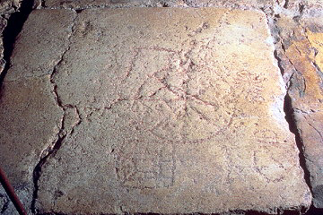
the book of
Psalms
22-23
“The King’s Game”

Slide 25
the book of
Psalms
22-23

Slide 26
the book of
Psalms
22-23
Wild oxen ~ KJV, unicorn

Slide 27
the book of
Psalms
22-23

Slide 28
the book of
Psalms
22-23
John 19:30 ~ So when Jesus had received the sour wine, He said, “It is finished!” And bowing His head, He gave up His spirit.
tetelestai ~ finished (perfect tense)
“Once and for all, never to be repeated, finished”
Wuest ~ He said, “It has been finished and stands complete.”

Slide 29
the book of
Psalms
22-23

Slide 30
the book of
Psalms
22-23
C. H. Spurgeon ~ “The position of this Psalm is worthy of notice. It follows the twenty–second, which is peculiarly the Psalm of the Cross. There are no green pastures, no still waters on the other side of the twenty–second Psalm. It is only after we have read, ‘My God, my God, why hast thou forsaken me!’ that we come to ‘The Lord is my Shepherd.’ We must by experience know the value of the blood–shedding, and see the sword awakened against the Shepherd, before we shall be able truly to know the sweetness of the good Shepherd’s care.”

Slide 31
the book of
Psalms
22-23

Slide 32
the book of
Psalms
22-23
C. H. Spurgeon ~ “I may not possess all that I wish for, but I shall not want. Others, far wealthier and wiser than I, may want, but I shall not. ‘The young lions do lack, and suffer hunger but they that seek the Lord shall not want any good thing.’ (Ps. 34:10) It is not only ‘I do not want,’ but ‘I shall not want.’ Come what may, if famine should devastate the land, or calamity destroy the city, ‘I shall not want.’ Old age with its feebleness shall not bring me any lack, and even death with its gloom shall not find me destitute. I have all things and abound; not because I
have a good store of money in the bank, not because I

Slide 33
the book of
Psalms
22-23
C. H. Spurgeon ~ have skill and wit with which to win my bread, but because 'The Lord is my Shepherd.' The wicked always want, but the righteous never; a sinner’s heart is far from satisfaction, but a gracious spirit dwells in the palace of content.”

Slide 34
the book of
Psalms
22-23

Slide 35
the book of
Psalms
22-23
pastures ~ the Word is our food
waters ~ life in the Spirit

Slide 36
the book of
Psalms
22-23

Slide 37
the book of
Psalms
22-23
pastures ~ He gives me rest
waters ~ He refreshes me
soul ~ He strengthens me
righteousness ~ He leads me

Slide 38
the book of
Psalms
22-23

Slide 39
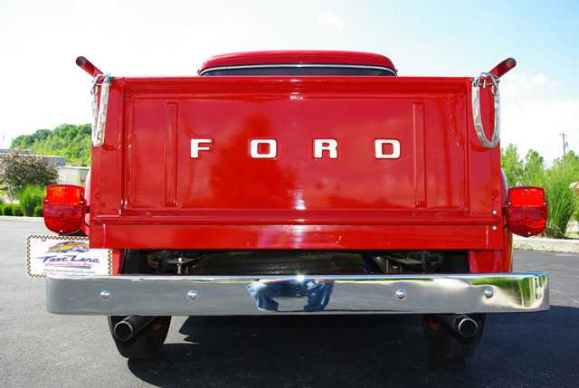
the book of
Psalms
22-23
C. H. Spurgeon ~ “Nobody is afraid of a shadow, for a shadow cannot stop a man’s pathway even for a moment. The shadow of a dog cannot bite; the shadow of a sword cannot kill; the shadow of death cannot destroy us.”

Slide 40
the book of
Psalms
22-23

