Slide 1
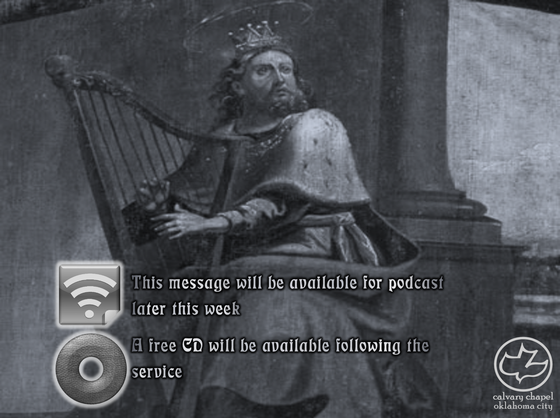

Psalms
the book of
19-21

Slide 2
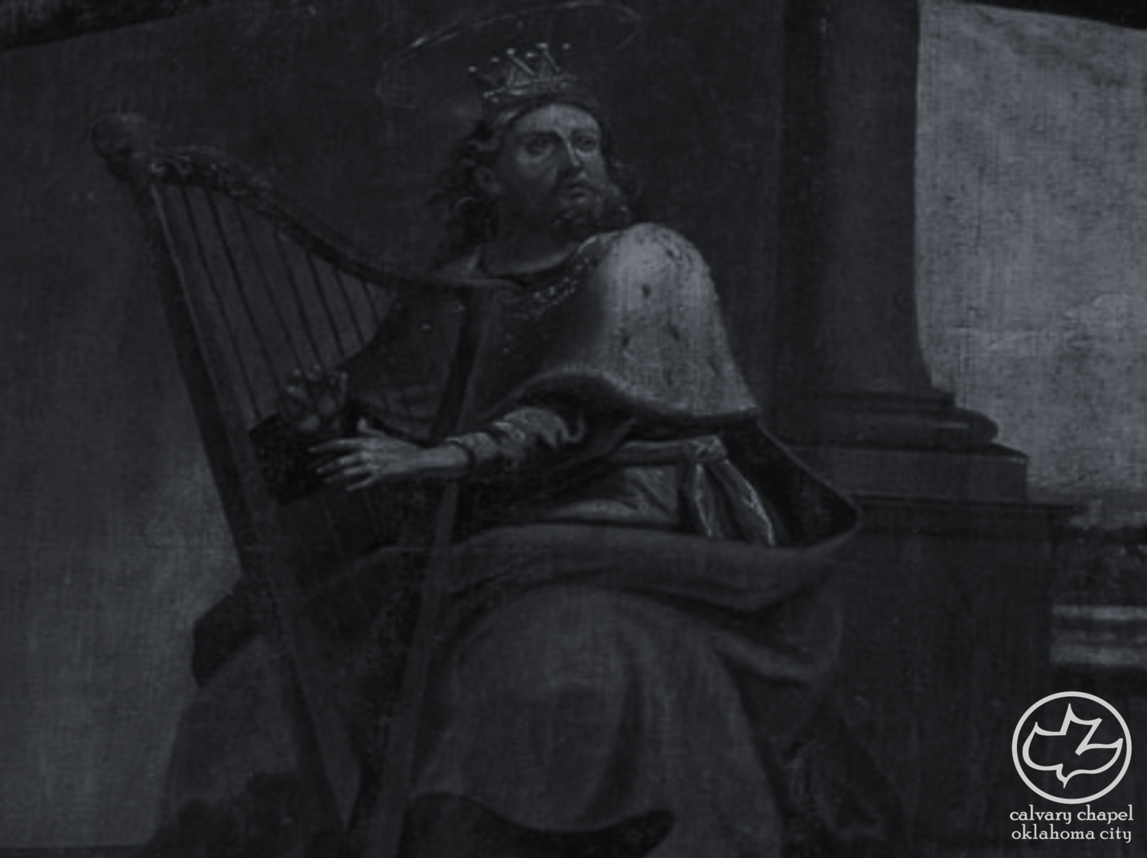
the book of
Psalms
19-21
C. H. Spurgeon ~ “In his earliest days the Psalmist, while keeping his father’s flock, had devoted himself to the study of God’s two great books—nature and Scripture; and he had so thoroughly entered into the spirit of these two only volumes in his library, that he was able with a devout criticism to compare and contrast them, magnifying the excellency of the Author as seen in both. How foolish and wicked are those who instead of accepting the two sacred tomes, and delighting to behold the same divine hand in each, spend all their wits in endeavoring to find discrepancies and contradictions.

Slide 3
the book of
Psalms
19-21
C. H. Spurgeon ~ We may rest assured that the true ‘Vestiges of Creation’ will never contradict Genesis, nor will a correct 'Cosmos' be found at variance with the narrative of Moses. He is wisest who reads both the world–book and the Word–book as two volumes of the same work, and feels concerning them, 'My Father wrote them both.’”

Slide 4
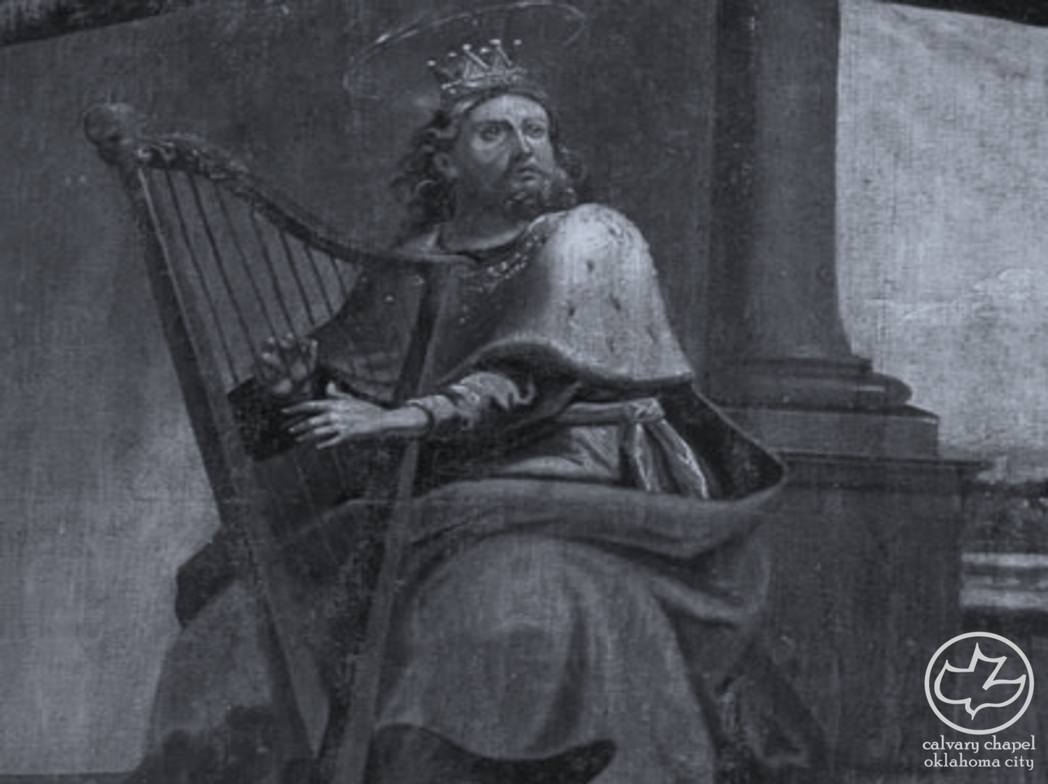
the book of
Psalms
19-21

Slide 5
the book of
Psalms
19-21
NASB ~ There is no speech, nor are there words; Their voice is not heard.

Slide 6
the book of
Psalms
19-21

Slide 7
the book of
Psalms
19-21
law ~ torah – instruction, direction
perfect ~ without error
converting ~ shuwb – NIV, reviving; literally to bring back
testimony ~ ‘eduwth – witness
sure ~ steadfast

Slide 8
the book of
Psalms
19-21

Slide 9
the book of
Psalms
19-21
statutes ~ piqquwd – precepts (NIV)
right ~ for our good
commandment ~ mitzvah
bar-mitzvah ~ son of the commandment
pure ~ cleansing

Slide 10
the book of
Psalms
19-21

Slide 11
the book of
Psalms
19-21
Jer. 17:9 ~ The heart is deceitful above all things,
And desperately wicked;
Who can know it?
Heb. 4:12-13 ~ ¹² For the word of God is living and powerful, and sharper than any two-edged sword, piercing even to the division of soul and spirit, and of joints and marrow, and is a discerner of the thoughts and intents of the heart. ¹³ And there is no creature hidden from His sight, but all things are naked and open to the eyes of Him to whom we must give account.

Slide 12
the book of
Psalms
19-21

Slide 13
the book of
Psalms
19-21
presumptuous ~ zēd – usually translated proud

Slide 14
the book of
Psalms
19-21

Slide 15
the book of
Psalms
19-21
C. H. Spurgeon ~ “Words of the mouth are mockery if the heart does not meditate; the shell is nothing without the kernel; but both together are useless unless accepted; and even if accepted by man, it is all vanity if not acceptable in the sight of God. We must in prayer view Jehovah as our strength enabling, and our Redeemer saving, or we shall not pray aright.”
Warren Wiersbe ~ “Meditation is to the heart what digestion is to the body; it is the taking in of the Word of God and making it a part of the inner being.”

Slide 16
the book of
Psalms
19-21

Slide 17
the book of
Psalms
19-21
C. H. Spurgeon ~ “Alas, how many in our day who profess to be the Lord’s are as abjectly dependent upon their fellow–men or upon an arm of flesh in some shape or other, as if they had never known the name of Jehovah at all. Jesus, be thou alone our rock and refuge, and never may we mar the simplicity of our faith.”

Slide 18
the book of
Psalms
19-21

Slide 19
the book of
Psalms
19-21
salvation ~ yeshua

Slide 20
the book of
Psalms
19-21

Slide 21
the book of
Psalms
19-21
offspring ~ literally, fruit (KJV)

Slide 22
the book of
Psalms
19-21

Slide 23
the book of
Psalms
19-21
Psalm 1 ~ the Preface Psalm

Slide 24
the book of
Psalms
19-21

