Slide 1
Psalms
the book of
16-18

Slide 2
the book of
Psalms
16-18
Michtam ~ technical musical term found in 6 Psalms
From a root meaning “to mark”
A Messianic Psalm

Slide 3
the book of
Psalms
16-18

Slide 4
the book of
Psalms
16-18
KJV ~ Thou art my Lord: my goodness extendeth not to thee…

Slide 5
the book of
Psalms
16-18

Slide 6
the book of
Psalms
16-18
NLT ~ The godly people in the land are my true heroes!
I take pleasure in them!

Slide 7
the book of
Psalms
16-18

Slide 8
the book of
Psalms
16-18
heart ~ KJV, reins – literally, kidneys
vv. 8-11 quoted by Peter in Acts 2:25-28 (LXX)

Slide 9
the book of
Psalms
16-18

Slide 10
the book of
Psalms
16-18
Sheol ~ KJV ~ hell
NIV ~ grave
NASB footnote ~ the nether world

Slide 11
the book of
Psalms
16-18

Slide 12
the book of
Psalms
16-18
Ps. 119:105 ~ Your word is a lamp to my feet
And a light to my path.

Slide 13
the book of
Psalms
16-18

Slide 14
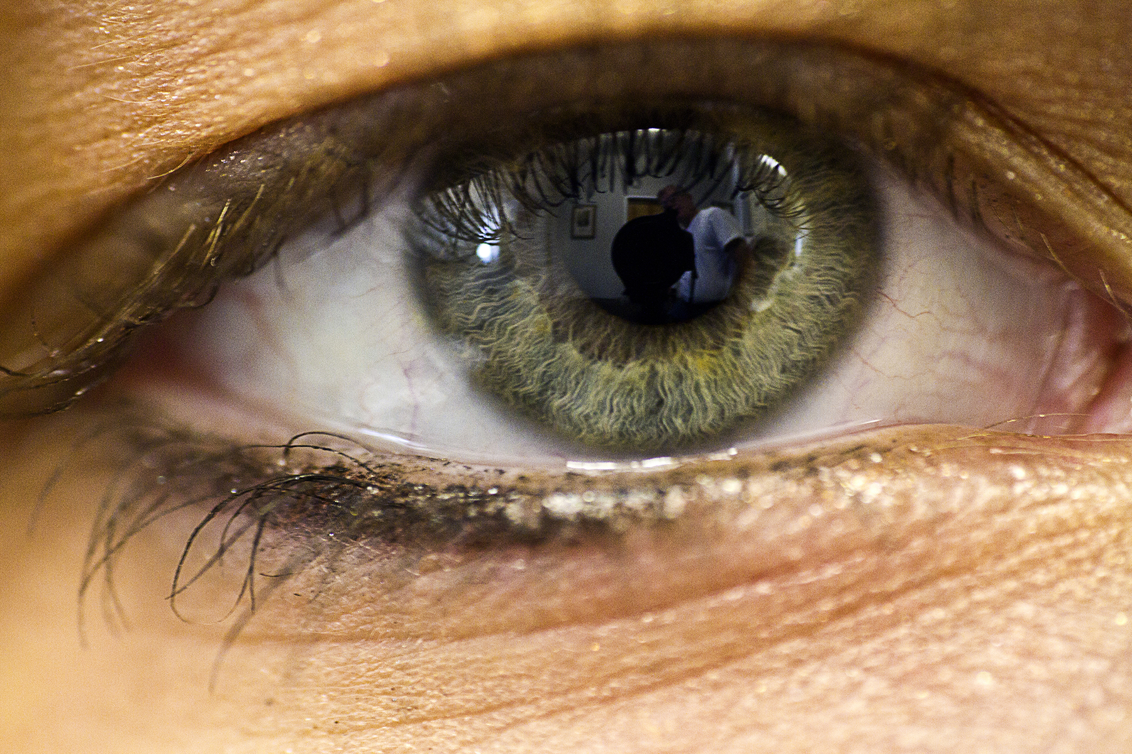
the book of
Psalms
16-18
apple of Your eye ~ literally, the little man of the eye

Slide 15
the book of
Psalms
16-18

Slide 16
the book of
Psalms
16-18
KJV ~ they are enclosed in their own fat:

Slide 17
the book of
Psalms
16-18

Slide 18
the book of
Psalms
16-18
C. H. Spurgeon ~ “To behold God’s face and to be changed by that vision into his image, so as to partake in his righteousness, this is my noble ambition; and in the prospect of this I cheerfully waive all my present enjoyments. My satisfaction is to come; I do not look for it as yet. I shall sleep awhile, but I shall wake at the sound of the trumpet; wake to everlasting joy, because I arise in thy likeness, O my God and King! Glimpses of glory good men have here below to stay their sacred hunger, but the full feast awaits them in the upper skies. Compared
with this deep, ineffable, eternal fullness of delight,

Slide 19
the book of
Psalms
16-18
C. H. Spurgeon ~ the joys of the worldling are as a glowworm to the sun, or the drop of a bucket to the ocean.”

Slide 20
the book of
Psalms
16-18

Slide 21
the book of
Psalms
16-18
To the Chief Musician. A Psalm of David The Servant of the Lord, Who Spoke to the Lord The Words of This Song on the Day that the Lord Delivered Him from the Hand of All His Enemies and from the Hand of Saul. And He Said:
Psalms of David

Slide 22
the book of
Psalms
16-18
YHWH (Yahweh) ~ 19x in this Psalm
Parallel with 2 Sam. 22

Slide 23
the book of
Psalms
16-18

Slide 24
the book of
Psalms
16-18
love ~ racham – usually translated mercy or compassionate

Slide 25
the book of
Psalms
16-18

Slide 26
the book of
Psalms
16-18
rock ~ sela; strength ~ tsur
Both mean “rock”

Slide 27
the book of
Psalms
16-18

Slide 28
the book of
Psalms
16-18
C. H. Spurgeon ~ “A godly man has a clear conscience, and knows himself to be upright; is he to deny his own consciousness, and to despise the work of the Holy Ghost, by hypocritically making himself out to be worse than he is? A godly man prizes his integrity very highly, or else he would not be a godly man at all; is he to be called proud because he will not readily lose the jewel of a reputable character? A godly man can see that in divine providence uprightness and truth are in the long run sure to bring their own reward; may he not, when he sees that reward bestowed in his own case, praise the Lord for it?”

Slide 29
the book of
Psalms
16-18

Slide 30
the book of
Psalms
16-18
YHWH ~ I AM that I AM or I Will Be Who I Will Be
He is the Becoming One

Slide 31
the book of
Psalms
16-18

Slide 32
the book of
Psalms
16-18
NIV ~ You stoop down to make me great

Slide 33
the book of
Psalms
16-18

