Slide 1
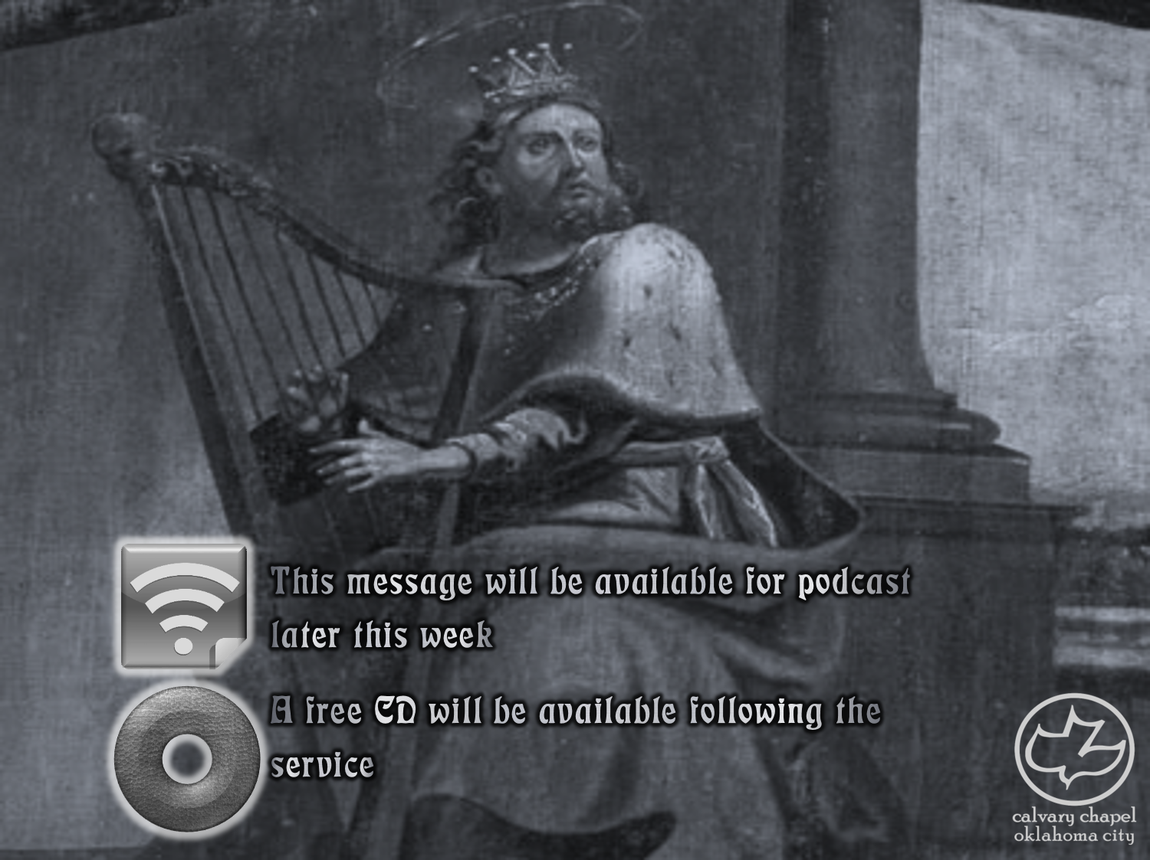

Psalms
the book of
12-15

Slide 2
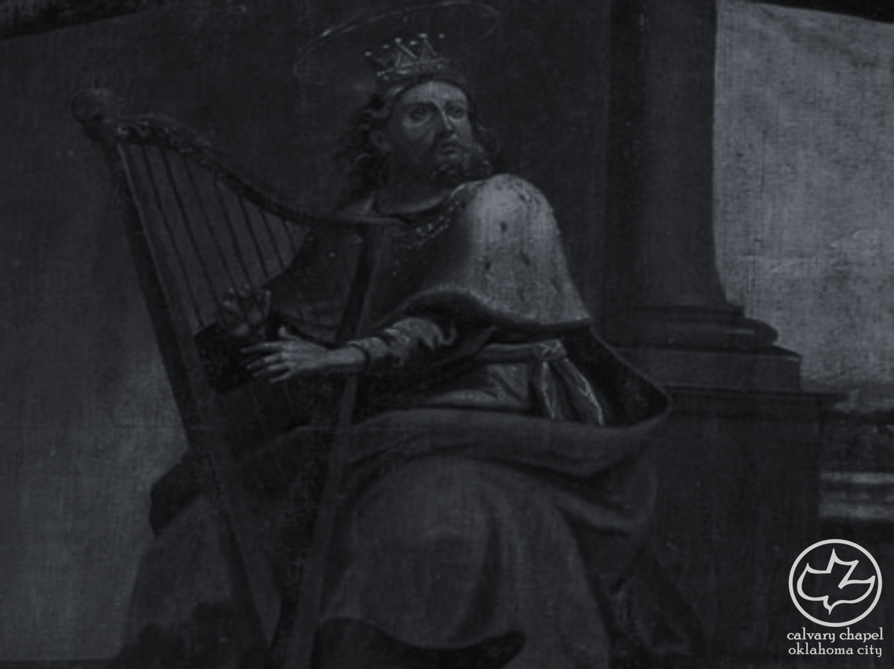

the book of
Psalms
12-15
Eight-Stringed Harp ~ sheminith – literally, upon the eight
o
o
o
Possibly an octave
o
o
o
o
o
Also Psalm 6
c d e f g a b c

Slide 3
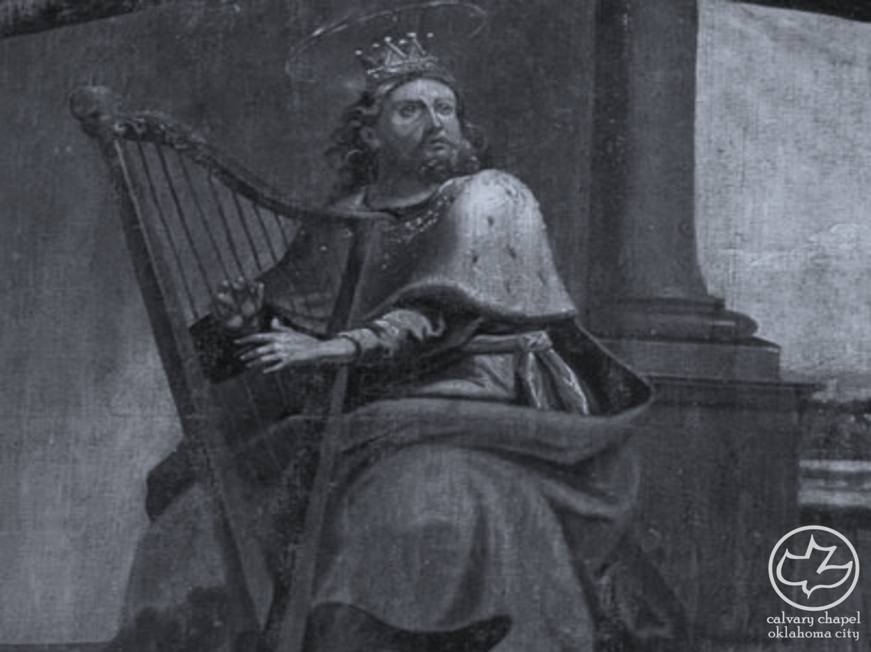
the book of
Psalms
12-15

Slide 4
the book of
Psalms
12-15
a double heart ~ literally, a heart and a heart

Slide 5
the book of
Psalms
12-15

Slide 6
the book of
Psalms
12-15
C. H. Spurgeon ~ “Strange is it that the easy yoke of the Lord should so gall the shoulders of the proud, while the iron bands of Satan they bind about themselves as chains of honor: they boastfully cry unto God, ‘Who is lord over us?’ and hear not the hollow voice of the evil one, who cries from the infernal lake, ‘I am your Lord, and right faithfully do ye serve me.’”

Slide 7
the book of
Psalms
12-15

Slide 8
the book of
Psalms
12-15
KJV ~ I will set him in safety from him that puffeth at him.

Slide 9
the book of
Psalms
12-15

Slide 10
the book of
Psalms
12-15
Rev. 5:9-10 ~ ⁹ When He opened the fifth seal, I saw under the altar the souls of those who had been slain for the word of God and for the testimony which they held. ¹⁰ And they cried with a loud voice, saying, “How long, O Lord, holy and true, until You judge and avenge our blood on those who dwell on the earth?”

Slide 11
the book of
Psalms
12-15

Slide 12
the book of
Psalms
12-15
C. H. Spurgeon ~ “Whenever you look into David’s Psalms, you may somewhere or another see yourselves. You never get into a corner but you find David in that corner. I think that I was never so low that I could not find that David was lower; and I never climbed so high that I could not find that David was up above me, ready to sing his song upon his stringed instrument, even as I could sing mine.”

Slide 13
the book of
Psalms
12-15

Slide 14
the book of
Psalms
12-15
Atheist ~ a (no, not) + theos (God)
C. H. Spurgeon ~ “The Atheist is the fool pre–eminently, and a fool universally. He would not deny God if he were not a fool by nature, and having denied God it is no marvel that he becomes a fool in practice.”
Fool ~ nabal (Nabal and Abigail – 1 Samuel 25)

Slide 15
the book of
Psalms
12-15
John Trapp (1601-1669) ~ “…that sapless fellow, that carcass of a man, that walking sepulcher of himself, in whom all religion and right reason is withered and wasted, dried up and decayed.”
Larry Norman (1947-2008) ~ “You're so open-
minded your brains leaked out.”

Slide 16
the book of
Psalms
12-15

Slide 17
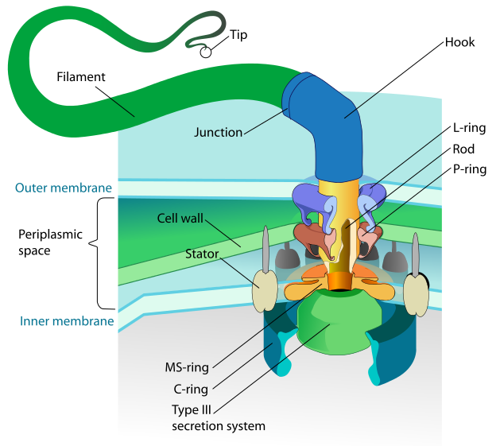
the book of
Psalms
12-15
20 nanometers (.00000002 meters)
Flagellum rotates between 6,000 – 17,000 rpms
Can change
directions in ¼
turn

Slide 18
the book of
Psalms
12-15

Slide 19
the book of
Psalms
12-15
C. H. Spurgeon ~ “Save only where grace reigns, there is none that doeth good; humanity, fallen and debased, is a desert without an oasis, a night without a star, a dunghill without a jewel, a hell without a bottom.”

Slide 20
the book of
Psalms
12-15

Slide 21
the book of
Psalms
12-15
C. H. Spurgeon ~ “Though truths, like roses, have thorns about them, good men wear them in their bosoms.”

Slide 22
the book of
Psalms
12-15

Slide 23
the book of
Psalms
12-15
2 Pet. 1:5-8 ~ ⁵ But also for this very reason, giving all diligence, add to your faith virtue, to virtue knowledge, ⁶ to knowledge self-control, to self-control perseverance, to perseverance godliness, ⁷ to godliness brotherly kindness, and to brotherly kindness love. ⁸ For if these things are yours and abound, you will be neither barren nor unfruitful in the knowledge of our Lord Jesus Christ.

Slide 24
the book of
Psalms
12-15

