Slide 1
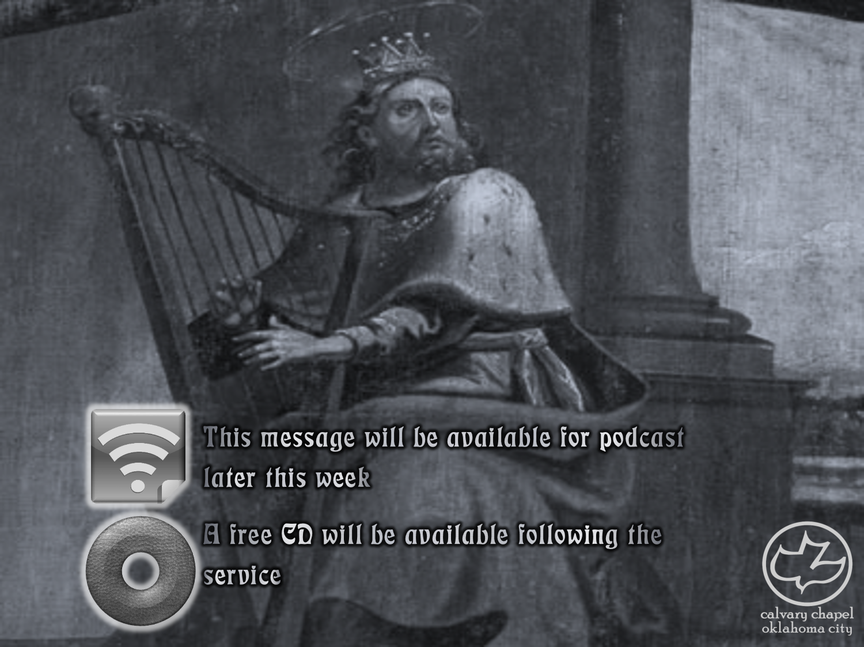

Psalms
the book of
09-11

Slide 2
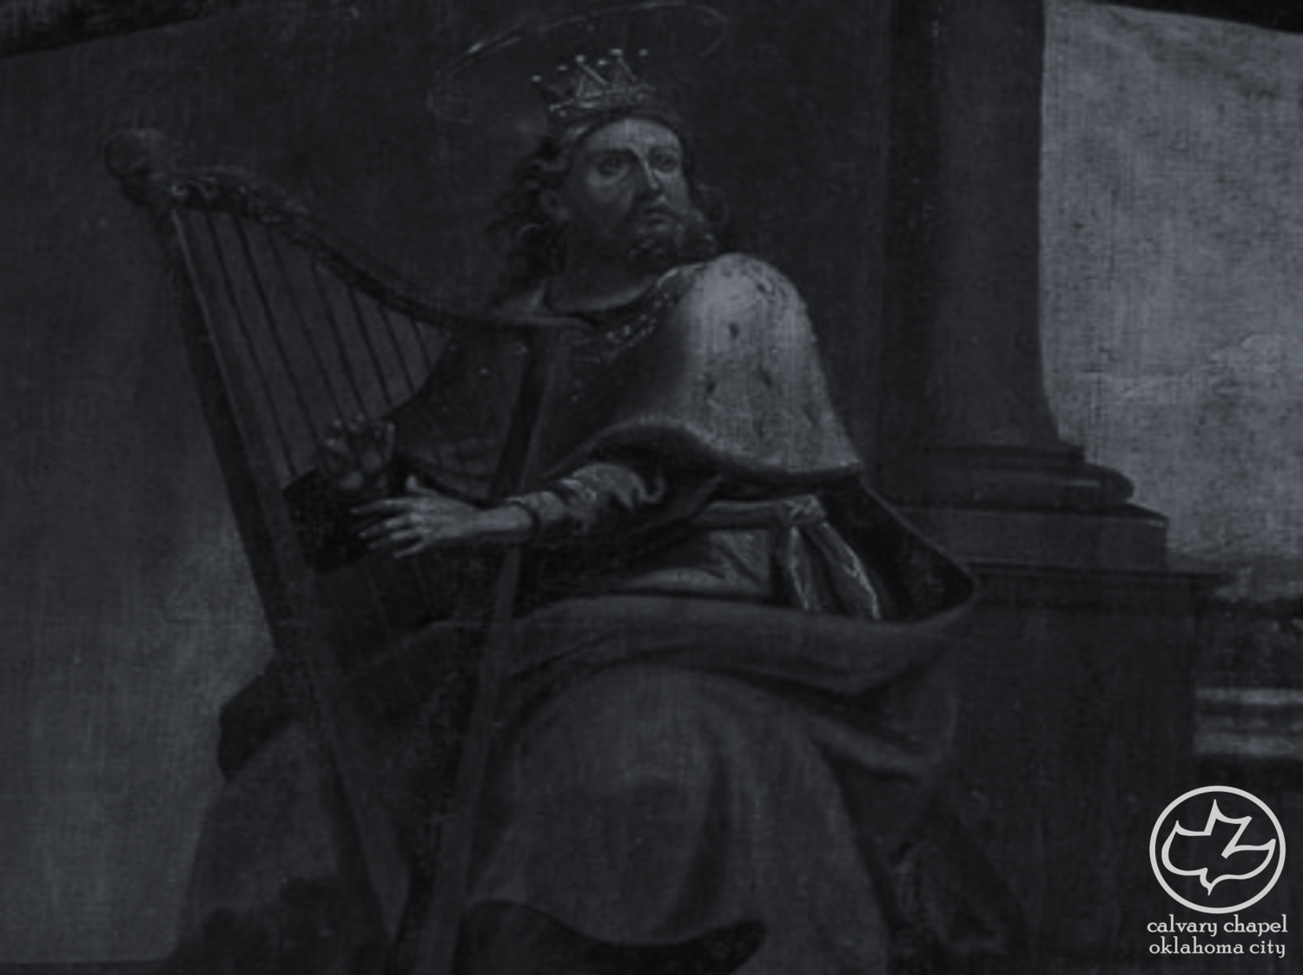
the book of
Psalms
09-11
Psalms 9 and 10 form one Psalm in LXX and Vulgate

Slide 3
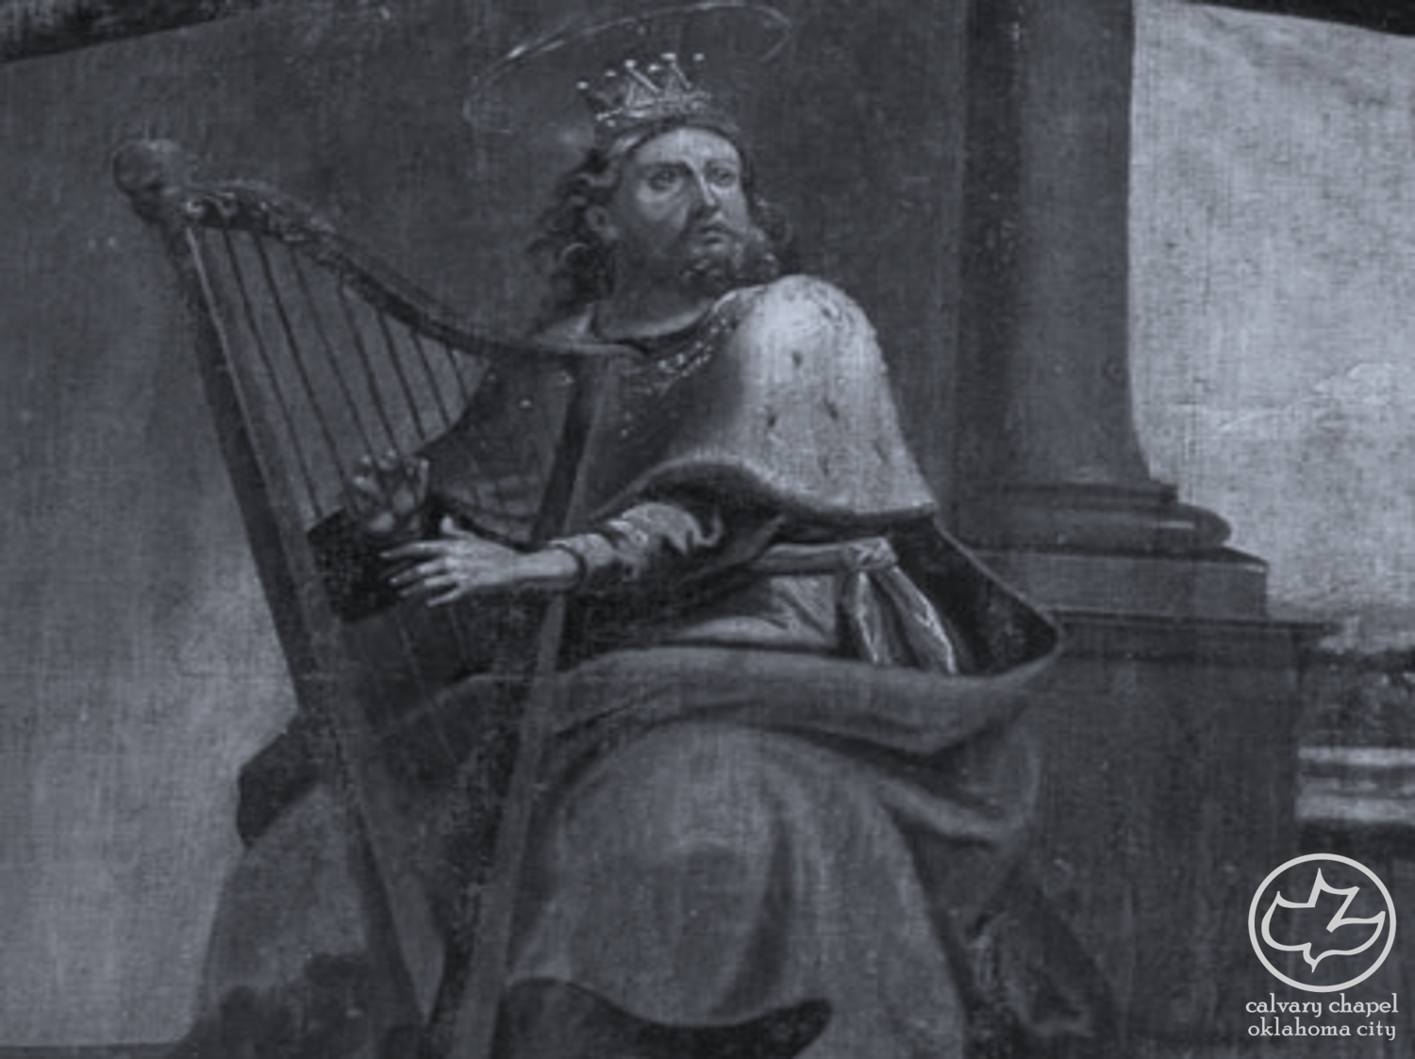
the book of
Psalms
09-11

Slide 4
the book of
Psalms
09-11
Title ~ Muth-labben – NASB, KJV
Targum ~ “concerning the death of the champion who went out between the armies.”

Slide 5
the book of
Psalms
09-11

Slide 6
the book of
Psalms
09-11
nations ~ goyim – gentiles
KJV, heathen

Slide 7
the book of
Psalms
09-11

Slide 8
the book of
Psalms
09-11
John 6:37 ~ All that the Father gives Me will come to Me, and the one who comes to Me I will by no means cast out.

Slide 9
the book of
Psalms
09-11

Slide 10
the book of
Psalms
09-11
C. H. Spurgeon ~ “Saints are not so selfish as to look only to self; they desire mercy’s diamond that they may let others see it flash and sparkle, and may admire Him who gives such priceless gems to his beloved.”

Slide 11
the book of
Psalms
09-11

Slide 12
the book of
Psalms
09-11
Meditation ~ Higgaion (KJV, NASB, NIV)
Adam Clarke ~ “There is nothing that a wicked man does that is not against his own interest. He is continually doing himself harm, and takes more pains to destroy his soul than the righteous man does to get his saved unto eternal life. This is a weighty truth; and the psalmist adds: Higgaion; Selah. Meditate on this; mark it well.”

Slide 13
the book of
Psalms
09-11

Slide 14
the book of
Psalms
09-11
hell ~ NIV, NLT – grave; NASB – sheol

Slide 15
the book of
Psalms
09-11

Slide 16
the book of
Psalms
09-11
Ps. 46:1 ~ God is our refuge and strength,
A very present help in trouble.

Slide 17
the book of
Psalms
09-11

Slide 18
the book of
Psalms
09-11
Break the arm ~ i.e. stop his power

Slide 19
the book of
Psalms
09-11

Slide 20
the book of
Psalms
09-11
Charles Simeon (1759-1836) – “The Psalms are a rich repository of experimental knowledge. David, at the different periods of his life, was placed in almost every situation in which a believer, whether rich or poor, can be placed; and in these heavenly compositions he delineates all the workings of the heart. He introduces, too, the sentiments and conduct of the various persons who were accessory either to his troubles or his joys; and thus sets before us a compendium of all that is passing in the hearts of men throughout the world. When he penned this Psalm he was under persecution from Saul, who sought his

Slide 21
the book of
Psalms
09-11
Charles Simeon (1759-1836) – tile, and hunted him ‘as a partridge upon the mountains.’ His timid friends were alarmed for his safety, and recommended him to flee to some mountain where he had a hiding–place, and thus to conceal himself from the rage of Saul. But David, being strong in faith, spurned the idea of resorting to any such pusillanimous expedients, and determined confidently to repose his trust in God.”
Spurgeon called this one “The Song of the Steadfast”

Slide 22
the book of
Psalms
09-11

Slide 23
the book of
Psalms
09-11
Ps. 127:1 ~ Unless the Lord builds the house,
They labor in vain who build it;
Unless the Lord guards the city,
The watchman stays awake in vain.

Slide 24
the book of
Psalms
09-11

Slide 25
the book of
Psalms
09-11
Ex. 17:14-15 ~ ¹⁴ Then the Lord said to Moses, “Write this for a memorial in the book and recount it in the hearing of Joshua, that I will utterly blot out the remembrance of Amalek from under heaven.” ¹⁵ And Moses built an altar and called its name,
Jehovah-Nissi;
The-LORD-is-My-banner;

Slide 26
the book of
Psalms
09-11

Slide 27
the book of
Psalms
09-11
NASB ~ The upright will behold His face.

Slide 28
the book of
Psalms
09-11

