Slide 1
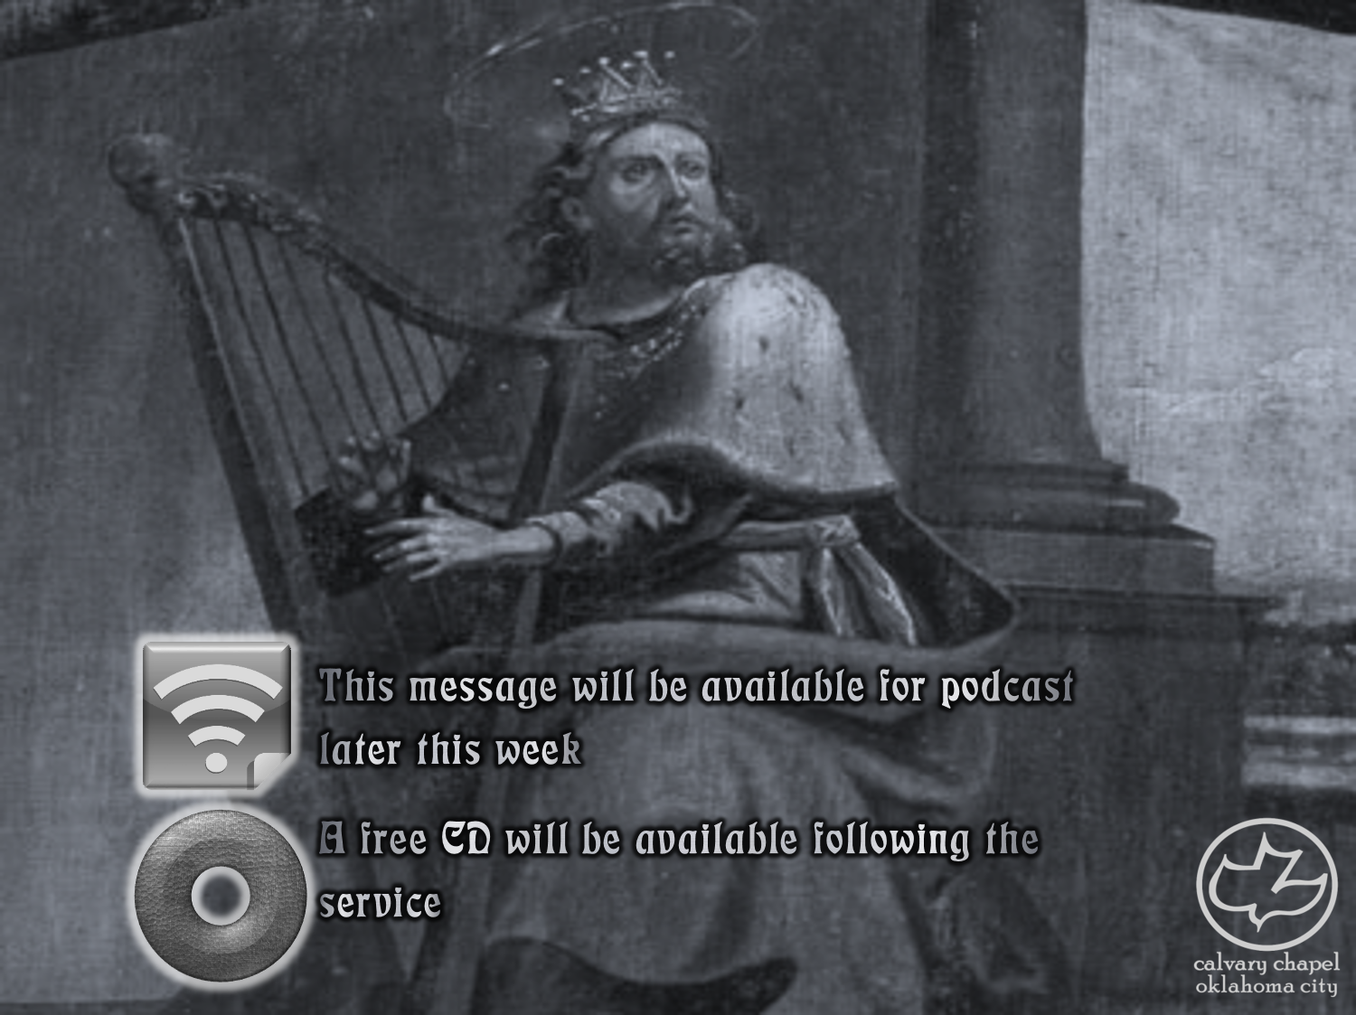

Psalms
the book of
06-08

Slide 2
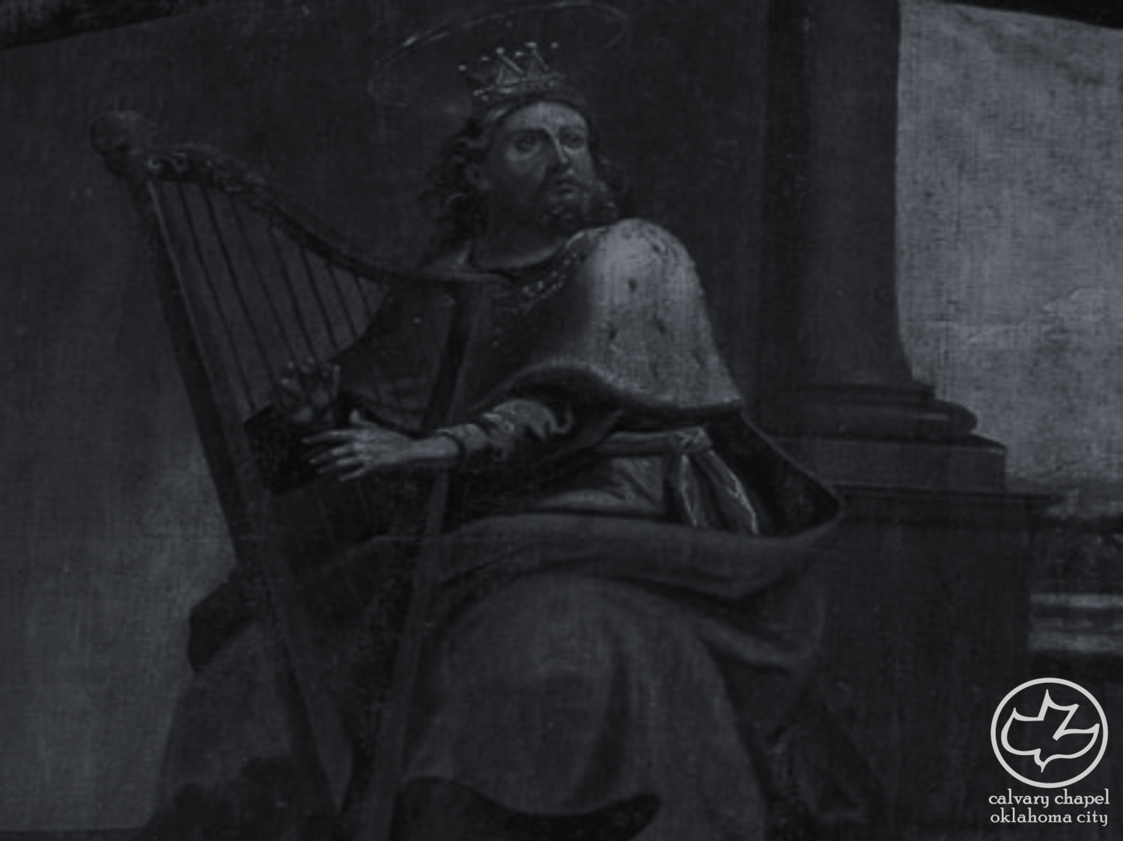
the book of
Psalms
06-08
1st of 7 of the Penitential Psalms
Psalms 6, 32, 38, 51, 102, 130, and 143

Slide 3
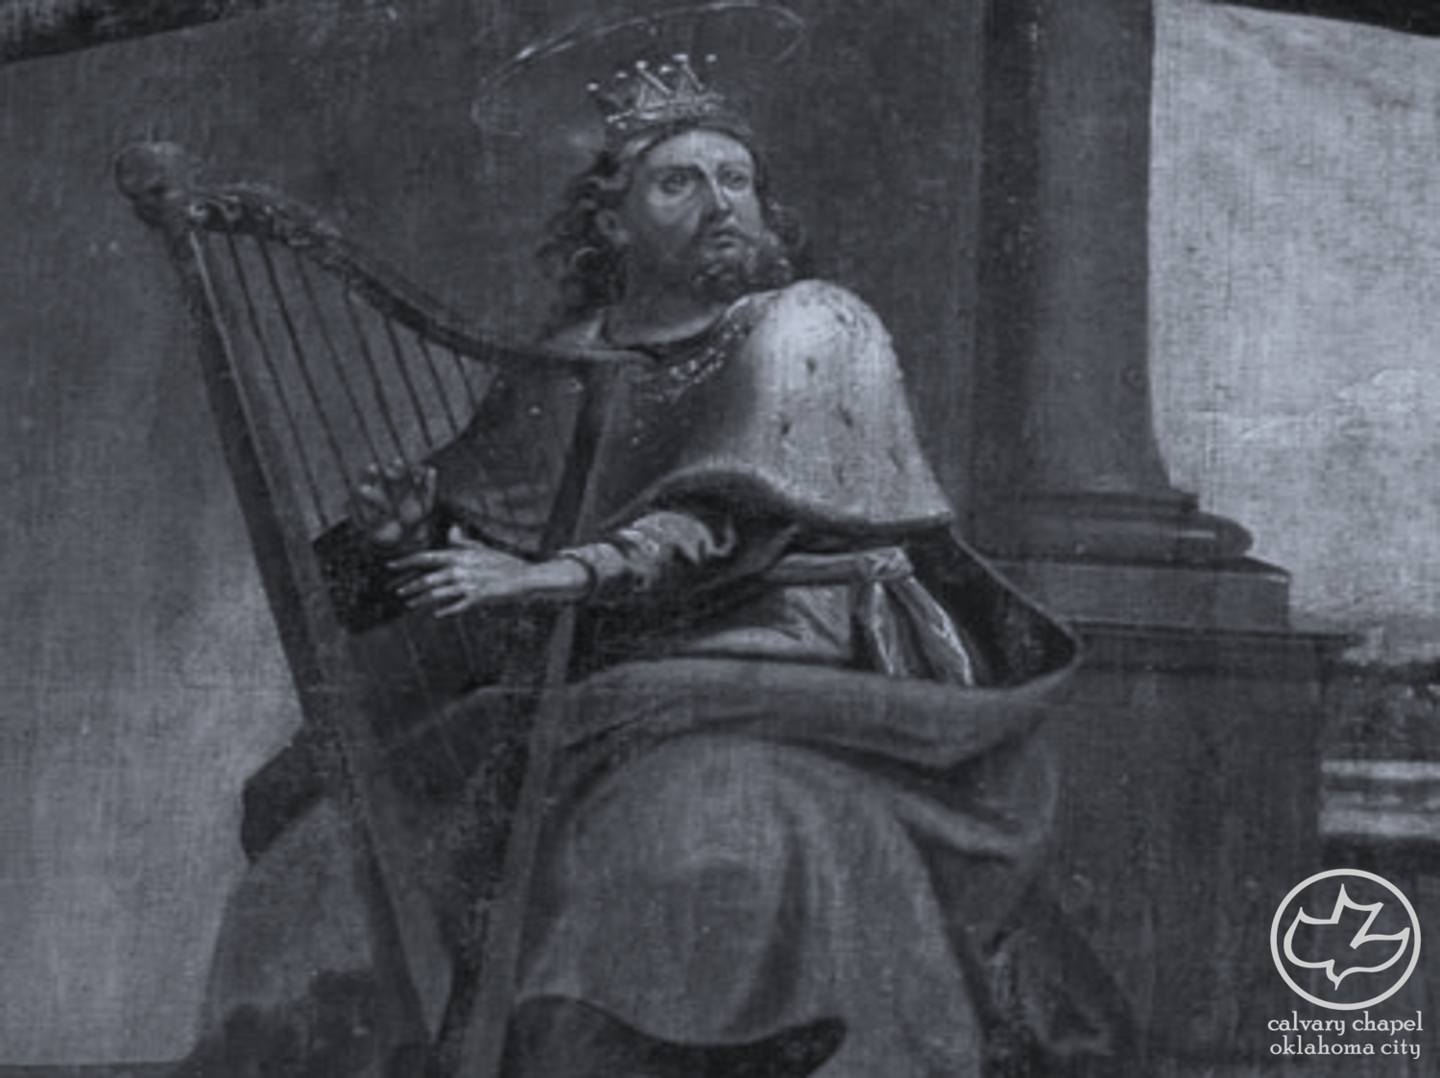
the book of
Psalms
06-08

Slide 4

the book of
Psalms
06-08
To the Chief Musician. With Stringed Instruments. On An Eight-Stringed Harp. A Psalm of David.
Eight-Stringed ~ sheminith – literally, upon the eight
o
o
o
possibly an octave
o
o
o
o
o
c d e f g a b c

Slide 5
the book of
Psalms
06-08

Slide 6
the book of
Psalms
06-08
Jer. 10:24 ~ O LORD, correct me, but with justice;
Not in Your anger, lest You bring me to nothing.

Slide 7
the book of
Psalms
06-08

Slide 8
the book of
Psalms
06-08
C. H. Spurgeon ~ “Churchyards are silent places; the vaults of the sepulchre echo not with songs. Damp earth covers dumb mouths. ‘O Lord?’ said he, ‘if thou wilt spare me I will praise thee. If I die, then must my mortal praise at least be suspended; and if I perish in hell, then thou wilt never have any thanksgiving from me.’ Songs of gratitude cannot rise from the flaming pit of hell.”

Slide 9
the book of
Psalms
06-08

Slide 10
the book of
Psalms
06-08
C. H. Spurgeon ~ “Repentance is a practical thing. It is not enough to bemoan the desecration of the temple of the heart, we must scourge out the buyers and sellers, and overturn the tables of the money changers.”

Slide 11
the book of
Psalms
06-08

Slide 12
the book of
Psalms
06-08
Martin Luther ~ “Vicimus! Vicimus!”

Slide 13
the book of
Psalms
06-08

Slide 14
the book of
Psalms
06-08
A Meditation Of David, Which He Sang to the Lord Concerning the Words of Cush, a Benjamite.
Meditation ~ shiggaion – believed to be from a root meaning to err or to go astray (wander)
KJV, NASB, NIV just transliterate it
Martin Luther ~ “David made Psalms; we also will make Psalms, and sing them as well as we can to the honor of our Lord, and to spite and mock the devil.”

Slide 15
the book of
Psalms
06-08

Slide 16
the book of
Psalms
06-08
Morgan Blake (cited by George Sweeting) ~ “I am more deadly that the screaming shell of a howitzer. I win without killing. I tear down homes, break homes and wreck lives. I travel on the wings of the wind. I travel on the wings of the wind. No innocence is strong enough to intimidate me, no purity pure enough to daunt me. I have no regard for truth, no respect for justice, no mercy for the defenseless. My victims are as numerous as the sands of the sea and often as innocent. I never forget and seldom forgive.
My name is Gossip.”

Slide 17
the book of
Psalms
06-08

Slide 18
the book of
Psalms
06-08
minds ~ literally, kidneys (KJV, reins)
NET ~ But make the innocent secure, O righteous God, you who examine inner thoughts and motives!

Slide 19
the book of
Psalms
06-08

Slide 20
the book of
Psalms
06-08
C. H. Spurgeon ~ “Even now the thirsty arrow longs to wet itself with the blood of the persecutor. The bow is bent, the aim is taken, the arrow is fitted to the string, and what, O sinner, if the arrow should be let fly at thee even now! Remember, God’s arrows never miss the mark, and are, every one of them, ‘instruments of death.’”

Slide 21
the book of
Psalms
06-08

Slide 22
the book of
Psalms
06-08
Message ~ Look at that guy! He had sex with sin, he’s pregnant with evil. Oh, look! He’s having the baby—a Lie-Baby!

Slide 23
the book of
Psalms
06-08

Slide 24
the book of
Psalms
06-08
To the Chief Musician. On the Instrument of Gath. A Psalm of David.
Gath ~ Gittim – possibly a guitar-like instrument
guitar
Sp. guitarra
Gr. kithara
Heb. gittim?

Slide 25
the book of
Psalms
06-08
Matt. 21:16; Heb. 2:6-8; 1 Cor. 15:27 and Eph. 1:22 all show this to be a Messianic Psalm

Slide 26
the book of
Psalms
06-08

Slide 27
the book of
Psalms
06-08
LORD ~ Yahweh; Lord ~ Adon
Phil. 2:9 ~ … and bestowed on Him the name which is above every name,

Slide 28
the book of
Psalms
06-08
C. H. Spurgeon ~ “Traverse the silent valleys where the rocks enclose you on either side, rising like the battlements of heaven till you can see but a strip of the blue sky far overhead; you may be the only traveler who has passed through that glen; the bird may start up affrighted, and the moss may tremble beneath the first tread of human foot; but God is there in a thousand wonders, upholding yon rocky barriers, filling the flower cups with their perfume, and refreshing the lonely pines with the breath of his mouth. Descend, if you will, into
the lowest depths of the ocean, where undisturbed the

Slide 29
the book of
Psalms
06-08
C. H. Spurgeon ~ water sleeps, and the very sand is motionless in unbroken quiet, but the glory of the Lord is there, revealing its excellence in the silent palace of the sea. Borrow the wings of the morning and fly to the uttermost parts of the sea, but God is there. Mount to the highest heaven, or dive into the deepest hell, and God is in both hymned in everlasting song, or justified in terrible vengeance.”

Slide 30
the book of
Psalms
06-08

Slide 31
the book of
Psalms
06-08
Matt. 21:16b ~ “Yes. Have you never read,
‘Out of the mouth of babes and nursing infants
You have perfected praise’? ”
ordained ~ NASB, better, established

Slide 32
the book of
Psalms
06-08

Slide 33
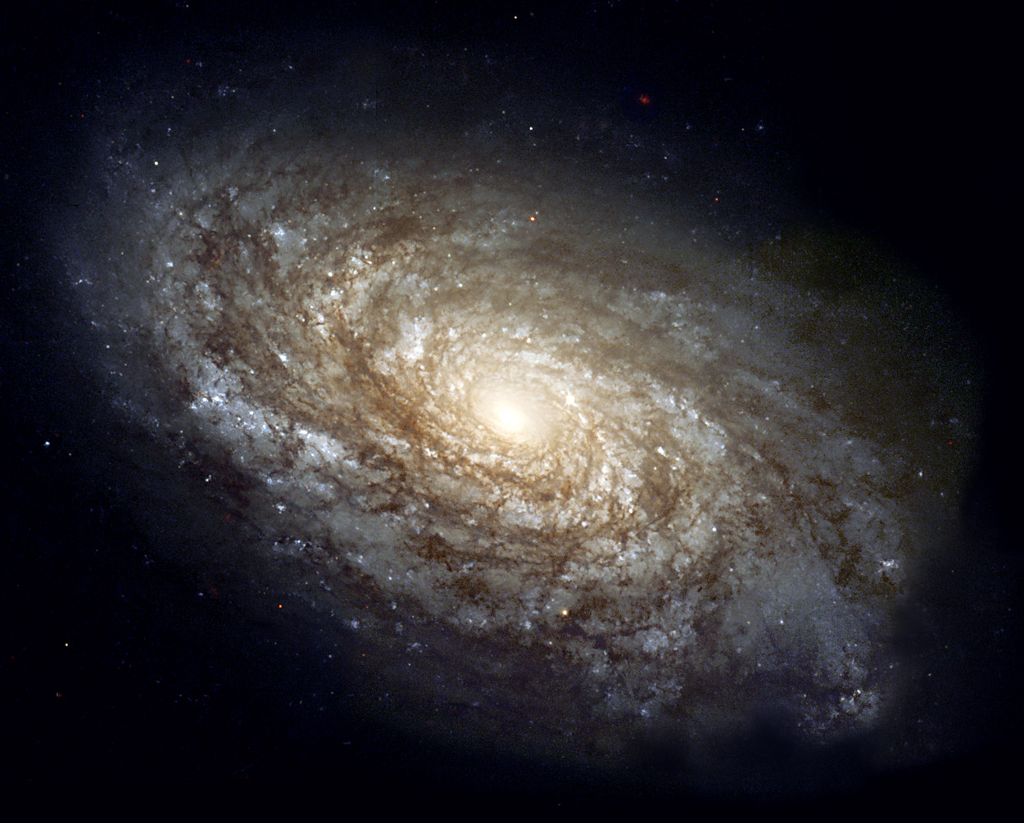
the book of
Psalms
06-08
man ~ enosh – NLT, mortal (better)
You are here

Slide 34
the book of
Psalms
06-08

Slide 35
the book of
Psalms
06-08
“man is nothing more than a rash on the epidermis of a second-rate planet.”

Slide 36
the book of
Psalms
06-08

Slide 37
the book of
Psalms
06-08
Made ~ literally, reduce or decrease
Gen. 1:26 ~ Then God said, “Let Us make man in Our image, according to Our likeness …”
Heb. 2:7 (NASB) ~ You have made him for a little while lower than the angels;
You have crowned him with glory and honor,
And have appointed him over the works of Your hands…
James 3:9 ~ With it we bless our God and Father, and with it we curse men, who have been made in the similitude of God.

Slide 38
the book of
Psalms
06-08

Slide 39
the book of
Psalms
06-08
Heb. 2:8b ~ … For in that He put all in subjection under him, He left nothing that is not put under him. But now we do not yet see all things put under him.
Heb. 9a ~ But we see Jesus …
The First Adam forfeited that dominion
The Last Adam regained it

Slide 40
the book of
Psalms
06-08

