Slide 1
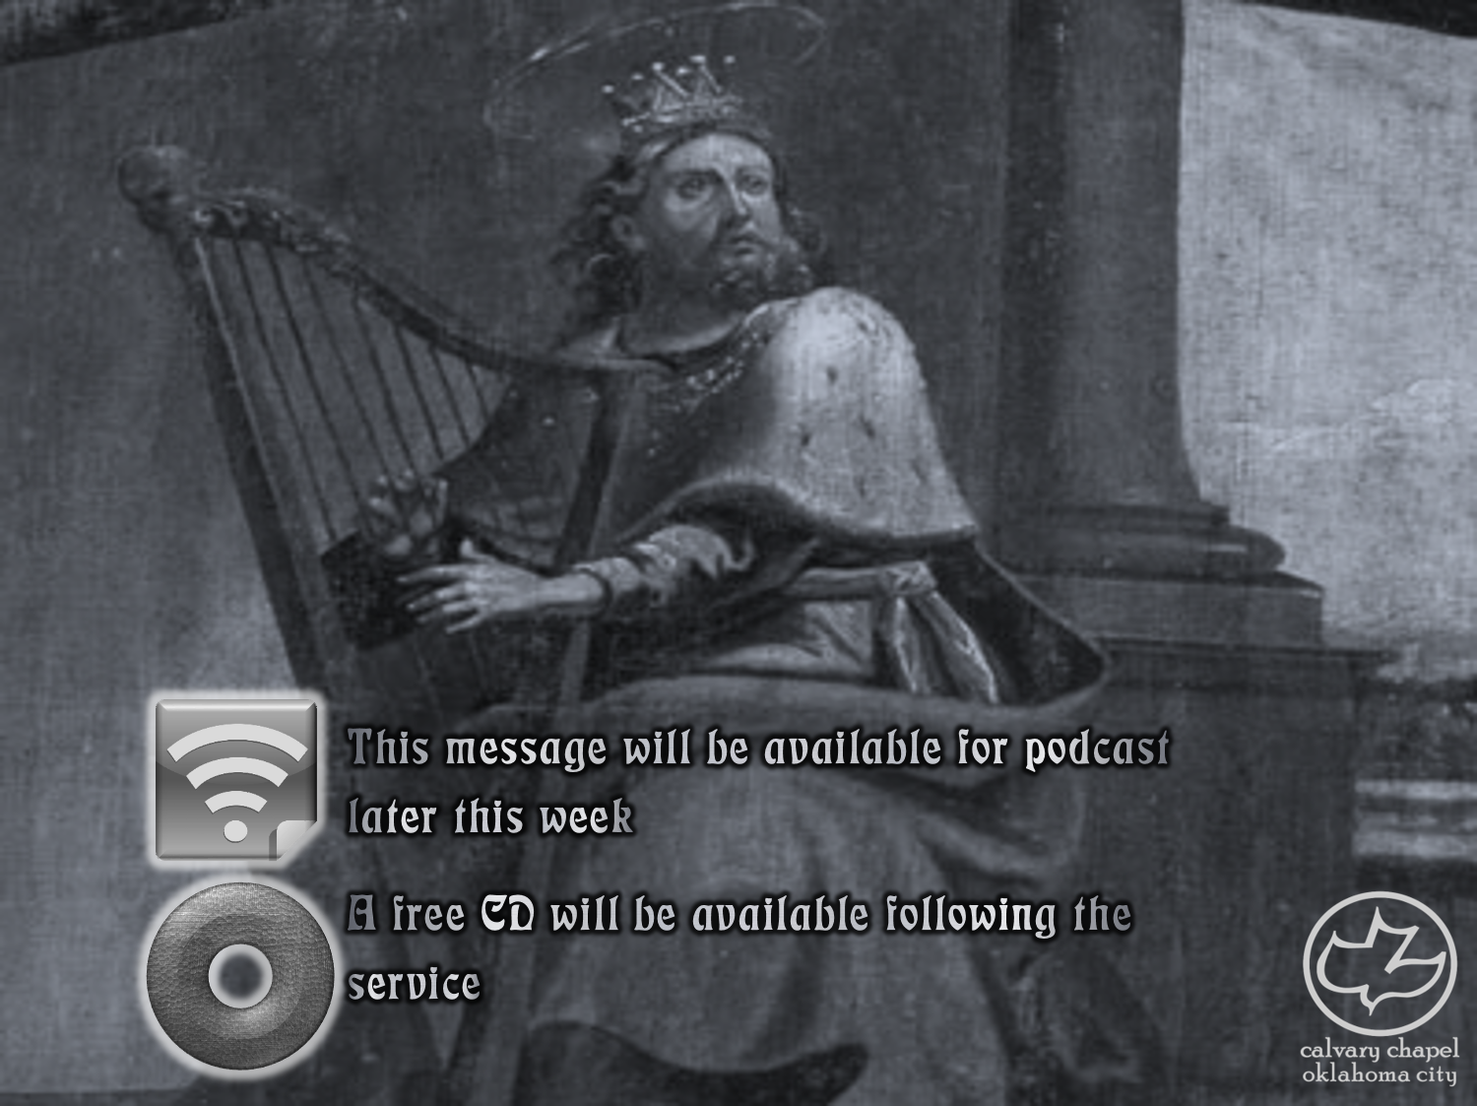

Psalms
the book of
03-05

Slide 2
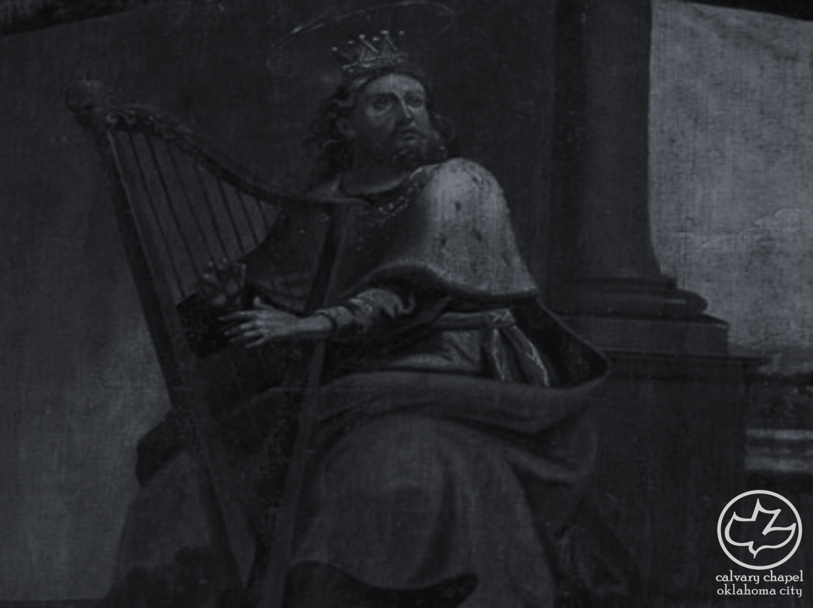
the book of
Psalms
03-05
A Psalm of David when he fled from Absalom his son.
4 stanzas of 2 verses each

Slide 3
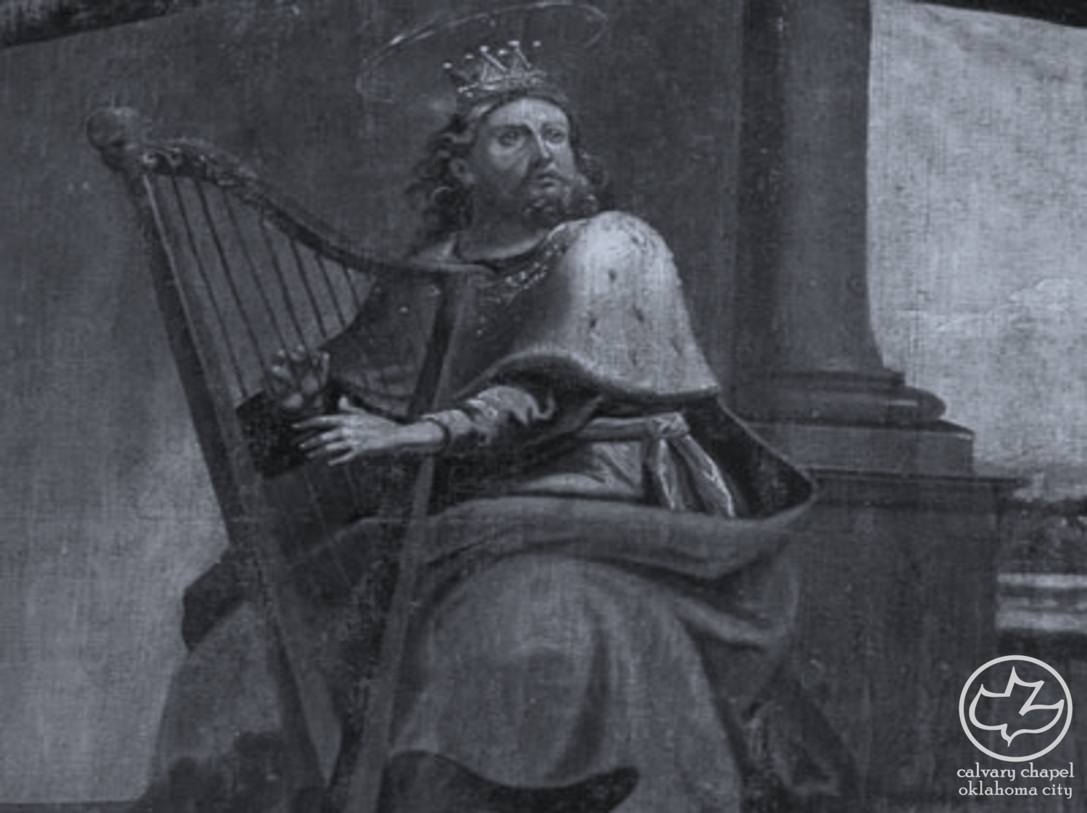
the book of
Psalms
03-05

Slide 4
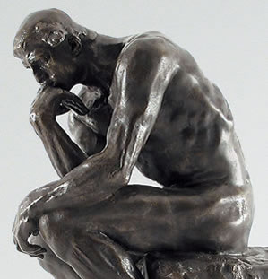
the book of
Psalms
03-05
Wilhelm Gesenius (1786-1842) ~ “Let the instrumental music continue while the singer paused.”
What do you think about that?
Hmmm…
Selah

Slide 5
the book of
Psalms
03-05

Slide 6
the book of
Psalms
03-05
Lam. 3:21-23 ~ ²¹ This I recall to my mind,
Therefore I have hope.
²² Through the Lord's mercies we are not consumed,
Because His compassions fail not.
²³ They are new every morning;
Great is Your faithfulness.

Slide 7
the book of
Psalms
03-05

Slide 8
the book of
Psalms
03-05
To the Chief Musician. With stringed instruments. A Psalm of David.
stringed instruments ~ neginoth (guitar)
Evening prayer

Slide 9
the book of
Psalms
03-05

Slide 10
the book of
Psalms
03-05
relieved ~ KJV, enlarged
mercy ~ chesed
Life's experiences
126x in Psalms
Life

Slide 11
the book of
Psalms
03-05

Slide 12
the book of
Psalms
03-05
falsehood ~ kazab – KJV, leasing

Slide 13
the book of
Psalms
03-05

Slide 14
the book of
Psalms
03-05
angry ~ better, as KJV, stand in awe
NASB, tremble
C. H. Spurgeon – “Surely a thinking man might have enough sense to discover the vanity of sin and the worthlessness of the world. Stay, rash sinner, stay ere thou take the last leap. Go to thy bed and think upon thy ways. Ask counsel of thy pillow, and let the quietude of night instruct thee!"

Slide 15
the book of
Psalms
03-05
Sinner, Is Thy Heart At Rest?
Sinner, is thy heart at rest?
Is thy bosom void of fear?
Art thou not by guilt oppress’d?
Speaks hot conscience in thine ear?
Can this world afford thee bliss?
Can it chase away thy gloom?
Flattering, false, and vain it is;
Tremble at the worldling’s doom!

Slide 16
the book of
Psalms
03-05
Sinner, Is Thy Heart At Rest?
Think, O sinner, on thy end,
See the judgment–day appear,
Thither must thy spirit wend,
There thy righteous sentence hear.
Wretched, ruin’d, helpless soul,
To a Saviour’s blood apply;
He alone can make thee whole,
Fly to Jesus, sinner, fly!” – Jared B. Waterbury © 1831

Slide 17
the book of
Psalms
03-05

Slide 18
the book of
Psalms
03-05
Message ~ ⁶ Why is everyone hungry for more? “More, more,” they say.
“More, more.” I have God’s more–than–enough,
⁷ More joy in one ordinary day
Than they get in all their shopping sprees.

Slide 19
the book of
Psalms
03-05

Slide 20
the book of
Psalms
03-05
To the Chief Musician. With Flutes. A Psalm of David.
Flutes ~ nehiloth – to perforate, to bore through
Evening prayer

Slide 21
the book of
Psalms
03-05

Slide 22
the book of
Psalms
03-05
C. H. Spurgeon ~ “This is the fittest time for intercourse with God. An hour in the morning is worth two in the evening. While the dew is on the grass, let grace drop upon the soul.”
direct ~ literally, arrange
look up ~ for Your response

Slide 23
the book of
Psalms
03-05

Slide 24
the book of
Psalms
03-05
Robert Haldane (1764-1842) ~ “Nothing can be more abominable to the senses than an open sepulcher, when a dead body beginning to putrefy steams forth its tainted exhalations. What proceeds out of their mouth is infected and putrid and as the exhalation from a sepulcher proves the corruption within, so it is with the corrupt conversation of sinners.”

Slide 25
the book of
Psalms
03-05

