Slide 1
29-30

Slide 2
29-30
Merrihew Standard Version ~ If a man continues reject constructive correction, some day it will cave in all around him.

Slide 3
29-30

Slide 4
29-30
Matt. 5:45b ~ for He makes His sun rise on the evil and on the good, and sends rain on the just and on the unjust.

Slide 5
29-30

Slide 6
29-30
KJV ~ Where there is no vision, the people perish:
Living Bible ~ Where there is ignorance of God, crime runs wild; but what a wonderful thing it is for a nation to know and keep his laws.

Slide 7
29-30

Slide 8
29-30
NIV ~ If a man pampers his servant from youth, he will bring grief in the end.
Living Bible ~ Pamper a servant from childhood, and he will expect you to treat him as a son!
NLT ~ A servant pampered from childhood will become a rebel.
Good News Bible ~ If you give your servants everything they want from childhood on, some day they will take over everything you own.

Slide 9
29-30

Slide 10
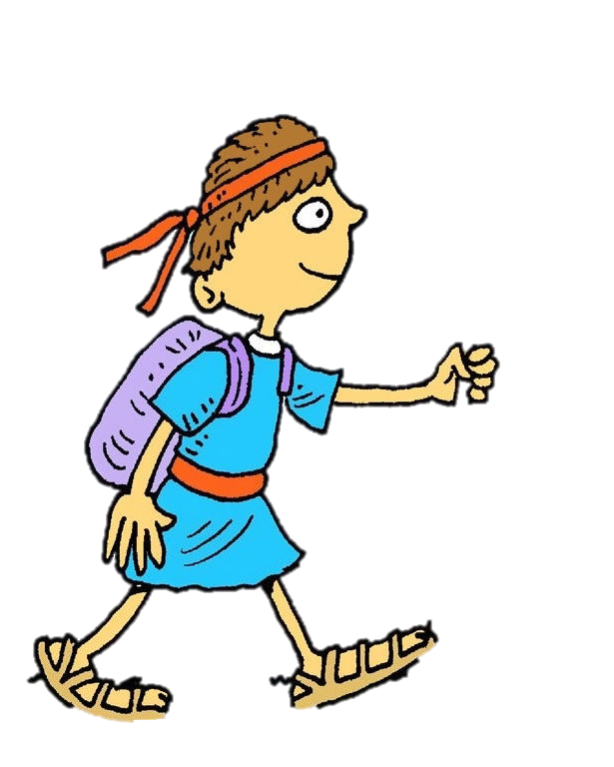
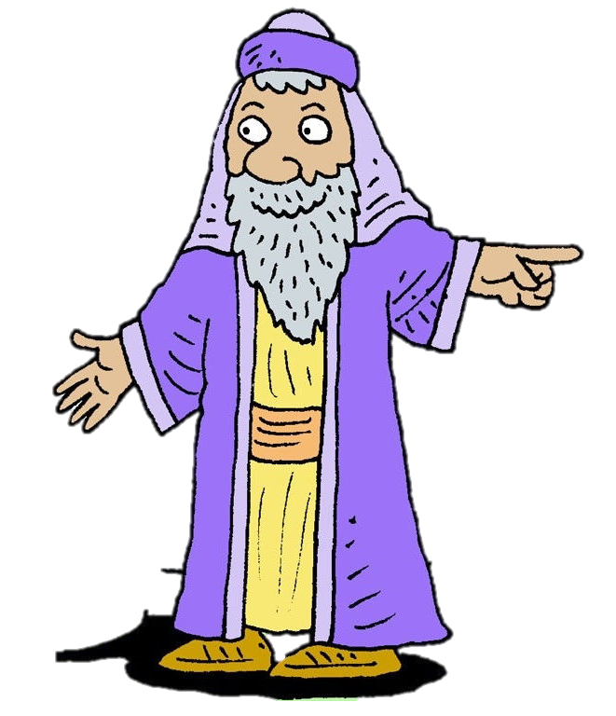
29-30
Agur
Ucal
Ithiel

Slide 11
29-30

Slide 12
29-30
Rev. 22:18 ~ For I testify to everyone who hears the words of the prophecy of this book: If anyone adds to these things, God will add to him the plagues that are written in this book;
Deut. 4:2 ~ You shall not add to the word which I command you, nor take from it, that you may keep the commandments of the Lord your God which I command you.
Deut. 12:32 ~ Whatever I command you, be careful to observe it; you shall not add to
it nor take away from it.

Slide 13
29-30
Books of Moses (Deuteronomy)
Books of Proverbs
Books of John (Revelation)
1300 BC
1100 BC
900 BC
700 BC
500 BC
300 BC
100 BC

Slide 14
29-30
Bible Quotation Quiz (NKJV):
T
F
4
Cleanliness is next to godliness.
4
God helps those who help themselves.
4
It is more blessed to give than to receive.
4
Do unto others before they do unto you.
4
God knocked Paul off his horse on the road to Damascus.
4
Early to bed and early to rise, makes a man healthy, wealthy, and wise.

Slide 15
29-30
Bible Quotation Quiz:
T
F
4
Lion will lie down with the lamb.
4
The truth will make you free.
4
Spare the rod and spoil the child.
4
When you die, you become an angel.
4
“God has said, ‘You shall not eat it, nor shall you touch it, lest you die.’”
Did Eve say to the serpent,
?

Slide 16
29-30

Slide 17
29-30
Disrespectful
Generation X
Hypocritical
Arrogant
Oppressive
Baby Boomers
Millennials

Slide 18
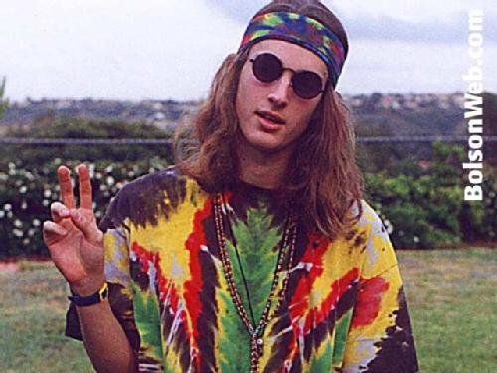
29-30
Disrespectful
Generation X
Hypocritical
Arrogant
Oppressive
Baby Boomers
Millennials

Slide 19
29-30

Slide 20
29-30
Someone who reigns but
has no responsibility
Someone who eats but
hasn’t earned it
Sense of entitlement
Someone who is wed but
isn’t winsome
Someone who is advanced but isn’t accomplished

Slide 21
29-30

Slide 22
29-30
Rock badger, hyrax, coney

Slide 23
29-30

Slide 24
29-30
spider ~ better, lizard

Slide 25
29-30

Slide 26
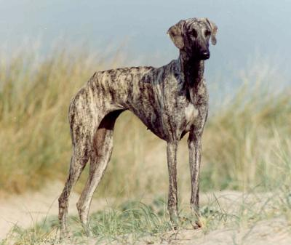
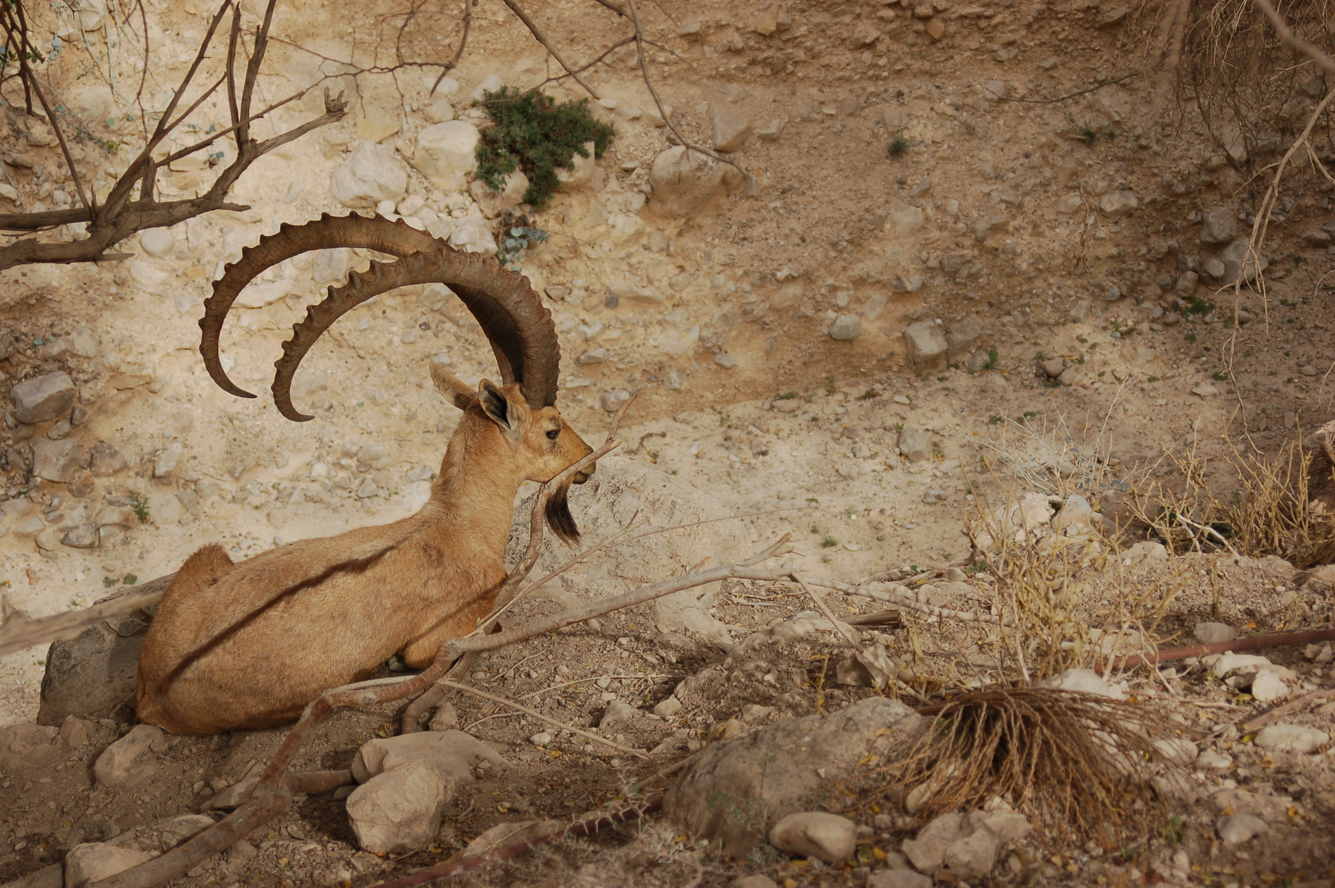
29-30
greyhound ~ literally, girded loins
strutting rooster
Sloughi
Ibex

Slide 27
29-30

Slide 28
29-30
churning, wringing, forcing ~ same Hebrew word, mis

Slide 29
29-30

