Slide 1

27-28

Slide 2

27-28
Jam. 4:13-17 ~ ¹³ Come now, you who say, “Today or tomorrow we will go to such and such a city, spend a year there, buy and sell, and make a profit”; ¹⁴ whereas you do not know what will happen tomorrow. For what is your life? It is even a vapor that appears for a little time and then vanishes away. ¹⁵ Instead you ought to say, “If the Lord wills, we shall live and do this or that.”
¹⁶ But now you boast in your arrogance. All such boasting is evil.
¹⁷ Therefore, to him who knows to do good and does not do it, to him it is sin.

Slide 3
27-28

Slide 4
27-28
1 Tim. 6:6 ~ Now Jesus-ness with contentment is great gain.
1 Tim. 6:6 ~ Now godliness with contentment is great gain.
Amy Carmichael ~ “In acceptance lieth peace.”
Polonius to Hamlet ~ “To thine own self be true.”

Slide 5
27-28

Slide 6
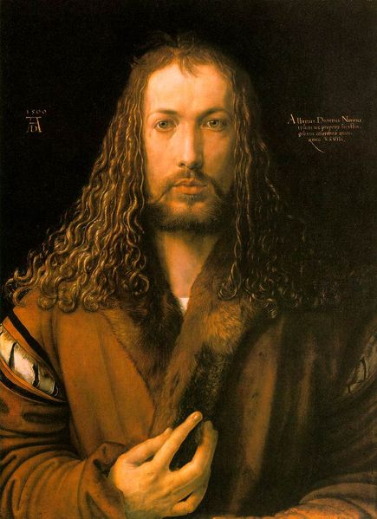
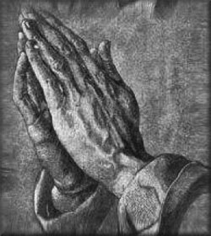
27-28
Albrect Dürer 1471-1528
“Praying Hands”

Slide 7
27-28

Slide 8
27-28
Merrihew Standard Version ~ As a mirror shows what we look like on the outside,
So our hearts show what we really look like.

Slide 9
27-28

Slide 10
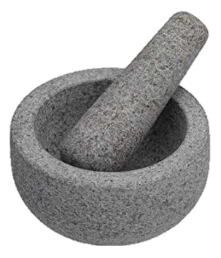
27-28
KJV ~ Though thou shouldest bray – a fool in a mortar among wheat with a pestle,
Mortar and Pestle

Slide 11
27-28

Slide 12
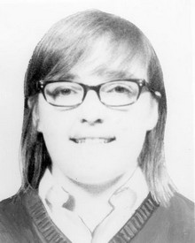
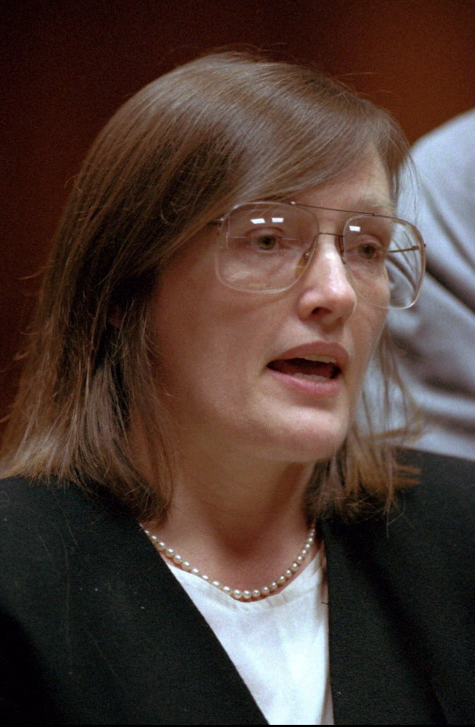
27-28
Katherine Ann Powers
(c. 1968)
Alice Metzinger
(1993)

Slide 13
27-28

Slide 14
27-28
Merrihew Standard Version ~ “Don’t expect God to answer your prayers if you’re not letting the His Word direct your life.”

Slide 15
27-28
Is. 59:1-2 ~ Behold, the Lord’s hand is not shortened,
That it cannot save; nor His ear heavy, that it cannot hear.
But your iniquities have separated you from your God;
And your sins have hidden His face from you,
So that He will not hear.
Ps. 66:18 ~ If I regard iniquity in my heart, the Lord will not hear.

Slide 16
27-28

Slide 17

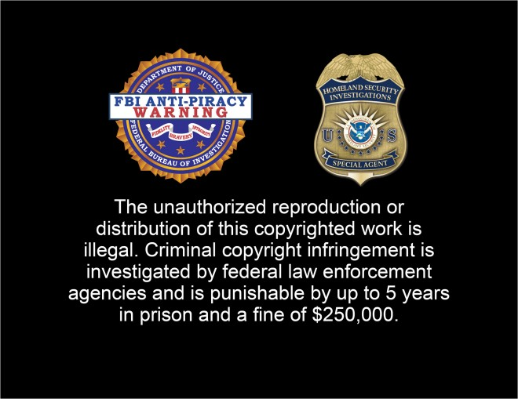
27-28

Slide 18
27-28

Slide 19
27-28
J. Vernon McGee ~ “You will find in the average church that there is a bandage Band-Aid of silence wrapped over the cancer of sin. People don't like to talk about it; in fact, they won't admit its existence.”

Slide 20
27-28

Slide 21

27-28
Mega Millions + Power Ball >
$1,600,000,000

Slide 22
27-28

Slide 23

27-28
prospered ~ KJV,
at
f
ph !

Slide 24
27-28

Slide 25
27-28
Jer. 17:9 ~ The heart is deceitful above all things, And desperately wicked;
Who can know it?
Prov. 3:5-6 ~ ⁵ Trust in the LORD with all your heart,
And lean not on your own understanding;
⁶ In all your ways acknowledge Him,
And He shall direct your paths.
Ps. 119:105 ~ Your word is a lamp to my feet And a light to my path.

Slide 26
27-28

