Slide 1
16-18

Slide 2
16-18
Phil. 2:13 ~ … for it is God who works in you both to will and to do for His good pleasure.

Slide 3
16-18

Slide 4
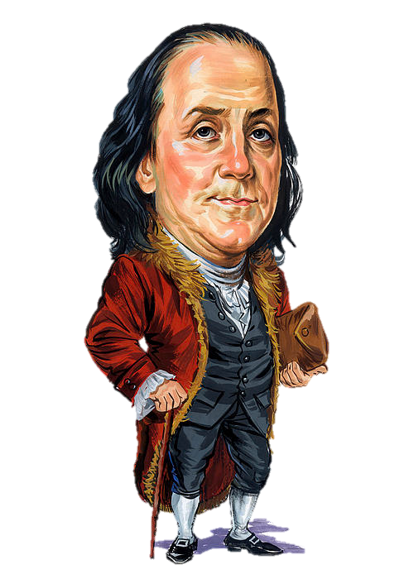
16-18
He who is good
at excuses is seldom good for anything else.
Benjamin Franklin

Slide 5
16-18

Slide 6
16-18
Commit ~ from verb meaning to roll
Luke 12:34 ~ For where your treasure is, there your heart will be also.

Slide 7
16-18

Slide 8
16-18
1 John 1:6 ~ If we say that we have fellowship with Him, and walk in darkness, we lie and do not practice the truth.

Slide 9
16-18

Slide 10
16-18
Ps. 37:23-24 ~ ²³ The steps of a good man are ordered by the Lord,
And He delights in his way.
²⁴ Though he fall, he shall not be utterly cast down; for the Lord upholds him with His hand.

Slide 11
16-18

Slide 12
16-18
ONLY YOU
CAN PREVENT FOREST FIRES
This Photo by Unknown Author is licensed under CC BY-SA

Slide 13
16-18

Slide 14
16-18
feasting ~ literally, sacrificial meals
KJV - sacrifices

Slide 15
16-18

Slide 16
16-18
spiteful
NASB – destructive
NIV – malicious
KJV – naughty

Slide 17
16-18

Slide 18
16-18
Real sayings from real kids:
Talc is found on rocks and on babies.
Lime is a green-tasting rock.
There are 26 vitamins in all, but some of the letters are yet to be discovered. Finding them all means living forever.
Q: What is one horsepower?
A: One horsepower is the amount of energy it takes to drag a horse 500 feet in one second.
You can listen to thunder after lightening and tell how close you came to getting hit. If you don’t hear it you got hit, so never mind.

Slide 19
16-18
Real sayings from real kids:
The law of gravity says no fair jumping up without coming back down.
When they broke open molecules, they found they were only stuffed with atoms.
But when they broke open atoms, they found them stuffed with explosions.
When people run around and around in circles we say they are crazy. When planets do it we say they are orbiting.
Rainbows are just to look at, not to really understand.

Slide 20
16-18
Real sayings from real kids:
While the earth seems to be knowingly keeping its distance from the sun, it is really only centrificating.
Someday we may discover how to make magnets that can point in any direction.
South America has cold summers and hot winters, but somehow they still manage.
Most books now say our sun is a star. But it still knows how to change back into a sun in the daytime.

Slide 21
16-18
Real sayings from real kids:
Water freezes at 32 degrees and boils at 212 degrees. There are 180 degrees between freezing and boiling because there are 180 degrees between north and south.
A vibration is a motion that cannot make up its mind which way it wants to go.
There is a tremendous weight pushing down on the center of the Earth because of so much population stomping around up there these days.
Genetics explain why you look like your father and if you don’t why you should.

Slide 22
16-18
Real sayings from real kids:
Vacuums are nothings. We only mention them to let them know we know they’re there.
Some oxygen molecules help fires burn while others help make water, so sometimes it’s brother against brother.

Slide 23
16-18

Slide 24
16-18
NIV ~ An unfriendly man pursues selfish ends; he defies all sound judgment

Slide 25
16-18

Slide 26
16-18
tasty trifles ~ KJV, wounds
Good News Bible~ Gossip is so tasty – how we love to swallow it!

Slide 27
16-18

Slide 28
16-18
NLT ~ Flipping a coin can end arguments; it settles disputes between powerful opponents.

Slide 29
16-18

Slide 30
16-18
NASB ~ A man of too many friends comes to ¹ruin, But there is a friend who sticks closer than a brother.
¹Literally, to break into pieces
NLT ~ There are “friends” who destroy each other, but a real friend sticks closer than a brother.

Slide 31
16-18

Slide 32
16-18
Manuel Cervantes (1547-1616) ~ “A short sentence with long experience.”
Ken Merrihew (b. 1951) ~ “‘Cream of Wheat' for the brain.”

Slide 33
16-18

