Slide 1
13-15

Slide 2
13-15
NIV ~ One man pretends to be rich, yet has nothing; another pretends to be poor, yet has great wealth.

Slide 3
13-15

Slide 4
13-15
NLT ~ The rich can pay a ransom for their lives, but the poor won’t even get threatened.
Living Bible ~ Being kidnapped and held for ransom never worries the poor man!

Slide 5
13-15

Slide 6
13-15
destroyed ~ literally, “is pledged to it”
Is. 66:2 ~ “For all those things My hand has made,
And all those things exist,”
Says the Lord.
“But on this one will I look:
On him who is poor and of a contrite spirit, And who trembles at My word.”

Slide 7
13-15

Slide 8
13-15
Living Bible ~ A man with good sense is appreciated. A treacherous man must walk a rocky road.

Slide 9
13-15

Slide 10
13-15
NLT ~ It is pleasant to see dreams come true,
But fools refuse to turn from evil to attain them.
Living Bible ~ It is pleasant to see plans develop. That is why fools refuse to give them up even when they are wrong.

Slide 11
13-15

Slide 12
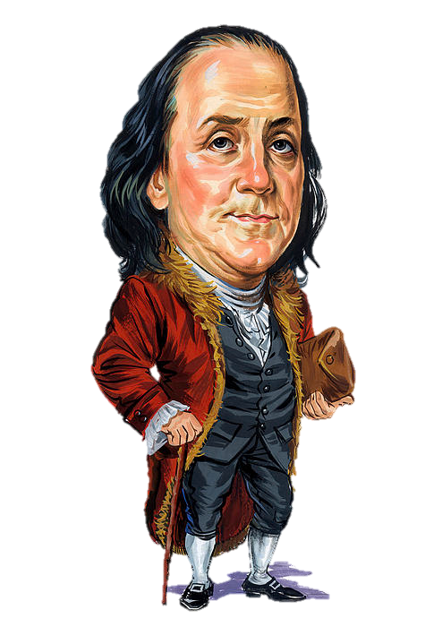
13-15
qui cum canibus concumbunt cum pulicibus surgent
He that lieth down with dogs …
… shall rise up with fleas
Benjamin Franklin

Slide 13
13-15

Slide 14
13-15
The Bible says, “Spoil the child.”

Slide 15
13-15

Slide 16
13-15
Charles Ryrie ~ “There is no milk without some manure. Some disturbance is the price of growth and accomplishment.”
V
B
S

Slide 17
13-15

Slide 18
13-15
backslider in heart ~ NIV, faithless

Slide 19
13-15

Slide 20
13-15
NIV ~ fears the Lord

Slide 21
13-15

Slide 22
13-15
Well,
that’s just the way I am
Then you
am a fool

Slide 23
13-15

Slide 24
13-15
Good News Bible ~ Work and you will earn a living; if you sit around talking you will be poor.

Slide 25
13-15

Slide 26
13-15
souls ~ better than, lives – (most other modern English versions)
nepesh – usually psuchē in the LXX

Slide 27
13-15

Slide 28
13-15
NASB ~ Sheol and Abaddon

Slide 29
13-15

Slide 30
13-15
1 Pet. 3:12 ~ For the eyes of the Lord are on the righteous,
And His ears are open to their prayers;
But the face of the Lord is against those who do evil. (quoting Ps. 34:15-16a from LXX)

Slide 31
13-15

Slide 32
13-15
NLT ~ If you listen to constructive criticism,
you will be at home among the wise.

Slide 33
13-15

Slide 34
13-15
10x time in Proverbs:
1:7 ~ The fear of the Lord is the beginning of knowledge,
But fools despise wisdom and instruction.
1:29 ~ Because they hated knowledge
And did not choose the fear of the Lord.
2:4-5 ~ ⁴ If you seek her as silver,
And search for her as for hidden treasures;
⁵ Then you will understand the fear of the Lord,
And find the knowledge of God.

Slide 35
13-15
10x time in Proverbs:
8:13 ~ The fear of the Lord is to hate evil;
Pride and arrogance and the evil way
And the perverse mouth I hate.
9:10 ~ The fear of the Lord is the beginning of wisdom,
And the knowledge of the Holy One is understanding.
10:27 ~ The fear of the Lord prolongs days,
But the years of the wicked will be shortened.
14:26 ~ In the fear of the Lord there is strong confidence,
And His children will have a place of refuge.

Slide 36
13-15
10x time in Proverbs:
14:27 ~ The fear of the Lord is a fountain of life,
To turn one away from the snares of death.
15:16 ~ Better is a little with the fear of the Lord,
Than great treasure with trouble.
15:33 ~ The fear of the Lord is the instruction of wisdom,
And before honor is humility.

Slide 37
13-15

Slide 38
