Slide 1
7-9

Slide 2
7-9
apple ~ Hebraism for pupil

Slide 3
7-9

Slide 4
7-9
impudent ~ to make strong or harden
NIV, NASB – brazen

Slide 5
7-9

Slide 6
7-9
take our fill ~ ravah ~ in the NKJV: satisfy, satisfied, abundantly, fill, waters, drench, bathed, soaked, water, satiate(d), drink

Slide 7
7-9

Slide 8
7-9
Boys give “love” in order to get sex
Girls give sex
in order to get “love”
1 Cor. 13:5 ~ (love) does not seek not its own,

Slide 9
7-9

Slide 10
7-9
as a fool to the correction of the stocks ~ NIV, like a deer stepping into a noose

Slide 11
7-9

Slide 12
7-9
Profundity alert!
It’s smart to be smart
It’s dumb to be dumb

Slide 13
7-9

Slide 14
7-9
possessed ~ qanah’ – same as 4:5 (Get wisdom! Get understanding!)
When used of God, means to create, originate

Slide 15
7-9

Slide 16
7-9
KJV, Then I was by him, as one brought up with him

Slide 17
7-9

Slide 18
7-9
gentle
Without partiality
PURE
Peaceable
Mercy and good fruits
Willing to yield
Without hypocrisy
James 3:17

Slide 19
7-9
gentle
Without partiality
PURE
Peaceable
Mercy and good fruits
Willing to yield
Without hypocrisy
James 3:17

Slide 20
7-9

Slide 21
7-9
harms himself ~ KJV, getteth himself a blot

Slide 22
7-9

Slide 23
7-9
Prov. 1:7 ~ The fear of the Lord is the beginning of knowledge,
But fools despise wisdom and instruction.
beginning ~ re’shith - start, choice part, head
(9:10) ~ t^{e}chillaw – beginning, first, initial
Prov. 8:13 ~ The fear of the Lord is to hate evil;
Pride and arrogance and the evil way
And the perverse mouth I hate.

Slide 24
7-9

Slide 25
7-9
NLT ~ If you become wise, you will be the one to benefit. If you scorn wisdom, you will be the one to suffer.

Slide 26
7-9

Slide 27
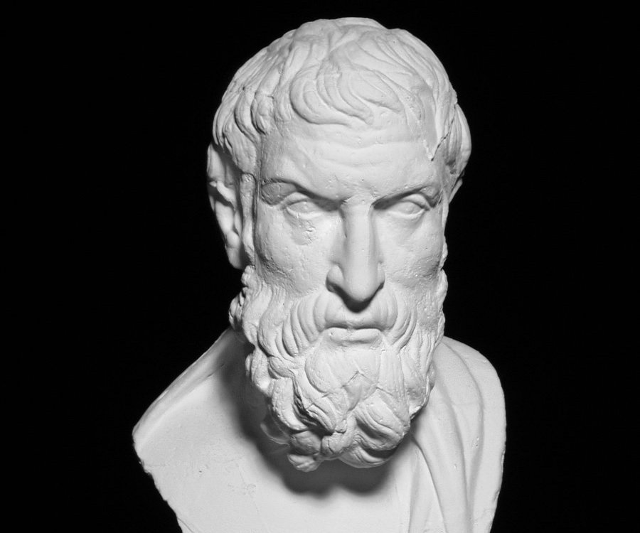
7-9
“While I am, death is not; and when death is, I am not. Therefore, death does not concern me.”
Epicurus (341-240BC)

Slide 28
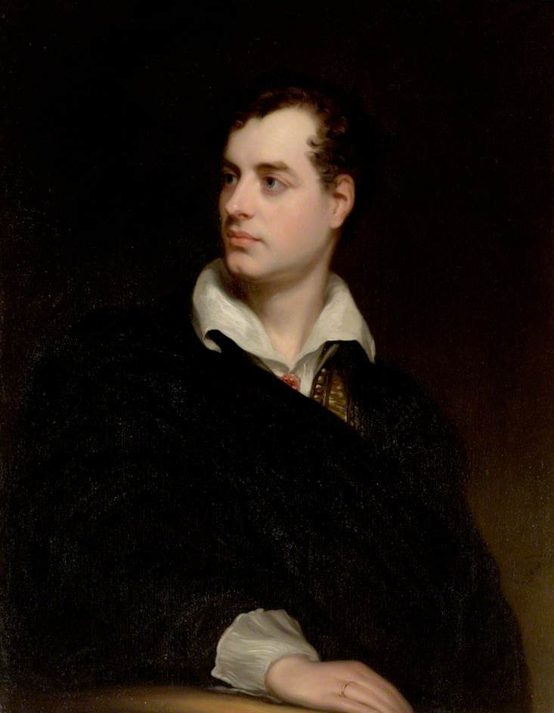
7-9
“Shall I sue for mercy? Come, come no weakness; let’s be a man to the last. The worm, the canker, and grief are mine alone.”
Lord Byron (1788-1824)

Slide 29
7-9
Svetlana Stalin (1926-2011) ~ “My father died a difficult and terrible death … God only grants an easy death to the just … At what seemed the very last moment he suddenly opened his eyes and cast a glance over everyone in the room. It was a terrible glance, insane or perhaps angry and full of fear of death … Then he lifted his left hand as though he were pointing to something above and bringing down a curse on us all. The gesture was full of menace … The next moment … the spirit wretched itself free of the flesh.”

Slide 30
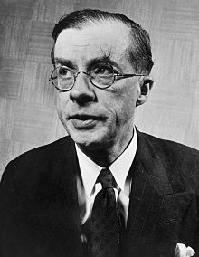
7-9
“So it is true after all!”
Julian Huxley (1887-1975)

Slide 31
7-9

