Slide 1

4-6

Slide 2

4-6
Get ~ qanah’ – 60 of 85 occurrences, buy, buyer, purchased, etc.

Slide 3
4-6

Slide 4
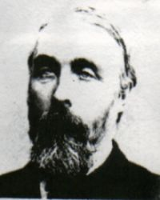
4-6
wisdom ~ the ability to apply knowledge correctly
understanding ~ intelligence, discernment
Robert Alden (1836-1911) ~ “Proverbs provides both a goal and a route. The goal is successful living and the route is wisdom.”

Slide 5
4-6

Slide 6
4-6
be hindered ~ KJV, be straitened
literally, to cramp

Slide 7
4-6

Slide 8
4-6
NIV ~ The path of the righteous is like the first gleam of dawn, shining ever brighter till the full light of day.

Slide 9
4-6

Slide 10


4-6
This is a
Lighthouse … Your call
Change your course … I’m a seaman 3rd class
Change your course 10º to the south
Change your course … I’m a ship’s captain!
Change your course 10º to the north
Change your course … This is battleship!

Slide 11
4-6

Slide 12
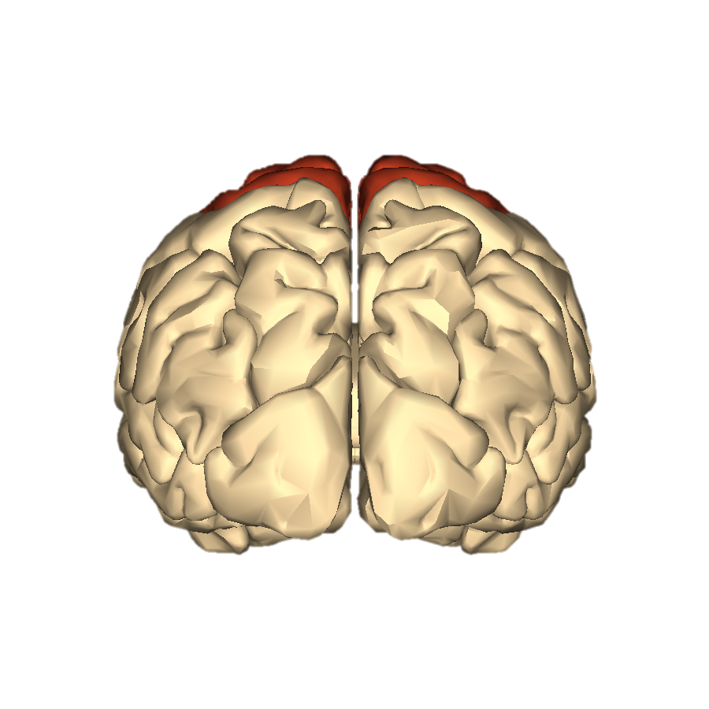


4-6
What I believe in my heart will affect my choices
What I believe in my head will not
This Photo by Unknown Author is licensed under CC BY-SA

Slide 13
4-6

Slide 14
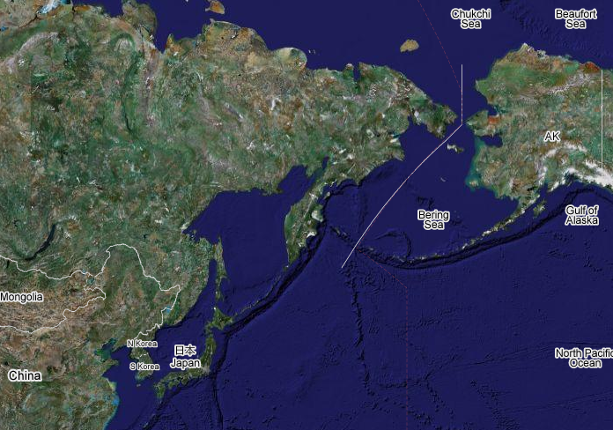
4-6
Korean Air fl #007
9/1/1983
USSR
Anchorage
1 ½ º
Seoul

Slide 15
4-6
Risk Behavior Survey of High Students 2017 (CDC)
Had ever drank alcohol ~ 60.4%
1st drink before age 13 ~ 13.6%
Currently practiced binge drinking ~ 13.5%
Drinking and driving ~ 10%
Ever used marijuana ~ 35.6%

Slide 16
4-6

Slide 17




4-6

Slide 18
4-6

Slide 19
4-6
Risk Behavior Survey of High Students 2017 (CDC)
Have engaged in sex ~ 42.8%
Used no form of birth control ~ 15%
Four or more sexual partners ~ 10%
Ages 13-24 account for 21% of new HIV cases
50% of all newly reported STDs are from ages 15-24

Slide 20
4-6

Slide 21
4-6
NLT ~ Why spill the water of your springs in the streets,
having sex with just anyone?
A couple more CDC statistics:
50% of sexually active will contract an STD or STI by age 24
20,000,000 new cases per year among ages 15-24

Slide 22
4-6

Slide 23
4-6
enraptured (be led astray)
KJV ~ ravished
NASB ~ exhilarated
NIV, NLT ~ captivated
ESV ~ intoxicated
shagah

Slide 24
4-6

Slide 25
4-6
NLT ~ ¹ My child, if you have put up security for a friend’s debt
or agreed to guarantee the debt of a stranger —
² if you have trapped yourself by your agreement
and are caught by what you said —

Slide 26
4-6

Slide 27
4-6
worthless ~ belial
KJV, naughty - NIV, scoundrel

Slide 28
4-6

Slide 29
4-6
Literally, the eyes of loftiness

Slide 30
4-6

Slide 31

4-6

Slide 32
4-6

Slide 33
4-6
A proud look
A lying tongue
Hands that shed innocent blood
A heart that devices wicked plans
Feet that are swift in running to evil
A false witness who speaks lies
One who sows discord
Two deal with the heart
Three deal with the mouth

Slide 34
4-6

Slide 35
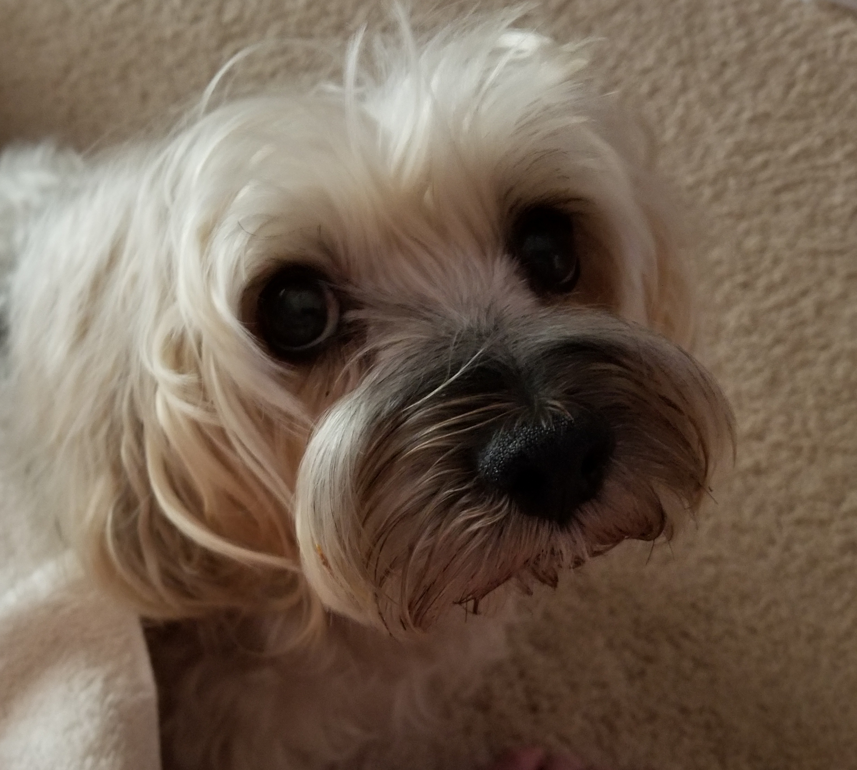
4-6
“Please scratch my
“It’s time to feed me.”
“It’s time for a treat!”
“I need to go outside, please.”
“Can we go for a walk?”
“Let’s play ball!”
“I need a bone!”
tummy.”
ears.”
armpits.”

Slide 36
4-6

Slide 37
4-6
To him who has ears to hear,
let him hear/see
To him who has eyes to see,

Slide 38
4-6

