Slide 1
3.15-4.5

Slide 2
3.15-4.5
“Boomer Sooner!”
“Sic ‘em, Bears!”
“Go Frogs!”

Slide 3
3.15-4.5

Slide 4
3.15-4.5
Note ~ skopeō – take heed, look out
Gal. 6:1 ~ Brethren, if a man is overtaken in any trespass, you who are spiritual restore such a one in a spirit of gentleness, considering yourself lest you also be tempted.

Slide 5
3.15-4.5

Slide 6
3.15-4.5
Walk (v. 17) ~ stoicheō - military term meaning to march
Walk (v. 18) ~ peripateō – to walk around (circumspectly)

Slide 7
3.15-4.5

Slide 8
3.15-4.5
Citizenship ~ KJV, conversation
politeuma ~ politics – to be a member of a community

Slide 9
3.15-4.5

Slide 10
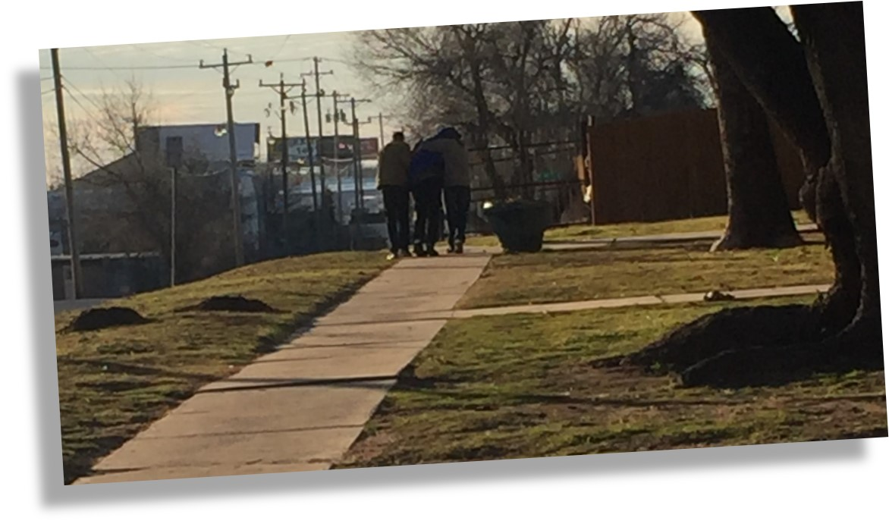
3.15-4.5

Slide 11
3.15-4.5

Slide 12
3.15-4.5
Department of Homeland Security terrorist threat levels
SEVERE
SEVERE RISK OF TERROR ATTACKS
HIGH
HIGH RISK OF TERROR ATTACKS
ELEVATED
SIGNIFICANT RISK OF TERROR ATTACKS
GUARDED
GENERAL RISK OF TERROR ATTACKS
LOW
LOW RISK OF TERROR ATTACKS

Slide 13
3.15-4.5

Slide 14
3.15-4.5
Euodia ~ a good way
Suntuchē ~ come together

Slide 15
3.15-4.5

Slide 16
3.15-4.5
True ~ gnēsios ~ same as genesia ~ of one’s birth, birthday
Suzugos ~ literally, to be paired together
Matt. 5:9 ~ Blessed are the peacemakers,
For they shall be called sons of God.

Slide 17
3.15-4.5

Slide 18
3.15-4.5
Gentleness ~ KJV, moderation;
NASB, forbearing spirit
Ralph Martin ~ “The spirit of willingness to yield under trial which will show itself in a refusal to retaliate when attacked.”

Slide 19
3.15-4.5

