Slide 1
2.9-18

Slide 2
2.9-18
1 Cor. 15:1-4 ~ ¹ Moreover, brethren, I declare to you the gospel which I preached to you, which also you received and in which you stand, ² by which also you are saved, if you hold fast that word which I preached to you—unless you believed in vain. ³ For I delivered to you first of all that which I also received: that Christ died for our sins according to the Scriptures, ⁴ and that He was buried, and that He rose again the third day according to
the Scriptures,

Slide 3
2.9-18
Old
English
gōd ~ good
Gospel
(Good news)
spel ~ story

Slide 4
2.9-18

Slide 5
2.9-18
John 14:6 ~ Jesus said to him, “I am the way, the truth, and the life. No one comes to the Father except through Me.”

Slide 6
2.9-18

Slide 7
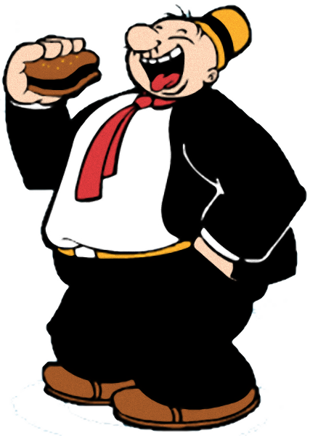
2.9-18
I’ll gladly pay you on Tuesday for a hamburger today.

Slide 8
2.9-18

Slide 9
2.9-18
… work your own salvation with fear and trembling
out
for

Slide 10
2.9-18
Good
stuff
Bad
stuff

Slide 11
2.9-18
Christ’s
Righteousness
Christ’s
Righteousness

Slide 12
2.9-18
… work out your own salvation with fear and trembling

Slide 13
2.9-18

Slide 14
2.9-18
Merrihew Standard Version ~ For if you do, God's working in you directs not only your actions but even your will and desires.
Phil. 1.6 - being confident of this very thing, that He who has begun a good work in you will complete it until the day of Jesus Christ;

Slide 15
2.9-18

Slide 16
2.9-18
Complaining ~ KJV, Murmuring ~ goggusmos
Onomatopoeic ~ hiss, coo, boom
, murmur
Disputing ~
dialogismos
#
Message ~ Do everything readily and cheerfully—no bickering, no second-guessing allowed!

Slide 17
2.9-18

Slide 18
2.9-18
John Newton, from The Letters of John Newton – “What will it profit a man if he gains his cause, and silences his adversary, if at the same time he loses that humble tender frame of spirit in which the Lord delights, and to which the promise of his presence is made!”
C. S. Lewis in Mere Christianity – “The Son of God became man to enable men to become the sons of God.”

Slide 19
2.9-18

Slide 20
2.9-18
Merrihew Standard Version ~ And if it ends up that I am poured out on the sacrifice of your faithful lives, we can be happy together.

Slide 21
2.9-18

