Slide 1
2.1-8

Slide 2
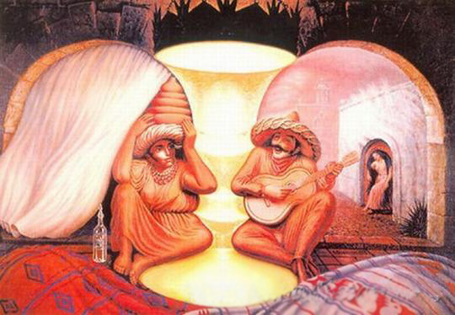
2.1-8

Slide 3
2.1-8

Slide 4
2.1-8
Phil. 1:29-30 ~ ²⁹ For to you it has been granted on behalf of Christ, not only to believe in Him, but also to suffer for His sake, ³⁰ having the same conflict which you saw in me and now hear is in me.
1 Pet. 3:14a ~ But even if you should suffer for righteousness’ sake, you are blessed.

Slide 5
2.1-8

Slide 6
2.1-8
If (v. 1) … then (v. 2 ~ implied in the NIV, NLT) conditional statements
A “condition of the 1st class” ~ assumes the condition to be true

Slide 7
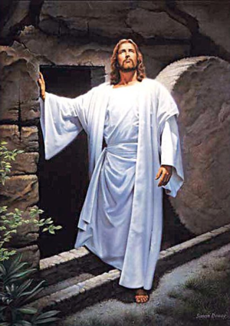
2.1-8
Consolation ~ paraklēsis – called alongside to help
Comfort ~ from a word meaning to persuade
Fellowship ~ koinonia – to have everything in common
Affection ~ splangnon – our emotions are involved
Mercy ~ from Greek word meaning to pity
Accord ~ sumpsuchos – with the same soul
In Christ

Slide 8
2.1-8

Slide 9
2.1-8
NASB (v. 6) ~ who, although He existed in the form of God, did not regard equality with God a thing to be grasped,
Equality ~ isos – e.g. an isosceles triangle
a
a
Father
Son
Holy Spirit
a

Slide 10
2.1-8
Form (vv. 6-7) ~ morphē - essence
Made ~ kenoō – to be emptied
Appearance ~ skēma – shape
morphē ~ who He is
skēma ~ who He appeared to be

Slide 11
2.1-8

Slide 12
2.1-8
St. Augustine ~ Sermons for Christmas …
Maker of the sun,
He is made under the sun.
In the Father He remains,
From His mother he goes forth.
Creator of heaven and earth,
He was born on earth under heaven.
Unspeakably wise,
He is wisely speechless.
Filling the world,
He lies in a manger.

Slide 13
2.1-8
St. Augustine ~ Sermons for Christmas …
Ruler of the stars,
He nurses at His mother's bosom.
He is both great in the nature of God,
and small in the form of a servant.
but so that His greatness is not diminished by His smallness,
nor His smallness overwhelmed by His greatness.

Slide 14
2.1-8

Slide 15
2.1-8
Heb. 5:8 - though He was a Son, yet He learned obedience by the things which He suffered.

Slide 16
2.1-8

Slide 17
2.1-8
1 Tim. 2:5 ~ For there is one God and one Mediator between God and men, the Man Christ Jesus,

Slide 18
2.1-8

