Slide 1
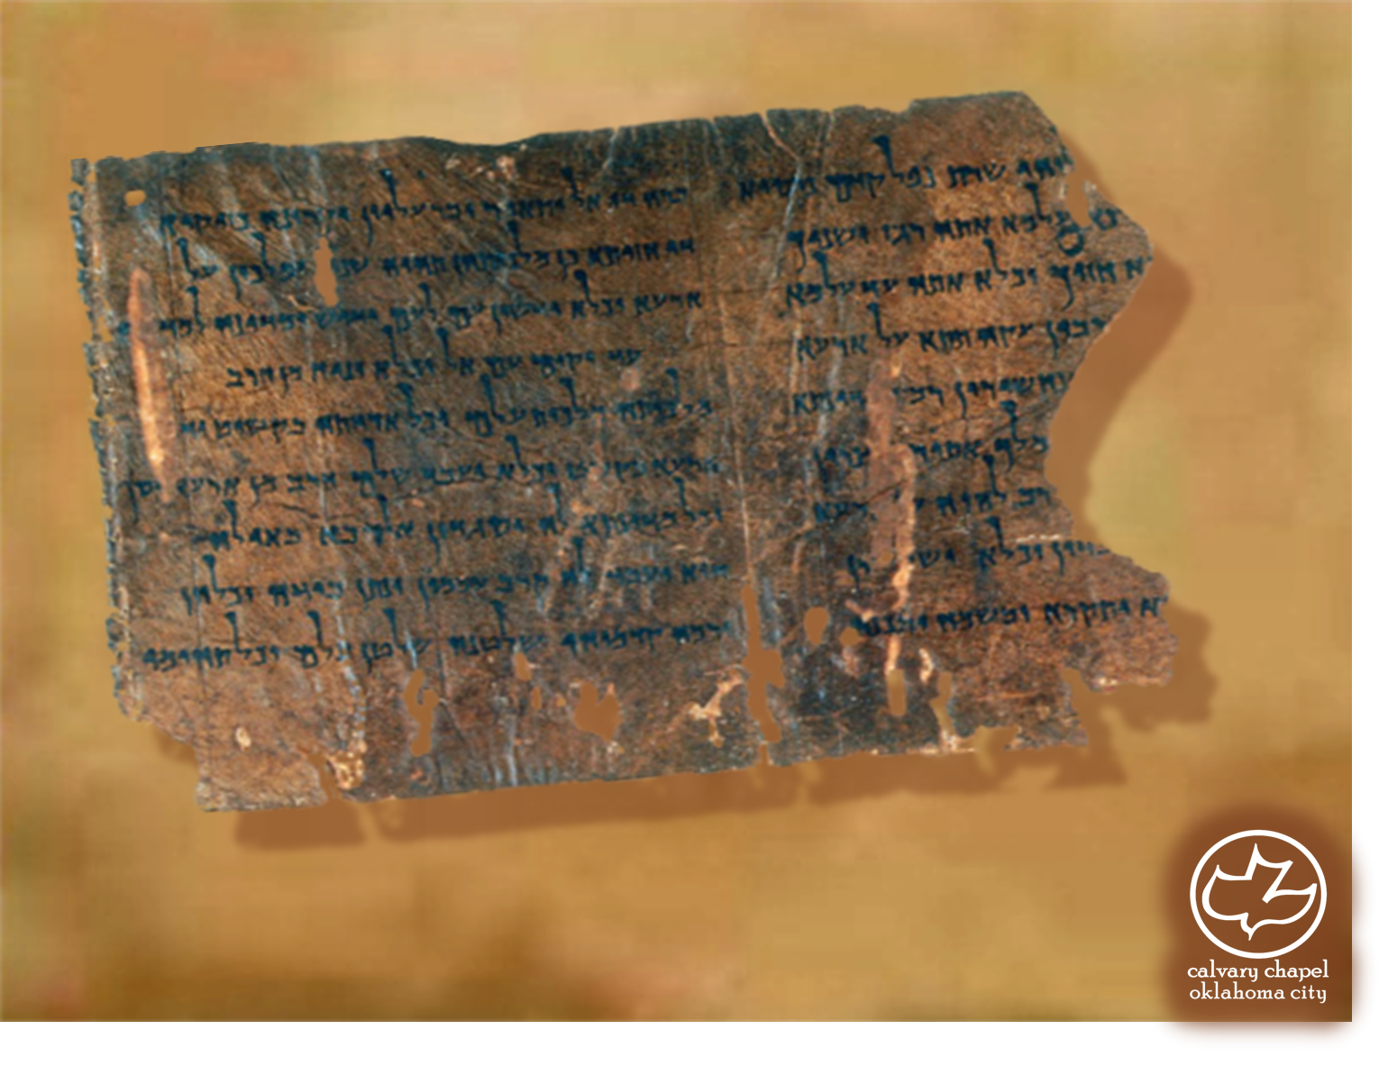

Minor Prophets … Major Message:
Obadiah 1:1-1:21
A CD of this message will be available (free of charge) immediately following today's message
This message will be available via podcast later this week at calvaryokc.com

Slide 2
Obadiah 1:1-1:21
1st Captivity
605 BC
2nd Captivity
597 BC
3rd Captivity
586 BC
608BC
604BC
600BC
596BC
592BC
588BC
Obadiah

Slide 3
Obadiah 1:1-1:21
Gen. 25:22 ~ And the LORD said to her: "Two nations are in your womb, Two peoples shall be separated from your body; One people shall be stronger than the other, And the older shall serve the younger."

Slide 4
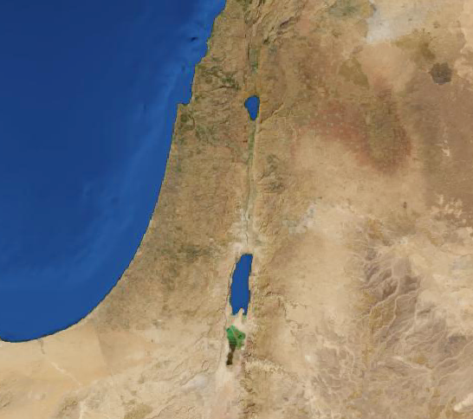
Obadiah 1:1-1:21
Edom
Petra

Slide 5
Obadiah 1:1-1:21
2 Tim. 3:16 ~ All Scripture is given by inspiration of God, and is profitable for doctrine, for reproof, for correction, for instruction in righteousness

Slide 6
Obadiah 1:1-1:21
Gal. 5:17 ~ For the flesh lusts against the Spirit, and the Spirit against the flesh; and these are contrary to one another, so that you do not do the things that you wish.

Slide 7
Obadiah 1:1-1:21
Mal. 1:2-3 ~ ² "I have loved you," says the LORD. "Yet you say, ‘In what way have You loved us?’ Was not Esau Jacob’s brother?" Says the LORD. "Yet Jacob I have loved; ³ But Esau I have hated, And laid waste his mountains and his heritage For the jackals of the wilderness."

Slide 8
Obadiah 1:1-1:21
Gen. 25:34 ~ And Jacob gave Esau bread and stew of lentils; then he ate and drank, arose, and went his way. Thus Esau despised his birthright.

Slide 9
Obadiah 1:1-1:21
Num. 20:18-21

Slide 10
Obadiah 1:1-1:21
Deut. 23:7a ~ You shall not abhor an Edomite, for he is your brother.

Slide 11
Obadiah 1:1-1:21
Obadiah ~ servant or worshipper of Yahweh
Messenger ~ not malak – NASB, NIV ~ envoy

Slide 12
Obadiah 1:1-1:21
Prov. 12:26 ~ The righteous should choose his friends carefully,
For the way of the wicked leads them astray.
Prov. 13:20 ~ He who walks with wise men will be wise,
But the companion of fools will be destroyed.
1 Cor. 15:33 ~ Do not be deceived: "Evil company corrupts good habits."

Slide 13
Obadiah 1:1-1:21
% of American preschool teachers, administrators, parents, and child-development specialist who said the most important thing for a child to learn in preschool is "self-reliance and self-confidence":
34%
5%
% who said "sympathy, empathy, and concern for others":

Slide 14
Obadiah 1:1-1:21
Gazed ~ better, NASB - gloat over – a mark of carnality
Prov. 24:17-18 ~ ¹⁷ Do not rejoice when your enemy falls, and do not let your heart be glad when he stumbles; ¹⁸ Lest the Lord see it, and it displease Him, and He turn away His wrath from him.

