Slide 1
A CD of this message will available immediately following the service …
… or you may download a podcast later in this week
3 1 – 3 3

Slide 2
3 1 – 3 3
Zur
Cozbi
(Num.25:15)
Num. 23:10 ~ Who can count the dust of Jacob,
Or number one-fourth of Israel?
Let me die the death of the righteous,
And let my end be like his!

Slide 3
3 1 – 3 3

Slide 4
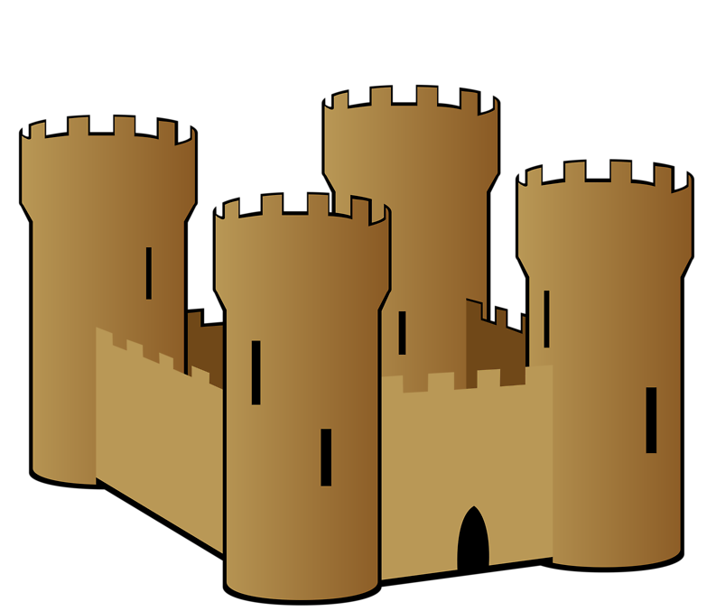
3 1 – 3 3
Forts ~ KJV, goodly castles

Slide 5
3 1 – 3 3

Slide 6
3 1 – 3 3
Gen. 15:16 ~ But in the fourth generation they shall return here, for the iniquity of the Amorites is not yet complete.
Ps. 137:8-9 ~ ⁸ O daughter of Babylon, who are to be destroyed,
Happy the one who repays you as you have served us!
⁹ Happy the one who takes and dashes
Your little ones against the rock!

Slide 7
3 1 – 3 3
Rev. 10:9-10 ~ ⁹ So I went to the angel and said to him, “Give me the little book.” And he said to me, “Take and eat it; and it will make your stomach bitter, but it will be as sweet as honey in your mouth.”
¹⁰ Then I took the little book out of the angel’s hand and ate it, and it was as sweet as honey in my mouth. But when I had eaten it, my stomach became bitter.

Slide 8
3 1 – 3 3

Slide 9
3 1 – 3 3
 | Sheep | Cattle | Donkeys | Totals
Soldier’s stuff
Minus 1/500th
Soldier’s net
Stuff watcher’s stuff
Minus 1/50th
Stuff watcher’s net
Totals
337500
36000
30500
404000
-675
-72
-61
-808
336825
35928
30439
403192
337500
36000
30500
404000
-6750
-720
-610
-8080
330750
35280
29890
395990
675000
72000
61000
808000

Slide 10
3 1 – 3 3

Slide 11
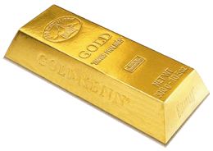
3 1 – 3 3
16,750 sh.
421 lb.
6,736 oz.
x $1,233
$8,290,464

Slide 12
3 1 – 3 3

Slide 13
3 1 – 3 3
Gen. 13:8-12 ~ ⁸ So Abram said to Lot, “Let’s not have any quarreling between you and me, or between your herdsmen and mine, for we are brothers. ⁹ Is not the whole land before you? Let’s part company. If you go to the left, I’ll go to the right; if you go to the right, I’ll go to the left.” ¹⁰ Lot looked up and saw that the whole plain of the Jordan was well watered, like

Slide 14
3 1 – 3 3
Gen. 13:8-12 ~ the garden of the Lord, like the land of Egypt, toward Zoar. (This was before the Lord destroyed Sodom and Gomorrah.) ¹¹ So Lot chose for himself the whole plain of the Jordan and set out toward the east. The two men parted company:
¹² Abram dwelt in the land of Canaan, and Lot dwelt in the cities of the plain and pitched his tent even as far as Sodom.

Slide 15
3 1 – 3 3
Godliness
Worldliness

Slide 16
3 1 – 3 3

Slide 17
3 1 – 3 3
2 ½ Trans-Jordan tribes
MANASSEH
BASHAN
GILEAD
GAD
AMMON
REUBEN
MOAB
EDOM

Slide 18
3 1 – 3 3

Slide 19
3 1 – 3 3
40 different places listed from Ramses to the Plains of Moab

Slide 20
3 1 – 3 3

Slide 21
3 1 – 3 3
 | Plague | god(s)
1
2
3
4
5
Blood
Osiris
Frogs
Heqt
Lice
Set, Geb
Flies
Uatchit
Cattle disease
Apis, Hathor

Slide 22
3 1 – 3 3
 | Plague | god(s)
6
7
8
9
10
Boils
Imhotep
Hail
Nut, Isis
Locusts
Osiris
Darkness
Amon, Ra
Death of firstborn
Osiris/Horus cycle

Slide 23
3 1 – 3 3

Slide 24
3 1 – 3 3
40 years in the Wilderness
Plains of Moab
Kadesh Barnea
Ezion Geber
Mt. Sinai?

Slide 25
3 1 – 3 3

