Slide 1



A CD of this message will available immediately following the service …
… or you may download a podcast later in this week
2 3 – 2 4

Slide 2

2 3 – 2 4
2 Pet. 2:15 ~ They have forsaken the right way and gone astray, following the way of Balaam the son of Beor, who loved the wages of unrighteousness …
Use of deceptive words for personal gain

Slide 3
2 3 – 2 4
Friedrich Nietzsche ~ “To win over certain people to something, it is only necessary to give it a gloss of love of humanity, nobility, gentleness, self-sacrifice—and there is nothing you cannot get them to swallow.”
Norman Vincent Peale ~ “Put God to work for you and maximize your potential in our divinely ordered capitalist system.”

Slide 4

2 3 – 2 4

Slide 5
2 3 – 2 4
Oracle ~ mashal – usually translated proverb or parable
1st of 7 oracles

Slide 6
2 3 – 2 4

Slide 7
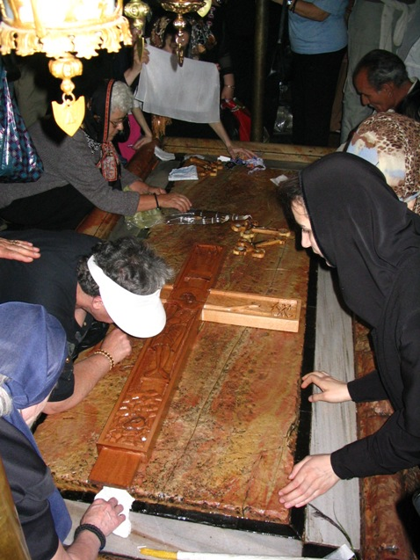
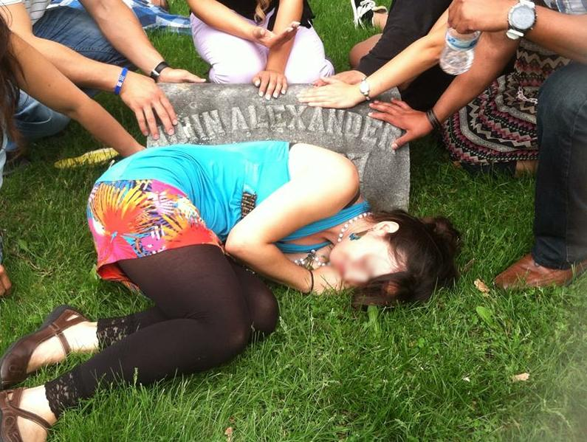
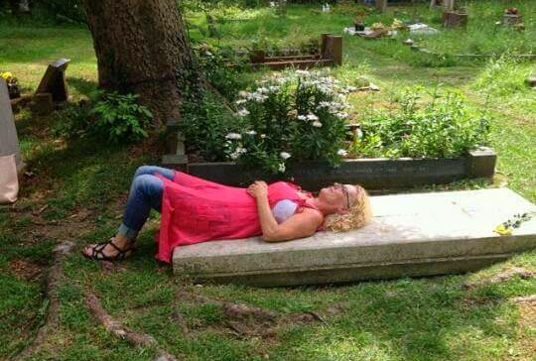
2 3 – 2 4
The Stone of Anointing
Grave Soaking

Slide 8
2 3 – 2 4

Slide 9
2 3 – 2 4
Jer. 31:33-34 ~ ³³ “But this is the covenant that I will make with the house of Israel after those days,” says the Lord: “I will put My law in their minds, and write it on their hearts; and I will be their God, and they shall be My people. ³⁴ No more shall every man teach his neighbor, and every man his brother, saying, ‘Know the Lord,’ for they all shall know Me, from the least of them to the greatest of them, says the Lord. For I will forgive their iniquity, and their sin I will remember no more.”

Slide 10
2 3 – 2 4

Slide 11
2 3 – 2 4
Wild ox ~ KJV, unicorn
LXX ~ monokerōs – one-horned
Vul ~ rinocerotis
Douay-Rheims ~ … whose strength is like to the rhinoceros.

Slide 12
2 3 – 2 4

Slide 13
2 3 – 2 4
Is. 54:17 ~ No weapon formed against you shall prosper,
And every tongue which rises against you in judgment
You shall condemn.
This is the heritage of the servants of the Lord,
And their righteousness is from Me,”
Says the Lord.

Slide 14
2 3 – 2 4

Slide 15
2 3 – 2 4
Jer. 45:5 ~ And do you seek great things for yourself? Do not seek them…

Slide 16
2 3 – 2 4

