Slide 1
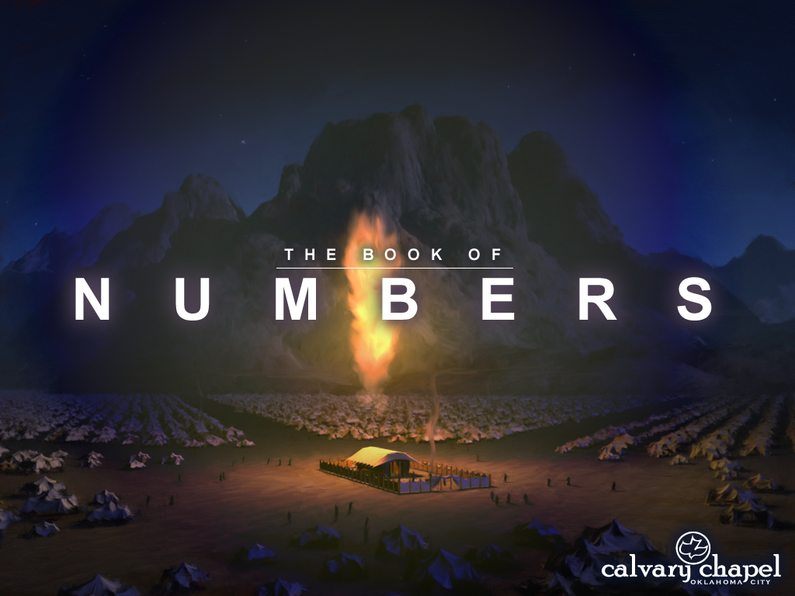


A CD of this message will available immediately following the service …
… or you may download a podcast later in this week
2 1 – 2 2

Slide 2
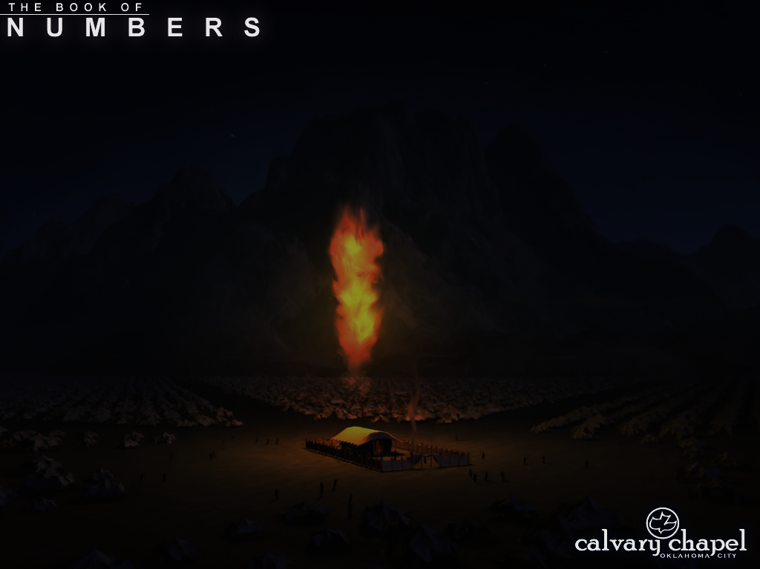
2 1 – 2 2
Hormah ~ from word sometimes translated “devoted” and sometimes “utterly destroyed”

Slide 3
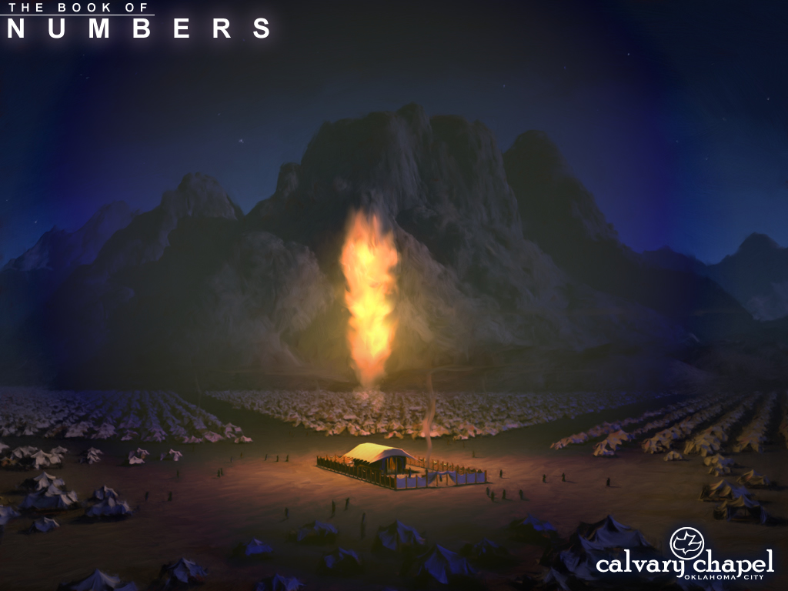
2 1 – 2 2

Slide 4
2 1 – 2 2
Worthless bread ~ KJV – this light bread
NASB, NIV ~ this miserable food
ESV ~ this worthless food
NLT ~ this horrible manna
TLB ~ this insipid manna

Slide 5
2 1 – 2 2

Slide 6

2 1 – 2 2
Staff of Asclepius

Slide 7
2 1 – 2 2
2 Kings 18:4 ~ He removed the high places and broke the sacred pillars, cut down the wooden image and broke in pieces the bronze serpent that Moses had made; for until those days the children of Israel burned incense to it, and called it Nehushtan.

Slide 8


2 1 – 2 2
700 years
1400 BC
1200 BC
1000 BC
800 BC
(dates approx.)
Moses (early 15th cent. BC)
Hezekiah (early 8th cent. BC)

Slide 9
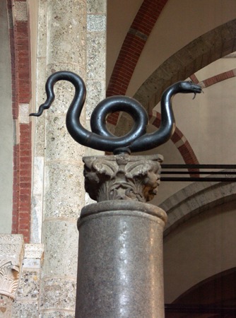
2 1 – 2 2
St. Ambrose Basilica, Milan, Italy
“Serpent Column”

Slide 10
2 1 – 2 2
John 3:12-15 ~ ¹² If I have told you earthly things and you do not believe, how will you believe if I tell you heavenly things? ¹³ No one has ascended to heaven but He who came down from heaven, that is, the Son of Man who is in heaven. ¹⁴ And as Moses lifted up the serpent in the wilderness, even so must the Son of Man be lifted up, ¹⁵ that whoever believes in Him should not perish but have eternal life.

Slide 11
2 1 – 2 2

Slide 12
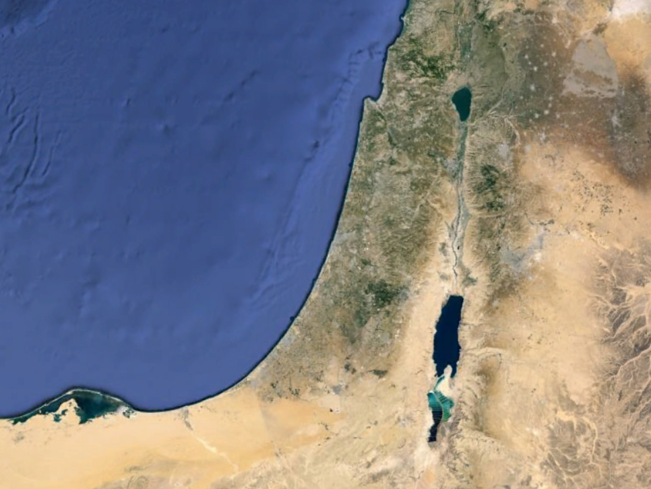
2 1 – 2 2
Mt. Pisgah
Moab

Slide 13
2 1 – 2 2

Slide 14
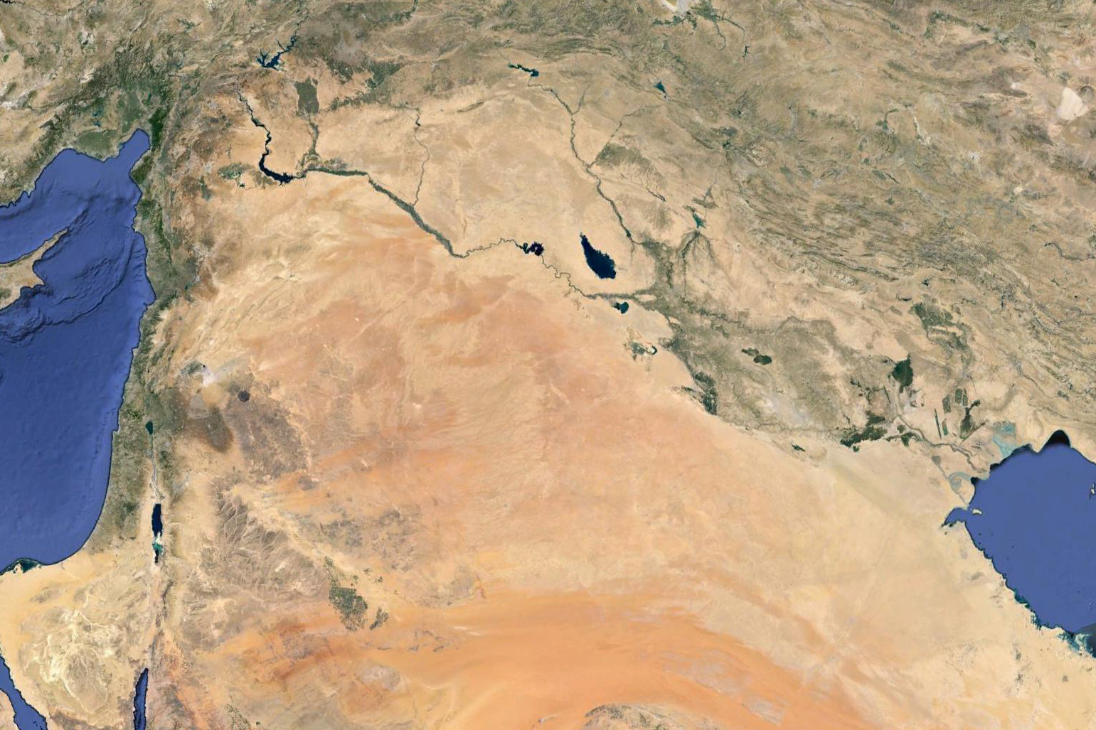
2 1 – 2 2
Fertile Crescent
Amorites

Slide 15
2 1 – 2 2

Slide 16
2 1 – 2 2
Deut. 3:11 ~ For only Og king of Bashan remained of the remnant of the giants. Indeed his bedstead was an iron bedstead. (Is it not in Rabbah of the people of Ammon?) Nine cubits is its length and four cubits its width, according to the standard cubit.

Slide 17
2 1 – 2 2
13.6'
6'

Slide 18
2 1 – 2 2

Slide 19
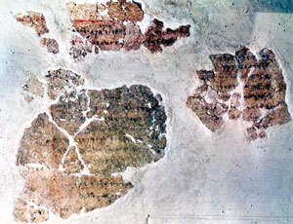
2 1 – 2 2
Balaam inscription 25 miles
north of the Plains of Moab at Deir Alla in 1967 (dating to 8th century BC)

Slide 20
2 1 – 2 2

Slide 21
2 1 – 2 2
Mesopotamian methods of divination
Extispicy ~ divination using animal entrails
Lecanomancy ~ divination by dripping oil in basin of water
Oneiromancy ~ divination through dream interpretation

Slide 22
2 1 – 2 2

Slide 23
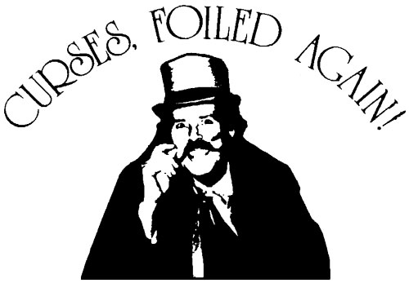
2 1 – 2 2
Have Curses
Will Travel

Slide 24
2 1 – 2 2

Slide 25
2 1 – 2 2
Jude 11 ~ Woe to them! For they have gone in the way of Cain, have run greedily in the error of Balaam for profit, and perished in the rebellion of Korah.
Error of Balaam ~ following greed

Slide 26
2 1 – 2 2

Slide 27
2 1 – 2 2
The Angel of the Lord ~ a Theophany, a preincarnate appearance of the Son
The Angel of the LORD
Gen. 16
Hagar in wilderness
v. 13
Num. 22
Balaam and donkey
v. 28
Judges 2
Naming of "Bochin"
v. 1
Judges 6
Gideon
v. 14
Judges 13
Samson's parents
v. 22
Several places in the Kings, Psalms & Zechariah
Ex. 3
Burning bush
v. 4

Slide 28
2 1 – 2 2

Slide 29
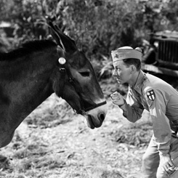
2 1 – 2 2

Slide 30
2 1 – 2 2

Slide 31
2 1 – 2 2
Abused ~ KJV, mocked

Slide 32
2 1 – 2 2

